Slide 1
My body now: How my body changes as I grow
I can name parts of my body.
I can talk about the different parts of my body and what they do.
I can describe the changes that take place with puberty.
I understand how to maintain personal hygiene.
I can identify things to do or someone to talk to if I have a question or a worry.

Slide 2



Puberty is the time in your life when your body begins to change.
Some of the changes are about preparing your adult body for reproduction – that is to have a baby, if that’s what you want to do.
Some changes you can see.
Some changes happen inside your body.
Puberty happens at different times to people.

Slide 3

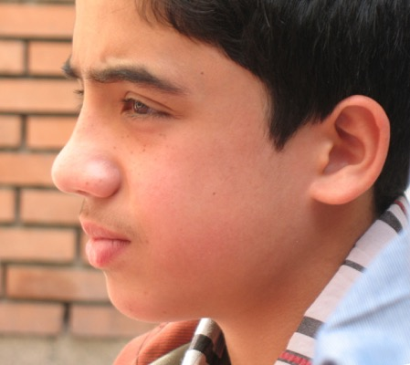
When will puberty happen to me?
Puberty changes happen over several years. Usually between the ages of 9 and 16.
Some changes in your body might be happening now, some will happen later. This is different for everybody.

Slide 4


Puberty in girls: Boobs and more (duration 3 minutes 8) https://youtu.be/umpBnIxOqy8
Top signs boys are in puberty (duration 3 minutes 24) https://youtu.be/onggxBVl4qw

Slide 5
Can you remember what changes happen to our bodies with puberty?

Slide 6

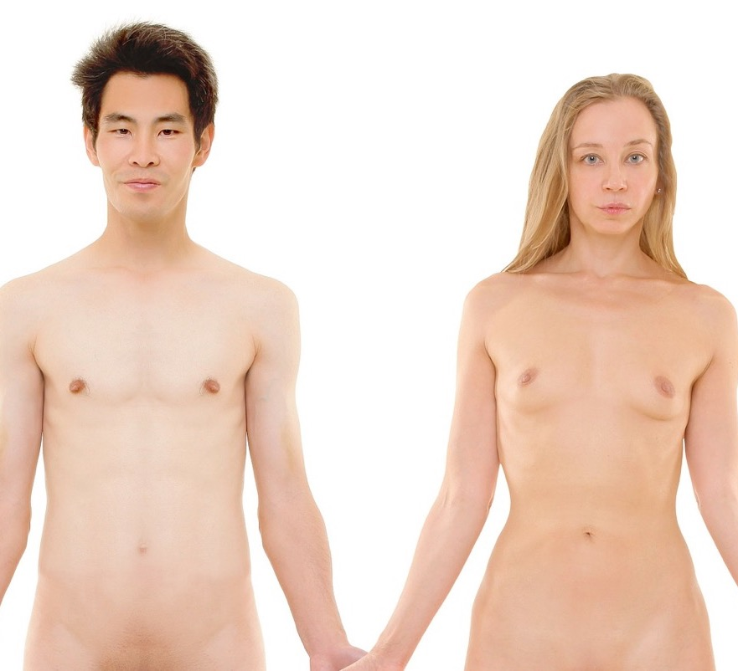
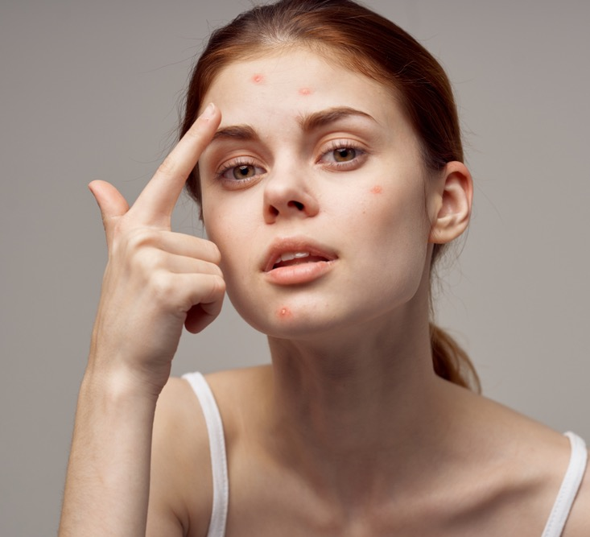
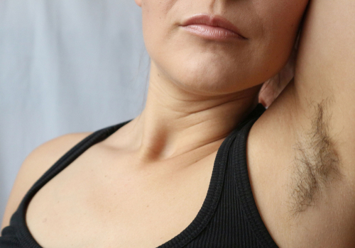
Changes with puberty
Facial hair
Body hair – genitals, arm pits and body generally
Changes in skin – possibly spots/acne
Girls breasts grow – some boys develop breasts too
Increase in size of nipples (both boys and girls)

Slide 7


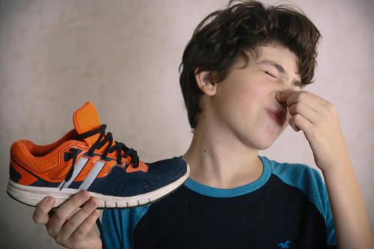
Changes with puberty
Sweating and change of smell
Body shape – shoulders, hips or thighs
Stronger feelings of being attracted to another person

Slide 8

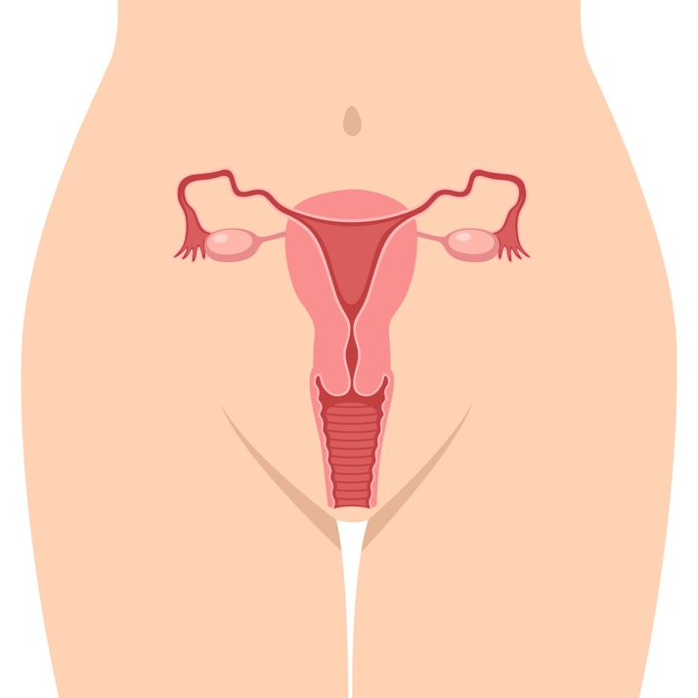
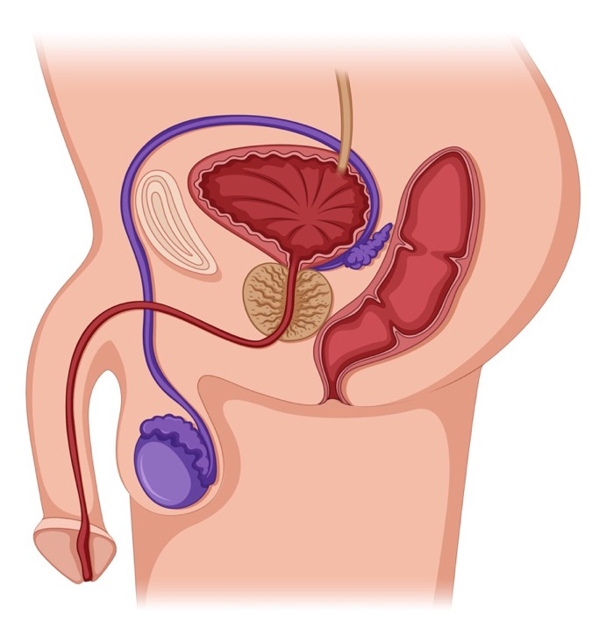
Changes with puberty
Girls start their period (menstruation)
Boys voices might get deeper
Boys penis and testicles grow
Boys get erections
Boys produce sperm – if it happens at night when they are asleep it’s called a wet dream

Slide 9
Going through puberty changes
youtu.be/reC8CV8NF5Q

Slide 10

What’s the most annoying thing about puberty?

Slide 11

Personal hygiene
If you don’t keep yourself and your things clean, then bacteria can grow.
What can you do to look after yourself and keep you and your things clean?

Slide 12

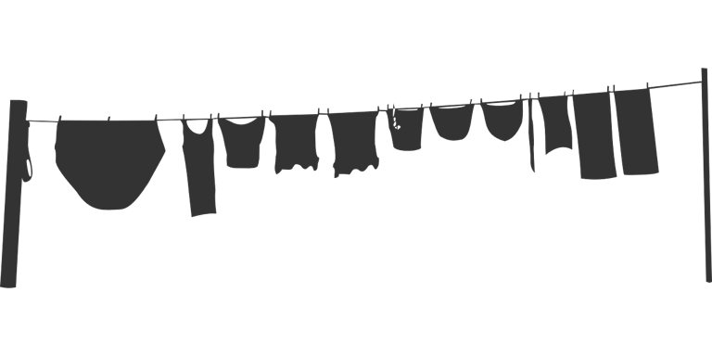




Oral hygiene
Body hygiene
Hand hygiene
Hair care
Feet & shoes
Clothes hygiene

Slide 13

If you are worried about body changes and puberty, who can you talk to?
Childline
https://www.childline.org.uk/info-advice/you-your-body/puberty/

