Slide 1
Where do we go online?
I can discuss what I do online.
I understand that my online activity requires me to have strategies for safe use.
I can identify an adult/adults I trust and who can help when I have a worry.

Slide 2

Activity:
Class Survey

Slide 3

Time spent online.
The big national survey said that on an average school day kids your age spend:
    1 hour 42 minutes watching TV
    1 hour 36 minutes online
    1 hour 6 minutes gaming
At the weekend, kids your age say they spend longer online:
    School day: 1 hour 36 minutes online
    Saturday or Sunday: 2 hours 30 minutes

Slide 4
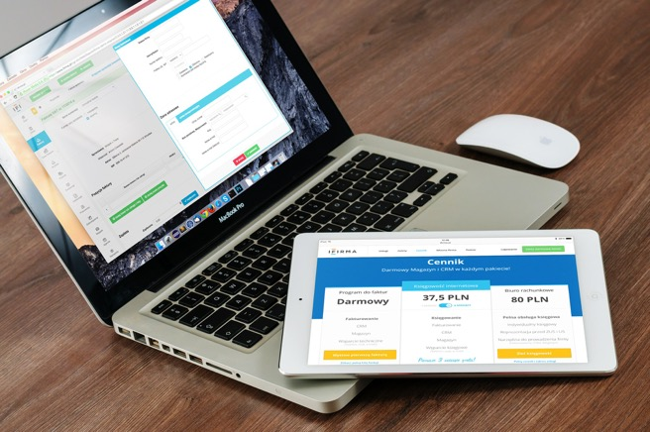
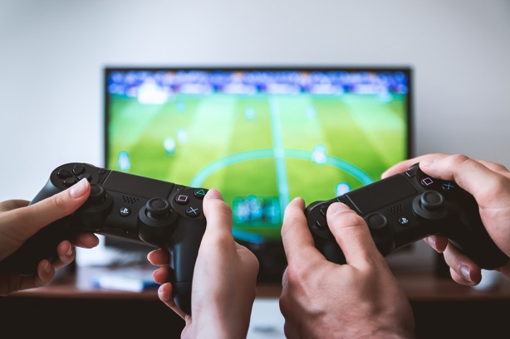
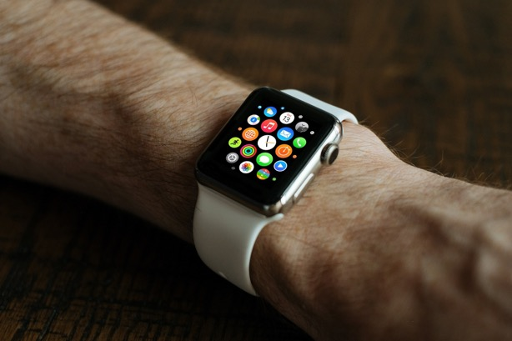
When you go online, what devices do you use? The big survey said:
Tablet/iPad: 57%
Laptop: 55%
Phone: 35%
Computer: 20%
Game consul: 20%
TV: 5%

Slide 5
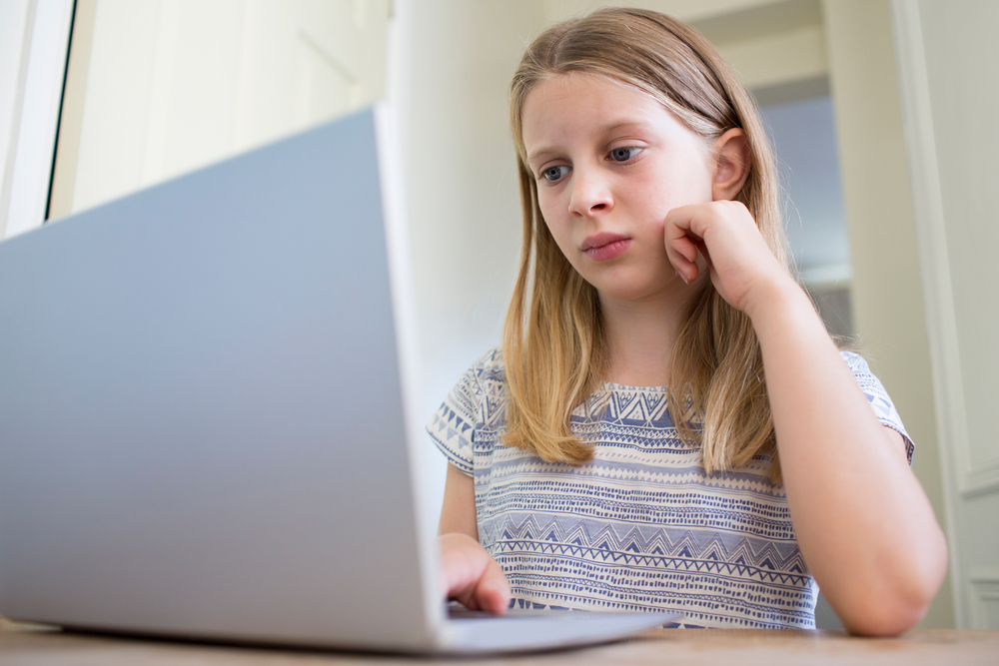
Do you make or create anything online? The big survey said:
Drawing/Making pictures 40%
Making videos 32%
Changing or editing photos 31%
Make an avatar or character in a game 19%
Make an animation 12%
Make a music video 6%
Make a blog 6%

Slide 6

The big survey said that 73% of 8 to 11-year olds use the YouTube website or app to:
Watch funny videos and pranks 67%
Watch music videos 61%
Watch game tutorials or watch others play 45%
Watch ‘how to’ videos and tutorials 43%
Watch vloggers or YouTubers 36%
Watch programme, films or cartoons 29%
Watch film trailers, clips or highlights 26%
Watch unboxing videos 18%

Slide 7
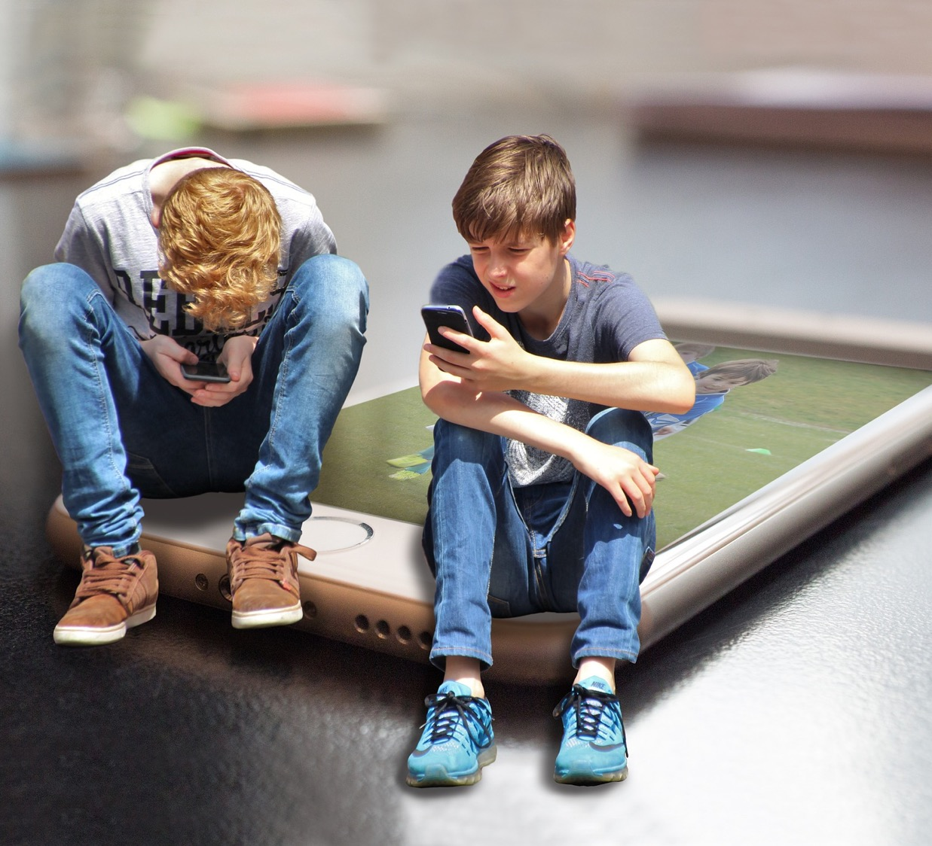
Nearly 7 in 10 of 8 to 11-year olds say they play games online
Playing games online is when you are connected to the internet, and some games allow you to work with or play against others while online.

Slide 8
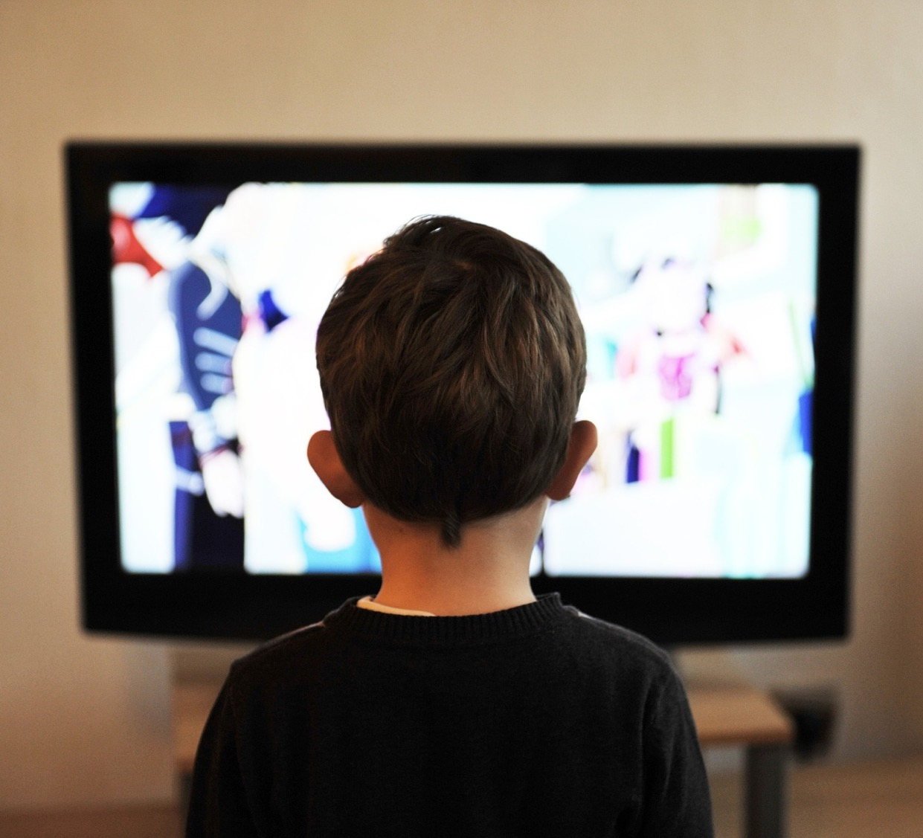
What things don’t you like about being online? 8 to 11-year olds said when…
When I feel pressure to buy things online or in-app purchases
When someone is nasty, mean or unkind
When I see things that make me feel sad, frightened or embarrassed

Slide 9
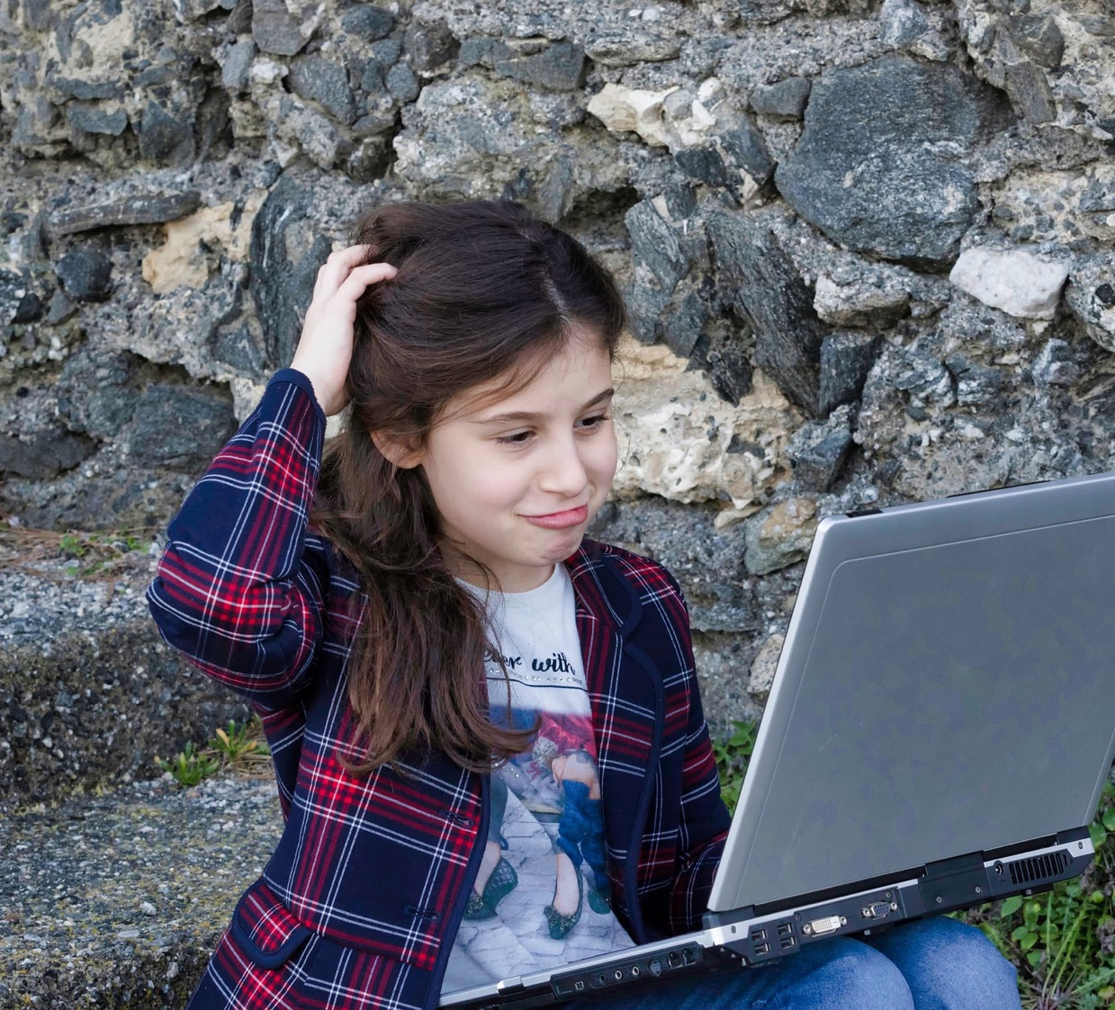
What things don’t you like about being online? 8 to 11-year olds said when…
When I sometimes spend too much time online
When I worry about strangers finding out information or pretending to be a kid
When there are too many adverts
When a website is blocked.

Slide 10
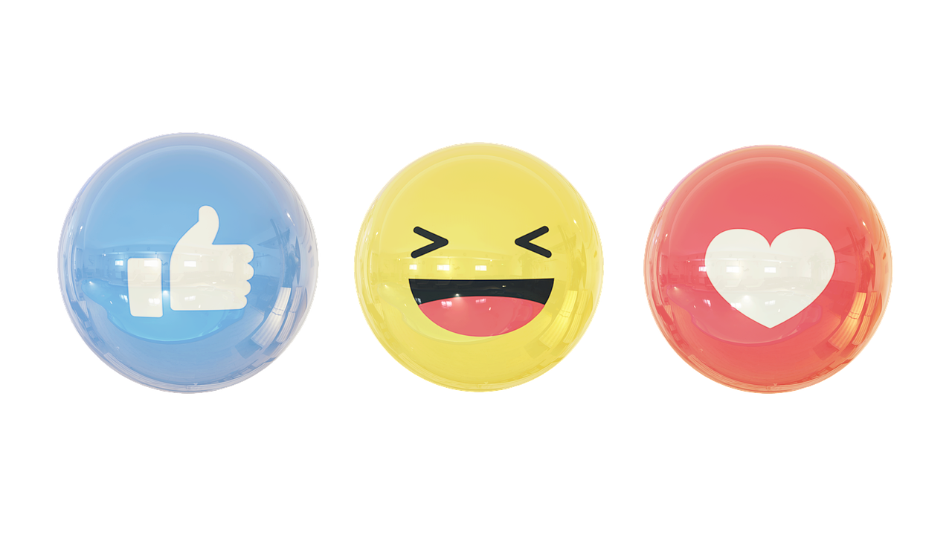
What do we think are all the things that are great about being online!

