Slide 1
My body now: Menstruation
I can name parts of my body.
I can talk about the different parts of my body and what they do.
I can describe the changes that take place with puberty.
I can identify things to do or someone to talk to if I have a question or a worry.

Slide 2
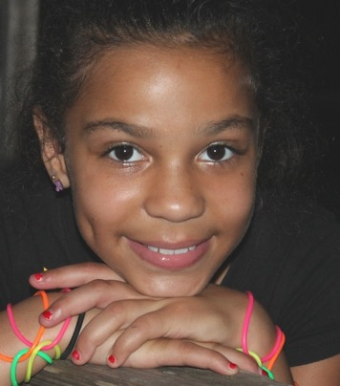
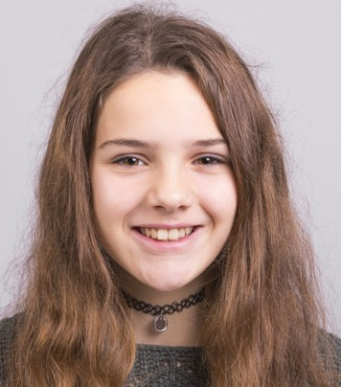
Periods. Another word for periods is menstruation.
Most girls start their period between the age of 10 and 16.
Some girls start earlier, some later.
It’s important to remember that not all girls have periods.
All girls are different and unique.

Slide 3
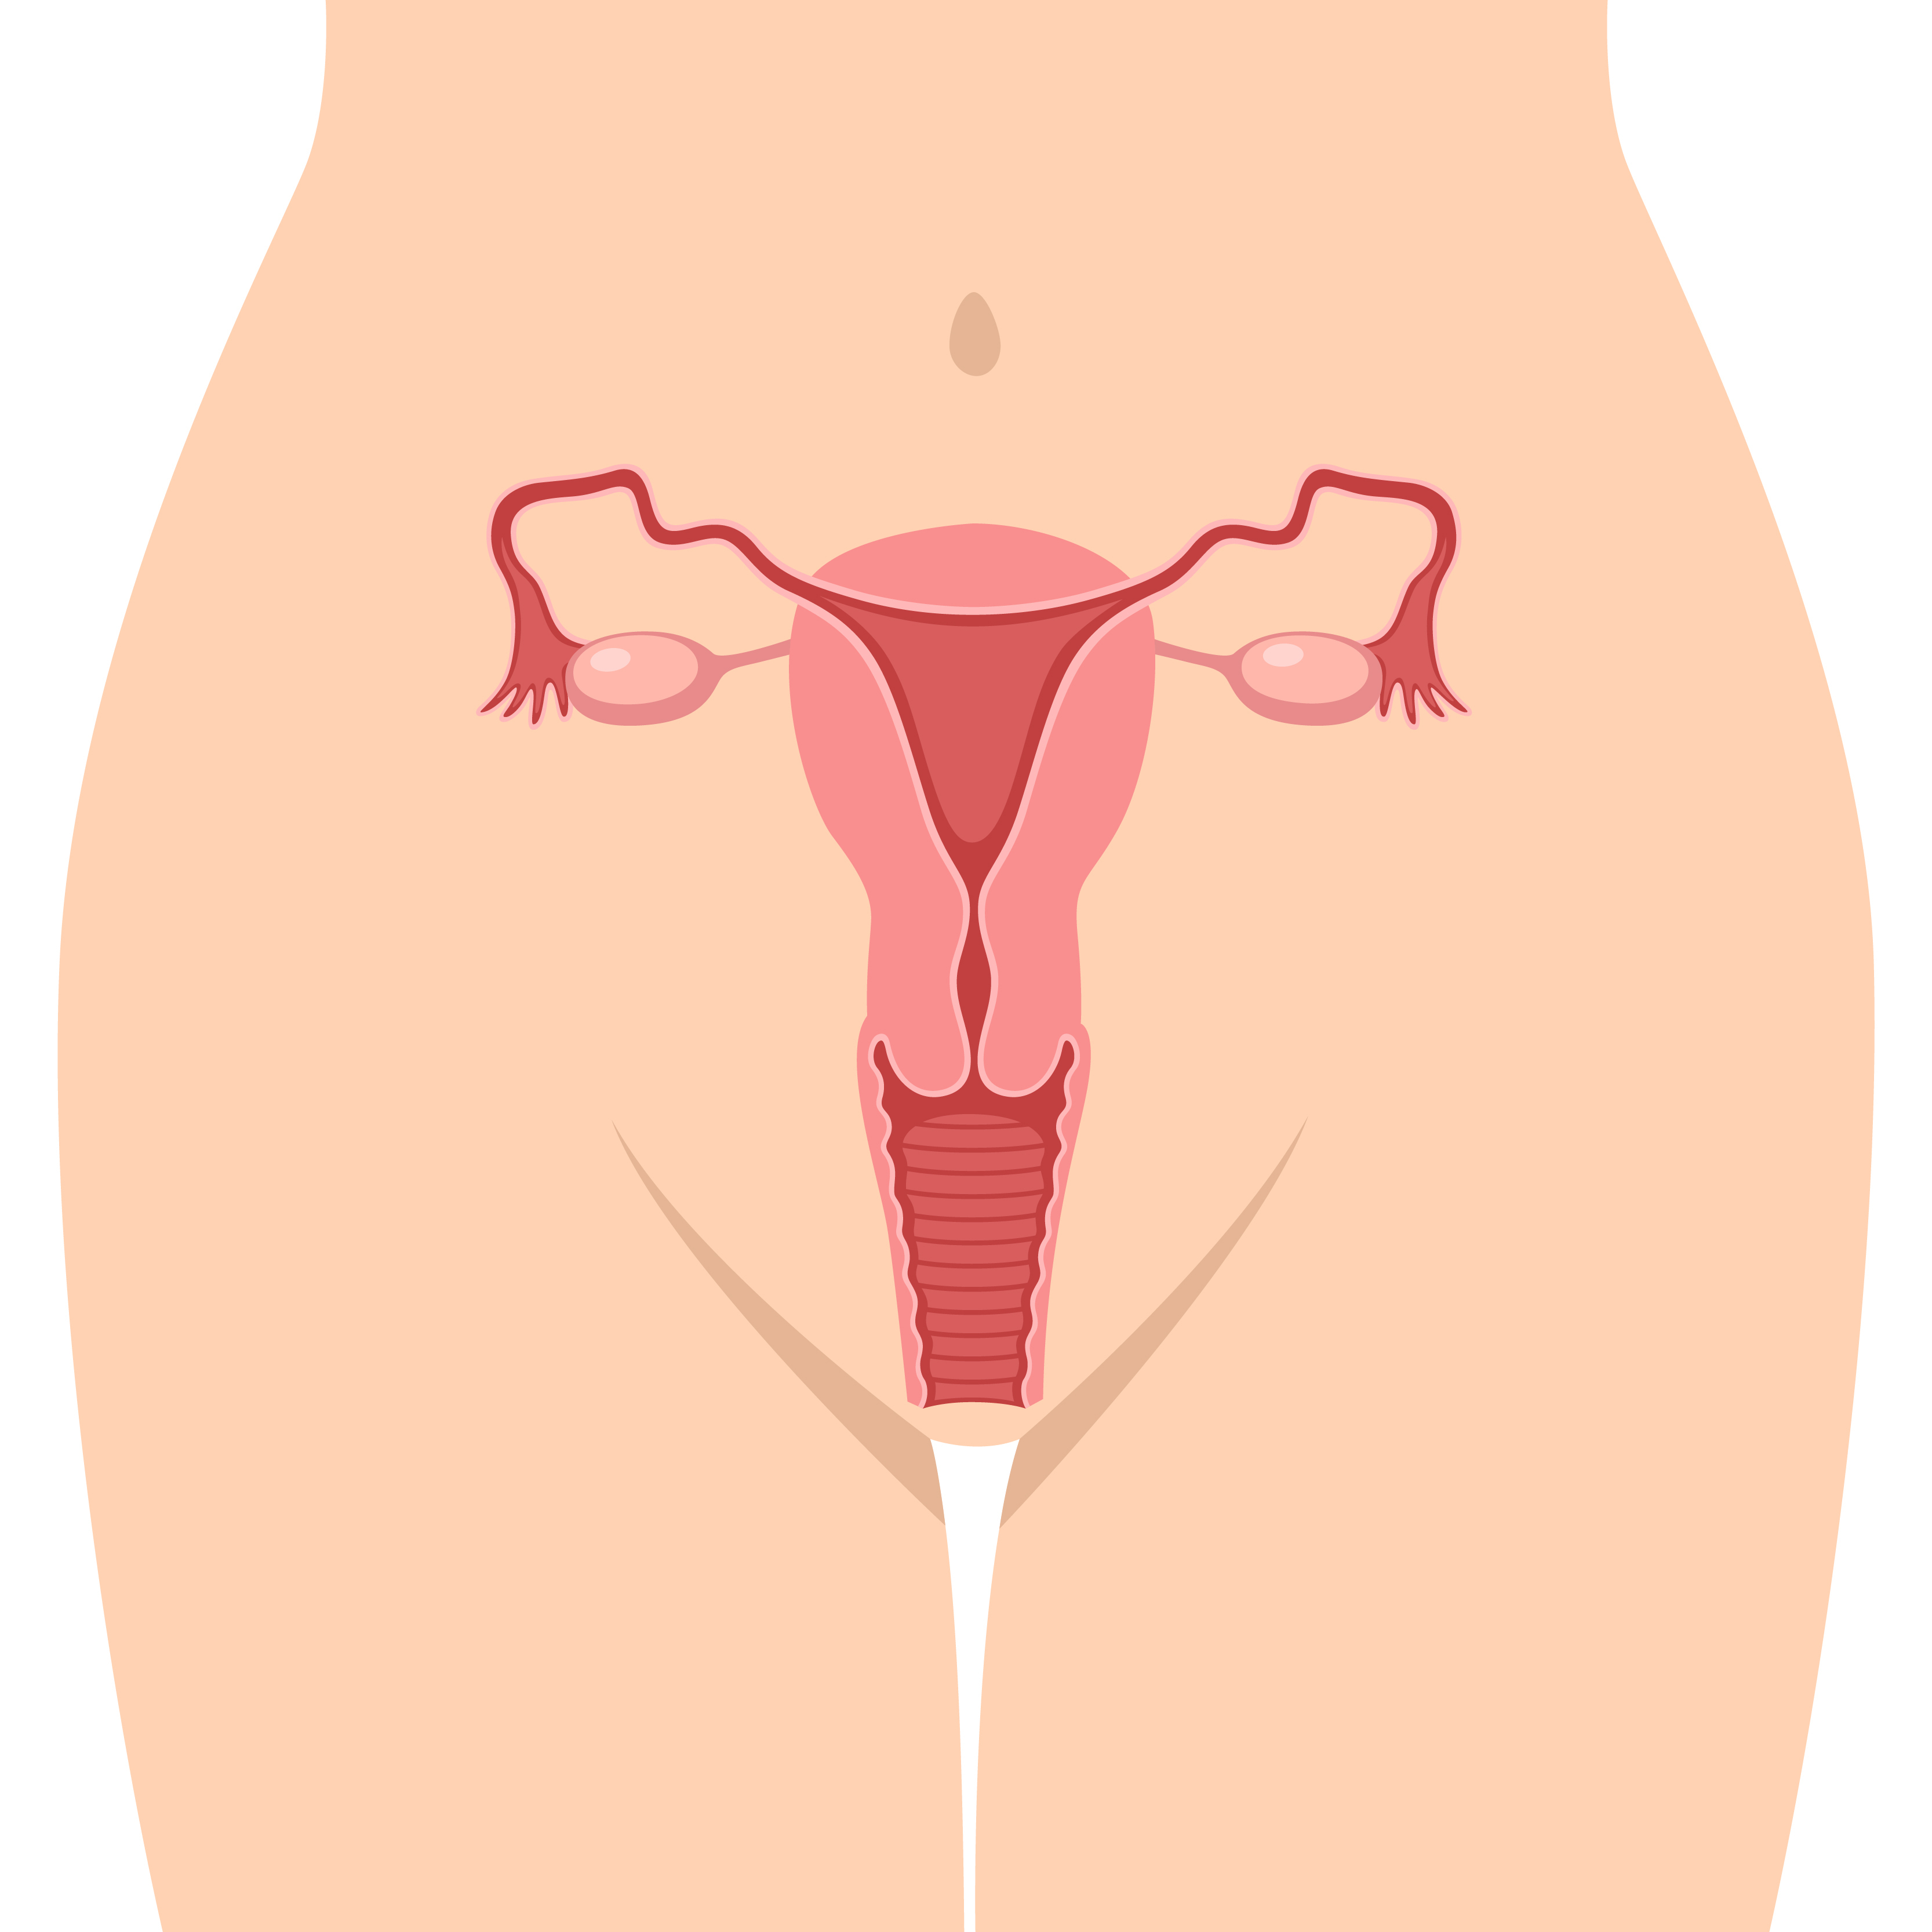
What is a Period?
When a girl goes through puberty her ovaries release an egg every month.
For a few days each month blood and other fluids pass out through the girl’s vagina.
There can be some fluids called pre-period discharge before the period starts.
This is completely normal.

Slide 4
Periods
When a girl has her period she wears a sanitary towel or tampon or menstrual cup to absorb the fluid.

Slide 5
A girl will need to change her sanitary towel or tampon a few times a day. Used sanitary wear should go in the bin.

Slide 6
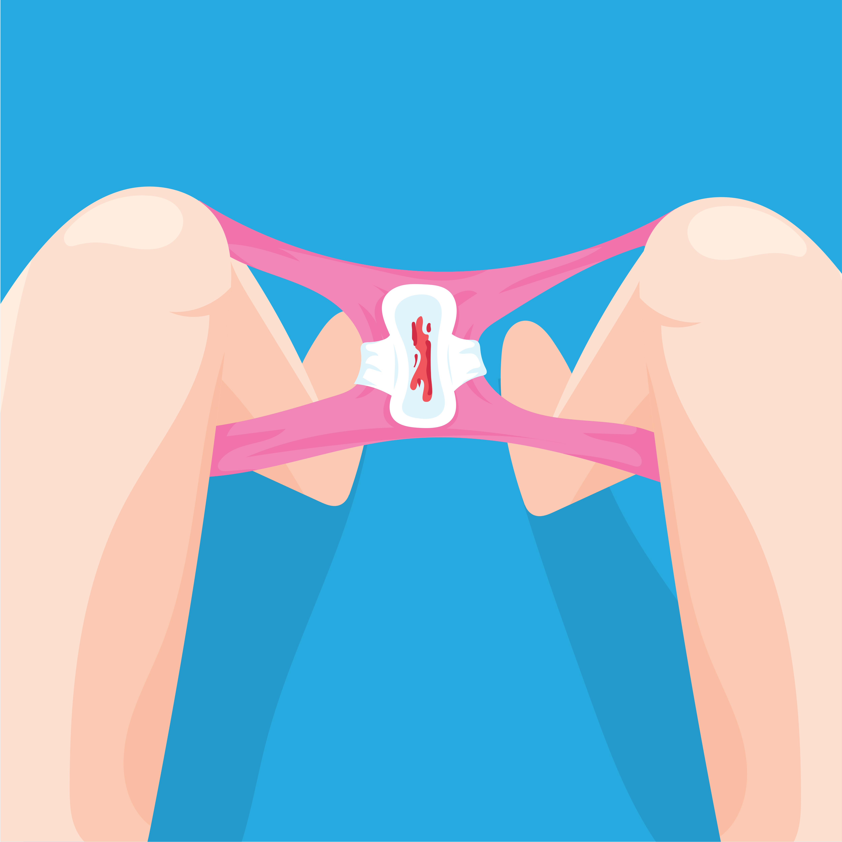
The average blood loss is around 1-2 egg cups full but it can look like more. If someone is losing a lot of blood they should see their doctor.

Slide 7
Some girls might experience pain or discomfort during their period.
If you have any questions or worries about periods, you should talk to an trusted adult.

Slide 8
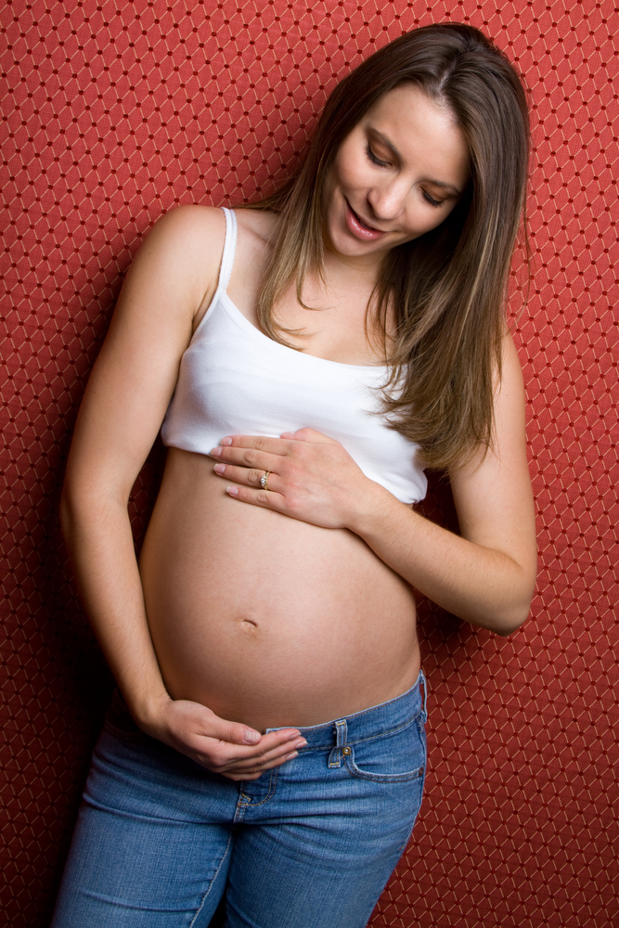
After starting to have her periods a girl can become pregnant if she has sexual intercourse.
If she has sex, she will need to use contraception to prevent pregnancy.

Slide 9
Menstruation: What to expect (duration 3 minutes 18) https://youtu.be/DBe7-PHRav8
Period hygiene: Tampons, Pads and Menstrual Cups (duration 2 minutes 9) https://youtu.be/kmWbOC8Fbb0

Slide 10
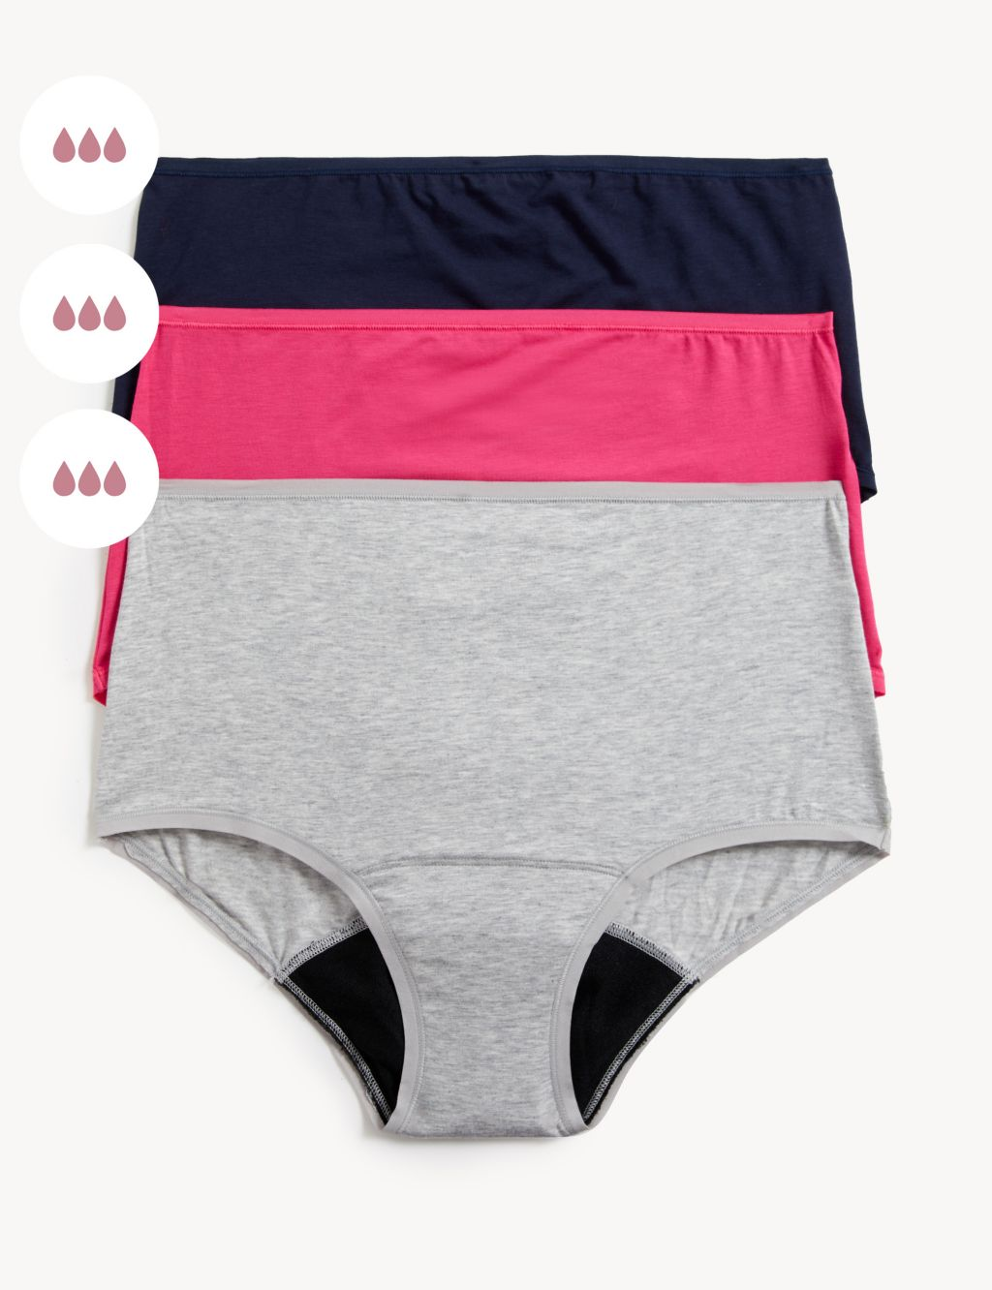
You can also use period pants.
Period pants are underwear that absorb the blood during your menstrual cycle. You can wear them like regular underwear, without the need for tampons or pads. Period pants are reusable and can be washed. They can be used while exercising, sleeping or at any point in our period.

Slide 11
What myths have you heard about periods?
A myth is something that people believe to be true – but in fact it’s false.

Slide 12
Talking periods (duration 4 minutes)
https://youtu.be/ypMyH0W1trs

Slide 13
Hey Girls
www.heygirls.co.uk/education/myth-buster/

Slide 14
Childline
https://www.childline.org.uk/info-advice/you-your-body/puberty/periods/

Slide 15
In Scotland, all girls and women can get sanitary towels or tampons at school or college for free. This is because it is unfair that girls and women have to pay for something that is essential for them when they have their periods.
The Scottish Government gives the money for this to the Council and then the products are available where young people learn.

Slide 16
What questions do you have about menstruation (periods)?

