Slide 1
Finding and using sexual health services and online information
I know how to find and access sexual health services.
I understand what happens when a young person engages with a sexual health service.
I know good sources of online information about sexual health.

Slide 2
Having sex should be a positive and enjoyable experience when you and your partner feel ready for it. Good sexual health is about:
Feeling safe
Feeling confident about your sexuality
Knowing how to treat others with respect
Being able to talk about likes and dislikes
Not having any regrets
Taking steps to avoid getting any sexually transmitted infections
Making informed choices about contraception and pregnancy.

Slide 3
Who can you go to… to talk, to get information or to find support when….

Slide 4
You are going out with someone for the first time, its like a date, just you two, but you’re not too sure how it’s going to go….

Slide 5
You have been going out for a while, you are thinking about having sex, you’re not quite sure what kind of sex yet….

Slide 6
You are a boy, you had (penetrative) sex with your girlfriend last night, didn’t use a condom and your girlfriend isn’t using contraception…

Slide 7
You have had sex with a couple of people in the past couple of months, different kinds of sex…

Slide 8
You’re not having sex with anyone, you are leaving school soon to go to College, you think you should probably be thinking about your options…

Slide 9
You are a girl, having sex (penetrative) with your boyfriend, you haven’t had your period this month.

Slide 10
Confidentiality
If you are under 16 and want contraception, an abortion or tests for sexually transmitted infections (STIs), the doctor, nurse or pharmacist won't tell your parents (or carer) as long as they believe that you are not at risk of significant harm.
You have the same rights to confidentiality as an adult.

Slide 11
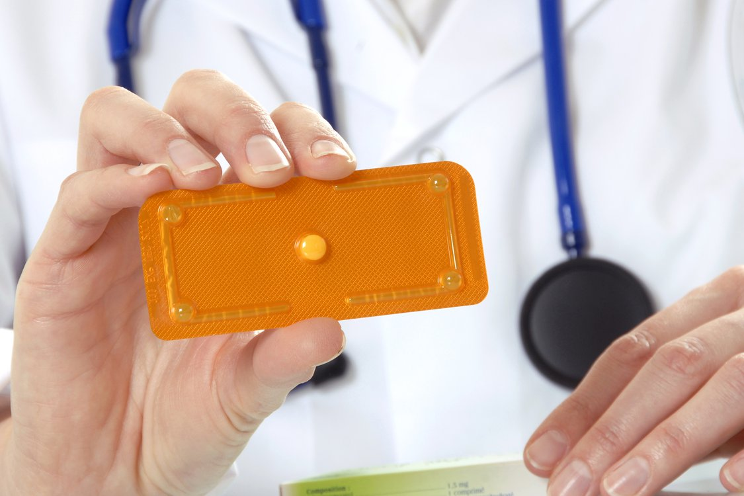
Emergency contraception
If you've had unprotected sex, that is, sex without using contraception, or think your contraception might have failed, you can use emergency contraception.
An emergency contraceptive pill needs to be taken as soon as possible after sex to have the best chance of working. There are 2 kinds available – one can be taken up to 3 days after having sex, the other up to 5 days after. BUT they are most effective if you take it as soon after unprotected sex as possible.

Slide 12
Emergency contraception
In most areas the Emergency Contraception pill is available from your local pharmacy and of course nearest sexual health clinic or drop in or your GP.
In most areas pharmacies provide it free and it is available to under 16s.
Another kind of emergency contracpetion is the IUD which is sometimes called the coil. It is a small copper and plastic device which is put into the uterus. This must be fitted by a doctor or nurse.

Slide 13
Emergency contraception
INSERT DETAILS OF LOCAL PHARMACIES and SEXUAL HEALTH CLINICS OR YOUNG EPOPLE’S DROP-INS THAT PROVIDE A SERVICE

Slide 14
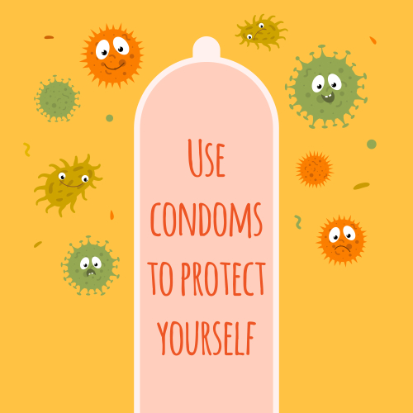
Condoms
Condoms protect against STIs
They also prevent pregnancy.
INSERT DETAILS OF LOCAL FREE CONDOM SERVICE

Slide 15
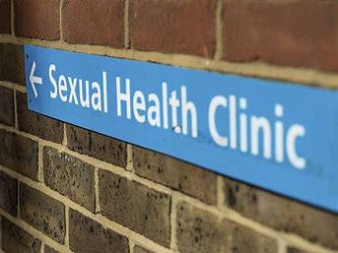
What happens at a sexual health clinic?

Slide 16
Before you arrive
Some clinics need you to phone in advance to make an appointment.
Please visit your local sexual health clinic’s website to check whether you can drop-in or need an appointment.
You can ask your partner or a friend to come along with you, or go by yourself.

Slide 17
When you arrive
Go to reception.
The receptionist may ask you to fill in a form with your name and contact details. The form may also ask you why you are there – this allows the clinic to make sure that you see the right person at the right time. You can choose to stay anonymous if you want.
You don't have to let the clinic know who your GP is but it can be helpful if you do.
You may be able to see either a female or a male doctor. You can ask if this is possible at the time of making your appointment.

Slide 18
Confidentiality
If you are under 16 and want contraception, an abortion or tests for sexually transmitted infections (STIs), the doctor or nurse won't tell your parents (or carer) as long as they believe that you are not at risk of significant harm.
You have the same rights to confidentiality as an adult.

Slide 19
Questions
The doctor or nurse will ask you some questions about your sexual activity, experiences, and symptoms.
Answer as honestly as you can so they can work out which tests to do and what treatment to offer.
Staff are very experienced. Their job is to help. They will never judge anyone.

Slide 20
Getting tests
This will depend on your symptoms and the type of sex you have had. You might be asked for a:
Urine (pee) or blood sample
Swabs: This is like a cotton bud wipe taken from your genitals, throat or rectum (bum). Sometimes you can do this yourself in private.
Taking a look – usually at your genitals (private parts). If you haven’t had any symptoms, you don’t usually need to be examined.

Slide 21
Getting results
When you get tested, the doctor or nurse will explain when and how you’ll get the results. You may have to go back to the clinic to get them, or you may be able to receive them by phone or text. The doctor or nurse will also tell you what will happen next.

Slide 22
Telling someone if you have an STI
If you have an STI, it’s best to find a way to tell your current partner and any past partners who could be at risk of infection. You don’t have to do this yourself and you can discuss this with the doctor or nurse at the clinic.

Slide 23
Where do young people your age go to online if they have a question or worry about relationships or sexual health?

Slide 24
Being ready for sex and being healthy, happy, and safe means you can find and go to the people and places that will help make sure you get what you need.
This could be someone to talk to, condoms, contraception and sexual health check-ups.
If you go online use NHS branded sites for information or an agency you know has a good reputation.
Online Help and Advice
http://youngpeoples.sandyford.org/
www.healthyrespect.co.uk
www.wavehighland.com
www.fpa.org.uk
www.bpas.org
www.bishuk.com
www.lgbtyouth.org.uk
INSERT LOCAL INFORMATION AND SERVICES

