Slide 1
The age of consent
I am building understanding that I am responsible for my actions towards others.
I know that I do not need to be in a relationship, and that relationships do not need to be sexual unless I wish them to be so.
I can explain what the age of consent is.
I can identify a place or person to go to if I have questions or a worry.

Slide 2
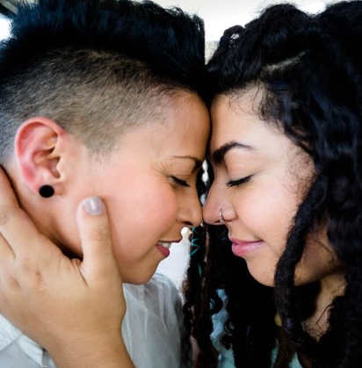
The age of consent is the law that states what age a person needs to be before they can agree to have sex lawfully.
It is the same age for all young people, whatever their sex or gender or the sex/gender of their partner.
The age of consent for everyone in Scotland is 16.

Slide 3
Activity: The age of consent
Sort the cards into 2 piles:
2
We have a question
1
OK we understand this

Slide 4
Part 1 cards/statements
The age of consent in Scotland for young men and women is 16.
The age of consent is the same for everyone – so if you are straight, lesbian, gay, bisexual or transgender.
Most people wait until they are 16 or older to have sex.
If you’re both over 16, and both want to have sex, then it’s legal.
If you are both aged 13,14 or 15, then you and your partner are breaking the law.
If one of you is 13, 14 or 15 years old and one of you is 16 or over, and you have sex, then the older person is breaking the law.

Slide 5
Part 2 cards/statements
If you are under the age of 13, the law says you are too young to give consent to any kind of sexual activity at all, like sexual touching or oral sex or vaginal sex or anal sex.
It is very unusual for young people (age 13, 14 or 15) to be prosecuted if both young people are happy and one person is not forcing the other to have sex.
If you are 13, 14 or 15 and you speak to a professional person about having sex with your boyfriend/girlfriend then they need to be sure you are safe with this person.
If you are under 16 and you are having sex with someone much older than you, a professional person will be concerned about your safety. If there is a concern about your safety, the person you speak to may have to share information in order to protect you, but they will always speak to you about this first unless it is absolutely necessary to share the information urgently to protect you from harm.
It is always wrong and against the law to force someone to have sex, no matter what age you or they are.
To help protect young people, it is an offence for someone aged 18 or over, to engage in sexual activity with someone aged 16 or 17 if the older person is in a position of trust. A position of trust is someone who looks after you for example, in a school or a care home.

Slide 6
The law:
If you are 13, 14 or 15 and thinking about having sex or having sex, you might be worried about the law.

Slide 7
Sexual health clinics see young people aged 13 and over. It is confidential and they are not allowed to tell your parent or carer.

Slide 8
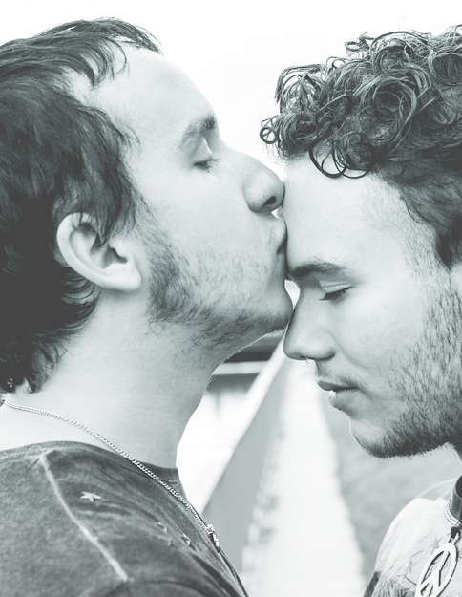
Confidential means keeping your stuff private. If you speak to a nurse or doctor, they will keep your information private. They will check that you are safe. They will not share information about you unless someone is harming you or you are in danger.

Slide 9
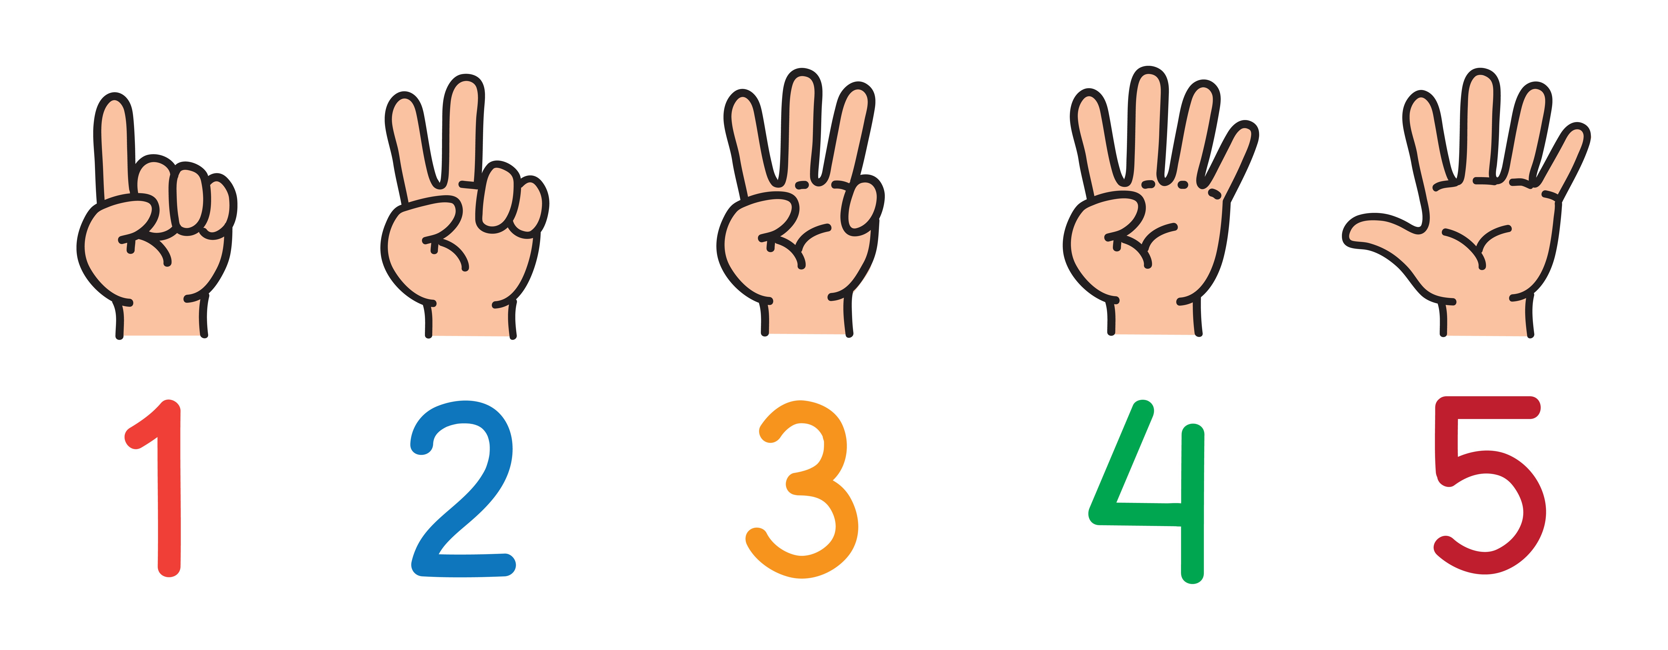
Activity: My 5 trusted people.

Slide 10
Insert information about local health or community services where young people can go for confidential help or support.

