Slide 1
Sexual health: Getting advice and support
I understand the benefits of regular sexual health checks when I am sexually active.
I can describe how to access sexual health services.
I can explain how confidentiality works.

Slide 2
Where would I go when….

Slide 3
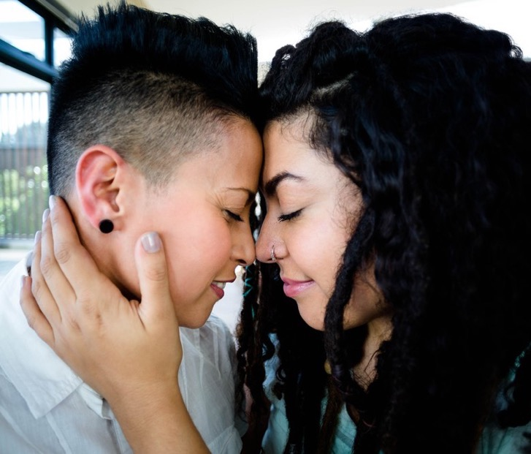
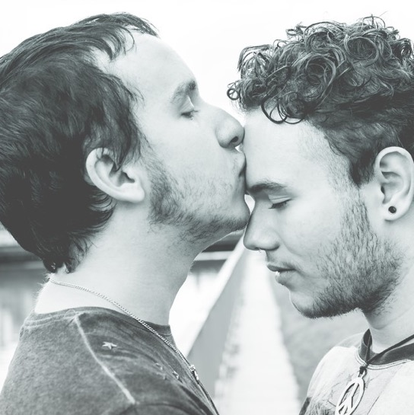
Sexuality is about our sexual feelings, thoughts, attractions and behaviours towards other people.
We can find other people physically, sexually or emotionally attractive, and all those things are a part of our sexuality.

Slide 4
Sexual health
You have a right to be healthy, happy and safe.
When you are ready, having a relationship or having sex should be a positive and pleasurable experience.
There are professional people and services that can help you to have good sexual health.

Slide 5
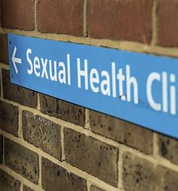
What is a sexual health service or clinic?
A sexual health service is a place where you can get information and support about anything to do with sex and relationships. .
It can be at a sexual health clinic, a young people’s drop-in or a service at your local GP.

Slide 6
At a sexual health service or clinic you can get:
Free pregnancy testing
Testing for STIs (sexually transmitted infections)
Advice and referrals for termination of pregnancy (abortion).
You can talk about relationships.
Free contraception and condoms.
These services are for everyone. You are welcome whatever your gender or sexuality.

Slide 7
Going to a service: This is what happens

Slide 8
Things to know before you go
Some clinics you can just drop-in when they are open for young people.
Some clinics need you to phone in advance to make an appointment. You can check on their website.
You can ask your partner or a friend to come along with you, or go by yourself.

Slide 9
When you arrive
Go to reception.
The receptionist may ask you to fill in a form with your name and contact details.
The form may also ask you why you are there – this allows the clinic to make sure that you see the right person at the right time.

Slide 10
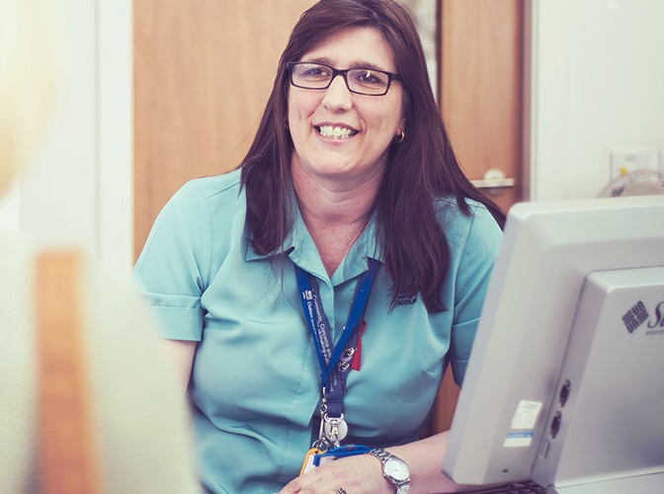
You don't have to let the clinic know who your GP is but it can be helpful if you do.
You may be able to see either a female or a male nurse or doctor. You can ask if this is possible.

Slide 11
What happens when you see the nurse or doctor
The nurse or doctor or nurse will ask you some questions about your relationships, sexual activity and experiences. Answer as honestly as you can.
If you have a question or a worry they will be able to help you.
Their job is to help. They will never judge anyone.

Slide 12
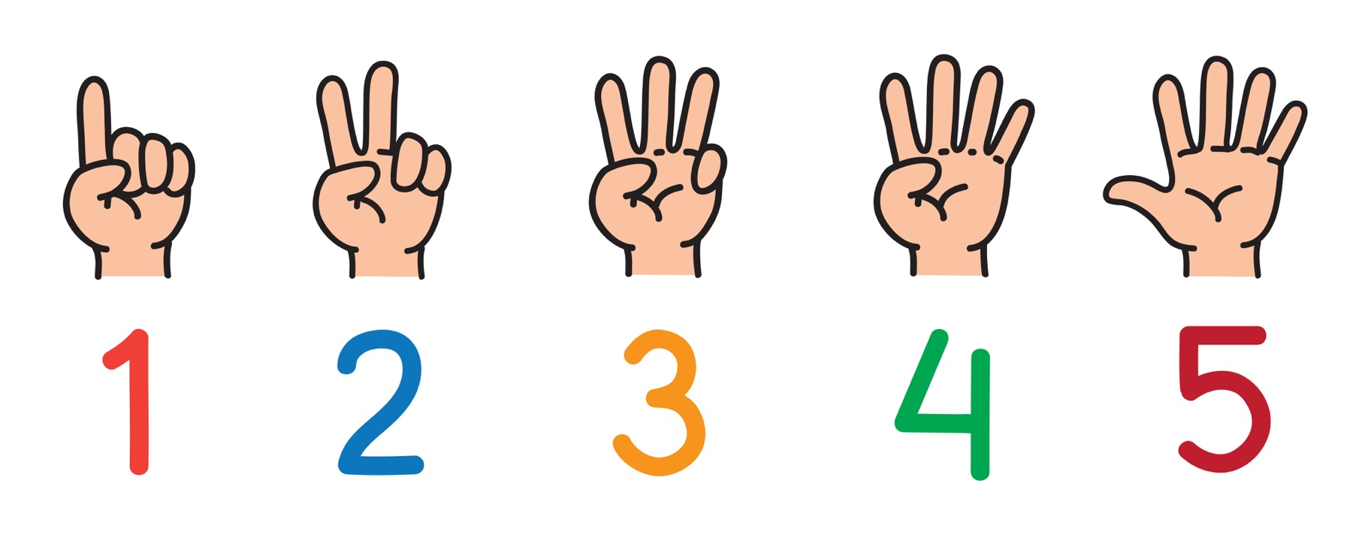
Confidentiality

Slide 13
Confidentiality
5 things you need to know
In sexual health services, all young people age 13, 14 and 15 have a right to confidentially.
No personal details or information about the tests or treatments can be shared with anyone outside the sexual health service without the young person’s permission.

Slide 14
Confidentiality
If you go to a GP the same rules apply. Doctors and nurses have very strict rules on confidentiality. Everything a patient tells them, their personal details and medical records are kept completely private.

Slide 15
Confidentiality
A doctor or nurse might encourage a young person to tell a trusted adult if they think the young person needs help and support.

Slide 16
Confidentiality
If the doctor or nurse is concerned that a young person is in danger of being harmed, especially if they are under the age of 16, they may need to pass information to other professionals.
This is called child protection.
Even then will talk to the young person first before they tell anyone else, unless that would put someone at risk of harm.

Slide 17
Confidentiality
If you are confused or worried about how confidentiality works in a drop-in, at the GP or sexual health service, ask the nurse or doctor you see to explain it to you before you share anything personal. They want you to be safe. They are there to help you.

Slide 18
Confidentiality: can you explain it?

Slide 19
Our local sexual health services, clinics and pharmacies:
(Insert information from your locality here)

