Slide 1
Sex: Masturbation, Oral and Anal Sex
I can describe the range of sexual behaviours that are considered ‘sex’.
I understand the social taboos about some sexual practices, but I know that accurate information, support or help is available when I need it.
I can explain the need for consent in all sexual activity.

Slide 2
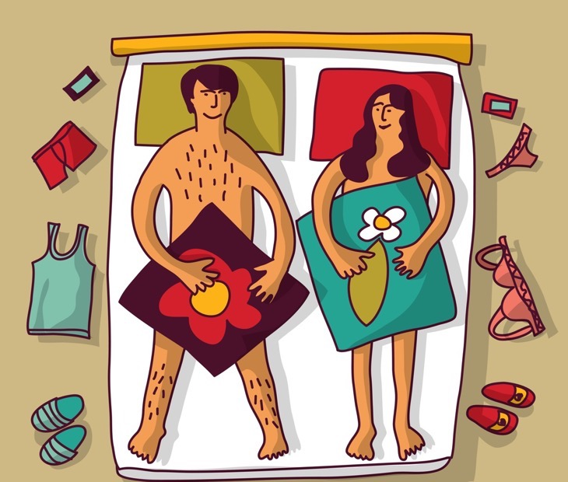
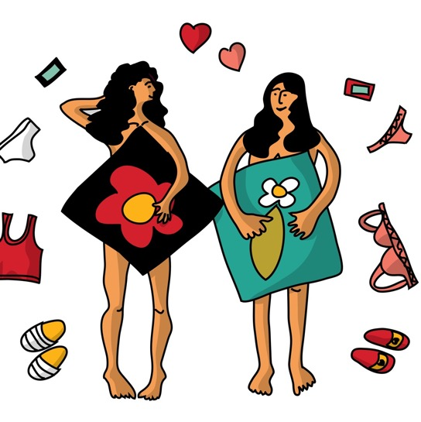
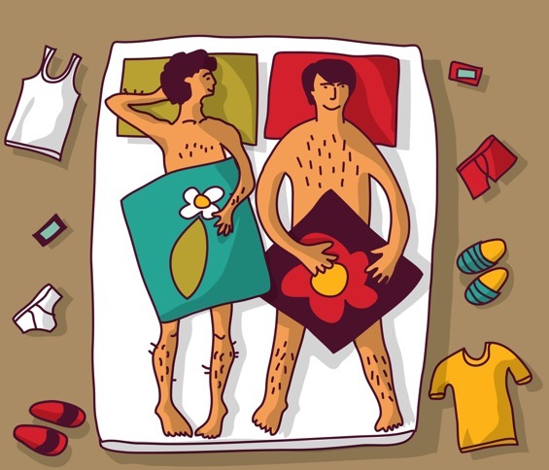
The law says that sexual activity includes mutual masturbation, oral sex or penetrative sex. Penetrative sex is when a person puts their finger or penis or something else (like a sex toy/dildo) into a person’s vagina or anus (anal sex).

Slide 3
A history of masturbation:
People have always masturbated. But in some countries, cultures or religions, some people began to say that it’s wrong because it’s a waste of semen, which is supposed to be about creating life. Some people also claimed that masturbation could be bad for you, that it caused headaches or baldness or madness, none of which is true! Today we know that masturbation is perfectly normal and a healthy sexual activity.
What myths have you heard about masturbation?

Slide 4
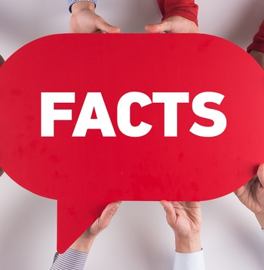
Some facts about masturbation
Boys/men do it.
Girls/women do it.
It’s an individual thing – you work out what to do and what to imagine.
It helps you get to know your body and what you like.
Masturbation is a solo thing and can also be part of couple sex.

Slide 5
Is masturbation good for you?
https://youtu.be/GU3JqoUDkjA

Slide 6
Oral sex: Who’s doing it? What do they think about it?
There are different types of oral sex, involving using your mouth and tongue to stimulate:
A woman’s vagina, vulva and clitoris – known as cunnilingus, going down, giving head.
A man’s penis – known as fellatio, blow job, going down, giving head.
A person’s anus – known as anilingus, rimming.
In a study, over three-quarters of both men and women had experienced oral sex in the year of the survey.

Slide 7
Despite what the law says, many young people still think that oral sex isn’t really sex… why so?

Slide 8
Anal sex: Who is doing it?
In a national study more than 10% of adults said they had had anal intercourse in the past year.
A 2017 survey by a condom company of over 3,000 sexually active young adults shows that 35% of women and 15% of men are engaging in anal sex "at least some of the time."
While people think that anal sex is most common activity for gay men in fact many don’t, or it depends on the person and the relationship.

Slide 9
Attitudes towards anal sex
Anal sex is considered a taboo. A taboo is something that is forbidden or disapproved of.
or
Anal sex is becoming more normalised or commonly discussed or expected.

Slide 10
Condoms and lube
Any penetrative sex carries risks – of pregnancy or STIs.
Condoms protect from both.
Use condoms and lube for anal sex, it is safer and more pleasurable.

Slide 11
The impact of pornography
Data from a major porn site shows that from 2009 to 2015, search volume for anal sex videos increased by 120%
In a 2010 study, researchers watched the 50 most popular porn movies and found 356 depictions, in 55% of the scenes, of men and women having anal sex.
Do you think pornography is influencing what young people do or want to do sexually? Is this a good or a bad thing?

Slide 12
Your body during sex
https://youtu.be/f-xbQeGZ6rk

Slide 13
Anal sex
Using a sample of 130 heterosexual men and women between the ages of 16 and 18 from the cities and suburbs of England, scientists conducted group interviews and individual interviews to find out about the participants’ sexual practices.
The results revealed major gender differences in the ways men and women talk about anal sex and their motivations to have it.
While men in the study tended to correlate anal sex with pleasure and macho sexual achievement, women brought up a fear of physical pain and a damaged reputation.

Slide 14
Anal sex
Male subjects often expressed that they wanted to have anal sex to mimic pornography and because it was more pleasurable than vaginal penetration, while women mainly said they did it to please their partners.
There was a shared understanding between interviewees that women were supposed to be begged or forced into participating and should expect it to hurt, and if they turned down anal sex, they were uptight. The idea of “if you try it, you’ll like it” was frequently referred to as a tactic men used to convince women to try it.
And unfortunately, many subjects were unaware that STIs can easily be transmitted through anal sex.
Source: Women’s Health magazine 2014 https://www.womenshealthmag.com/sex-and-love/a19931416/anal-sex/

Slide 15
If you are considering having sex:
Be clear with yourself about what you are ready for.
Make sure your partner is taking the decision to have sex as seriously as you are.
Don’t wait until the heat of the moment to decide what you are ready for.
Explain what you are not ready for.

Slide 16
If you are considering having sex:
Discuss and sort what you and your partner need when it comes to contraception and/or condoms.
You have the right to say no, to change your mind, to stop at any time.
You can discuss or ask anything at a young people’s drop in/sexual health clinic.

