Slide 1
Sex:
How people have sex /
What do they do?
I can name the private parts of my body.
I can talk about how puberty results in physical and emotional changes.
I can describe what sex/sexual intercourse can involve.
I understand that sex is something adults do in a relationship.

Slide 2
Names for private parts of my body

Slide 3
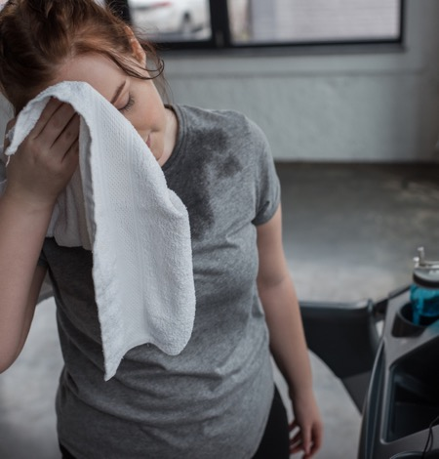
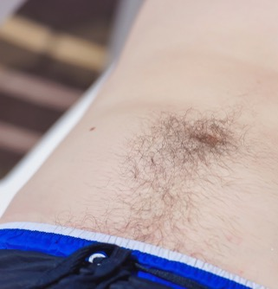
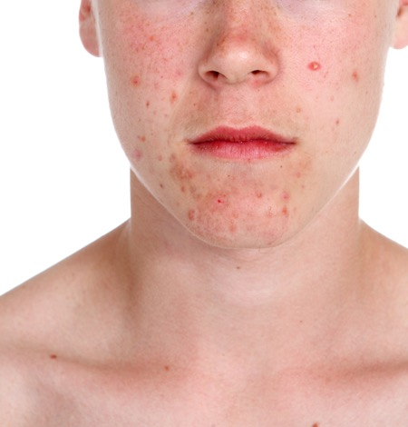
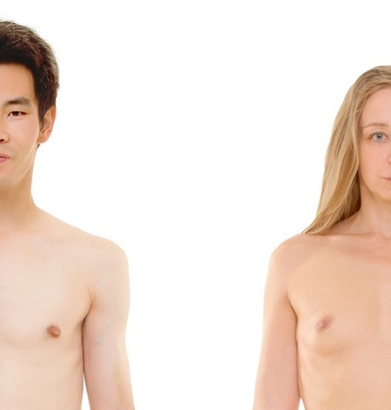
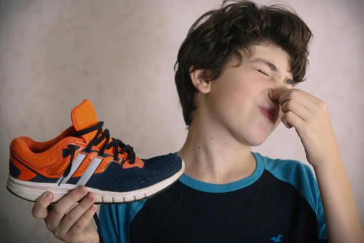
When we go through puberty what happens to:
Hair?
Voices?
Breasts?
Skin?
Smell?
Body shape?

Slide 4


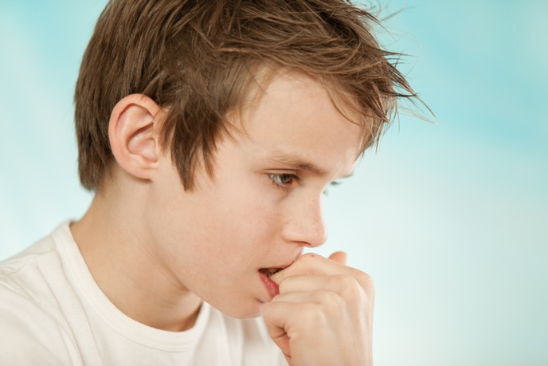

When we go through puberty what happens to our feelings and emotions?

Slide 5




How does a person show love for someone?

Slide 6

You must be 16 years or older to have sex.

Slide 7

What is sex?
Sex is something that adults can do when they love and care for each other. Sometimes people talk about ‘making love’.

Slide 8

When a couple want to have sex they will go to a private place like their bedroom.
They will kiss and cuddle and touch each other’s bodies. They will touch the private parts of each other’s bodies.

Slide 9

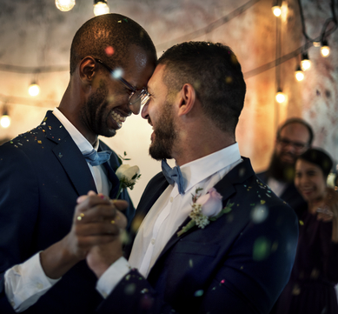

When the couple are two men, we say they are gay.
When a couple are two women, we say they are gay or lesbian.
If the couple is a man and a woman, we say they are heterosexual or straight.

Slide 10

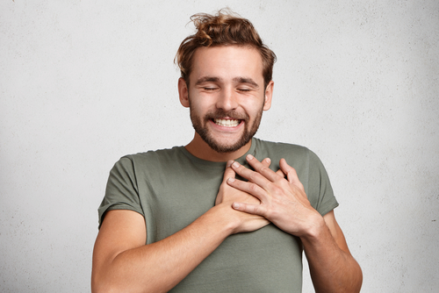
Sex should feel nice. Adults learn what they like and don’t like.

Slide 11

When a man feels like he wants to have sex with his partner his penis will get hard, this is called an erection.

Slide 12
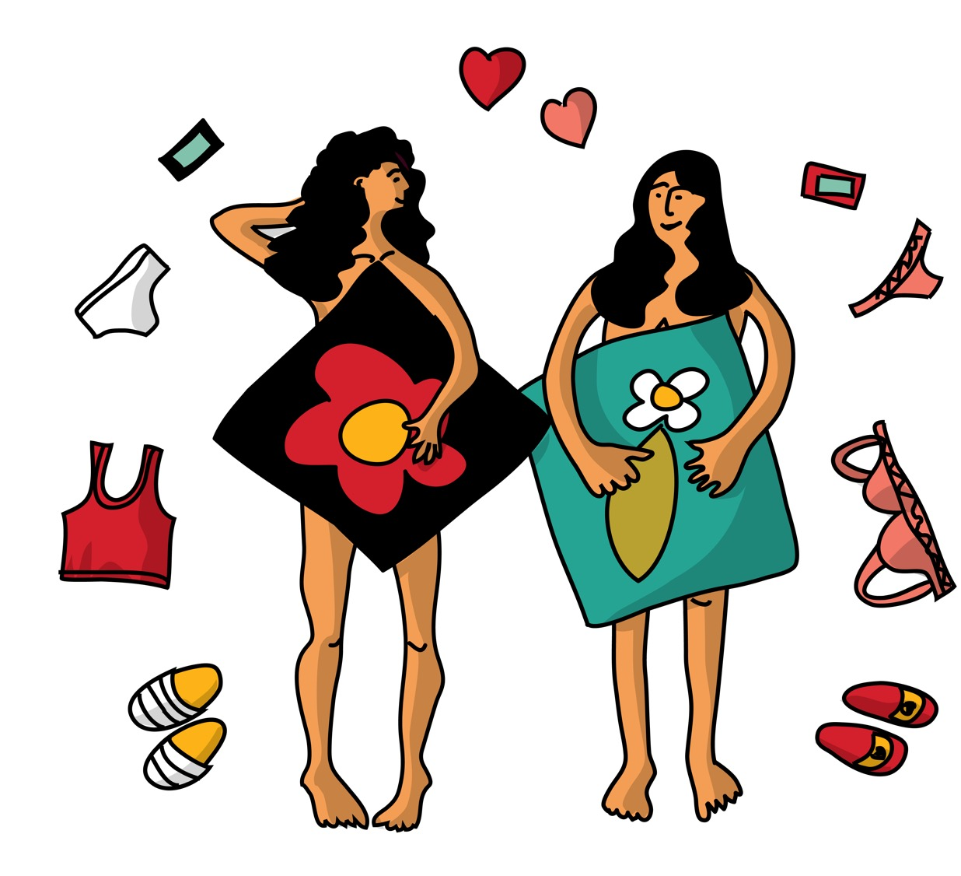
When a woman feels like having sex with her partner her vulva and vagina might feel tingly and wet or slippery to touch.

Slide 13
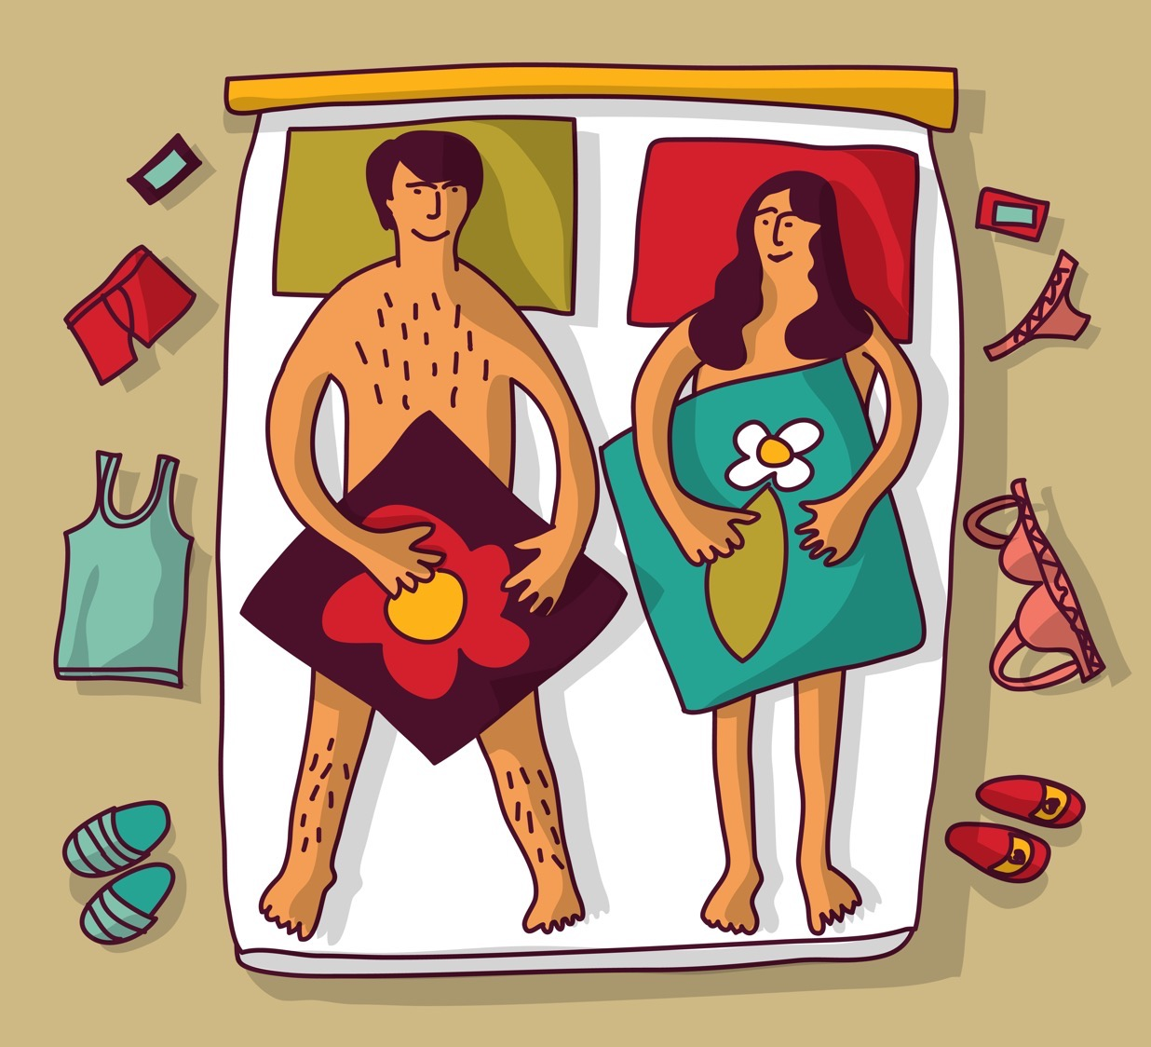
If a man and a woman are having sex, and they both want to do it, the man can put his penis inside a woman’s vagina and gently move his penis in and out. This should feel nice for both people.

Slide 14
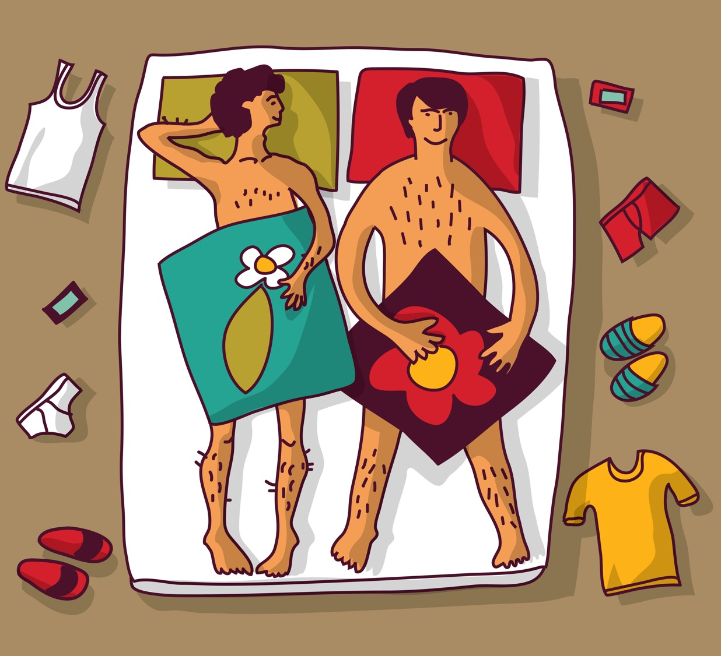
When people have sex, they might have an orgasm.
For a woman an orgasm is a pleasurable feeling in her body.
For a man, if he has an orgasm (called ejaculation) a white liquid called semen will come out of his hard penis. He will enjoy this feeling.

Slide 15


If a man has an orgasm (ejaculates) when his penis is inside the woman’s vagina, then the sperm may meet the egg and this is the way a woman can get pregnant and have a baby.

Slide 16

So, this is what sex is. Why do you think adults have sex?

Slide 17

Do you have any questions about sex?

