Slide 1
Sex: Consent, Pressure, Pleasure (and first-time sex)
I can describe what sex/sexual intercourse can involve.
I can describe what consent is.
I understand the physiological and mental responses in the body when having sex.
I can articulate what is important to me before embarking on intimate/sexual relationships.

Slide 2
Today’s session is about:
Consent, Pressure, Pleasure and First time sex

Slide 3
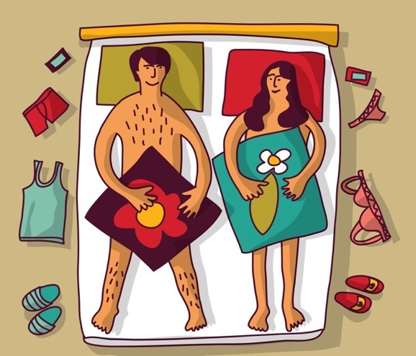
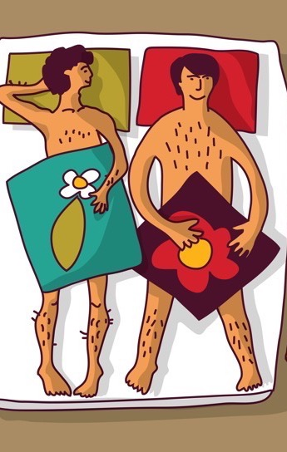
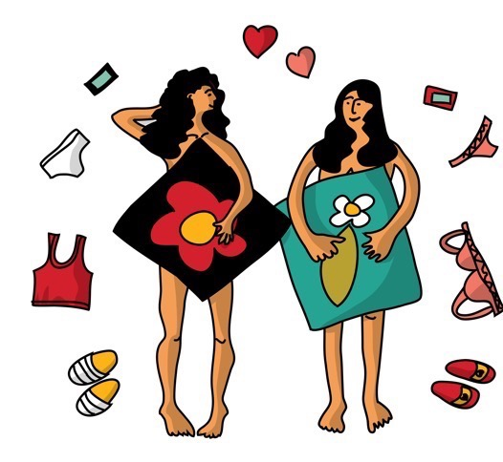
What is sex?
The law says that sexual activity includes mutual masturbation, oral sex or penetrative sex.
Penetrative sex is when a person puts their finger or penis or something else (like a sex toy/dildo) into a person’s vagina or anus (bottom).

Slide 4
Consent means…
Asking someone if you can do something or if they want something.
If they say yes, they give consent.
If they say no, they do not give consent.
If they don’t say anything, or they aren’t sure or aren’t clear, they do not give consent.
If they give consent once, you still must ask the next time.

Slide 5
Putting pressure on someone to do something sexual is the opposite of them giving their free and enthusiastic consent.

Slide 6
Cycling through Consent
(3 minutes 47 seconds)
https://youtu.be/-JwlKjRaUaw
Consent Explained
(duration 2minutes 44) https://youtu.be/5vmsfhw-czA
Consent – cup of tea
(duration 3 minutes) https://youtu.be/u7Nii5w2FaI

Slide 7
Pleasure is a feeling of happy satisfaction and enjoyment

Slide 8
Male vs Female orgasm:
Which is better?
https://youtu.be/5ioQ8a7o3Mo

Slide 9
First time sex:
This could be the first time ever, or the first time with a new partner.
Sex should always be with consent. It should be pleasurable.
Here is a list of things to consider about first time sex. Which of these would be important for you, and which would be essential for you. Place as many as you want in each category.
Things to consider
I feel ready.
I feel safe.
I have someone I can speak to about this before I do anything.
We are both 16 years old or older
If we need contraception, it’s sorted.
If we need condoms, it’s sorted.
We are both sober.
We have the time and we are in a safe comfortable place.
I trust them.
I want to. We both want to.
I know I can change my mind, say ‘no’ or stop at any time. I know they can too.

Slide 10
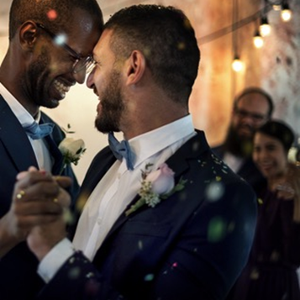
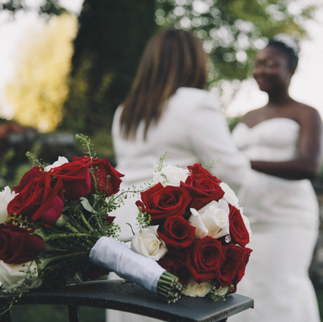
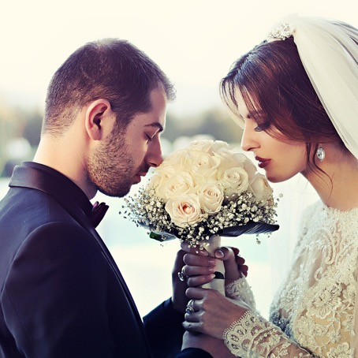
Some people think that sex should be part of a relationship where people are committed to each other, perhaps in marriage.
What do you think?

