Slide 1
Safe and happy online
I can discuss my online life.
I understand that my online presence requires me to have strategies for safe use.
I can identify adults that I trust and who can help when I have a worry or a question.

Slide 2
Safe and happy online
PART 1

Slide 3
What do you do online? What games or apps or websites do you visit?

Slide 4
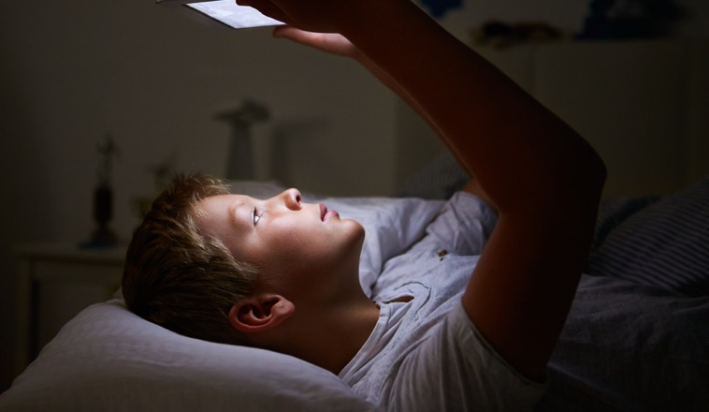
How do we get online? Who uses: A phone? A tablet/iPad? A laptop? A computer? A games console?

Slide 5
What do you do online?
Do you:
Chat?
Read?
Send messages?
Play games?
Watch things on YouTube?
Watch things on TikTok?
Create things?
Find out things for hobbies or for schoolwork?
Take photos? Send photos to people?

Slide 6
Do you have any rules that you follow online?

Slide 7
Safe and happy online
PART 2

Slide 8
Films: Kara and Winston and the SMART Crew The Adventures of Kara, Winston and the SMART Crew | Childnet

Slide 9
Safe and happy online
PART 3

Slide 10
The Adventures of Kara and Winston and the SMART Crew

Slide 11
What have we learned from Kara and Winston? Top tips: 1 People you don’t know are strangers. When you are online or playing a game people are not always who they say they are.

Slide 12
Top tips: 2 Keep your personal information private. Don’t tell people online where you live or the school you go to. Never take a photo of you and send it to a stranger, even if they ask. Never share a photo of another person like a friend or sister or brother. Photos are also private.

Slide 13
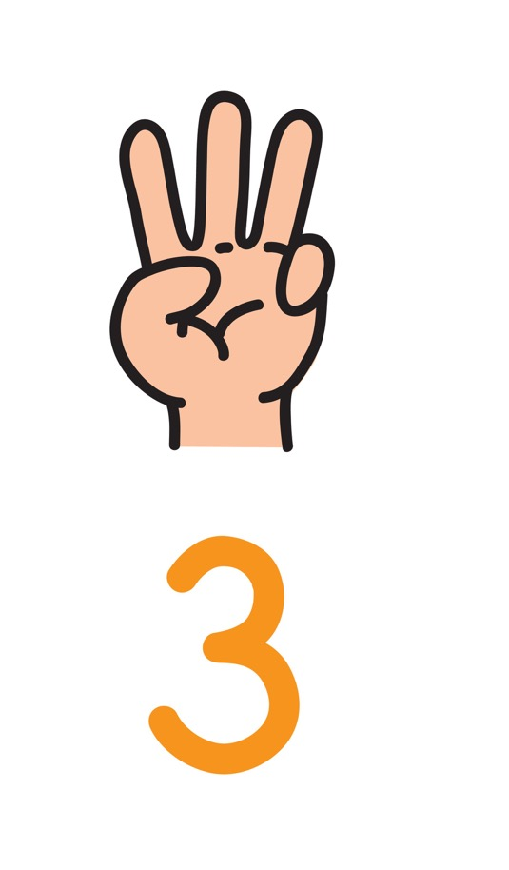
Top tips: 3 If someone says or does something that upsets you, tell an adult you trust.

Slide 14
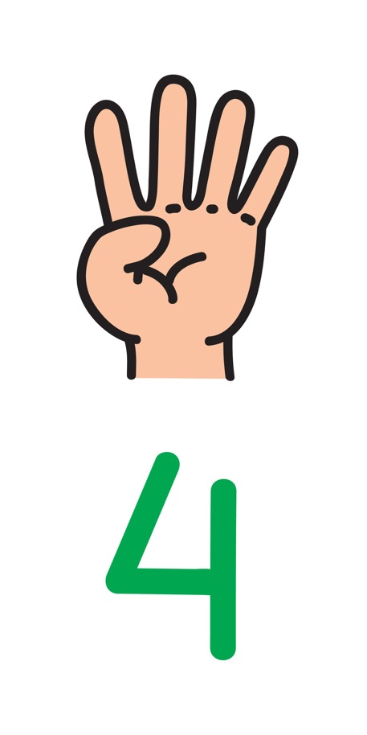
Top tips: 4 Don’t arrange to meet someone you only know online. If you are thinking about this, tell an adult you trust.

Slide 15
Top tips: 5 If you ever get that feeling in your body that tells you something isn’t right, maybe you feel a bit worried, then tell an adult you trust.

Slide 16
Activity: Safe and Happy Online posters

Slide 17
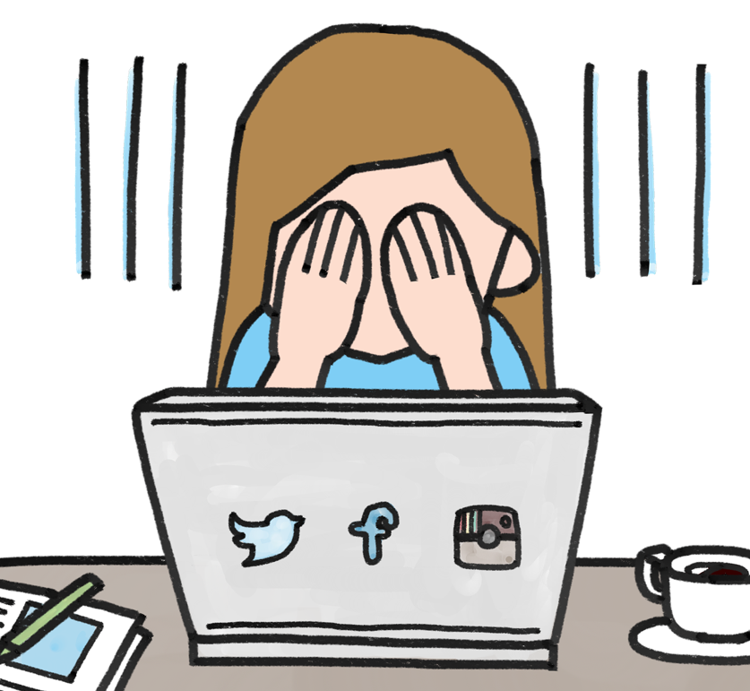
It’s great to watch things, play games and have fun online. If you feel upset about anything you have seen or if someone says something which makes you feel bad or worried inside, tell a grown up at home or at school.

