Slide 1
Protecting Me: Sexual Abuse
I can identify the different types of abuse a child can experience.
I know that all types of abuse are wrong.
I build confidence in my own feelings and judgements about what feels safe/unsafe or okay/not okay for me.
I can identify trusted adults who can help when I have a worry or a question.

Slide 2
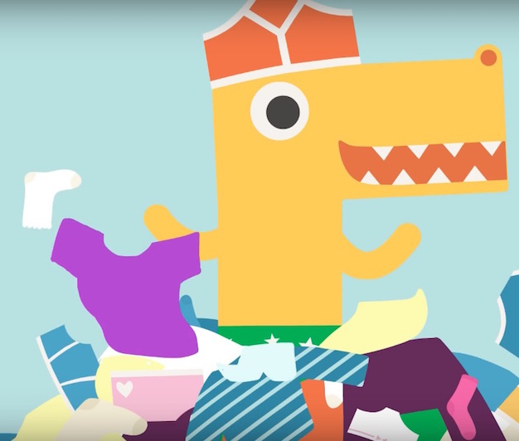
The PANTS Rule
P is for…
https://www.nspcc.org.uk/preventing-abuse/keeping-children-safe/underwear-rule/

Slide 3
Here are some important things we all need to know about sexual abuse:

Slide 4
Sexual abuse can be if you are touched in a way you don’t like, including your private parts. Your private parts are your breasts, penis, testicles, vulva, bottom.

Slide 5
Sexual abuse can happen to girls and boys.
A child can be sexually abused by someone they know, or by a stranger.

Slide 6
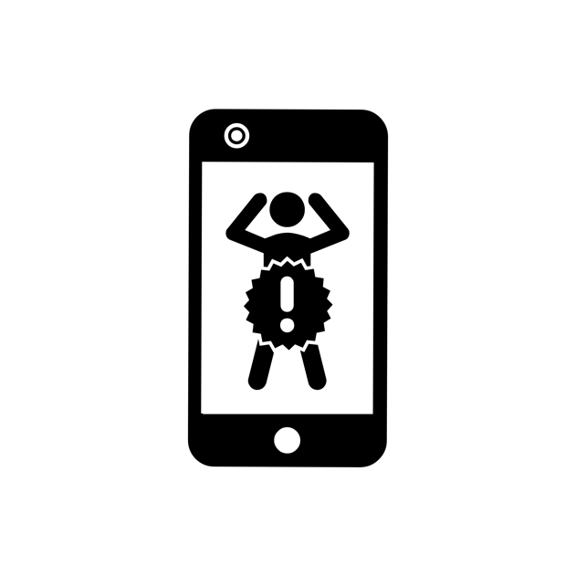
Sexual abuse can be if someone shows you a part of their body, including their private parts. They can do this when they are with you or online.

Slide 7
Sexual abuse can be when someone shows you sexual pictures or makes you watch people doing something sexual.
You might have heard this is called pornography.

Slide 8
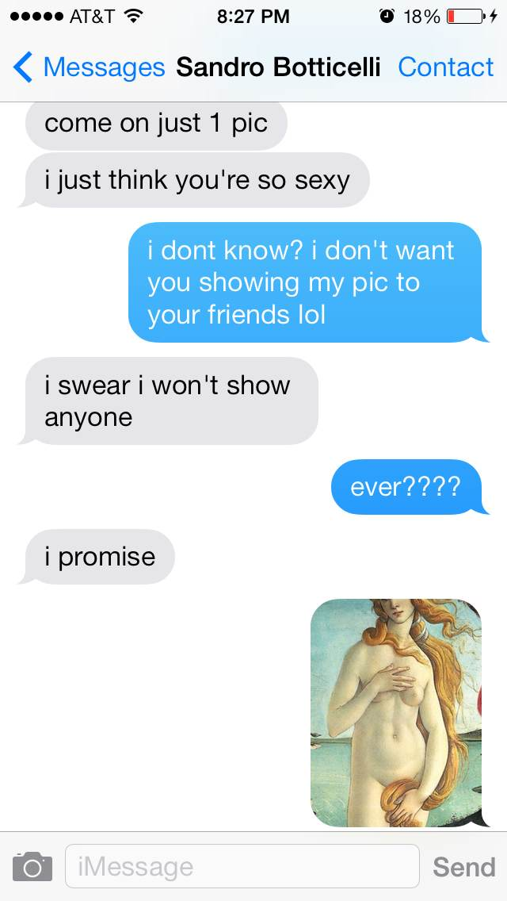
Sexual abuse can be if you are asked or forced to take a picture with clothes off, or a sexual picture and send it to someone.
Image Uffizi Gallery [CC BY-SA 3.0 (https://creativecommons.org/licenses/by-sa/3.0)]

Slide 9
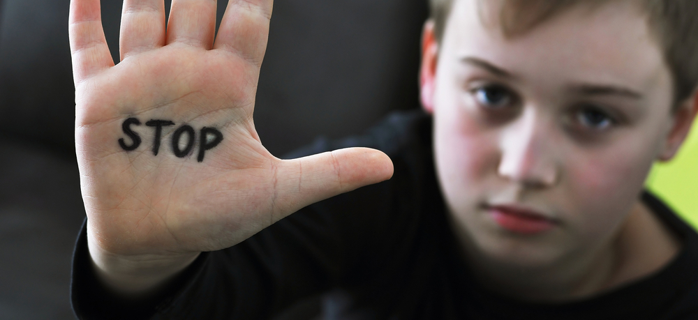
If someone sexually abuses a child it is against the law, that person knows what they are doing is wrong.
They might tell you to keep it a secret or try and make you believe that it’s okay. It’s not okay.

Slide 10
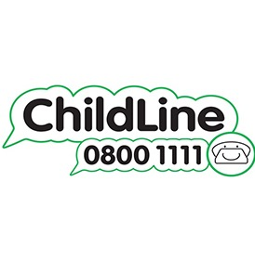
Sexual abuse is NEVER your fault. It is never too late to tell. Telling will help. You can tell an adult you trust.
ChildLine is always there for you. Online or phone 0800 1111
What happens when you contact ChildLine? https://youtu.be/fCA6EhBhiC8

Slide 11
The PANTS Rule
P is for…
https://www.nspcc.org.uk/preventing-abuse/keeping-children-safe/underwear-rule/

Slide 12
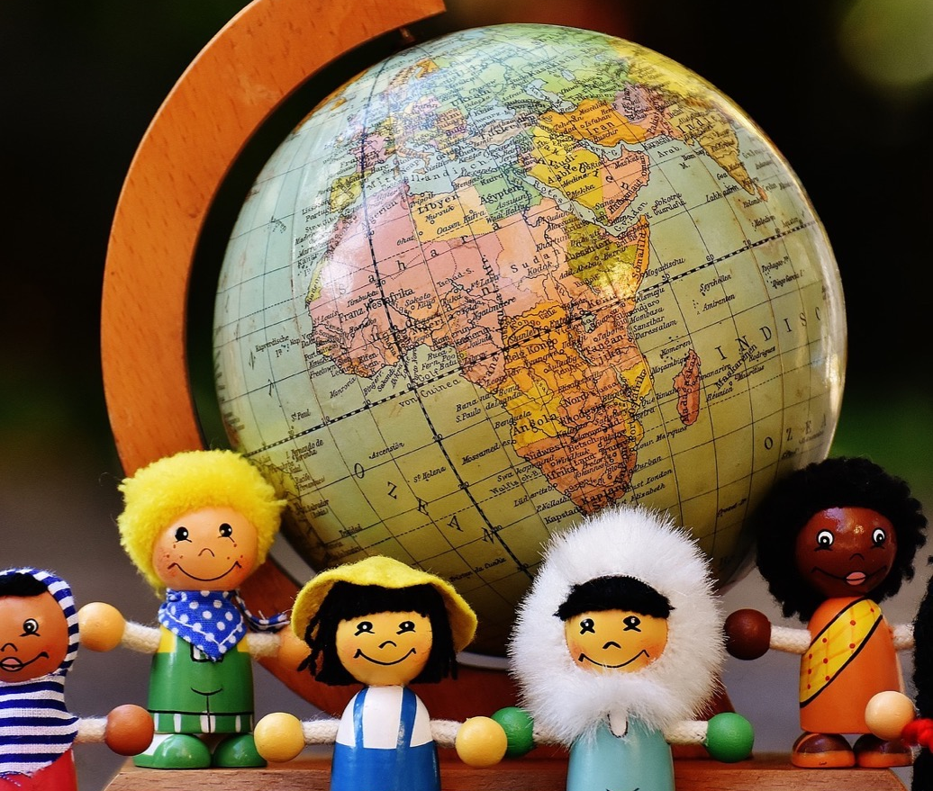
In this class, we are all individuals, different, unique and special.

