Slide 1
Protecting Me: Physical abuse and neglect
I can identify the different types of abuse a child can experience.
I know that all types of abuse are wrong.
I build confidence in my own feelings and judgements about what feels safe/unsafe or okay/not okay for me.
I can identify trusted adults who can help when I have a worry or a question.

Slide 2
Kindness
Trust
Empathy
Human Dignity

Slide 3
What does a child need to be healthy?

Slide 4
What does a child need to be happy?

Slide 5
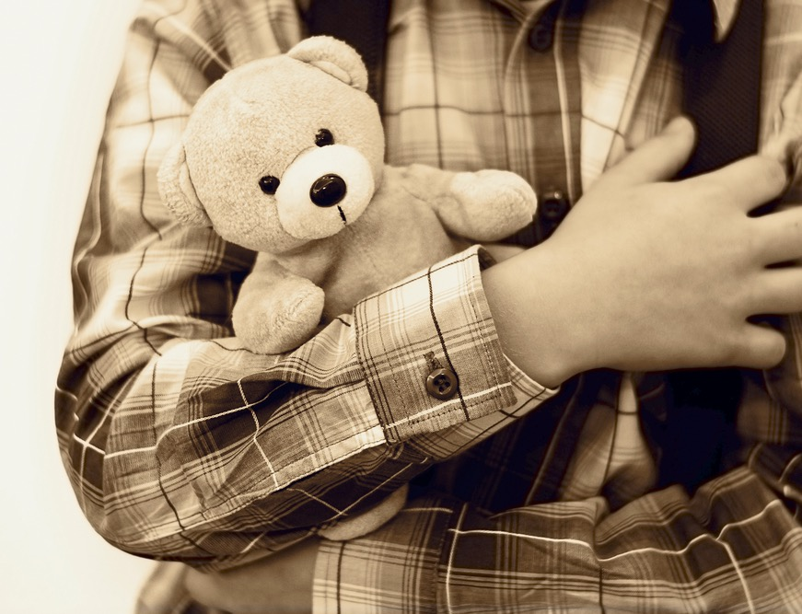
What does a child need to be safe?

Slide 6
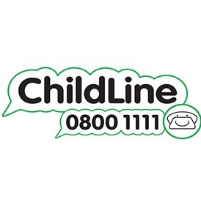
ChildLine says every child has the right to be looked after properly.
Sometimes a family are trying to do their best, but maybe they can’t provide a child with what they need.
This would be called neglect.

Slide 7
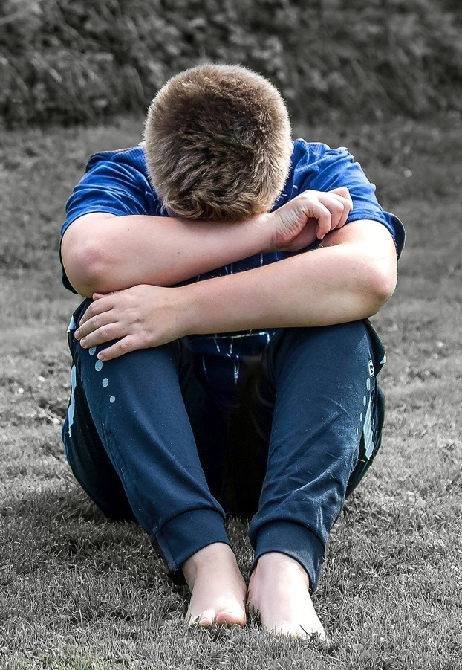
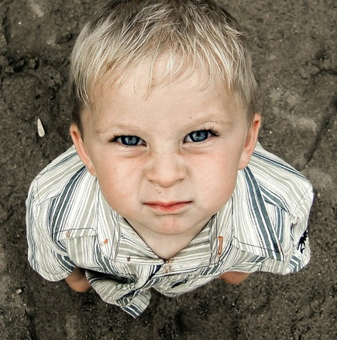
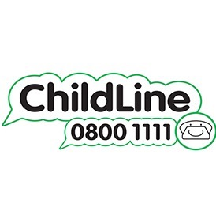
Neglect can be if a child is left without
Food and drink
Clean clothes
The right medication
Support or help when needed

Slide 8
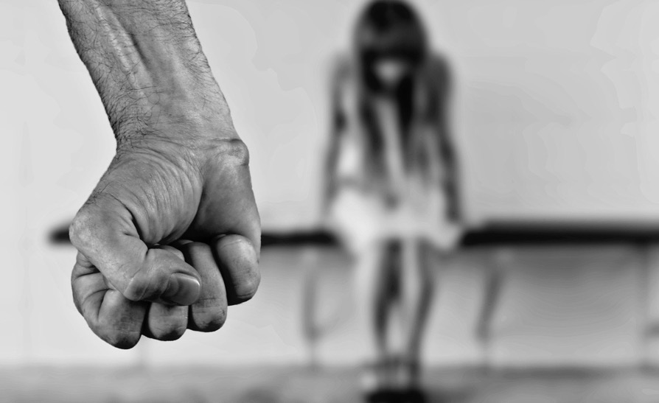
ChildLine says physical abuse is when someone is hurting you.
This could be hurting you with their hands, their feet, or an object.

Slide 9
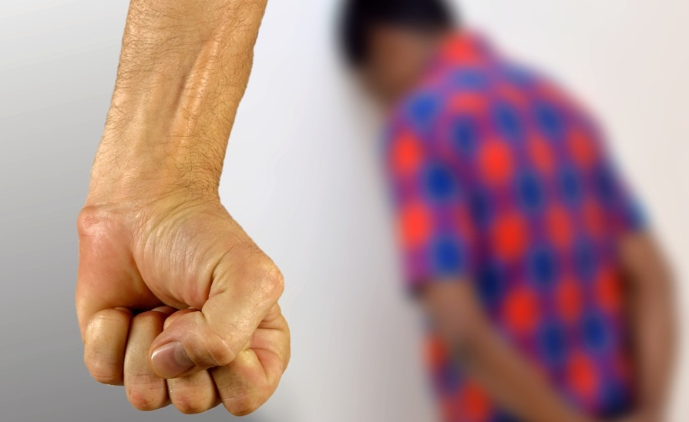
Some examples of physical abuse are:
hitting, smacking and slapping
punching and kicking
pinching, scratching or biting
shaking or suffocating a child
scalding or burning a child
hair pulling
spitting or throwing things at the child
making a child swallow something that hurts or makes them feel ill, including giving medicine when it’s not needed.

Slide 10
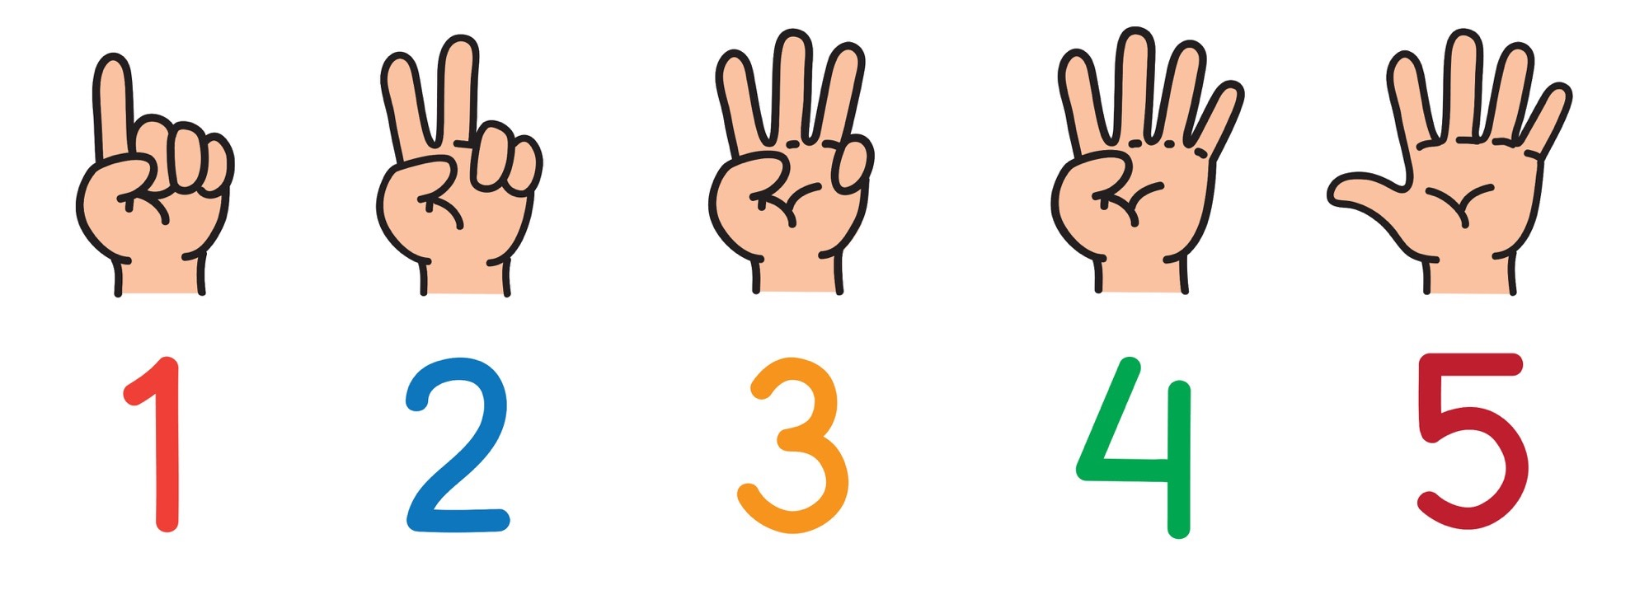
Things to remember

Slide 11
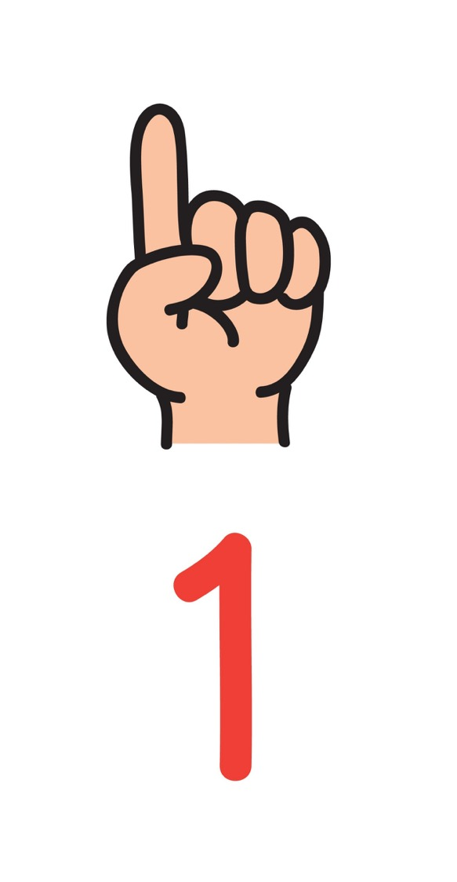
Every one of us should be healthy, happy and safe.

Slide 12
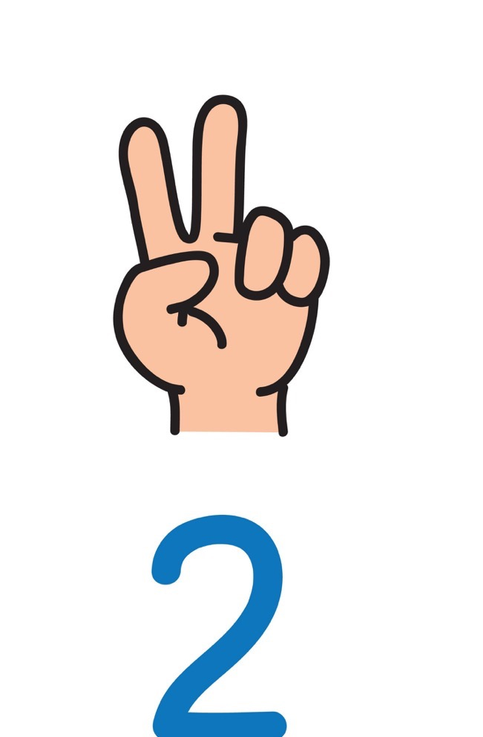
Physical abuse and neglect are never the fault of a child.

Slide 13
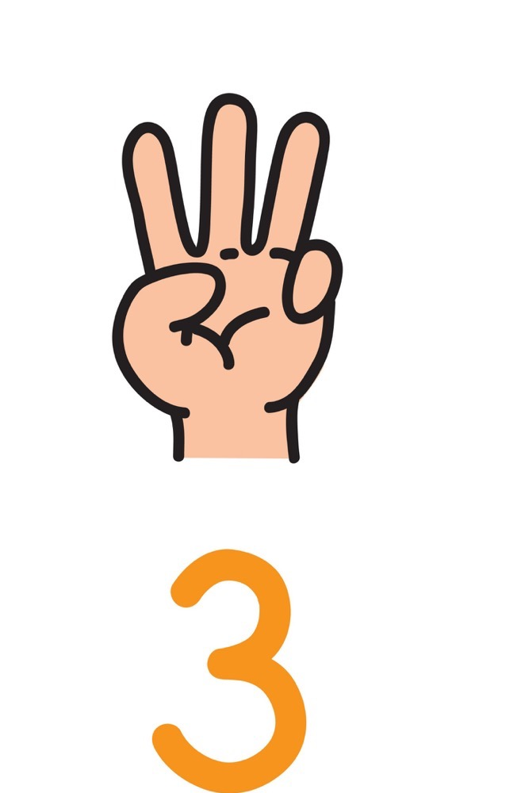
No child should be hurt or feel frightened.

Slide 14
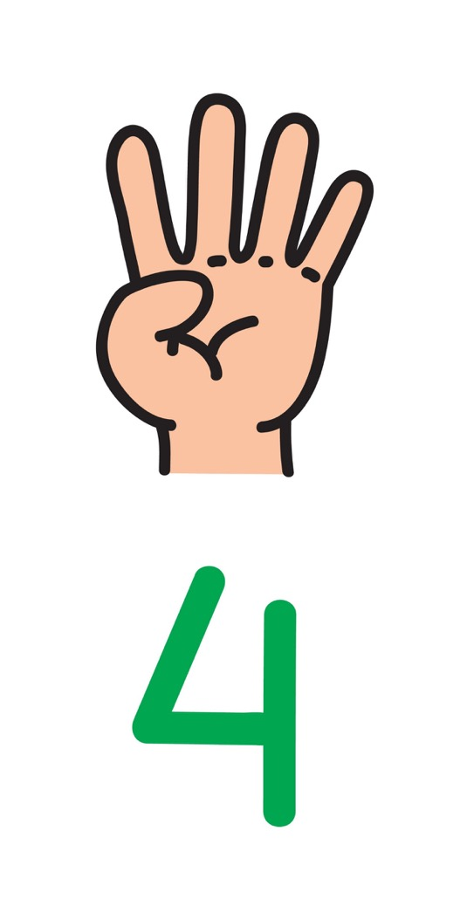
It’s always best to find someone to talk to if you have a worry.
Telling someone helps.

Slide 15
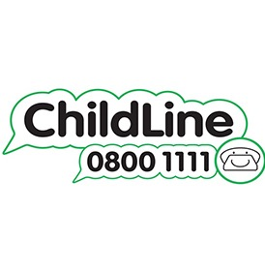
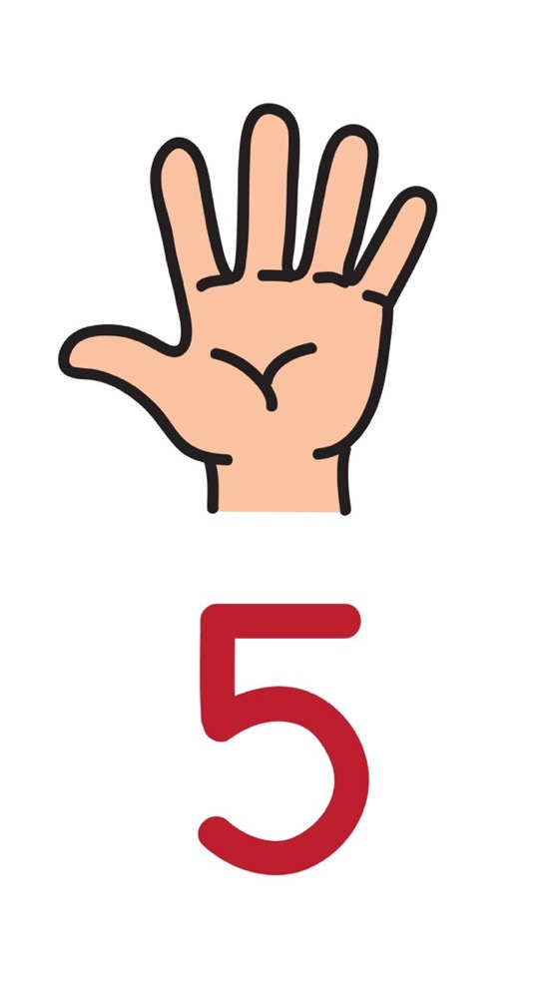
MY 5 trusted adults
Do you remember we all thought about 5 adults you could go to with a worry?
Remember, if you have a worry, you can speak to me.

