Slide 1
When I feel safe/unsafe
I can identify the different types of abuse a child can experience.
I know that all types of abuse are wrong.
I build confidence in my own feelings and judgements about what feels safe/unsafe or okay/not okay for me.
I can identify trusted adults who can help when I have a worry or a question.

Slide 2
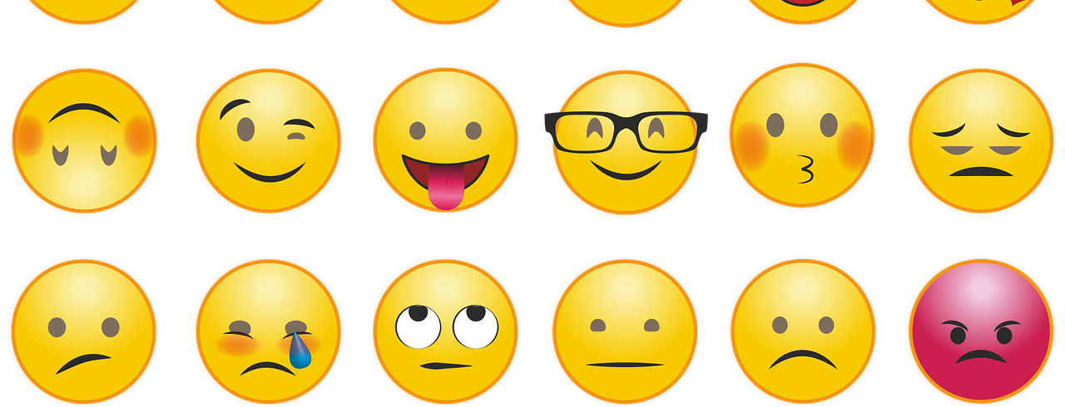
Game: Feelings charades

Slide 3
Feelings charades
Was it easy to tell how someone was feeling by looking at them?
How do we actually feel in our body when we have this feeling?

Slide 4
Feelings charades
Were there some feelings that were harder to tell?
Are there some feelings we sometimes don’t want to show? Or sometimes do we keep them private?

Slide 5
Traffic lights: do I feel red, amber or green?
RED I feel unsafe or not okay
AMBER I’m not sure how I feel
GREEN I feel safe or I feel okay

Slide 6
Feeling YES
Feeling NO

Slide 7
Jumping off a high diving board.
Do I feel safe?
YES or NO?

Slide 8
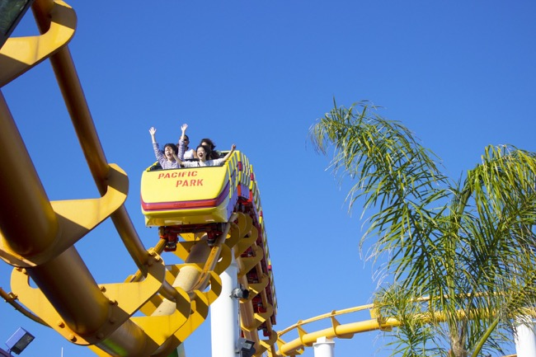
Going on a rollercoaster.
Do I feel safe?
YES or NO?

Slide 9
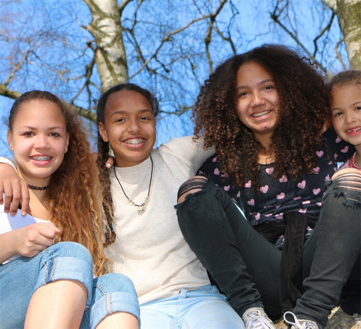
Playing outside on a sunny day.
Do I feel safe?
YES or NO?

Slide 10
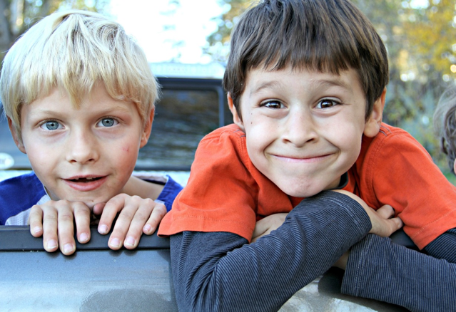
Playing in the school playground with my friends.
Do I feel safe?
YES or NO?

Slide 11
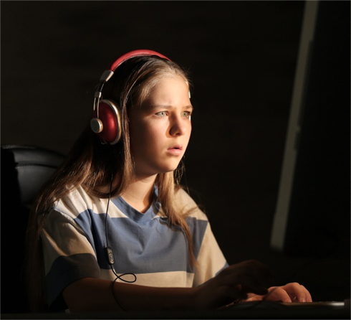
When a stranger on the internet asks where I live.
Do I feel safe?
YES or NO?

Slide 12
When a grown up suggests we watch something on the computer or TV that I don’t want to see.
Do I feel safe?
YES or NO?

Slide 13
If a stranger offered me a lift home in their car.

Slide 14
If someone online asks me for a photo of me.

Slide 15
If someone touches my private parts.

