Slide 1
Prostitution/Paying for Sex
I recognise and can discuss the different societal perspectives on prostitution.
I develop and articulate my own views on prostitution.
I can explain the vulnerabilities of, and harm done, to people working in prostitution.
I understand the commodification of sex is an abuse of power.

Slide 2
Words we will hear and use
Prostitution This is the word that people use to describe the business that is about selling sex. But we wouldn’t use the word ‘prostitute’ to describe a person as this is considered offensive, as if we are putting a negative label on someone.
Buying sex This is generally what we mean when we talk about prostitution, but sex can mean lots of different things to different people. The reality is that for women involved in prostitution sex is often experienced as violent or degrading.

Slide 3
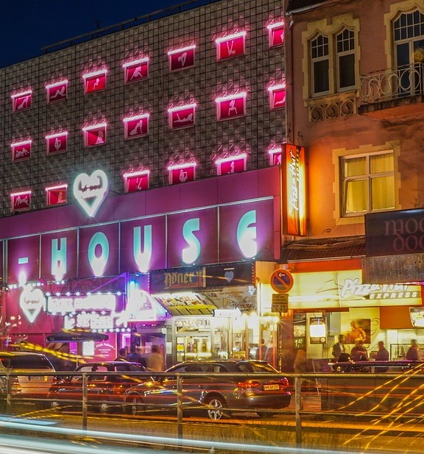
Sex industry/Sex Worker Many people would say that saying that prostitution is 'sex work' minimises the harm that it causes to those involved. It is therefore more helpful and sensitive to use the term 'women and men involved in prostitution' rather than 'sex workers' or 'prostitutes’.
While both women and men can be involved in prostitution it is by far mostly women. Around 75% of people working in prostitution are women, 20% are men and 5% are trans/non-binary. Almost all people who buy sex are men.

Slide 4
Human trafficking is the transportation of people from one place to another so that they can be forced to work, or be sold for sex. If the person is sold for sex this is a crime of being kidnapped and then raped. It is estimated that there are 1.4 million people in the world who have been trafficked and forced to work in prostitution. Many young people are vulnerable because of being abandoned by their families, or not having safe and trusted adults in their lives.
Modern day slavery Some people would say that working in prostitution is a part of slavery, that your body is being sold as if you were something to buy or rent. A slave has no control, no freedom, they are used and abused.

Slide 5
Numbers involved.
It is estimated that in in the UK between 58,000 and 72,800 individuals are involved in prostitution.

Slide 6
Having heard this information. What are your views on prostitution?

Slide 7
Things people say about prostitution:
It’s a choice
It’s a job
Prostitution is a useful service for lonely men.
Men will always want there to be prostitution
Prostitution has nothing to do with human trafficking
It doesn’t do the woman any harm
Women involved in prostitution make a lot of money
We will never be able to abolish prostitution.

Slide 8
Activity
Use the cards to have a conversation about Things people say about prostitution

Slide 9
Money and Power: Commercial Sexual Exploitation in Scotland https://youtu.be/fCYIJCGO2Gw
(duration 7 minutes 19)

Slide 10
The Law
In Scotland the exchange of sexual services for money (prostitution) is legal, but it is illegal to sell sex in a public place, or in a brothel (in a place like a house or sauna where sex is for sale from several people).
It is illegal to organise the selling of sex or to live off the money made by doing so (pimping).
When it comes to buying sex, it is illegal to try to buy sex if you are in a public place, including driving in the street (where there is prostitution happening on the street).

Slide 11
Amnesty International say that people working as prostitutes should not be considered criminals as this makes them more vulnerable. Prostitutes need to be protected. Some countries have laws that target the people who buy sex, saying they are in the wrong.
What do you think the law should do?

Slide 12
Real Men Don’t Pay: Rachel Moran Ted X presentation https://www.youtube.com/watch?v=9bkpotR3L4k
(duration 10 minutes 33 seconds)

