Slide 1
Preparing for parenthood/ Getting Ready for a Healthy Pregnancy
I can reflect on the need to prepare for parenthood.
I can talk about the value of pre-conception health.
I can discuss the choices and actions a potential parent can take to ensure the best start in life for the child.

Slide 2
Do I ever want to become pregnant, or for my partner to become pregnant?

Slide 3
If not, what could I do to avoid becoming pregnant or making someone pregnant?
If yes, when in my life do I think I might want to become pregnant or have my partner become pregnant?

Slide 4
If I want to be a parent….
What kinds of things would I like to be sorted/in place before any pregnancy happens?

Slide 5
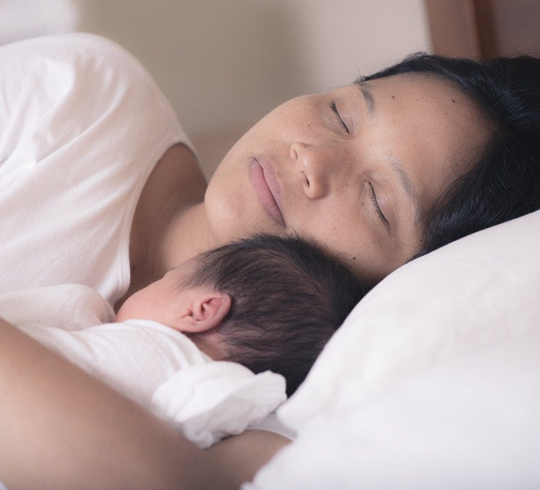
It’s said that anyone who wants to start a pregnancy and have a baby usually wants these 3 things:
A safe pregnancy
A thriving baby
A rewarding parenthood
Thinking about you – would you agree?
How do you think each can be achieved?

Slide 6
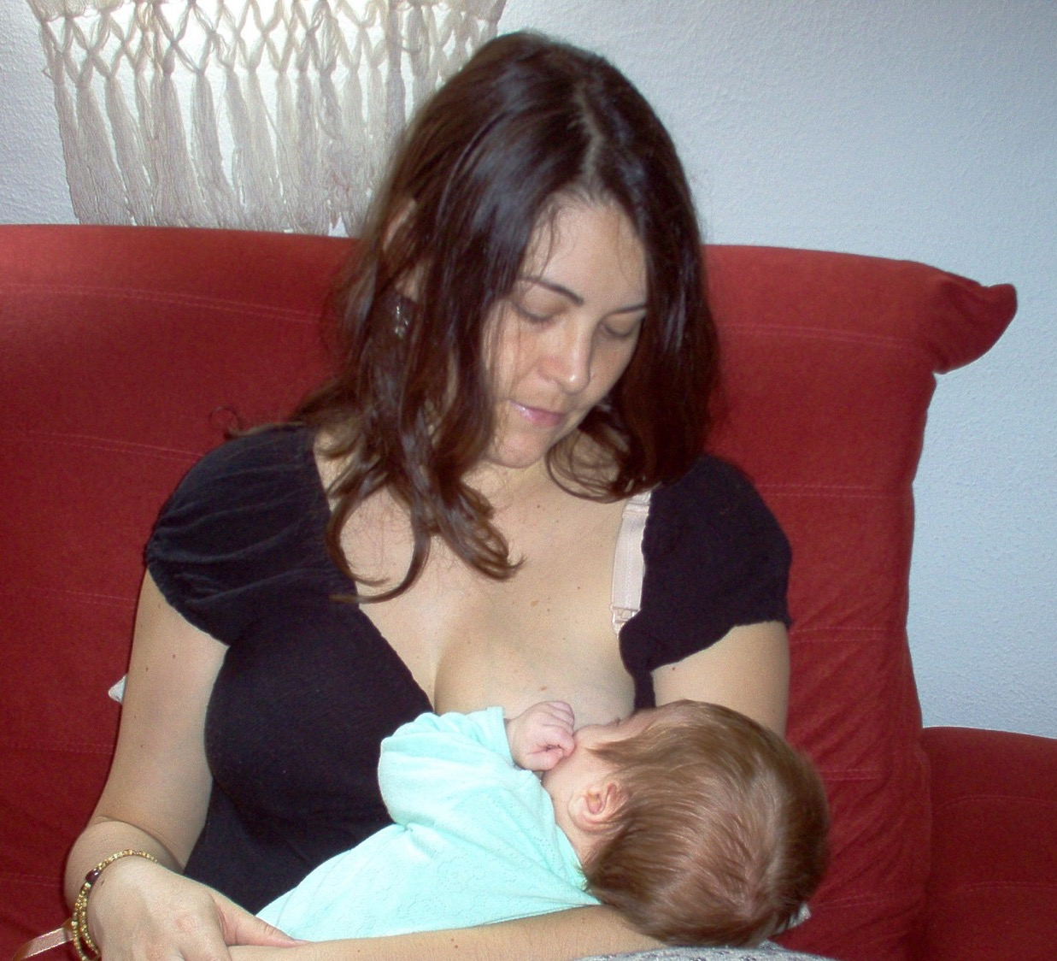
Babies born in Scotland every year.
How many babies are born every year?
What’s the average age of Mums or Dads when their first baby is born?
Do you think that most people plan or prepare for their baby?

Slide 7
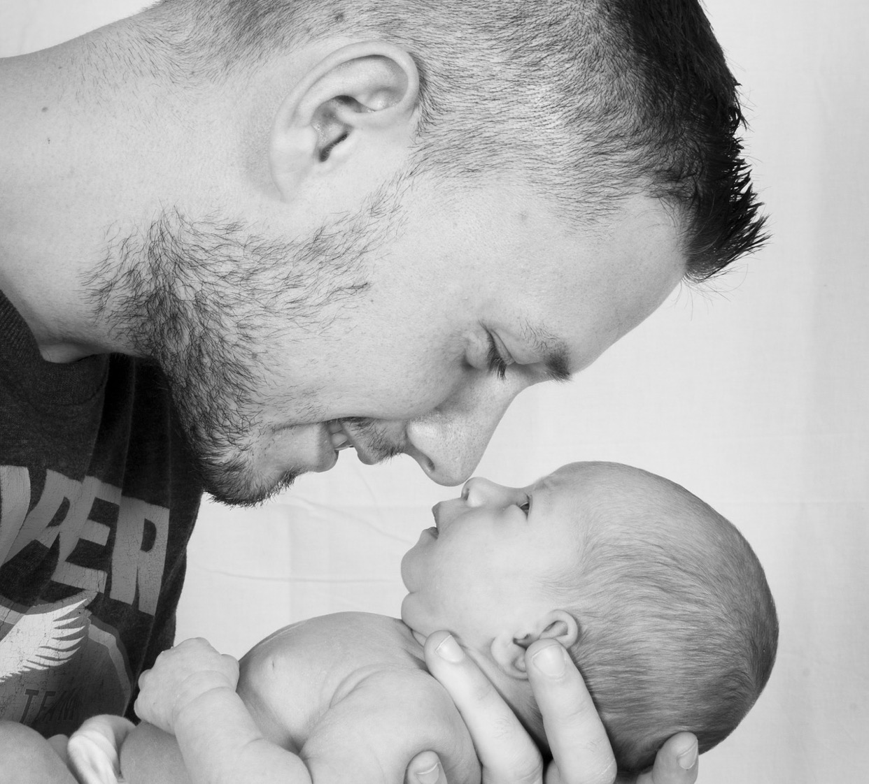
Almost 50,000 babies are born in Scotland every year.
The average age of a first time Mum is 30 years old and for Dads it’s 32.
Nearly one half of pregnancies are unintended and more than half are not well prepared for.

Slide 8
What might be the circumstances in which a pregnancy might be planned or prepared for?
What circumstances might there be in which a pregnancy is not planned or prepared for?

Slide 9
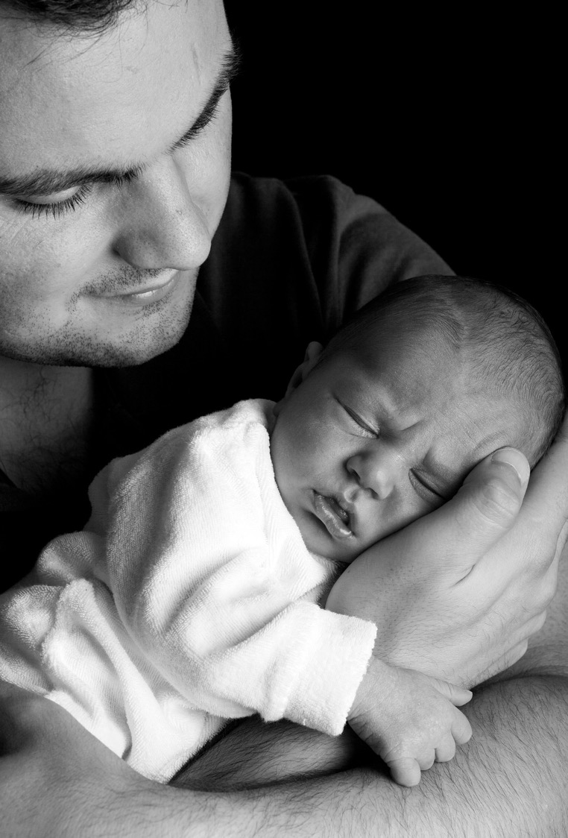
Pre-conception health is about the choices a woman and her partner make and especially what they actually do (or don’t do) before the beginning of any pregnancy.
We can usually expect that a healthy, thriving woman will give birth to healthy, thriving baby.
Pre-conception health is about doing our best to make sure that prospective parent(s) prepare well to achieve a positive pregnancy and a healthy baby.
It’s not just a matter of good luck.

Slide 10
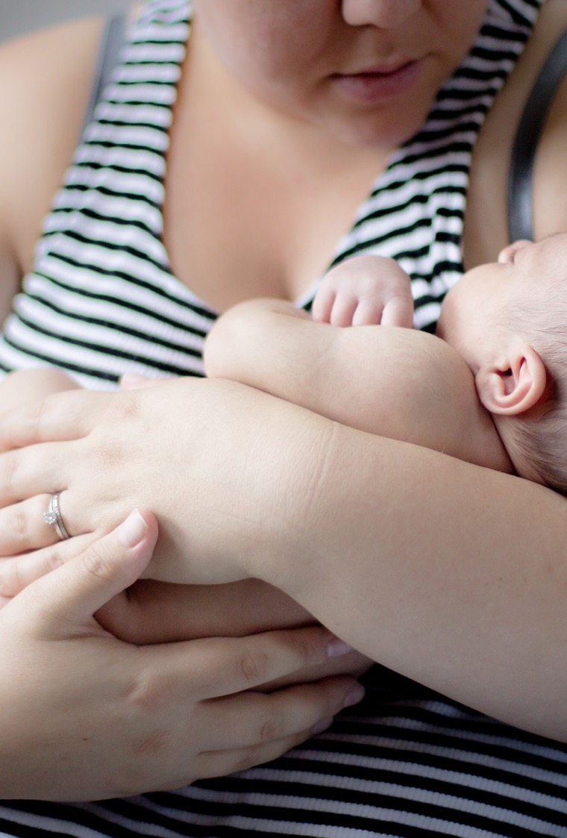
What can be happening in a woman’s life that could have a negative impact if she was to become pregnant? You can think about:
Environmental factors
Social situation
Health
Lifestyle

Slide 11
Pick one of the factors that can have a negative impact.
What could a parent/parents to be do, to end or minimise this negative factor?

Slide 12
Before Preparing for Parenthood/ Getting ready for a healthy pregnancy.

Slide 13
The importance of an alcohol free pregnancy
By making the choice not to drink any alcohol while pregnant or preparing for a baby parents are helping to keep their baby safe and healthy.

Slide 14
Drinking alcohol when pregnant can cause permanent, irreversible brain damage called Fetal Alcohol Spectrum Disorder (FASD)
Since women may not know a pregnancy has started for well over a month, they may be drinking while pregnant, even if they planned to stop drinking while pregnant. Not drinking alcohol is the safest, smartest choice when pregnancy is likely/possible – for example, when effective contraception is not always being used.
Please remember that when it comes to alcohol:
If you are pregnant, don’t drink alcohol.
If you are drinking alcohol, don’t get pregnant.

