Slide 1
Pornography: What is it? What harm does it do?
I can talk about the difference between sex as it is portrayed in pornography and sex between consenting adults in a relationship.
I can explain that pornography presents behaviours that can be violent or degrading, and that these behaviours are not appropriate in real-life relationships.
I can express my own developing opinion about pornography.
I can identify where or who to go to if I have a question or concern.

Slide 2
Pornography is sometimes called ‘porn’.
Pornography is a photograph, image, film or words that are about something sexual and is made or shared to make another person sexually excited.

Slide 3
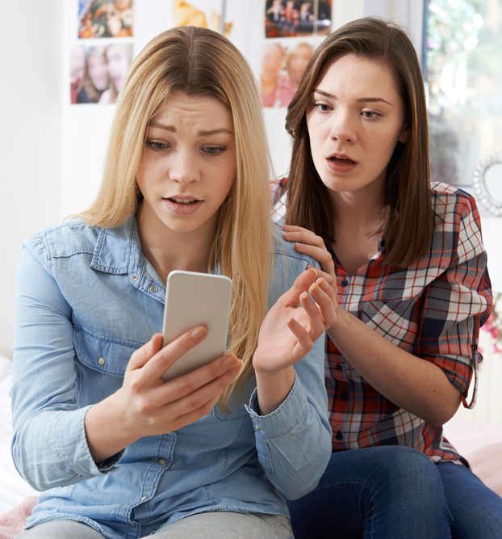
Porn can show people’s sexual body parts or show people having sex.
Some porn can be upsetting because it shows a person being hurt or abused. Porn can show sexual acts that many people would find distressing and painful in real life

Slide 4
Porn and sex are the most searched words on the internet.
Porn is easily accessible, especially online.

Slide 5
Agree, Disagree or ‘Depends’?
Watching porn is harmless fun

Slide 6
Watching porn is harmless fun
Some people are of the view that porn encourages the person watching to just see the other person as a sexual object, and not as an equal human being, so this is bad for our relationships. A lot of porn does show people being hurt or abused, this is not okay and it’s not normal or fun.

Slide 7
Agree, Disagree or ‘Depends’?
Porn is only for men and boys

Slide 8
Porn is only for men and boys
Most porn is watched by men and boys, but girls and women do watch it too. Nobody should be made to watch porn if they don’t want to.

Slide 9
Agree, Disagree or ‘Depends’?
You can watch too much porn

Slide 10
You can watch too much porn
New scientific research says people who watch too much porn can become addicted. Then they need to watch more and more to feel sexually excited. You can also lose touch with what real sex and relationships are actually like.

Slide 11
Agree, Disagree or ‘Depends’?
Watching porn can be bad for relationships

Slide 12
Watching porn can be bad for relationships
Porn can make boys or men think badly of women. If you watch too much porn, then you might have less enjoyment from real sex with a partner.

Slide 13
Agree, Disagree or ‘Depends’?
Most young people have seen porn

Slide 14
Most young people have seen porn
Recent research tells us that:
27% of children had seen pornography by age 11.
50% had seen pornography by age 13.
The average age at which young people first see pornography is just under 13.
Porn is really easy to find and see but it doesn’t mean you have to like it or watch it.

Slide 15
Agree, Disagree or ‘Depends’?
You need to be careful what you search for.

Slide 16
You need to be careful what you search for
If you search for something on the web you can’t predict where it will take you. And if a site you visit uses cookies it is possible that you then start getting pop ups or ads for the thing you looked for. So, if you have a question or a worry, best ask an adult you trust rather than the internet.

Slide 17
Agree, Disagree or ‘Depends’?
You can learn how to have sex by watching porn

Slide 18
You can learn how to have sex by watching porn
Real sex and porn sex are different…..

Slide 19
Real or not real? Porn: Fact or Fiction (duration 1 minute 58 seconds) https://youtu.be/GdB2rmGqqNU

Slide 20
Real Sex or Porn Sex?

Slide 21
People don’t always want to have sex. | Everyone is always up for sex.

Slide 22
You can get pregnant or get an STI if you don’t use condoms and contraception. | People don’t use condoms and there are no consequences.

Slide 23
Men have extra-large penises. Women have extra-large breasts and small vulvas. | Bodies, vulvas, breasts and penises can be all shapes and sizes.

Slide 24
People have body hair. | No-one has any body hair.

Slide 25
Sex is loud, people scream as soon as they start having sex. | People can be quiet, or loud and make different sorts of noises when having sex.

Slide 26
Men ejaculate/orgasm after a few minutes. | Men’s erections last for a long time without ejaculating.

Slide 27
Sex often involves lots of different people. | Sex usually involves 2 people.

Slide 28
Sex is rough and can be violent, without feelings or emotions. People are sometimes abused and hurt. | Sex can be fun, gentle and people can show love for each other.

Slide 29
You always have to get consent. | Consent is never discussed, men just assume, or don’t care.

Slide 30
Childline: information about Pornography
https://www.childline.org.uk/info-advice/bullying-abuse-safety/online-mobile-safety/online-porn/

