Slide 1
Make it good/Loving and intimate Relationships: The sexual relationship I want
I can describe what the good relationship would mean for me.
I am building skills and confidence to make decisions about my own personal relationships, including sexual relationships.

Slide 2
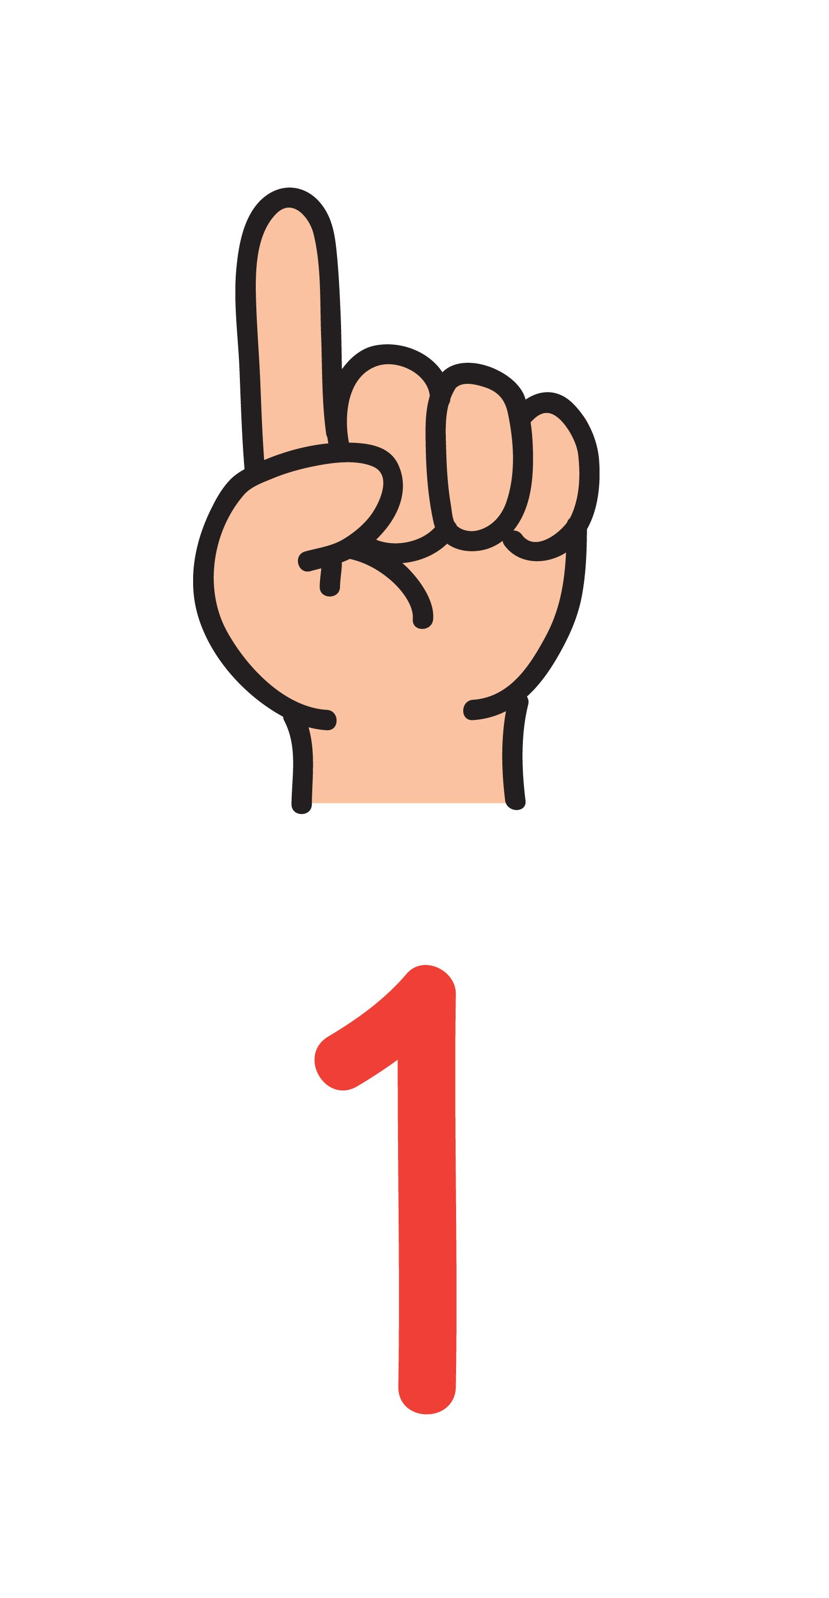
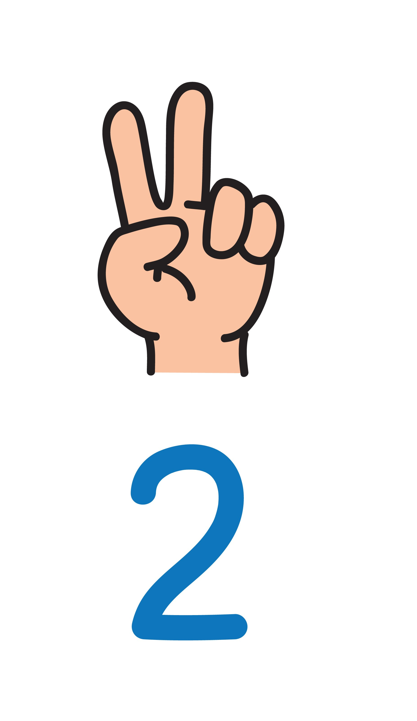
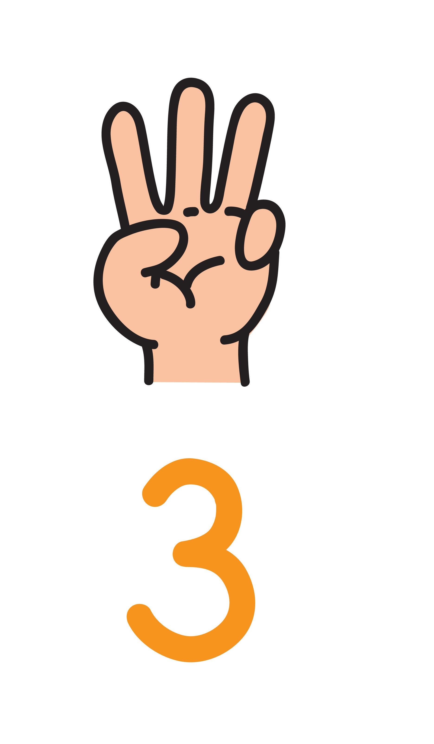
So, how do you know if you are ready to have sex?
You know your partner. You both respect each other. You want your first time to be with them (or that you are ready for your first time with them).
You feel emotionally ready. Sex is an emotional thing. If you don’t feel ready, you’re not, so wait.
Your body just feels ready. You never want to rush into it or feel pressured.

Slide 3
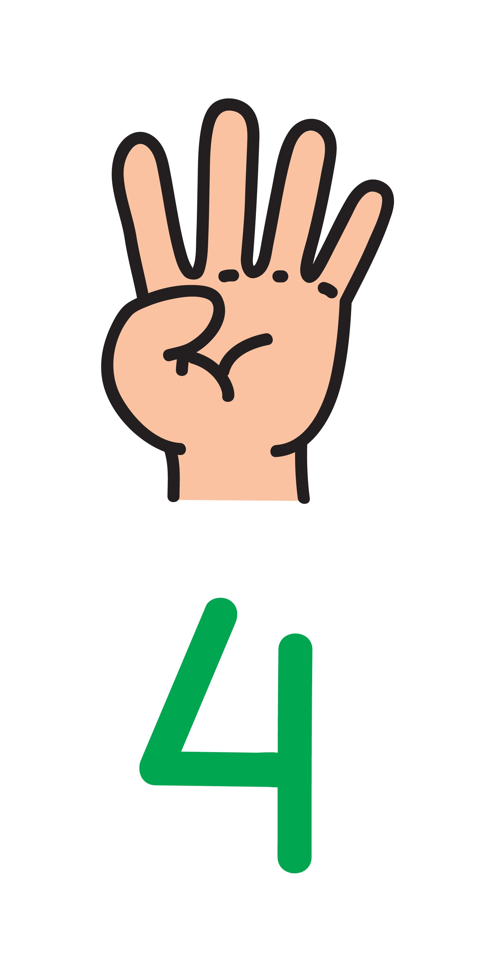
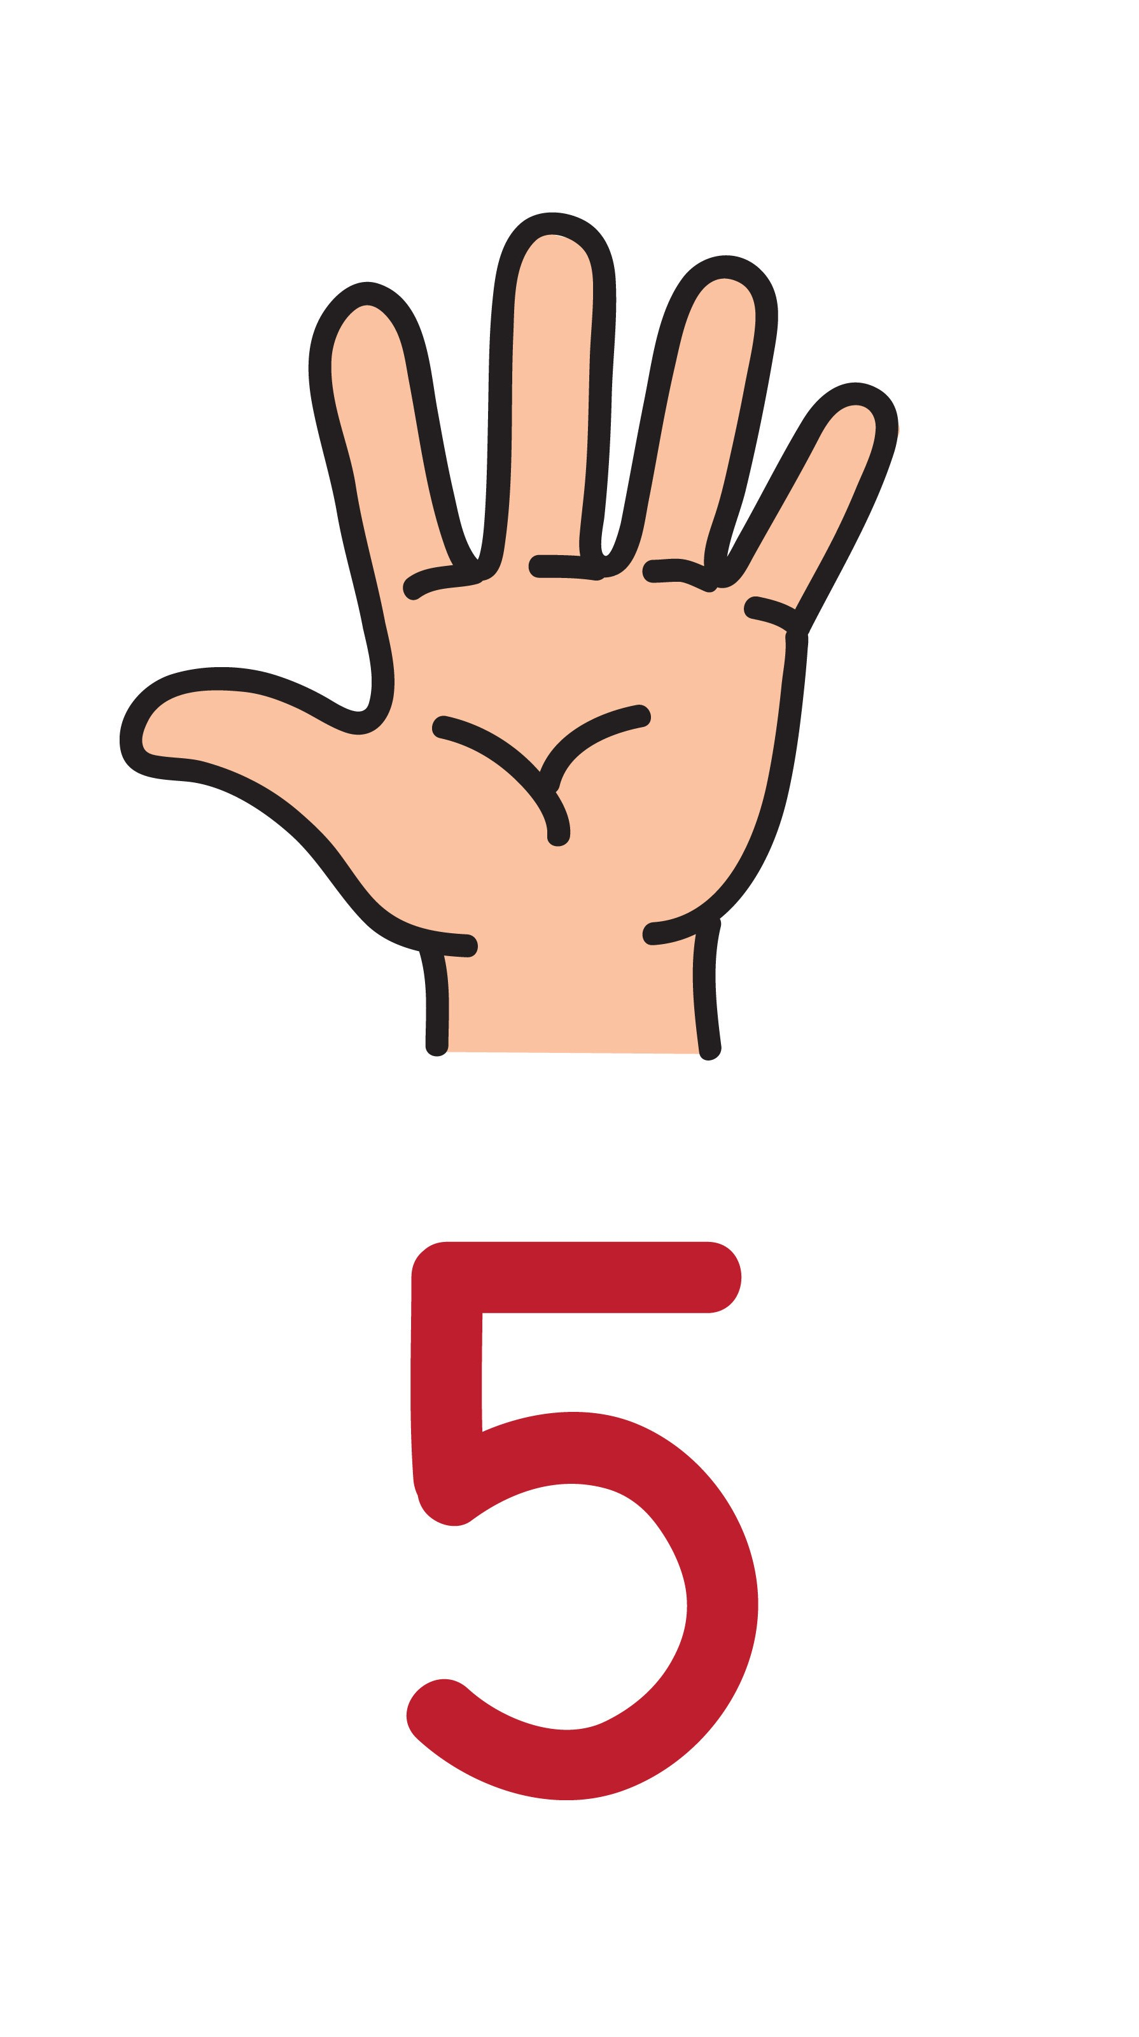
You are doing it because you really want to. Don’t give in to peer pressure, or pressure from a partner, and don’t believe that everybody else is doing it so you have to. Take a moment and think about this: if you decide you don’t want to have sex just now, will your partner be okay with that?
You have got condoms and contraception sorted. Yes, both. So that you are both protected from STIs and for heterosexual couples there is no risk of pregnancy.

Slide 4
“Sex ed puts us off having sex. It kind of just concentrates on all the negative stuff, like STIs and getting pregnant when you don’t want to. They don’t talk about how it can be good…I don’t think they want to tell us it can be good; in case everyone would want to do it.” (age 16)

Slide 5
Make 2 lists.
One a list of all the things that you think will make sex, good sex.
A second list, of all the things that would make sex, bad sex.

Slide 6
PLEASURE
Can I say something really obvious, I expect pleasure from sex. (age 16)
You need to speak, but it’s difficult, embarrassing. (age 16)

Slide 7
PLEASURE
Pleasure to me is about making each other feel wanted and to have a nice romantic time together. Both partners should feel that sense of love and affection. (age 19)
Pleasure is… fun, enjoyment, friendship, love, lust. (age 16)

Slide 8
PLEASURE
Pleasure is… cuddles Netflix chill (age 17)
Most guys probably don’t think about the girl’s pleasure – or their feelings. (age 17)

Slide 9
PLEASURE
Pleasure? Don’t rush it – like maybe getting a blowjob or finger first. You have to be comfortable to be intimate and to be comfortable you need to trust the person you are with. (Male, 16)
It’s something that you should both enjoy. It means talking to each other and working stuff out, it’s pretty unrealistic to think you will get it right first time together. (Male, 16)

Slide 10
Does pornography influence what young people think about sex and what they do?

Slide 11
Has pornography influenced what young people think about sex and what they do?
There is definitely an expectation to climax, even if you can’t or aren’t in the right mood, I think guys just expect a girl to come as soon as they touch you. They don’t talk about orgasm and stuff in school so unless you tell them, or they ask you, which is just really awkward, how are guys meant to know about it? It’s not like in the pornos. (age 17)
Porn influences what people think, people might think they want something they see and then they can’t say no. (age 16)

Slide 12
Extensive online research tell us that good sex:
Is in your brain as much as anywhere else – you need to be in the mood and feel comfortable.
Means having a laugh, deciding to have sex is a serious decision, but you have to have fun, and laugh at the embarrassing bits.
Is based on trust and honesty. You shouldn’t be worried about them having sex with others, or them talking about you after.
Is when your partner actually cares about you enjoying it too.
Means learning how to get condoms right. The more practice the easier it will become. Use lube.
It is never about being treated badly.

Slide 13
How do you know if someone wants to have sex with you?
https://youtu.be/qNN3nAevQKY

