Slide 1
Romantic and Loving Relationships: Qualities of a partner and talking about relationships
I can talk about the importance of communication, honesty and trust in relationships.
I can talk about the kind of partner I would want to involved with, and what I would bring to a relationship.
I understand that adults can be married, in a civil partnership or live together.
I am developing skills and confidence to make decisions about the relationships I want.

Slide 2
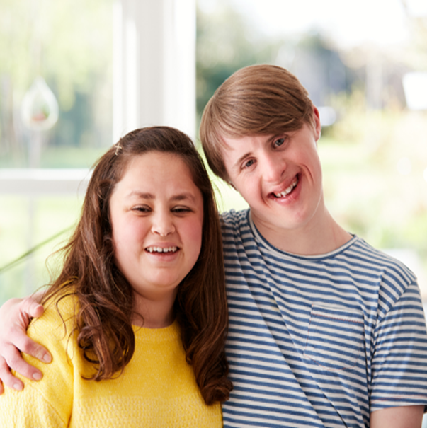
If I am in a relationship with someone, I would want a partner who…

Slide 3
A lot of different psychological research points to these characteristics as being good to have in your partner. A partner who…
Gives me some space, time for myself
I can trust
Supports me when I feel sad or fed up
Thinks about me when they make decisions
Gets on with my family.

Slide 4
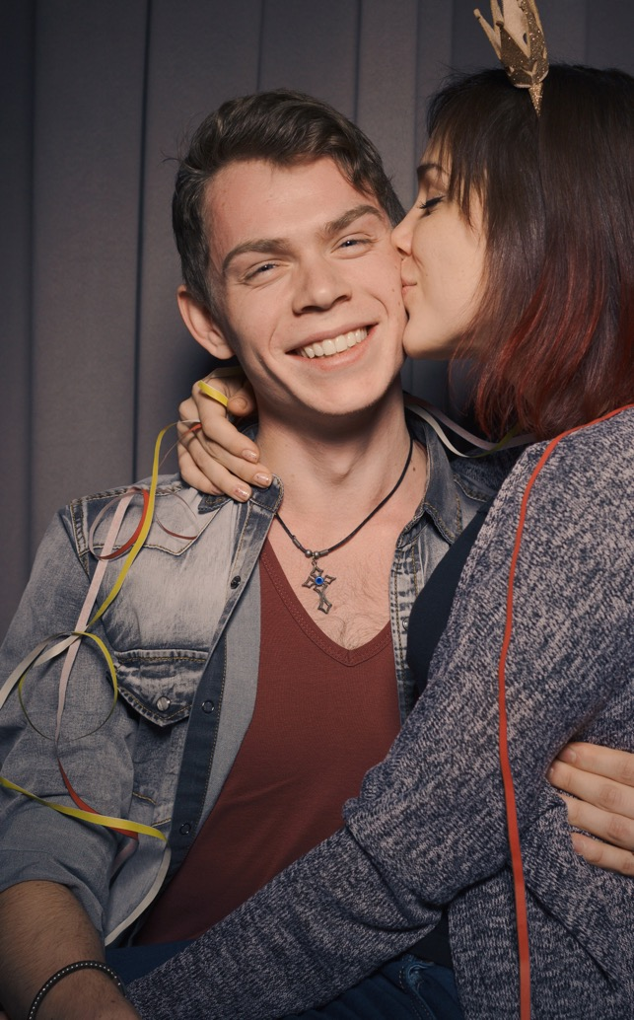
A partner who…
Tells me nice things about me
Likes the same things as me
Is interested in my opinions
Makes me feel like they understand me
Tells the truth
Has similar opinions about things

Slide 5
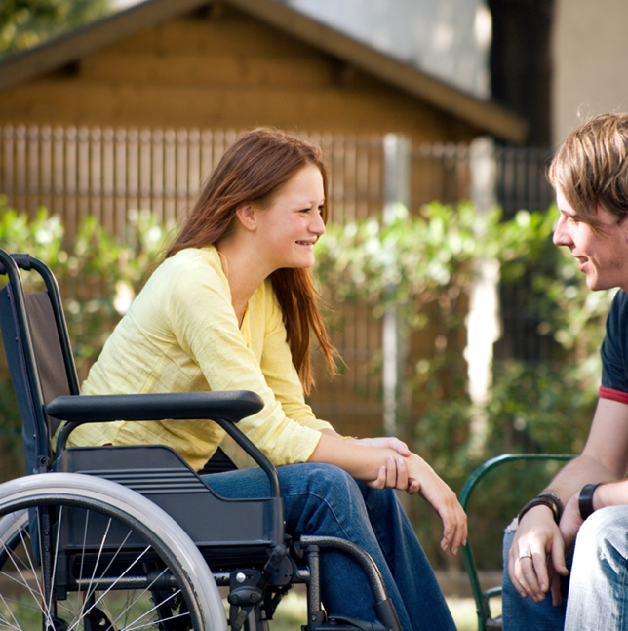
A partner who…
Likes spending time with me
Can make up after an argument
Feels like a friend
Feels the same way I do about sex/will wait/enjoys the same things
Is fun.

Slide 6
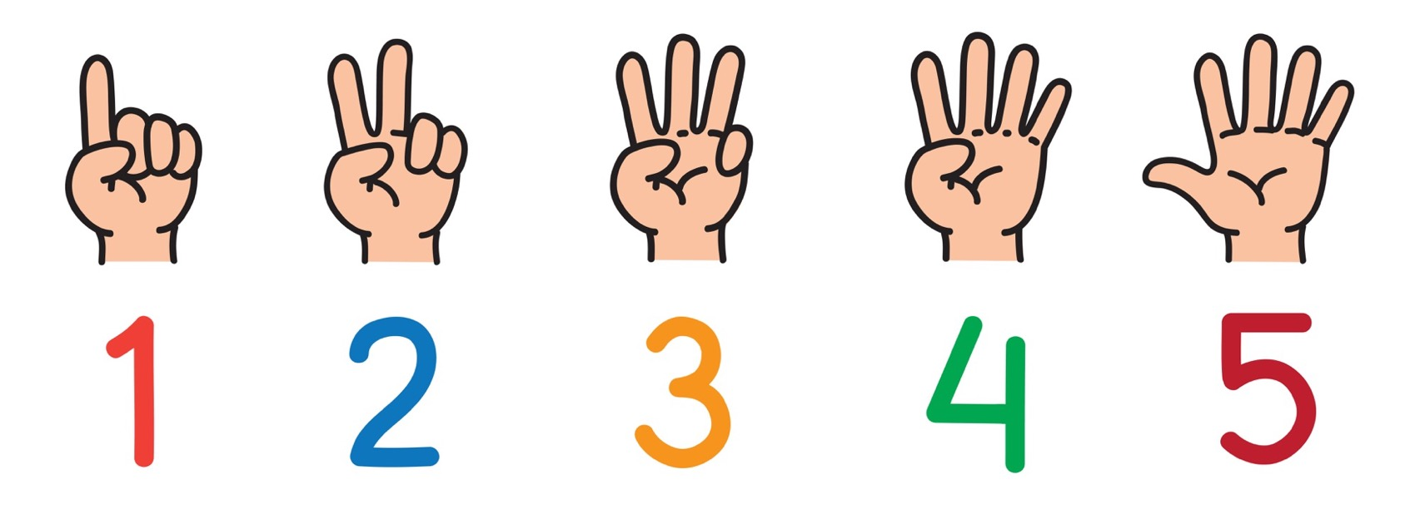
OK, but what 5 characteristics would I bring to a relationship?

Slide 7
Talking at home about relationships
Do you talk to anyone at home about relationships? Parent or carer? Maybe an older brother or sister? An auntie or uncle?
If yes, why them, what characteristics do they have?
What do you think stops young people talking about relationships with parents or carers?

Slide 8
A course for parents about teenage relationships

Slide 9
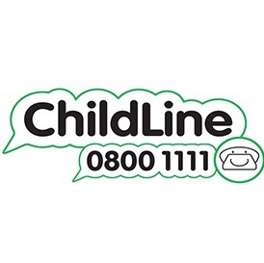
ChildLine
www.childline.org.uk
If you're under 19 you can confidentially call, email or chat online about any problem big or small
Freephone 24h helpline: 0800 1111
Sign up for a ChildLine account on the website to be able to message a counsellor anytime without using your email address
Chat 1:1 with an online advisor

