Slide 1
Similarity, diversity and respect: Heterosexual, Lesbian, Gay and Bisexual
I can give examples of what makes me a unique individual.
I show respect for others.
I understand that how I look, how I behave, and my aspirations should not be limited by stereotypes, my sex or expectations of what boys and girls should do.
I understand that some children have a disability that can affect how they walk, see, hear, speak, learn, or do other things.
I understand that the terms heterosexual, gay, lesbian, and bisexual can be used to describe who a person is attracted to or falls in love with.

Slide 2
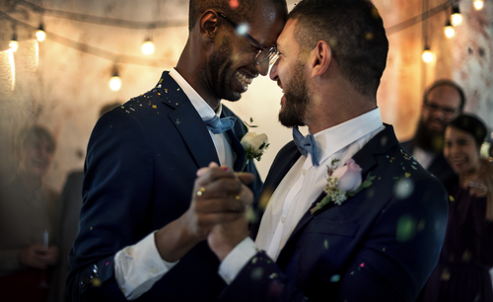
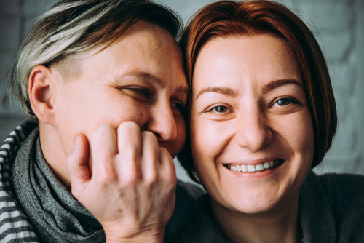
We say a person is gay when a person loves someone of the same sex, this can be two men together or two women together. We can also say that women who love each other are lesbian.

Slide 3
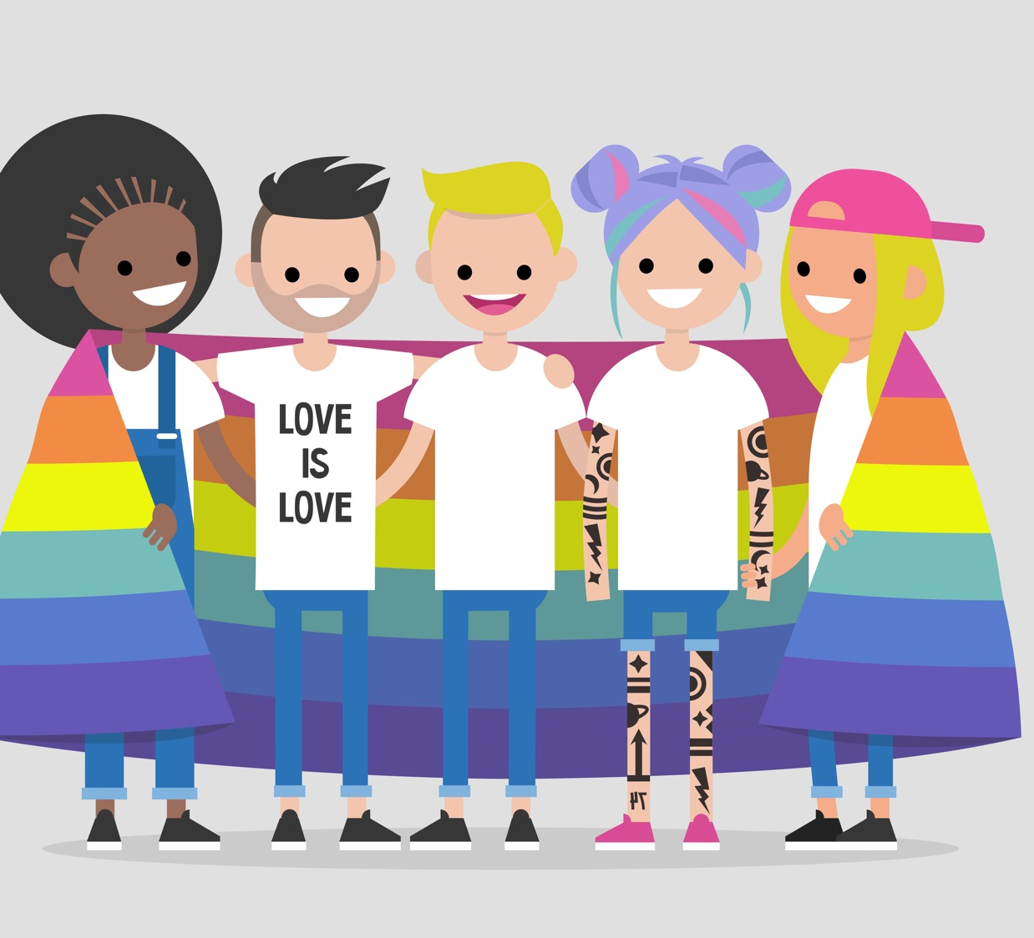
We say a person is bisexual when they feel they can be in love with a person who is the same sex as them, or someone of a different sex.

Slide 4
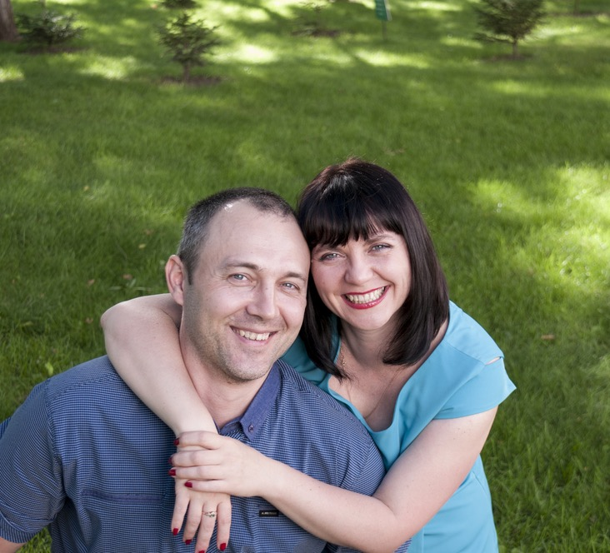
We say a person is heterosexual is when people of a different sex love each other, so a woman and a man.

Slide 5
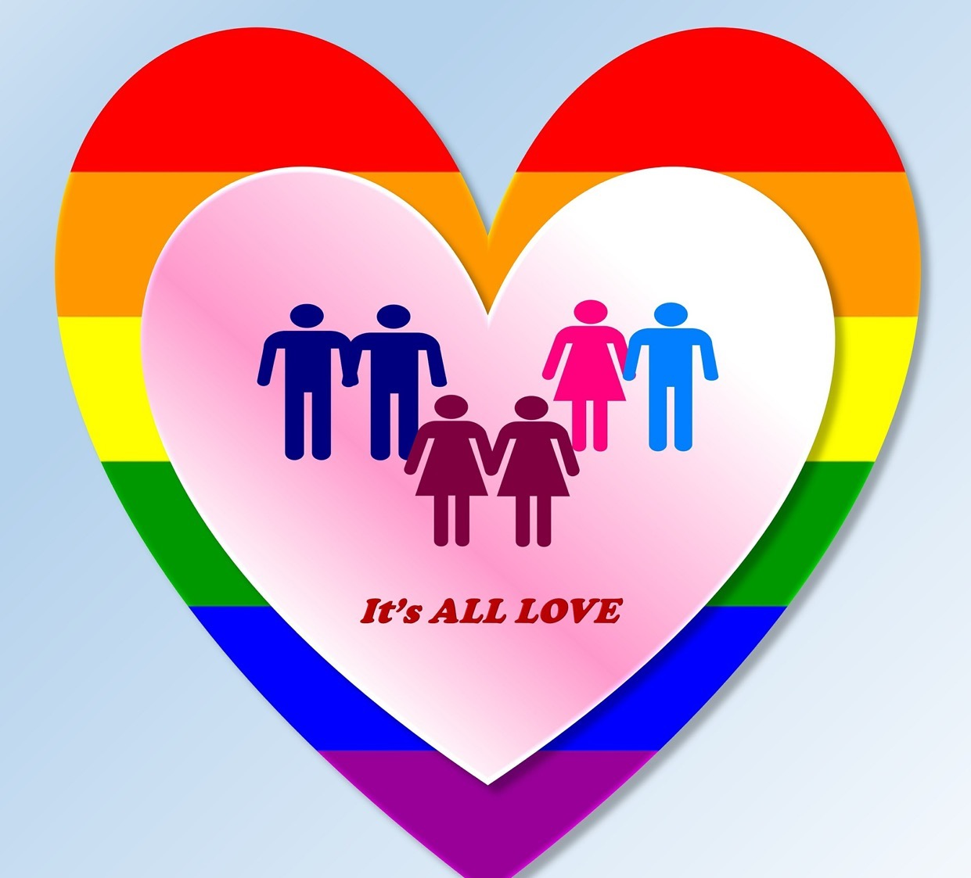
What is love?

Slide 6
What do people do when they are in love?

Slide 7
Hold hands

Slide 8
Eat together

Slide 9
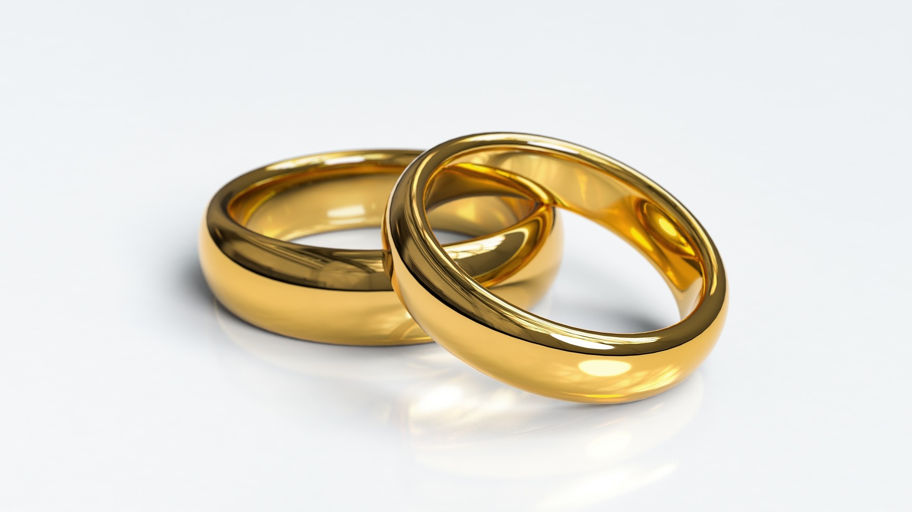
Get married

Slide 10
In a heartbeat https://vimeo.com/227690432

Slide 11
Kids with Gay Parents https://www.youtube.com/watch?v=JG0yqhzVuYA

Slide 12
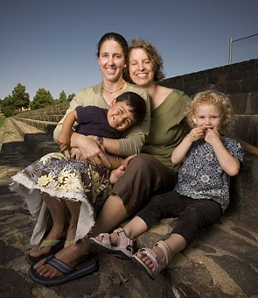
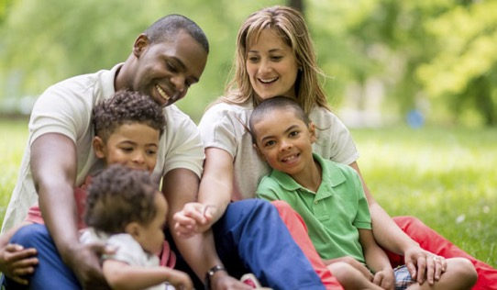
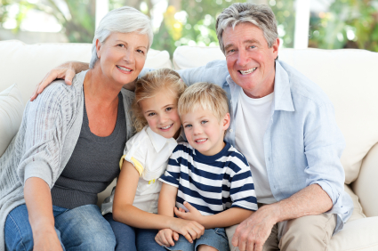
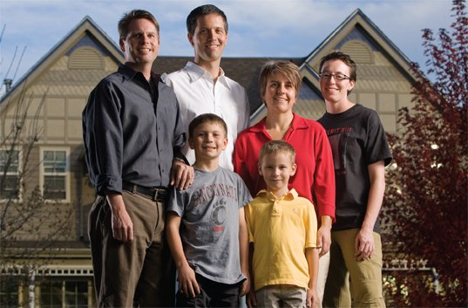
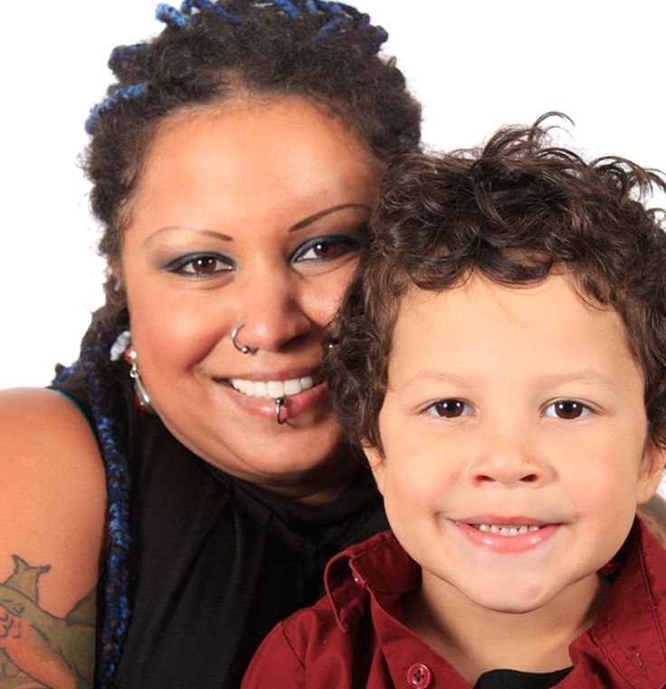
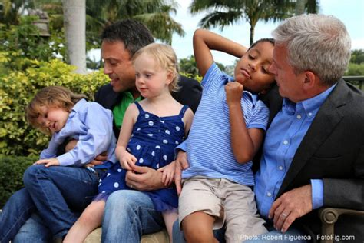
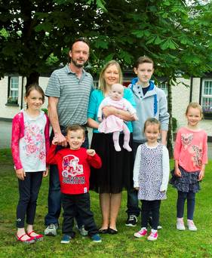
Some families have a mum and a dad
Some families have two mums
Sometimes children live with their grandparents
Some families have 2 mums and 2 dads
Some families have 2 dads
Some families are small
Some families are big

Slide 13
Lesbian, Gay, Bisexual and Heterosexual
Can you remember what these words mean?
Some people are gay or lesbian or bisexual.
Some members of our family may be gay or lesbian or bisexual.
It’s never okay to be mean to someone. It’s never okay to make fun of someone because of their family or who they are.

Slide 14
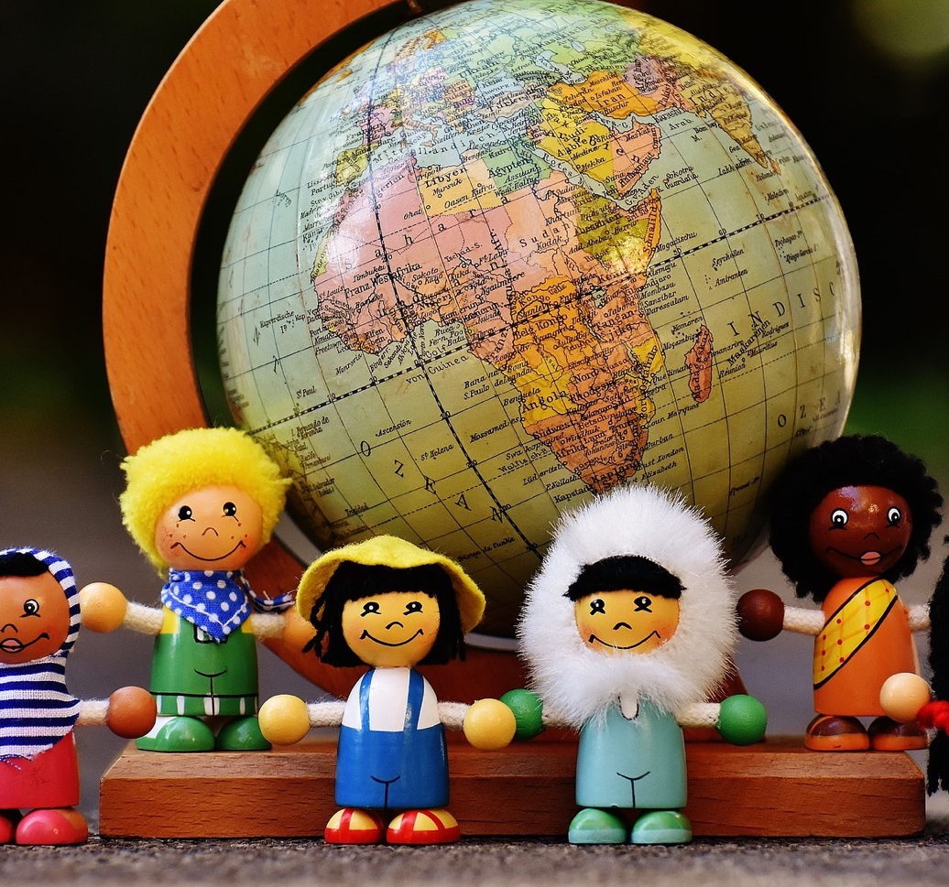
In this class, we are all individuals, different, unique and special.

