Slide 1
Transgender
I understand that how I look, how I behave, or my aspirations should not be limited by stereotypes, my sex or expectations of what boys and girls should do.
I can give examples of, and can challenge, stereotypes.
I show respect for others.
I understand and accept diversity amongst my peers.

Slide 2
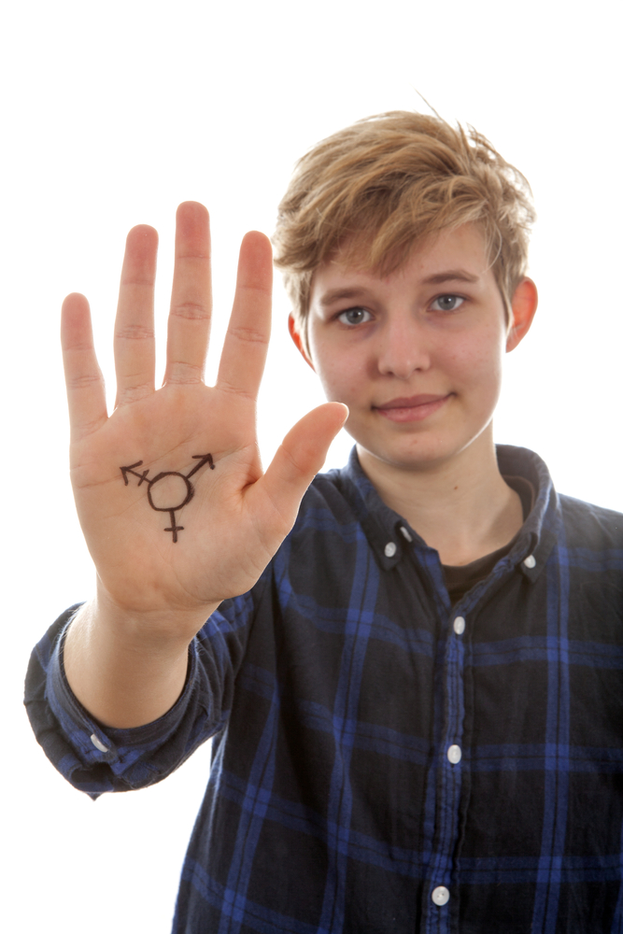
What is transgender?

Slide 3
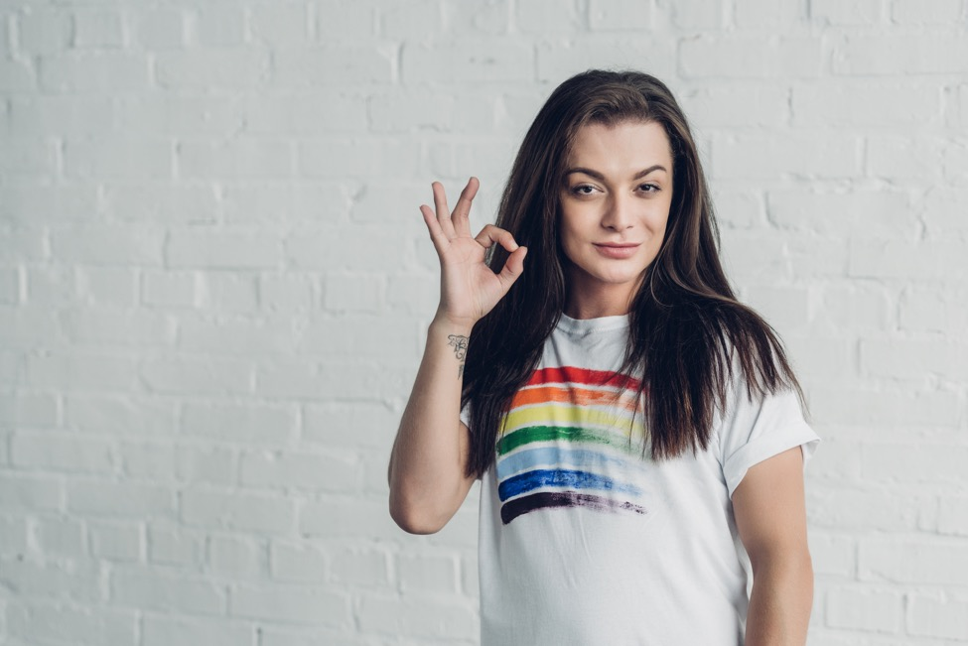
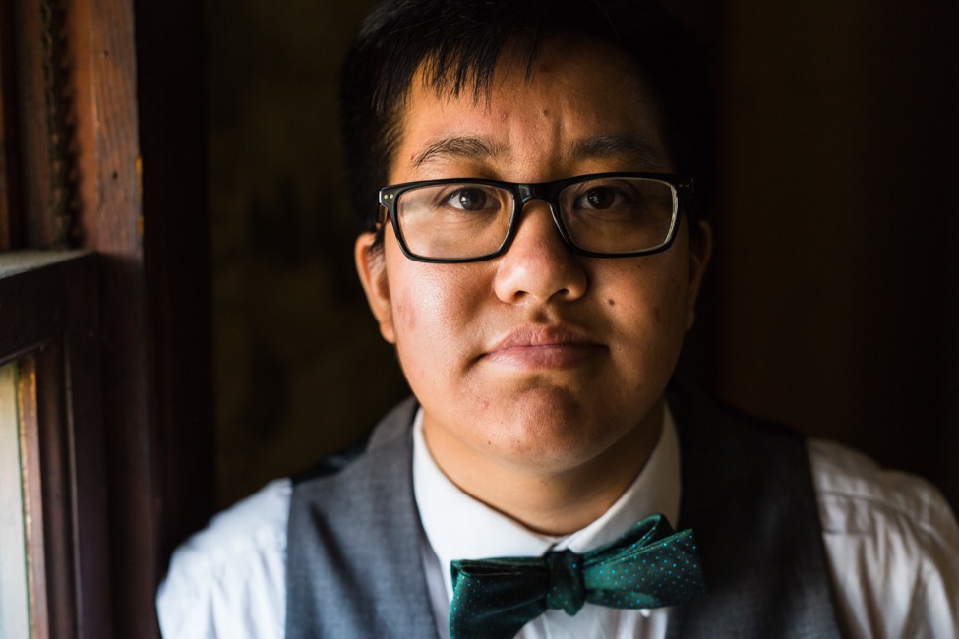
If a person describes themselves as transgender (sometimes people just say trans) they feel that the sex they were born doesn’t match how they feel inside.

Slide 4
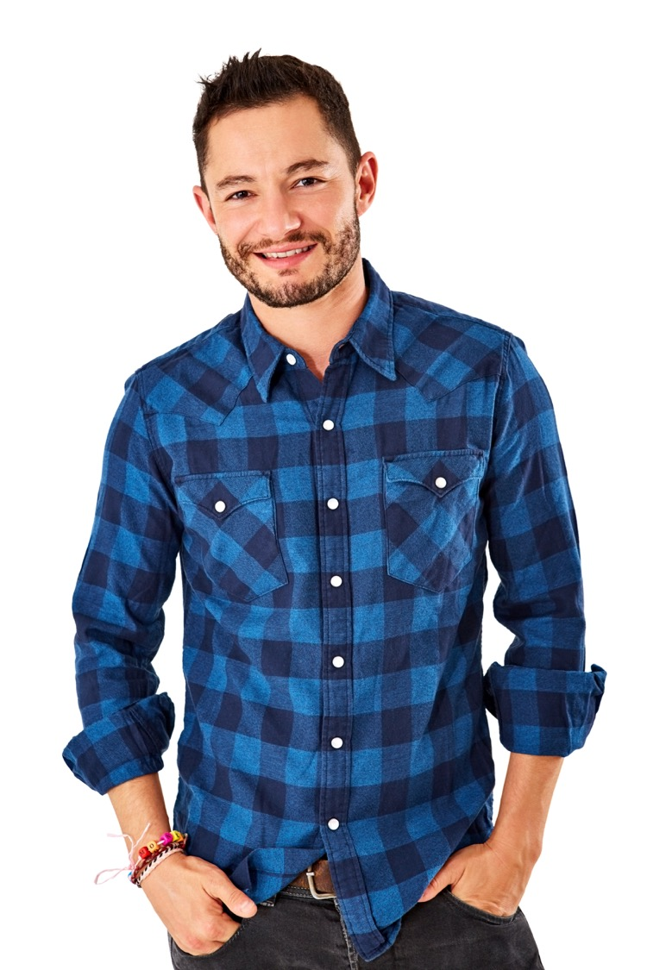
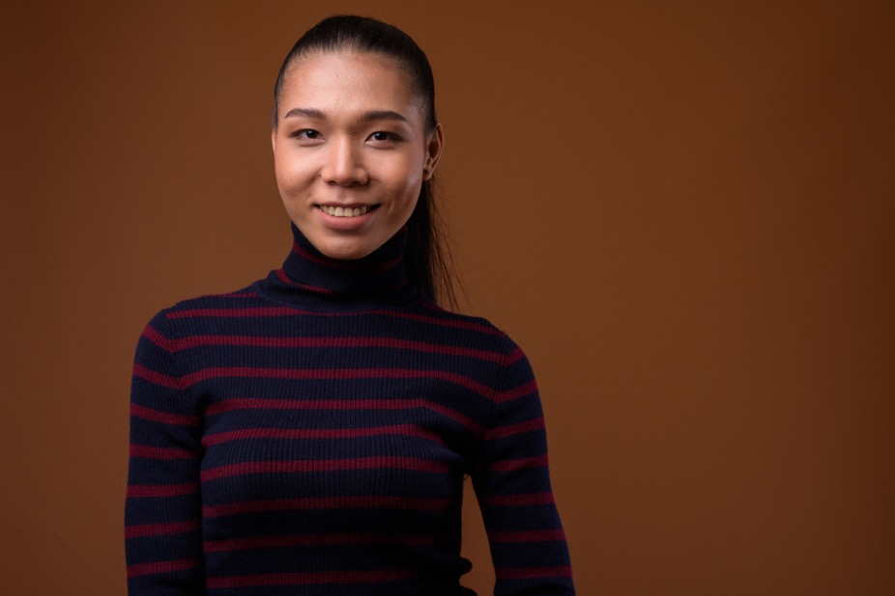
A transgender woman lives as a woman today but was born a boy.
A transgender man lives as a man today but was born a girl.

Slide 5
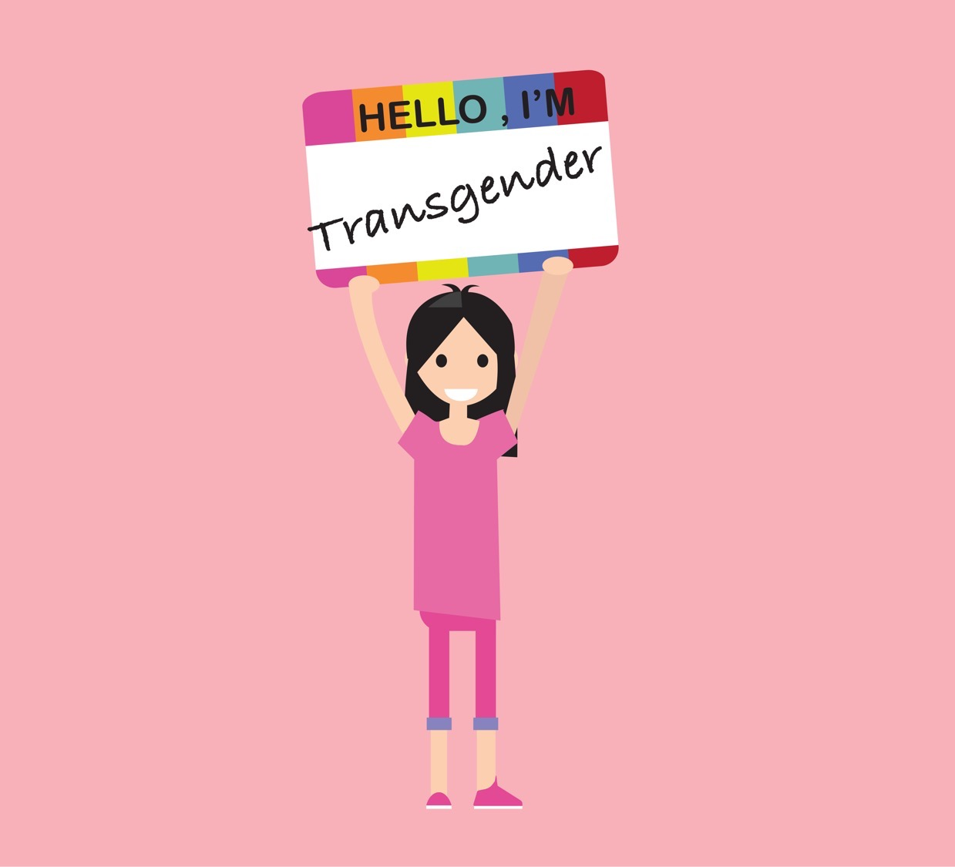
Transphobia is a kind of prejudice and discrimination.
It is when someone who is transgender is put down or hurt or discriminated against just because they are transgender.

