Slide 1
Social Media: Sending and sharing Images
I can describe what I do online.
I reflect on my own behaviour and actions when I am online.
I can reflect on the benefits and risks involved in being online.
I have strategies to deal with situations that cause me concern.
I can identify people or places to go to when I have questions or a worry.

Slide 2
For Your Eyes Only https://vimeo.com/154302864
Just For Fun https://vimeo.com/160080883

Slide 3
What do you think?
1. Girls face more pressure than boys to send photos or images.
Image: https://www.freepik.com/free-photos-vectors/house

Slide 4
What do you think?
2. The person whose image is shared is often blamed and shamed more than the person who asked them to take it.

Slide 5
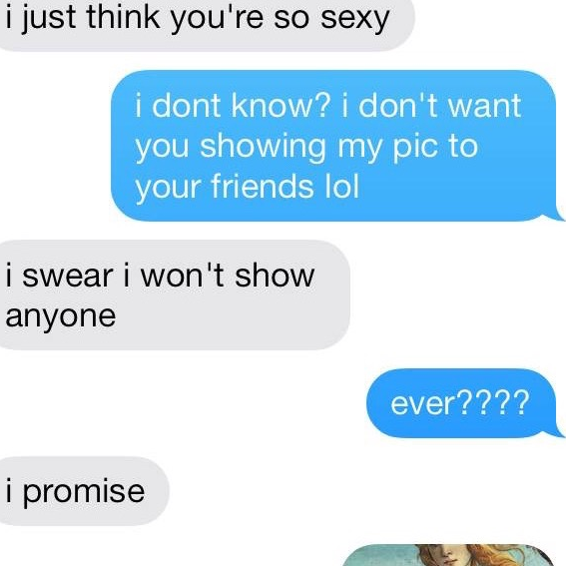
What do you think?
3. Someone asks for a photo/image, they say it’ll be private, and then they share it.

Slide 6
4. What do you think the law says about sending and sharing sexual images?

Slide 7
SEXTING AND THE LAW
The law says:
It is illegal to take, to share or to have sexual photographs or films of people under the age of 18, even if they gave permission.
A photograph or film is considered sexual when the person is nude or only in their underwear or doing something that would not normally be done in public.

Slide 8
What should you do if you receive a photo or image you didn’t ask for and shouldn’t have?

Slide 9
If you receive a photo or image you didn’t ask for and shouldn’t have:
Don’t show anyone.
Don’t forward it on, you will then be breaking the law.
Don’t use it for revenge or to be mean to someone you are angry with.
Don’t feel you have to respond, you can ignore it.
You could delete it, but it might be best to share it with a trusted adult first.
Block the person who sent you it.
If the person sending you things is older or putting pressure on you to send images, then talk to someone about it.

Slide 10
If you have shared a photo or image of yourself, here are 5 things you can do:
Tell a trusted adult. This will be tough, but it’s best they hear from you and then they can help you make things better.
Report it at school – they will help find who is sharing and stop them.
Tell the whole story. What is happening to you is wrong and whoever is sharing needs to be stopped.

Slide 11
Wherever your image is being shared on social media, report it and ask the administrator to remove all traces of it. If you don’t know how to do this, get help from family or school.
However you feel now, it will get better.
So you got naked online https://www.healthyrespect.co.uk/StayingSafeOnline/Documents/So%20you%20got%20naked%20online%20Leaflet.pdf

Slide 12
Report and Remove
Has an image, photo or video of you been shared online? Are you worried it has. You can report and remove. Go here for more information: Report Remove | Childline

Slide 13
Forever https://vimeo.com/154299804

Slide 14
ChildLine
www.childline.org.uk
If you're under 19 you can confidentially call, email or chat online about any problem big or small
Freephone 24h helpline: 0800 1111
Sign up for a ChildLine account on the website to be able to message a counsellor anytime without using your email address
Chat 1:1 with an online advisor

