Slide 1
People who help me and look after me – Professional People
I can identify the adults in my life who help, care for me and look after me.
I can talk about how adults help, care and look after me.
I can name who I can go to with a question or a worry or if I need help.

Slide 2
A professional person is someone who helps others as part of their job.
Guessing game:
At school, who helps me when….

Slide 3
Janitor

Slide 4
Teacher

Slide 5
PSA / Classroom Assistant

Slide 6
School office staff

Slide 7
School Cleaner

Slide 8
Kitchen/ Dinner hall staff

Slide 9
Lollipop person

Slide 10
Professionals who help out of school:

Slide 11
Police Officer

Slide 12
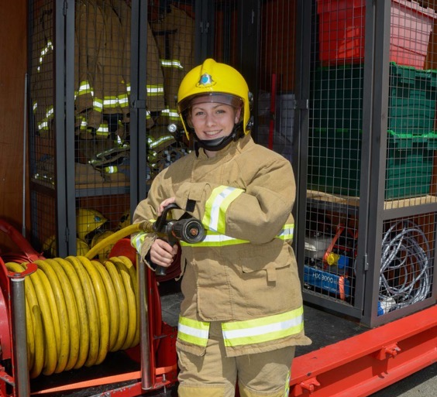
Fire fighter

Slide 13
Doctors

Slide 14
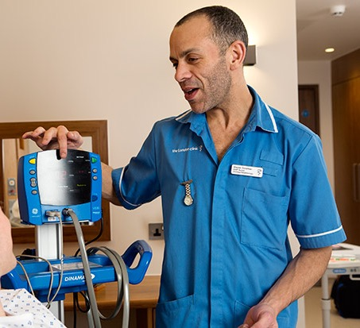
Nurse

Slide 15
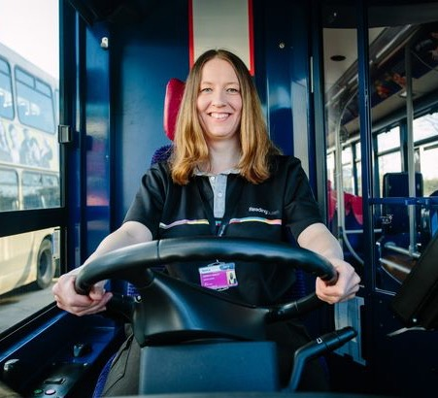
Bus driver

Slide 16
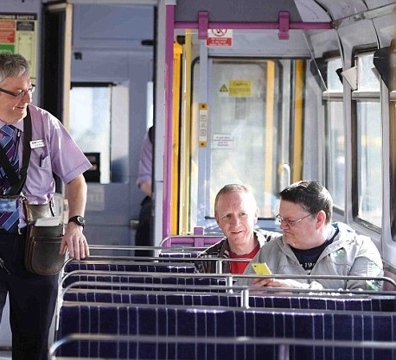
Train conductor

Slide 17
Shop keeper

