Slide 1
Friends and Friendships: Online/Offline friends
I can talk about what I want from friendships and what kind of friend I can be.
I can explain the benefits of friendships and as well as the challenges that come up in maintaining relationships.
I give examples of things I can do to make and maintain friendships.
I understand that I do not need to be best friends with everyone, but I can be friendly and kind.

Slide 2
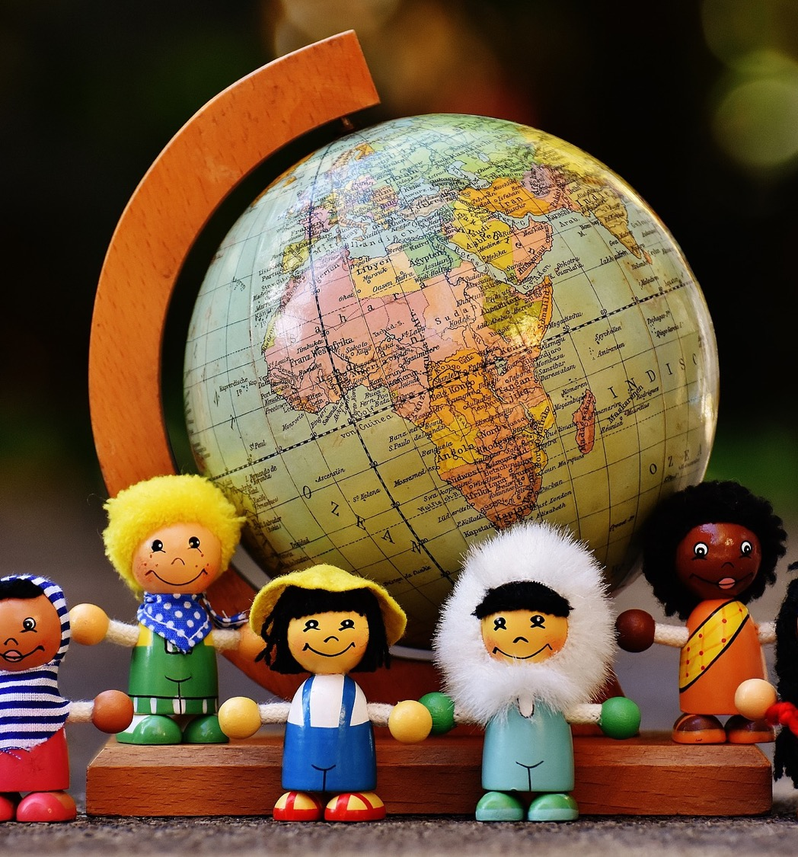
What is a friend?
A friend is a person who knows you well and that you like a lot. A friend is someone you can trust and will treat you well. You can be friendly with many people, but a friend is a special person to you.

Slide 3
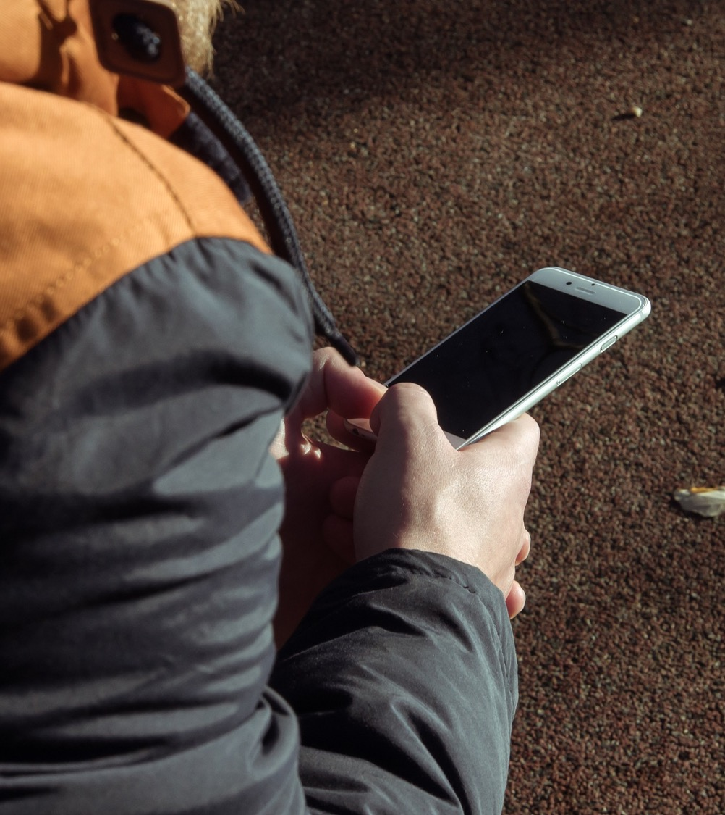
Does a friend have to be someone you can see in real life? Can a friend be someone you only know online?

Slide 4
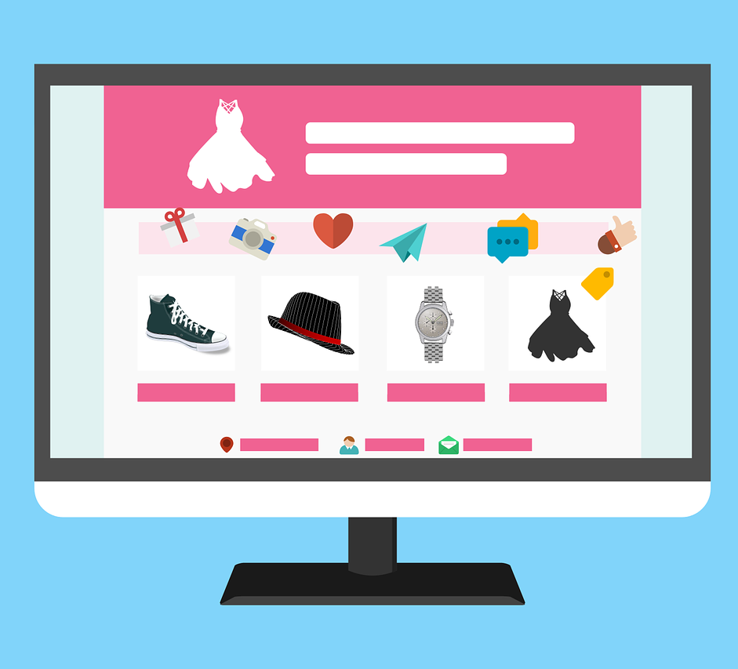
What do we do online?

Slide 5
We can have online friendships by:
Chatting online
Using apps like TokTok
Creating and sharing things
Using Instant Messenger (IM)
In chatrooms and online forums
Gaming

Slide 6
Online and safe
https://www.thinkuknow.co.uk/8_10/stay-safe/

Slide 7
Does a friend have to be someone you can see in real life? Can a friend be someone you only know online?

Slide 8
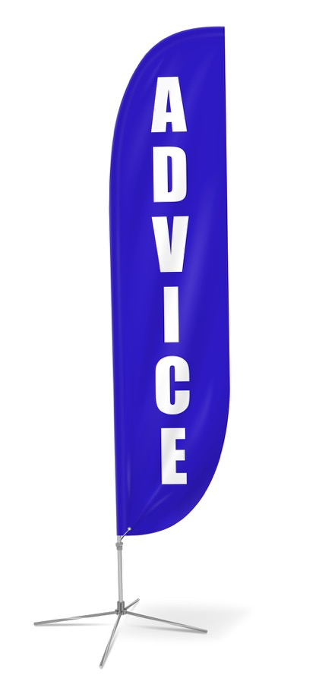
I need your friendship advice!

Slide 9
I have just started at a new school and I don’t really know anybody, apart from my big cousin who is in the class above me. I’m quite shy and I don’t find it easy to make new friends. What can I do?
From Katie, P5

Slide 10
I don’t like how some of my friends are behaving. They have been picking on this boy that comes to the football club after school. They call him names, make fun of him because he doesn’t have the same boots. I’m worried if I say something then they’ll stop speaking to me. What can I do?
From Sean, P7

Slide 11
I’ve been playing Minecraft for ages, I’m really good. This other player was okay at first, I’m not sure where he is from but he’s like my friend online, but now he’s saying stuff that I don’t like. If I tell my mum, she won’t understand, or she’ll just ban me from playing. What can I do?
From Paul, P6

