Slide 1
Being a parent/carer: The importance of play and the Baby Box
I can discuss the skills and qualities of a parent/carer.
I can talk about what a parent/carer does to make sure their child is healthy, happy and safe.
I can discuss some of the challenges of being a parent/carer and how to seek help and support.
I talk about the kind of parent or carer I would be.

Slide 2
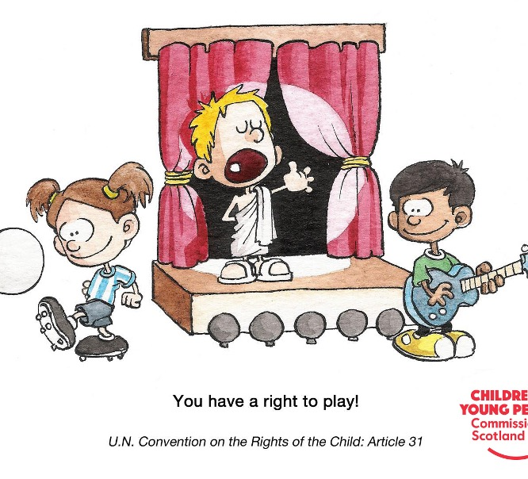
Article 31 of the United Nations Convention on the Rights of the Child says that all children and young people have a right to relax and play.
Why do you think play is important for children?
What do you remember playing as a child?
Who taught you games and activities?
Do you still play? What’s changed?
How can we make sure boys and girls are free to play whatever and with whatever they want – without gender stereotypes?

Slide 3
This is me: The Child’s Right to Play
http://ipaworld.org/ipa-video-this-is-me-the-childs-right-to-play/

Slide 4
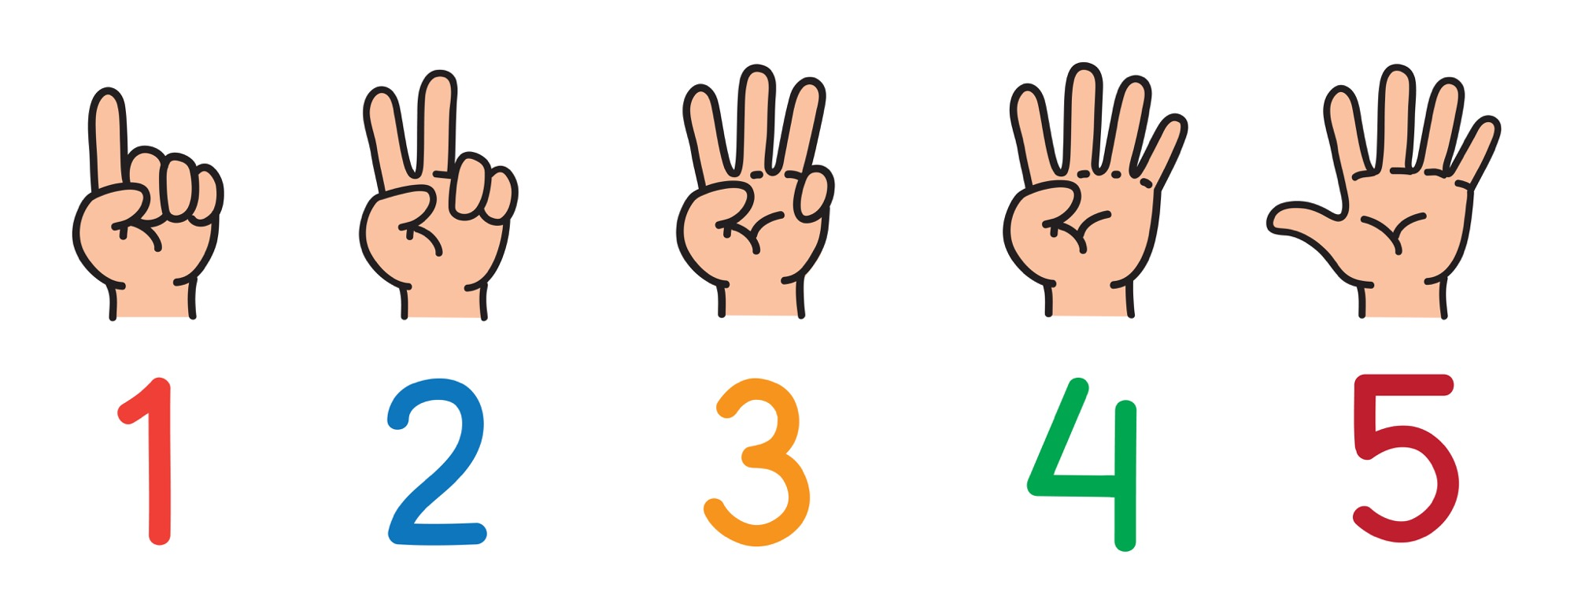
The child’s right to play
What 5 things can a parent/carer do to make sure their child can play?

Slide 5
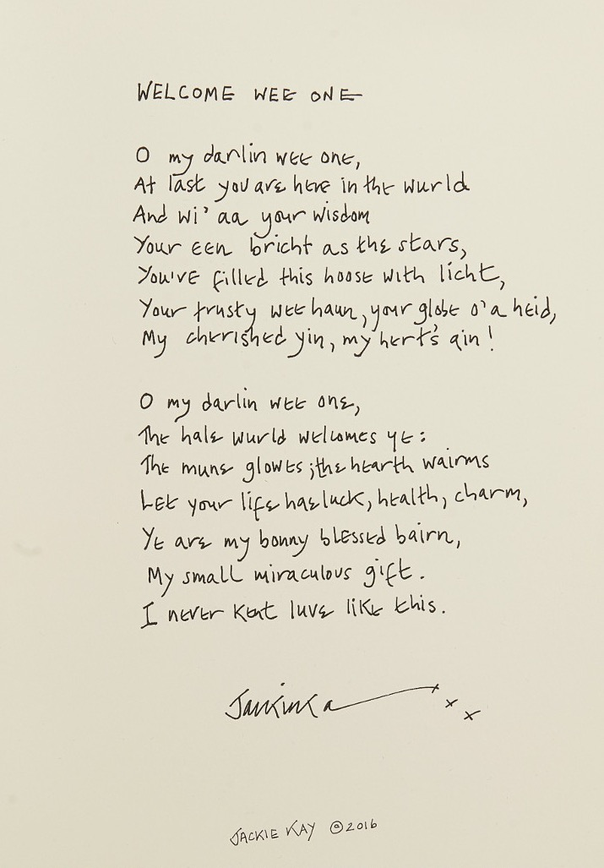
The Baby Box
https://www.parentclub.scot/baby-box#
Baby box: What’s inside
https://youtu.be/ZPONtczcPTs

Slide 6
Activity: Finding information, help and support if you are a parent.
Your task is to find out then feedback/comment on:
What does the site offer parents/carers?
What is most interesting about the site?
Is it helpful for parents/carers?
Choose one of the following sites to research:
Parent Club https://www.parentclub.scot/
Parent Line Scotland https://www.children1st.org.uk/help-for-families/parentline-scotland/
Parentzone https://education.gov.scot/parentzone

