Slide 1
Being a parent/carer: If I were a parent or carer
I can talk about what a parent/carer does to make sure their child is healthy, happy and safe.
I understand the challenges of being a parent/carer.
I know that all families are different.
I talk about the kind of parent or carer I would be.
I understand that parents/carers need support and help.

Slide 2
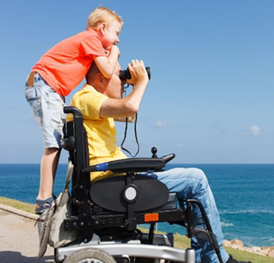
Did you agree, disagree or ‘don’t know’ when it comes to these statements:
Being a parent is easy.
Having a baby makes a relationship stronger.
Mothers are more important to young babies than fathers.
Parents are a child’s most important role model.
Parenting comes naturally to everyone.
Being a parent would be fun.

Slide 3
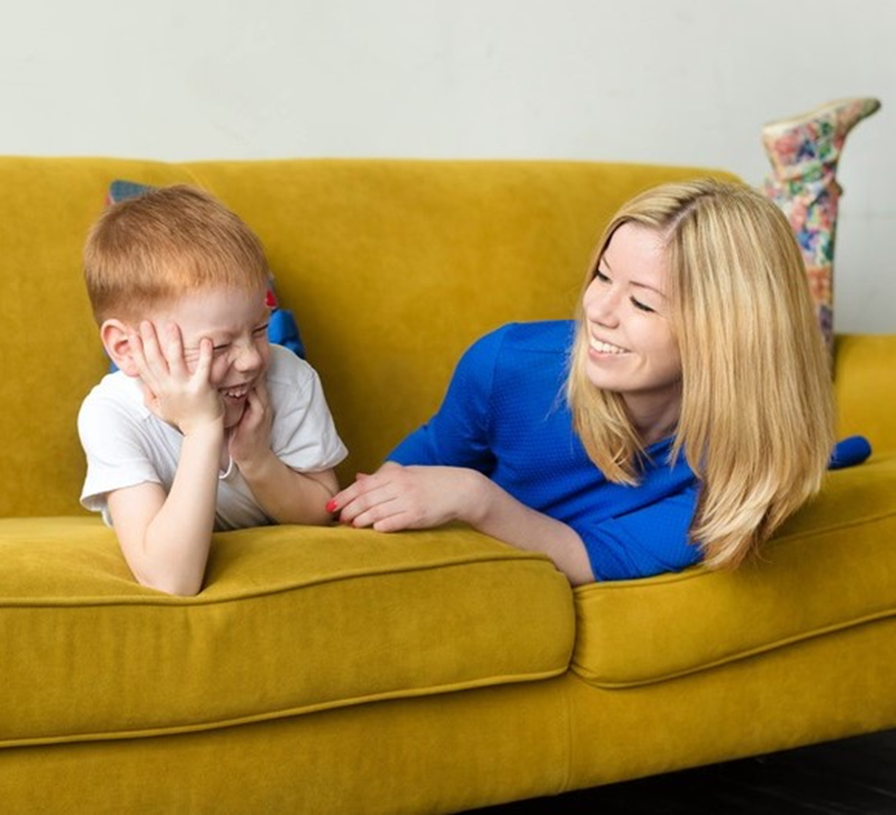
Activity: If I was a parent I would want to:
Make sure my child helps out doing chores at home.
Teach my child how to get on with other people.
Expect and encourage my child to do their best and help them to do their best.
Get on with my child’s other parent or carers – avoid arguments at home.
Play and read together.
Make sure my child knows I love them.
Be a good role model.
Be patient and not get stressed.
Spend time with my child.
Trust my child.
Have clear rules.
All are important, but which 5 would you want to aspire to most as a parent/carer?

Slide 4
What would you worry about if you were a parent?

Slide 5
Research found that the top 10 worries parents have are:
Being able to afford what their child needs
Dealing with a lack of sleep
Having enough patience
Encouraging the child to eat their meals
Dealing with an ill child
Keeping on top of household chores
Encouraging children to do their homework
Encouraging children to work hard at school
Coping with a child having a tantrum
Getting children up in the morning

Slide 6
Online worries: The Webwise 2017 Parent Survey

