Slide 1
Friends and Friendship: When friends fall out
I can talk about how to make and sustain friendships.
I understand the importance of kindness and empathy.
I understand that friends have disagreements and can think of positive ways to cope and respond.

Slide 2
Let’s play a game!
Human Bingo

Slide 3
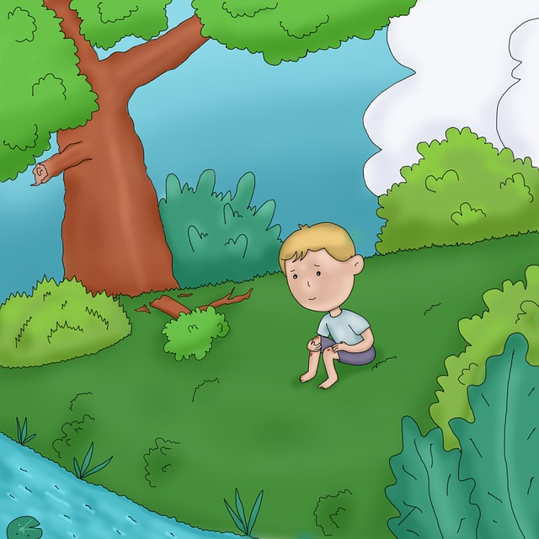
Why do friends fall out?

Slide 4
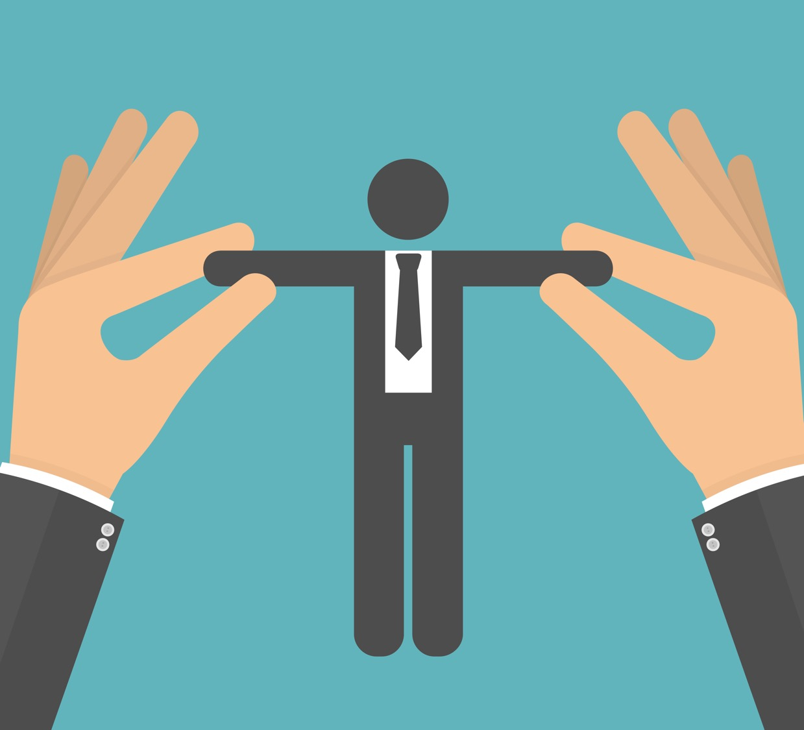
A puppet drama
What are the friends doing?
How does the story begin?
What do the friends fall out about?
What happens when they fall out?
How are each of them feeling now?

