Slide 1
Similarity, diversity and respect: Disability
I can give examples of what makes me a unique individual.
I show respect for others.
I understand that how I look, how I behave, and my aspirations should not be limited by stereotypes, my sex or expectations of what boys and girls should do.
I understand that some children have a disability that can affect how they walk, see, hear, speak, learn, or do other things.
I understand that the terms heterosexual, gay, lesbian, and bisexual can be used to describe who a person is attracted to or falls in love with.

Slide 2
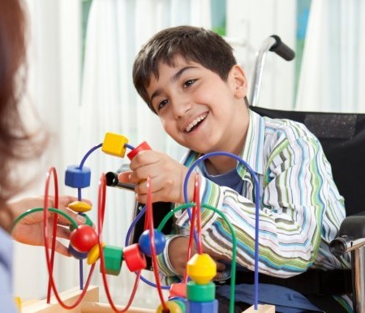
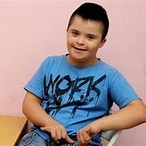
Disability
A disability is when a person finds it difficult (or maybe impossible) to walk, see, hear, speak, learn, or do other important things.

Slide 3
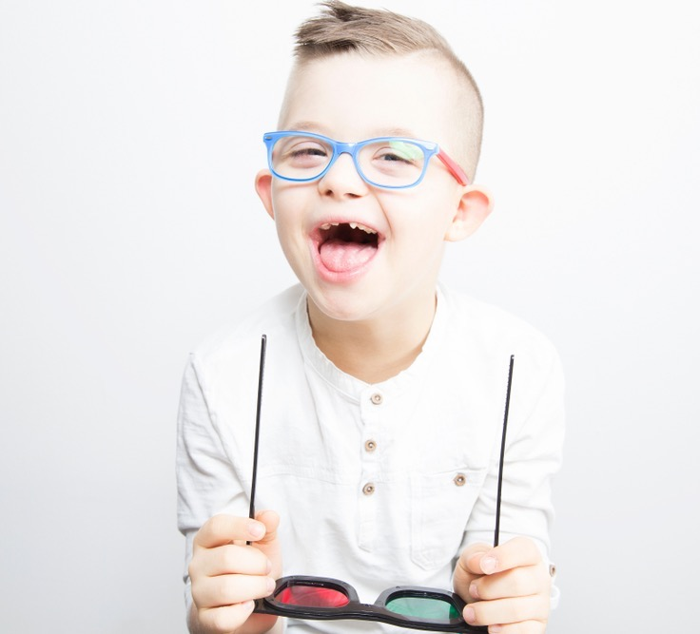
Disability
A disability can be something a person was born with.
A disability can be because the person has been ill or had an accident.

Slide 4
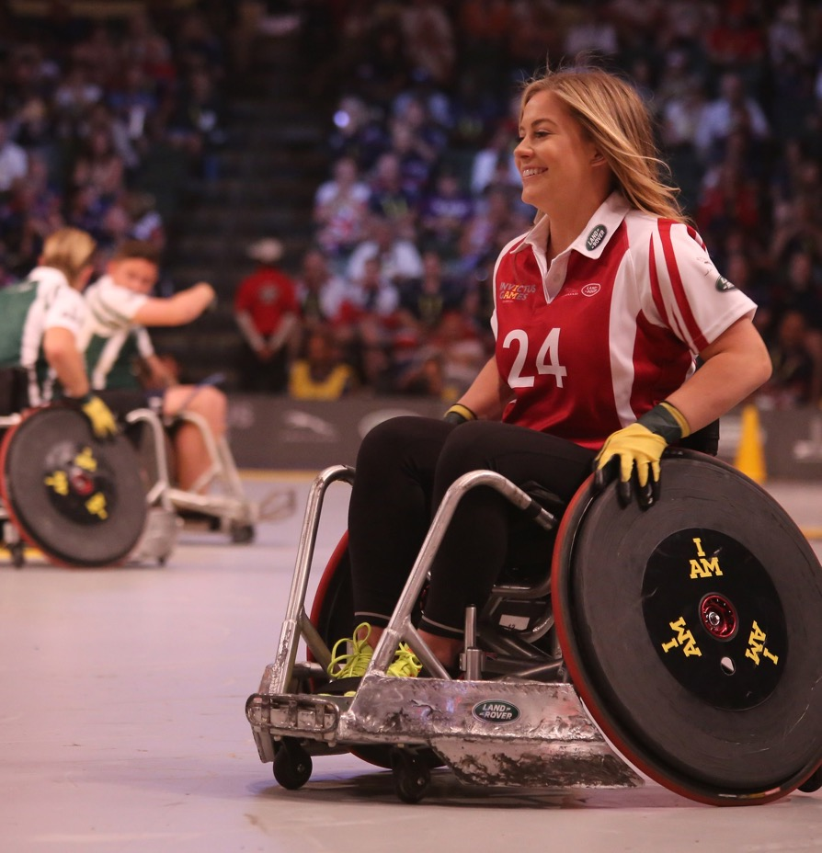
Disability
Many people have a disability.
Maybe you or someone in your family has a disability.

Slide 5
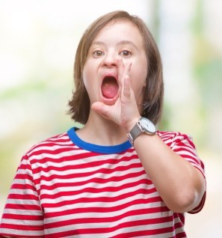
Disability
Sometimes you can see that someone has a disability, for example if they use a wheelchair.
Sometimes you can’t see a disability, like maybe someone is deaf or is autistic.
A disability can be something to do with your body. Or a disability can be about how you learn or understand the world around you.

Slide 6
Luke https://attitudelive.com/watch/Kids-with-Disabilities-Luke

Slide 7
What’s up with Nick? https://researchautism.org/resources/kit-for-kids/

Slide 8
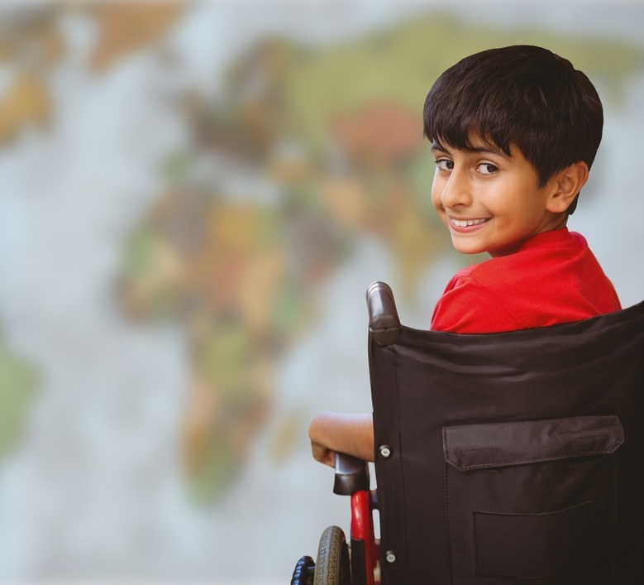
Disability
People with disabilities can usually do most things just like other people. They might just do them differently.
If you think a person with a disability needs help with something, ask them first.

Slide 9
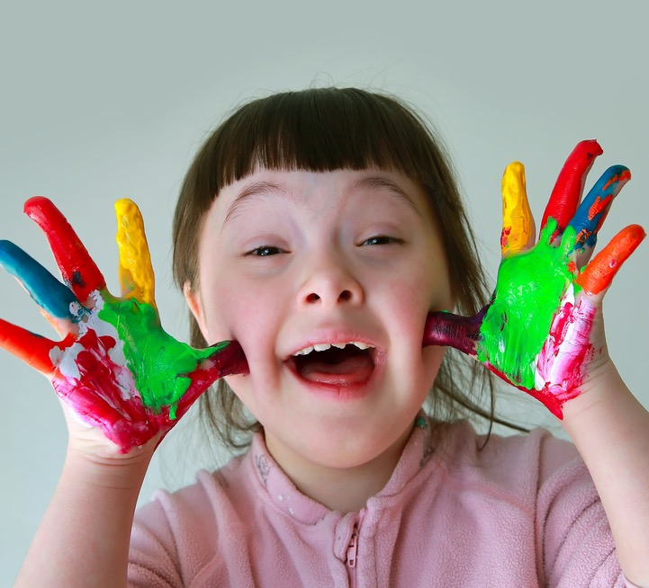
Disability
It’s okay to ask polite questions about a person’s disability.
It’s never okay to be mean to someone because of their disability.

Slide 10
Winnie https://attitudelive.com/watch/Kids-with-Disabilities-Winnie

Slide 11
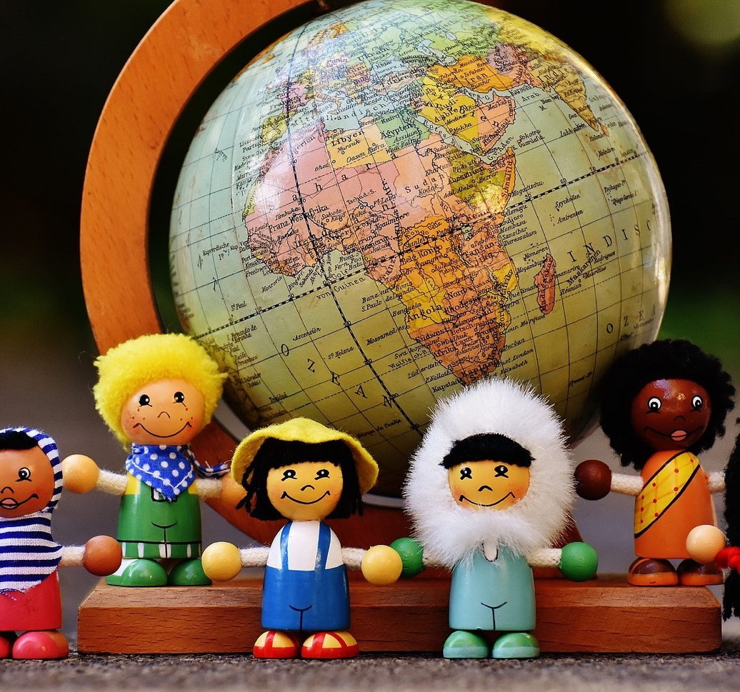
In this class, we are all individuals, different, unique and special.

