Slide 1
What babies need to be healthy, happy and safe.
I can explain how human life begins, what pregnancy is and how a baby is born.
I know, understand and can discuss some of a baby’s basic needs such as feeding, changing, washing, cuddling and sleeping.
I can demonstrate some basic skills needed to look after a baby.

Slide 2
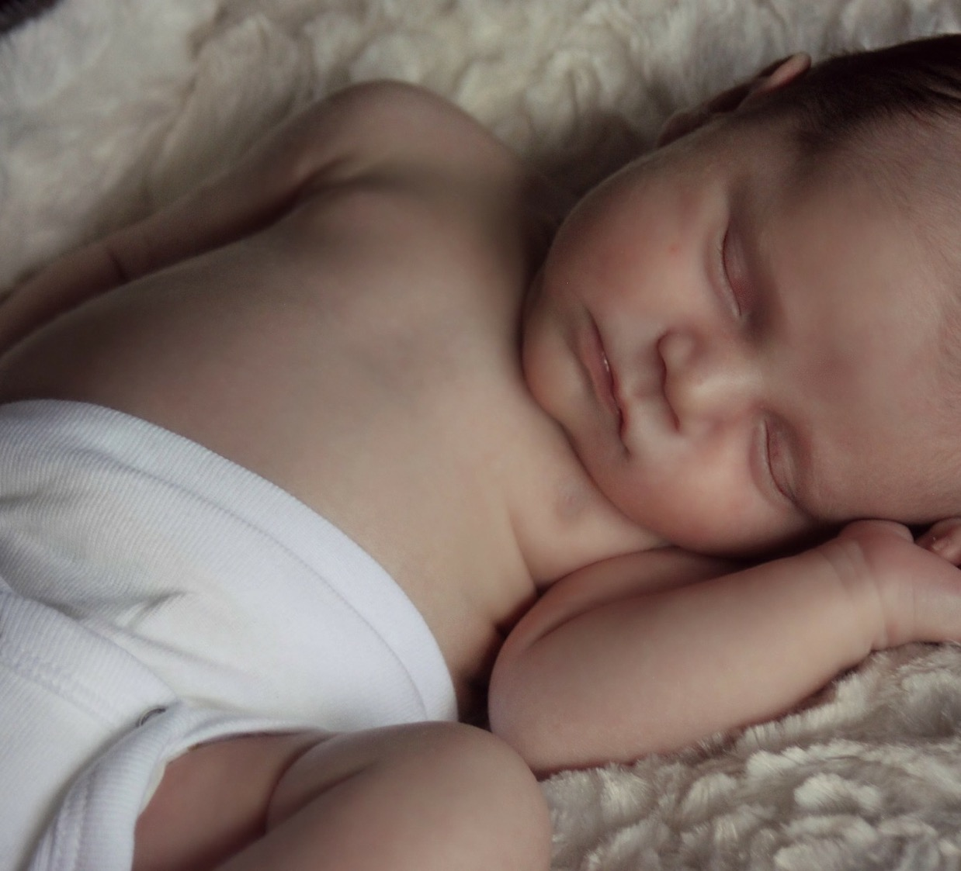
Getting ready for a baby
Imagine that you are planning for the arrival of a new baby.
Work together to make a list of all the items a baby might need and the things a family needs to do to prepare for their baby.

Slide 3
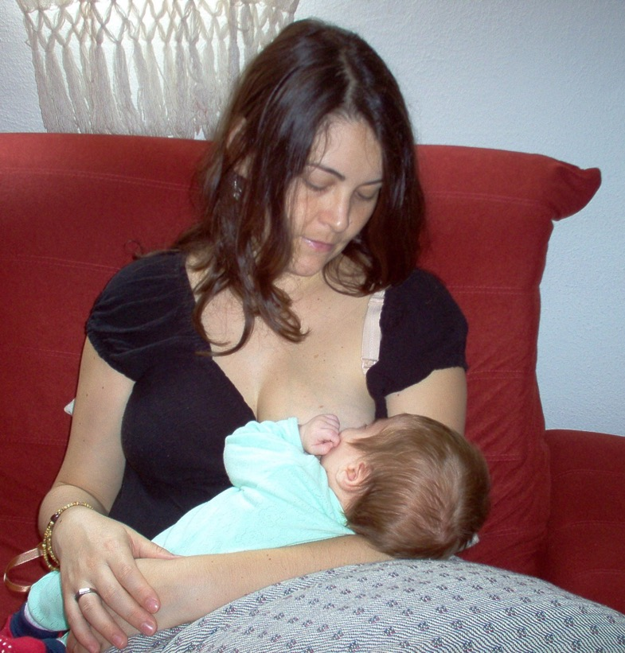
Breastfeeding is good for baby and mum
Breast milk is tailor-made for the baby and gives them all the nutrients they need.
Breast milk helps the baby to fight illness and infection.
https://www.babycentre.co.uk/v25007241/how-to-get-a-comfy-attachment-video
(duration 2 minutes)
https://youtu.be/qzSB_4rOlJU
(duration 2 minutes 13)

Slide 4
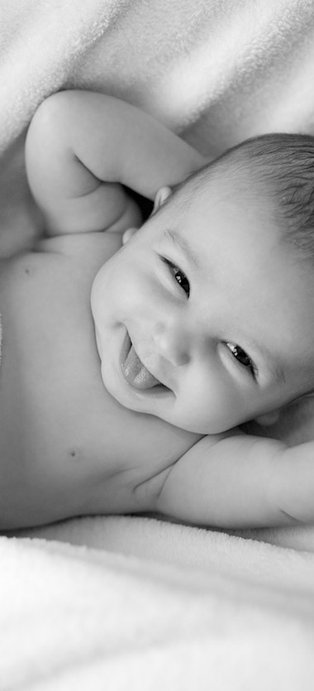
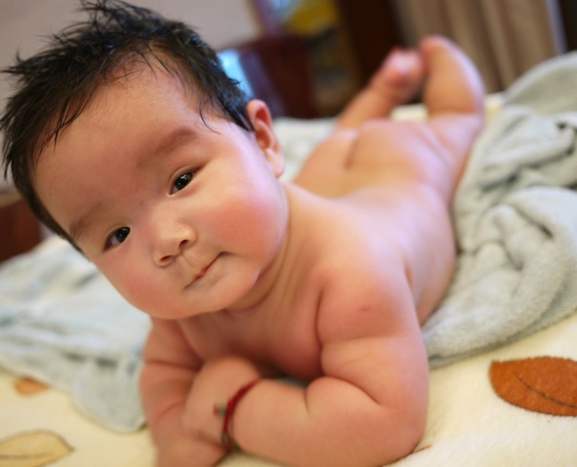
Babies in the class!
What will our babies need to be:
Healthy?
Happy?
Safe?

Slide 5
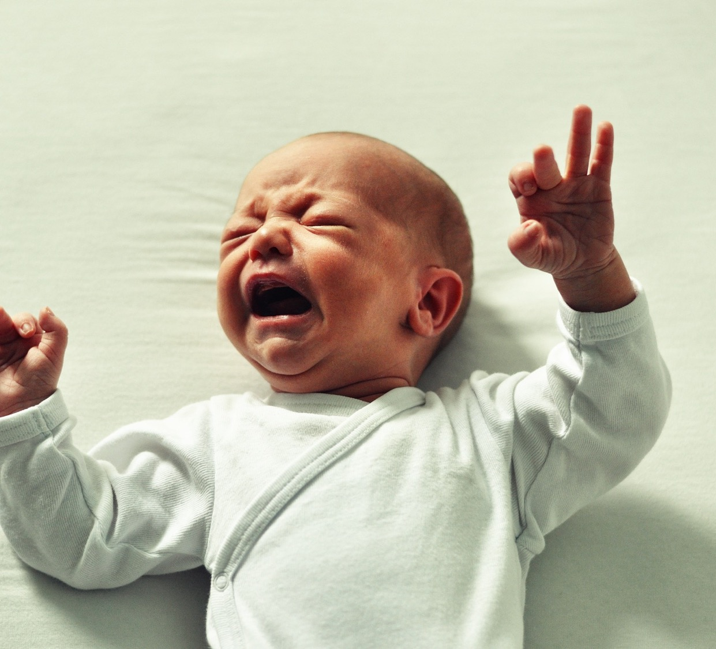
Baby crying sound: https://youtu.be/SuGyPmzHUBE

Slide 6
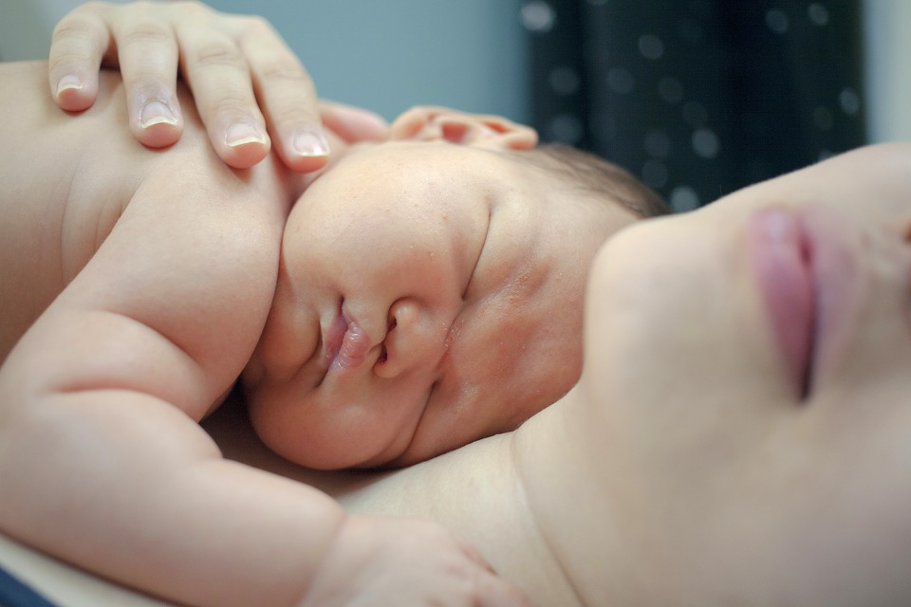
24 hours with a newborn baby
https://youtu.be/m9QndNXcnCU

Slide 7
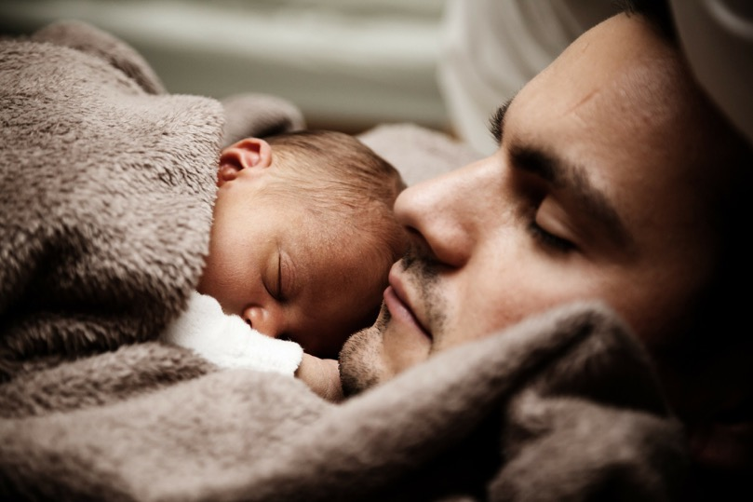
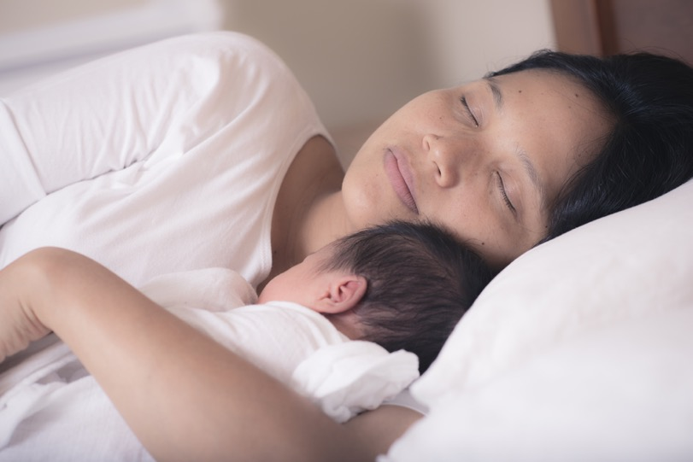
What would be the best thing about being a mum or dad?
What would be the hardest thing about looking after a baby?
Who thinks they would like to be a parent one day?

