Slide 1
Sexual Harassment
I understand what gender/sex-based equality means.
I can talk about what gender/sex-based equality and feminism mean to me.
I am developing skills and confidence to challenge inequality and abuse of power.

Slide 2
What is sexual harassment?

Slide 3
What is sexual harassment?
Sexual harassment is unwelcome sexual behaviour which compromises your dignity and makes you feel offended, humiliated, intimidated or threatened.

Slide 4
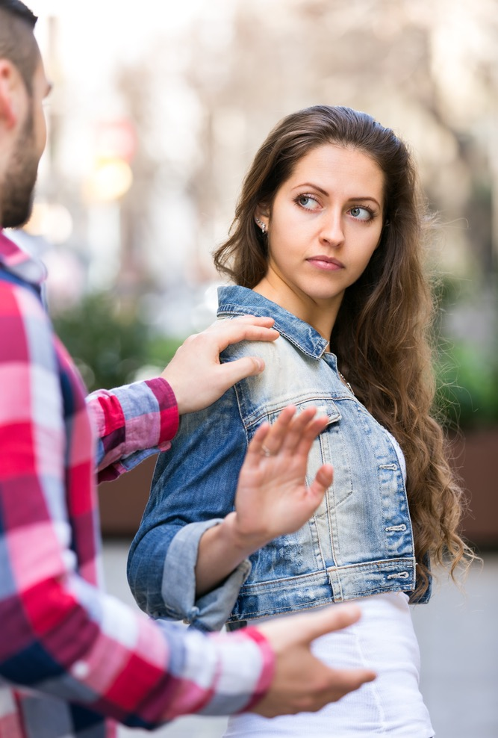
What is sexual harassment?
Sexual harassment can be verbal (someone saying things), non-verbal (how someone acts or looks at you) or physical (someone touching you in some way). It can range from rude remarks about your appearance to violence and assault.

Slide 5
Sexual harassment can include when someone:
Says something to you that is sexual to hurt you or make you feel bad
Ask you questions or comments about your sex life
Stares at you in a way you feel is sexual
Shows you something sexual or pornographic at school or in a workplace.

Slide 6
What is sexual harassment?
Sexual harassment can be face-to-face, indirect or online.

Slide 7
What is sexual harassment?
Although most victims of sexual harassment are women, harassed by men, men can also be harassed by women. Lesbian, gay and bisexual people may also find themselves harassed or bullied by people of either sex.

Slide 8
What impact does sexual harassment have on a person? How might it leave them feeling?

Slide 9
In their 2018 report on sexual harassment in schools, the Young Women Lead Committee said:
“The impact of sexual harassment on girls is significant and can be long-lasting. It can negatively impact everything from their mental health to their relationships and career choices. That this damage takes place in an environment where young women are meant to have space to learn about the world around them and their place in it, is fundamentally wrong and action must be taken to put an end to it.”

Slide 10
Over 90% of young women say sexual harassment happens at school.
What kind of things can happen in a school that we could understand as sexual harassment?

Slide 11
Sexual harassment scenarios
The science teacher….
Joe’s story
Ms. Jackson’s story…

Slide 12
Reporting sexual harassment:
So, if someone experiences sexual harassment in school why might they not report it?

Slide 13
So, if someone experiences sexual harassment in school why might they not report it? Research by Girlguiding Scotland tells us that girls might not report because….
Teachers often tell a girl to ignore sexual harassment.
Teachers don’t understand what you can go through as a young woman in school.
You might not have a teacher you can trust to tell.
Teachers might dismiss sexual harassment as just banter, “boys mucking around”.
If you report it a teacher might not keep it confidential.
There aren’t private spaces to report things like this to a teacher you trust.
If you report sexual harassment you are then more likely to be bullied or teased.

Slide 14
If these are the reasons that girls don’t report sexual harassment, would it be the same for boys? What might stop them from reporting harassment?
Teachers often tell a girl to ignore sexual harassment.
Teachers don’t understand what you can go through as a young woman in school.
You might not have a teacher you can trust to tell.
Teachers might dismiss sexual harassment as just banter, “boys mucking around”.
If you report it a teacher might not keep it confidential.
There aren’t private spaces to report things like this to a teacher you trust.
If you report sexual harassment you are then more likely to be bullied or teased.

Slide 15
What should we be doing in this school to tackle sexual harassment?

Slide 16
White Ribbon Scotland
http://www.whiteribbonscotland.org.uk/

Slide 17
If you experience sexual harassment….
It is not your fault. It is never your fault.
Speak to someone you trust at home or in school.
Use ChildLine 1-2-1 counsellor chat for confidential support. https://childline.org.uk/get-support/1-2-1-counsellor-chat/

