Slide 1
Privacy: Private and PANTS rule
I can explain that parts of my body are private and that this applies to others too.
I can explain that my body belongs to me.
I can say who I would go to if I have a question or worry.

Slide 2
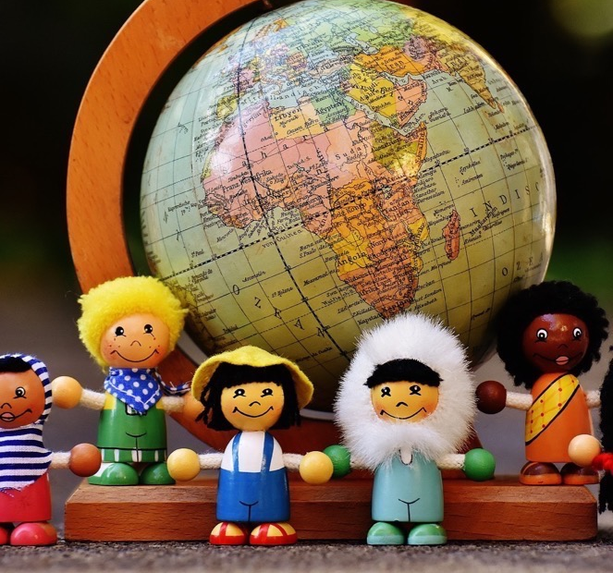
In this class, we are all individuals, different, unique and special.

Slide 3
What does private mean?
When something is private it belongs to you.

Slide 4
Your private parts
Your private parts are the parts of your body that people don’t see.
Your private parts are covered by your pants.

Slide 5
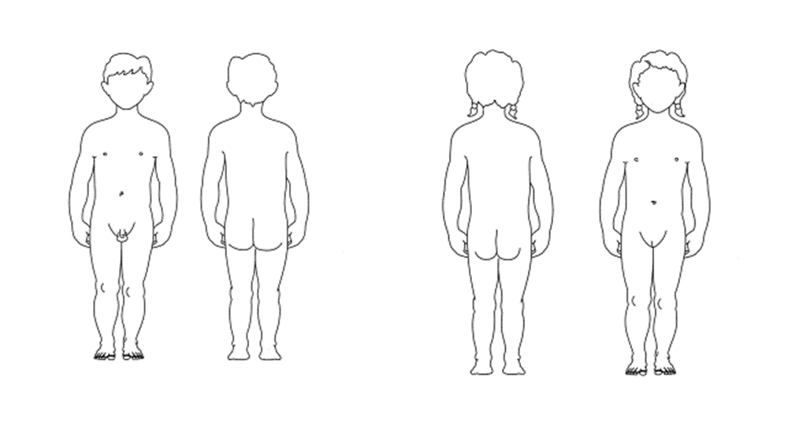
Your private parts
For a boy, your private parts are your penis and testicles and bottom.
For a girl, your private parts are your vulva and your bottom.

Slide 6
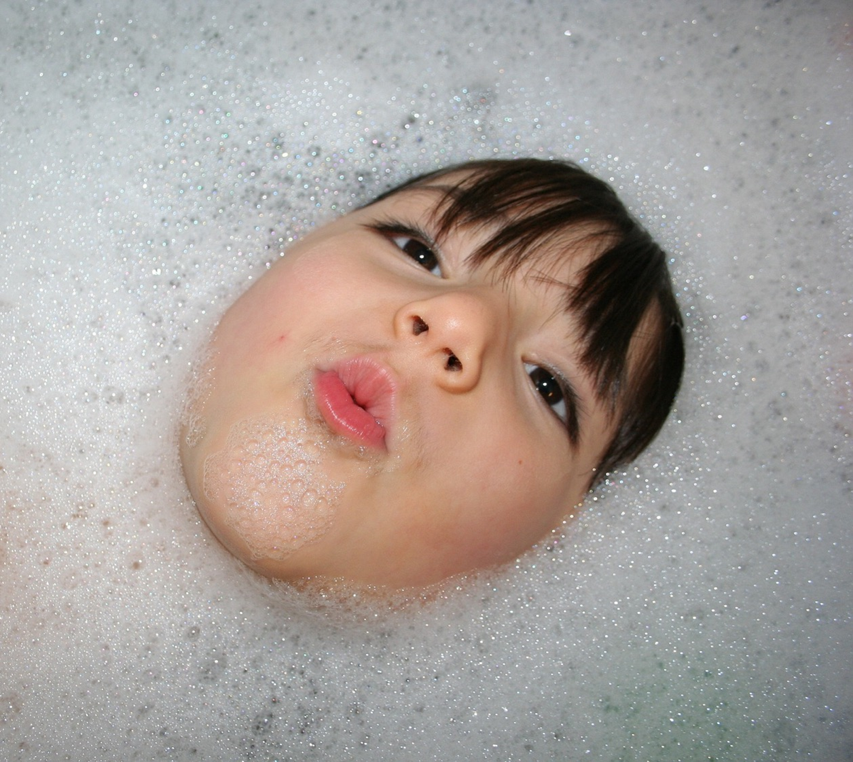
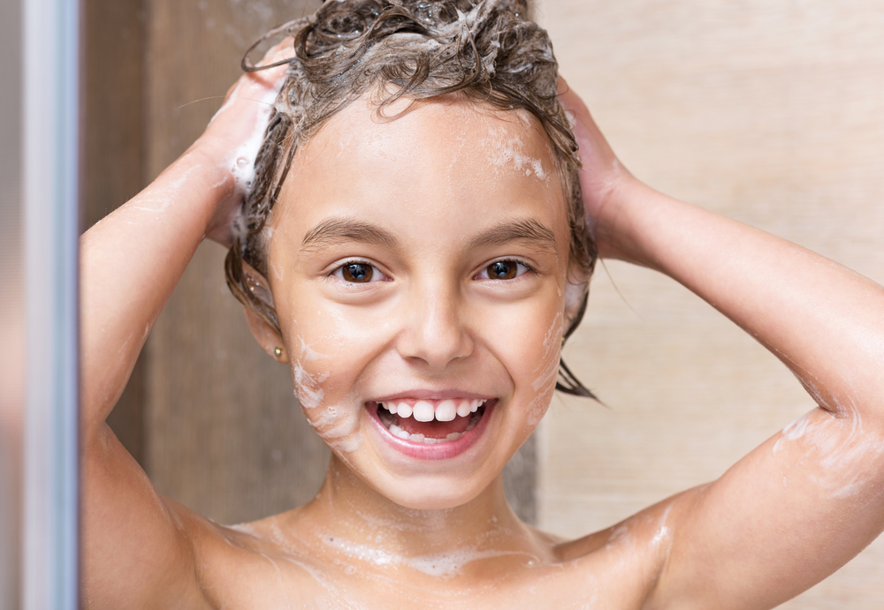
Your private parts
Your parent or carer may ask you about your private parts or see them, to help you learn or keep clean, or if you are not well.

Slide 7
Your private parts
When you are with your parent or carer a doctor or nurse might ask to see your private parts.
No-one else should ask to see or touch your private parts.

Slide 8
Animated film
(4 minutes 16 seconds or 2 minutes 10 seconds)
https://youtu.be/a-5mdt9YN6I
My body belongs to Me

Slide 9
P.A.N.T.S
Private parts are private
Always remember that your body belongs to you
No means no
Talk about secrets that upset you
Speak up, someone can help
https://www.nspcc.org.uk/preventing-abuse/keeping-children-safe/underwear-rule/

Slide 10
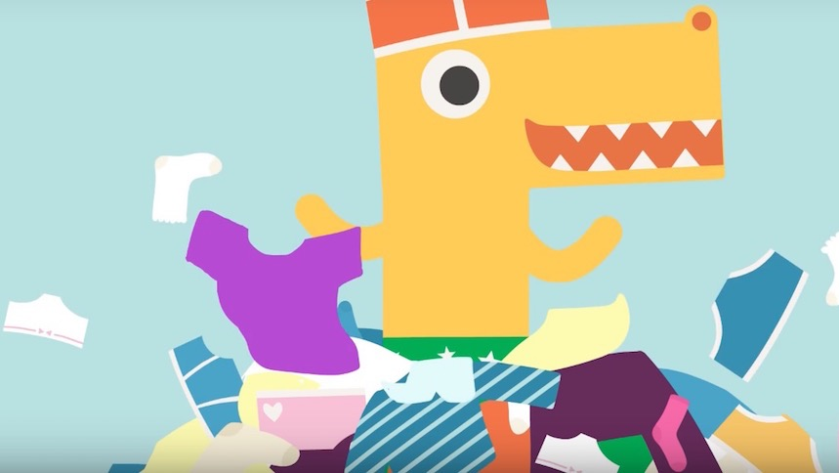
Pantosaurus Song
Animated film (2 minutes)
https://www.nspcc.org.uk/preventing-abuse/keeping-children-safe/underwear-rule/

