Slide 1
Pornography: What’s the problem?
I can describe the affect that exposure to pornography can have on the individual.
I can explain that pornography presents behaviours that can be violent or degrading, and that these behaviours are not appropriate in real-life relationships.
I understand the law on pornography.
I can express my own views on pornography.

Slide 2
Think about this statement:
Porn is everywhere
The question is: Just how much of what we are all exposed to in our day-to-day lives, is sexualised or pornographic?

Slide 3
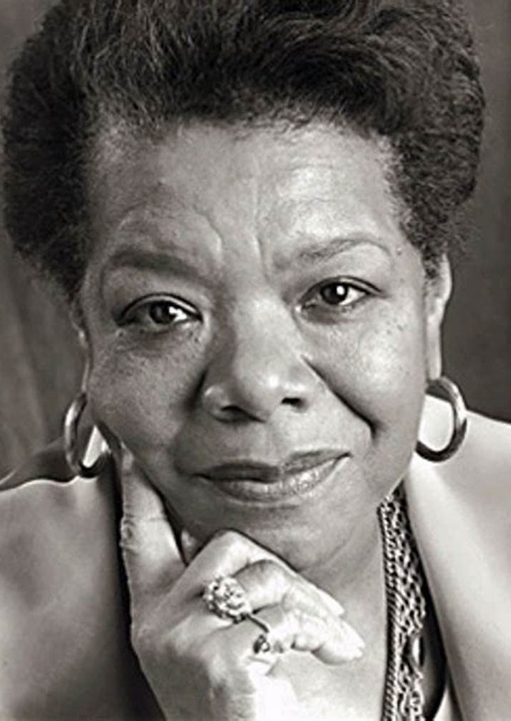
“If you don't like something, change it. If you can't change it, change your attitude.” Maya Angelou

Slide 4
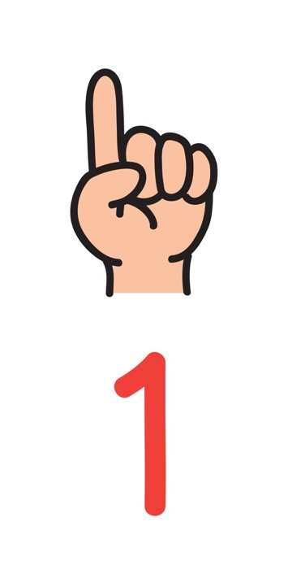
Problem 1: Porn and reality
Pornography is fantasy, and not realistic. People who we see in porn do not have realistic bodies. Porn can show some extreme and uncommon sex acts. It does not show the kind of sex that most people enjoy in real life.

Slide 5
Porn sex vs real sex: The differences explained with food https://youtu.be/q64hTNEj6KQ
(Duration 1 minutes 45)

Slide 6
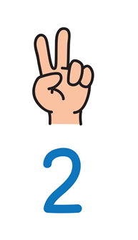
Problem 2:
Real sex is about sexual respect.
Porn sex is about sexual objectification.

Slide 7
Problem 2
Real sex is about sexual respect Both partners are able to express their feelings and respect each other’s boundaries about sex. In a healthy sexual relationship a partner respects your decisions about what kind of sexual activity you want to have. You can decide you don’t want sex. It also involves respecting a partner’s body and using contraception or condoms as you decide. | Porn sex is about sexual objectification Porn sex is the act of treating a person as an instrument of sexual pleasure. Objectification means a person is a commodity or an object. They have no dignity. They are a body and body parts, to be looked at or touched. Once sexually objectified, someone’s body or body part is judged by its physical appearance or potential sexual function. Then the body/body part is treated like it exists for others to use or consume.

Slide 8
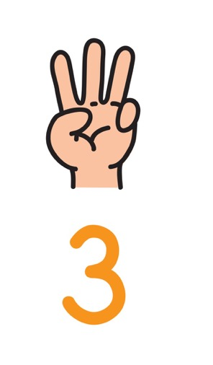
Problem 3: Porn and the brain
How Pornography Affects Individuals https://youtu.be/zHO568U2dkU (2 minutes 13 seconds)

Slide 9
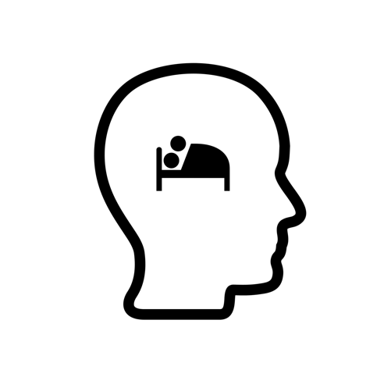
How does porn affect the brain?
As a young person you have a developing brain, compulsive viewing of porn – so watching a lot of porn - distorts the person’s idea of a healthy sexual relationship. Young men who worry about the amount of porn they watch report that “the script” of porn was always playing in the back of their minds when they were with a real partner.

Slide 10
How does porn affect the brain?
If an image or scene is no longer stimulating enough for someone looking at a lot of porn they will look for variety, surprise factor in the content, more hard-core and stranger material, anything they haven’t seen in order to attain a sexual climax. One result is that some brains are being “digitally rewired” in a totally new way to demand change, excitement, and constant stimulation.

Slide 11
How does porn affect the brain?
People who watch porn just have to hit the “reset” button and stop using porn completely for a few months. In fact, even if a person doesn’t think they are struggling, they might experiment with a break from porn, just to see if they can.
Source: https://www.skeptic.com/reading_room/how-porn-is-messing-with-your-manhood/

Slide 12
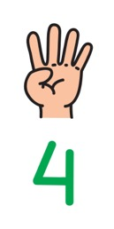
Problem 4: Pornography as a fast adapting business model/The case of OnlyFans
What started as a way for anyone to share what they made or did has become mostly a place where explicit content is sold.
There are concerns that young people can be led into making content that is sexualised.
Creators on OnlyFans can be pushed to become more explicit, take more risks.
Identities can be exposed, there is no guarantee that anything posted won’t be shared and impossible to remove it entirely from the internet.
Successful OnlyFan creators are now selling ‘how to’ guides and say they have hundreds of girls (lots being underage) messaging online for start-up advice.

Slide 13
Social action on porn
“If you don't like something, change it. If you can't change it, change your attitude.”
- Maya Angelou
Fight the new drug
https://youtu.be/VHPTV1OLkss
#PornKillsLove

Slide 14
PORN
Harmless Fun
PORN
Harmful to all

