Slide 1
Social Media: Netiquette
I can describe what I do online.
I reflect on my own behaviour and actions when I am online.
I can reflect on the benefits and risks involved in being online.
I have strategies to deal with situations that cause me concern.
I can identify people or places to go to when I have questions or a worry.

Slide 2
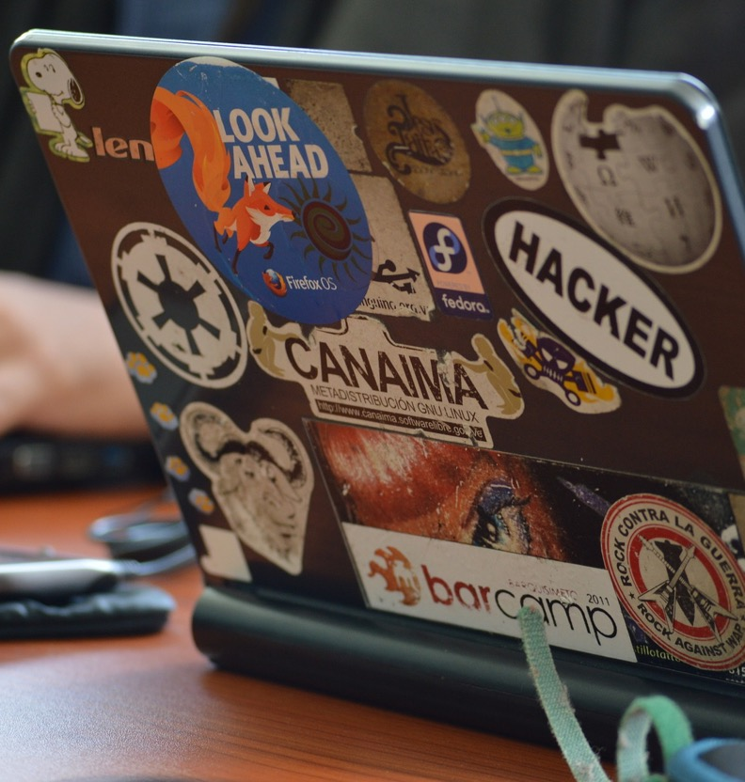
Netiquette is the set of rules about how we behave online.

Slide 3
Please don’t…
What do people do, or how do they behave online, that you would rather they didn’t do?

Slide 4
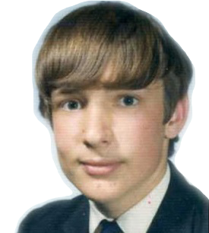
Who invented the internet?
Lots of people had ideas that came together but….
Vincent Cerf and Robert Kahn were writing about the idea in 1973.
The world wide web (www) that we know today was introduced in 1991 by Tim Berners-Lee.
The first website was created in 1991.
What if there was a place where people could go to share all of the world’s knowledge?
Tim Berners Lee at Primary School

Slide 5
Behaviour and manners matter.
What’s normally expected?

Slide 6
Netiquette: How should people behave online?

Slide 7
Trouser boy
https://vimeo.com/231619730
Promise
https://vimeo.com/58617678

Slide 8
ChildLine
www.childline.org.uk
If you're under 19 you can confidentially call, email or chat online about any problem big or small
Freephone 24h helpline: 0800 1111
Sign up for a ChildLine account on the website to be able to message a counsellor anytime without using your email address
Chat 1:1 with an online advisor

