Slide 1
Body image: My real body/Body confidence
I can describe how popular culture and social media promote stereotypes and unrealistic representations of both women, and men and can reflect on how these impact on groups and individuals.
I describe myself positively and can talk about my unique attributes and interests.
I understand and accept diversity amongst peers.

Slide 2
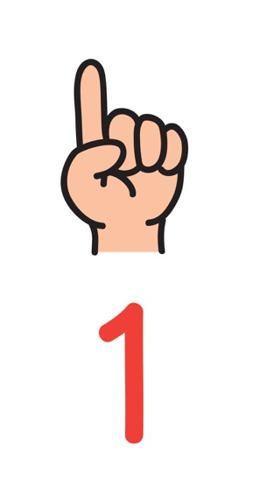
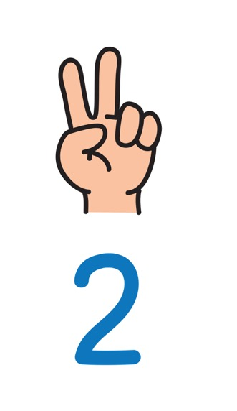
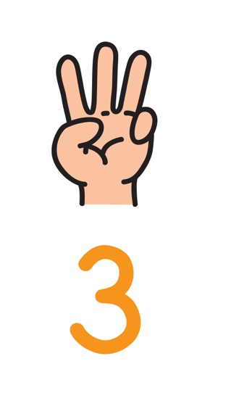
This can include our thoughts and feelings about our height, weight, shape, skin, colour, and our appearance and attractiveness more broadly.
We can have positive or negative body image. We might think positively or negative because of things like what we see around us in our family and friends and what we see and hear online.
Body image describes our idea of how our body looks and how we think it is viewed by others.

Slide 3
What can a poor body image and low self-esteem do to a young person?

Slide 4
What can a poor body image and low self-esteem do to a young person?
Recent research has found:
More than a third of young people (36%) agreed they would do whatever it took to look good.
1
Almost three in five young people (57%) have, or would consider, going on a diet to change the way they look.
2
One in 10 young people (10%) said they would consider plastic surgery to change the way they look.
3

Slide 5
Boys are affected too
https://www.bbc.co.uk/newsround/46311187

Slide 6
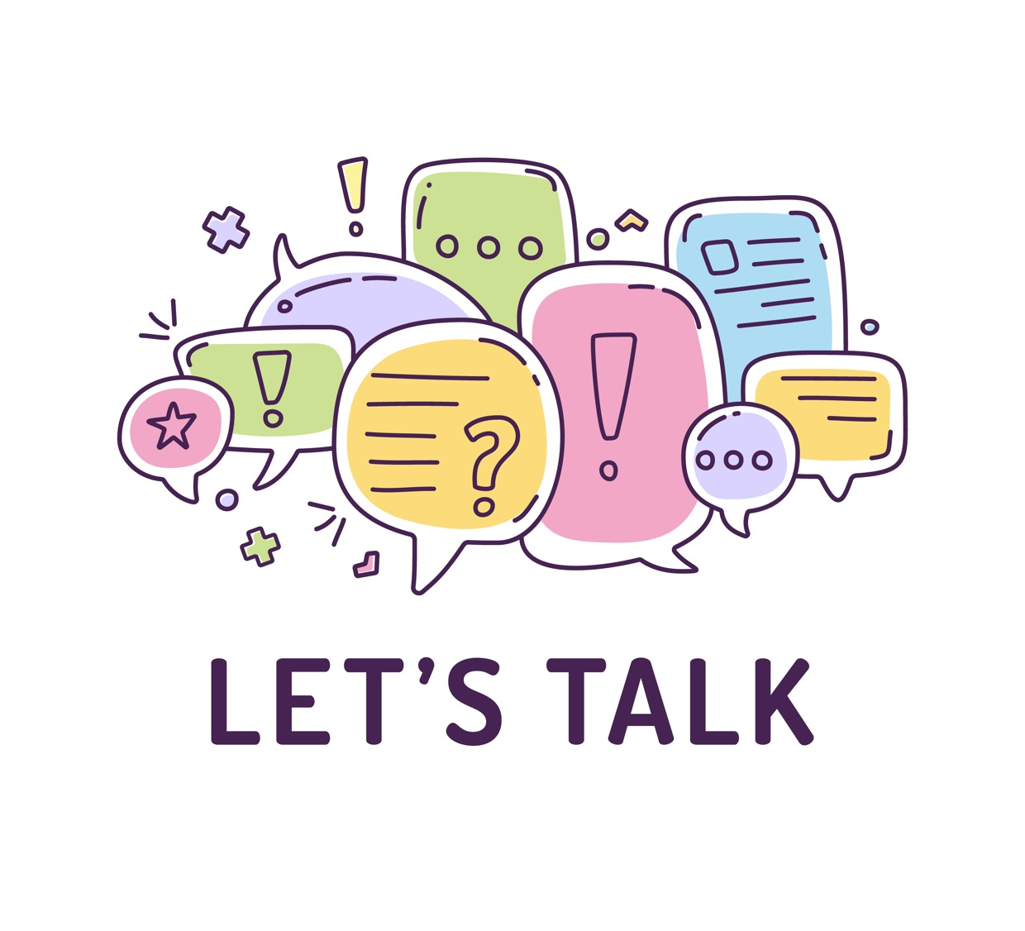
So, what can we do?
Do we need to protect ourselves from the negative images and messages we get from social media?

Slide 7
Self Portrait: Gimme 5

Slide 8
Building your body image and self-esteem: Advice for friends

Slide 9
Building your body image and self-esteem: Advice for friends:
Remember what you see online might be fake (or at least a bit fake)
Stop criticising yourself – be your own friend.
Don’t put you or your body down, be kind to yourself.
Find things to like about yourself – both physical and the kind of person you are.
Think about what you can do, not just what you find difficult or can’t do.

Slide 10
Building your body image and self-esteem: Advice for friends:
6. Understand your body – know when to rest or when to be active.
7. Get enough sleep.
8. Be active every day.
9. Keep a healthy weight but avoid ‘diets’
10. If you feel worried or anxious or have questions – talk to someone.
11. Think about spending less time online…..

Slide 11
Pressures to look a certain way comes up all the time. If you have the confidence to say no to being pressured to look a certain way you will feel more body confident. You will also help friends when they feel the same pressure.
Megan: Founder of Yellowberry Bras https://youtu.be/byBGUzKgXXc
Levi Author of Be Courageous https://youtu.be/2yTn7UvpUoQ
Mikhaila, Creator, The Cosmic Cuties https://youtu.be/V_hd9vA3MbE

