Slide 1
Friends and Friendships: Making and keeping friends
I can talk about what I want from friendships and what kind of friend I can be.
I can explain the benefits of friendships and as well as the challenges that come up in maintaining relationships.
I give examples of things I can do to make and maintain friendships.
I understand that I do not need to be best friends with everyone, but I can be friendly and kind.

Slide 2
What’s the best way to make a friend?
Its your first day at a new school.

Slide 3
What’s the best way to make a friend?
B. It’s the first day of term, it’s a new class, you know a lot of people but your friends from last year are in another class now.

Slide 4
What’s the best way to make a friend?
C. You have moved to a new street and go out to play.

Slide 5
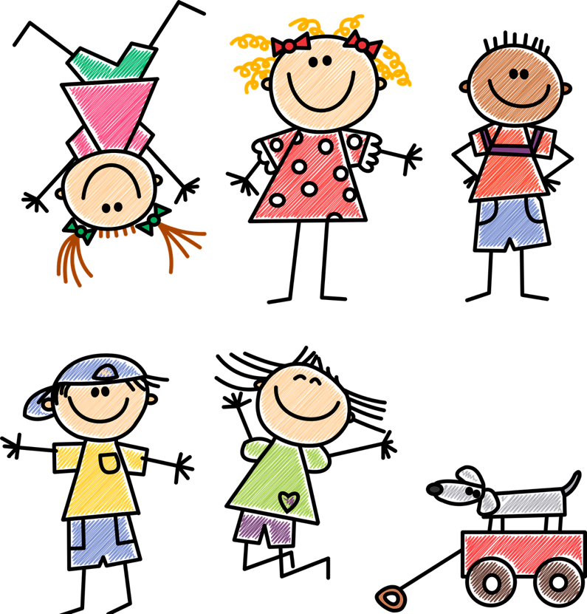
How to make a friend: Top tips
Ask someone their name. Tell them your name.
Smile at someone.
Ask if you can join in.
Start talking to someone, say what you like and ask questions about what they like.

Slide 6
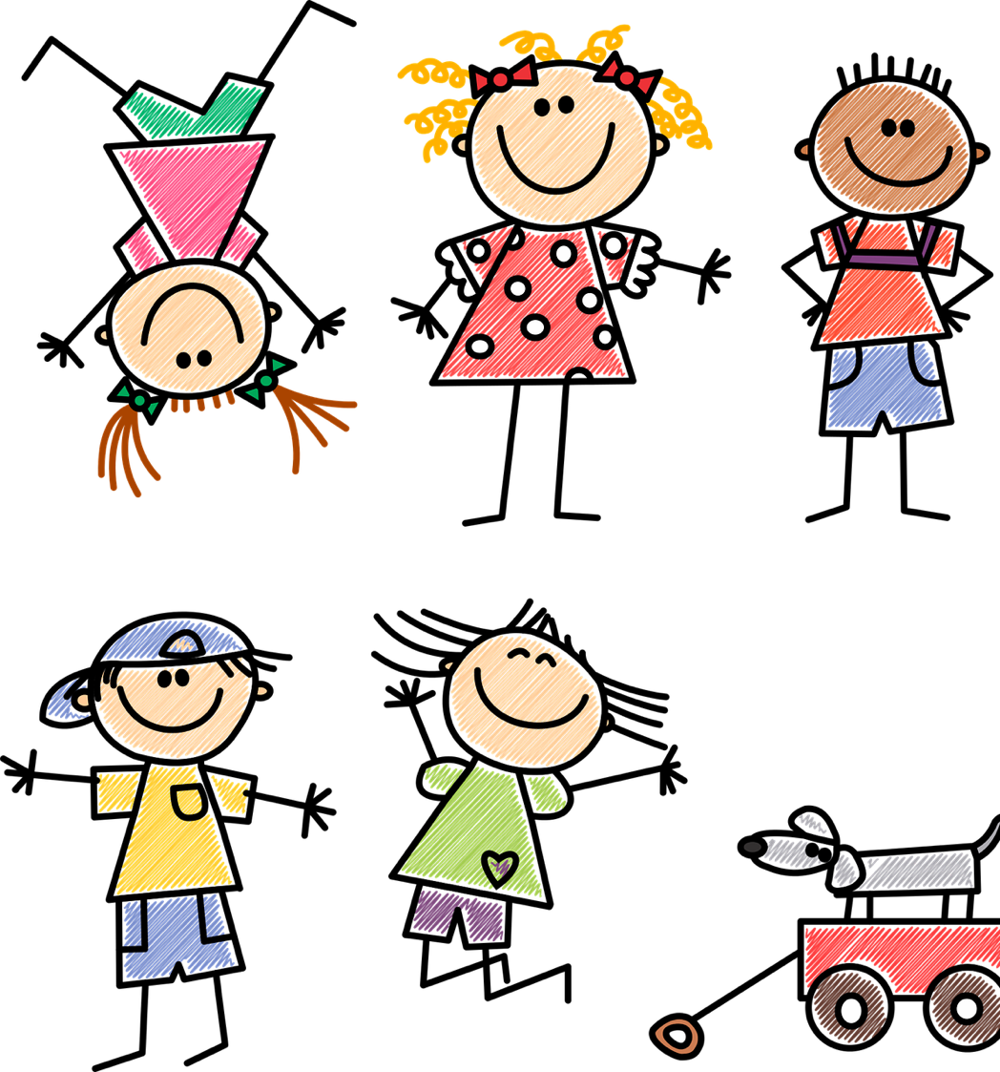
How to make a friend: Top tips
Listen to what someone is saying.
Give the other person a chance to talk.
If someone looks lonely or sad, go and talk to them.
Go to a club where they do something you like.

Slide 7
How to make a friend: Top tips
If someone looks like they are stuck with something, ask if you can help.
If someone needs something, let them borrow yours.
Go and speak to the new person.
Give someone a compliment.

Slide 8
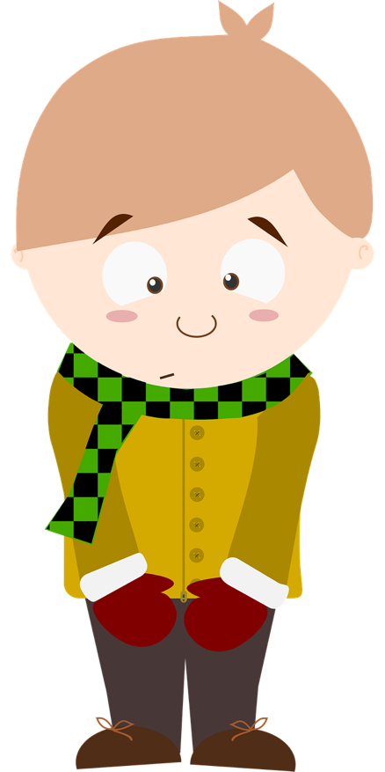
When a person is an introvert they probably prefer things to be calm, they might be quiet, they like their own company. They will have friends, but probably don’t like being in big groups. When a person is an extrovert they maybe have more energy, they get excited, they might be a bit loud. They like to be with other people and possibly like to be the centre of attention.
Introvert and extrovert

Slide 9
Why do friends fall out?

Slide 10
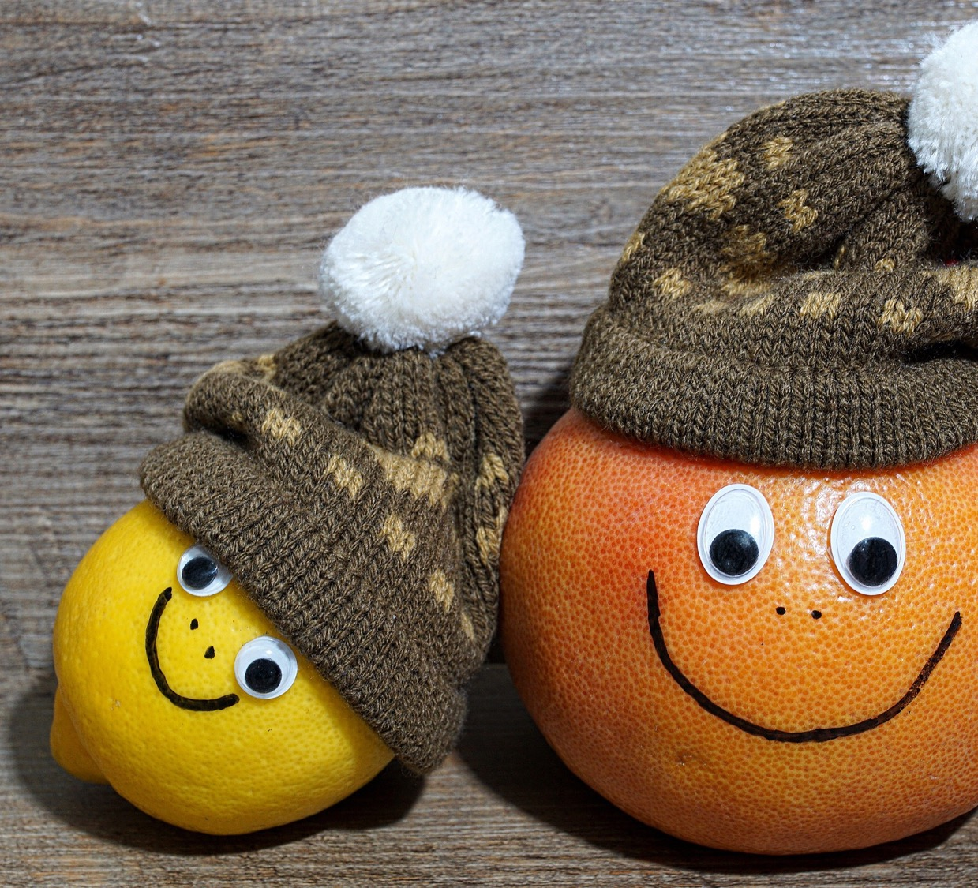
When friends fall out what can you do about it?

Slide 11
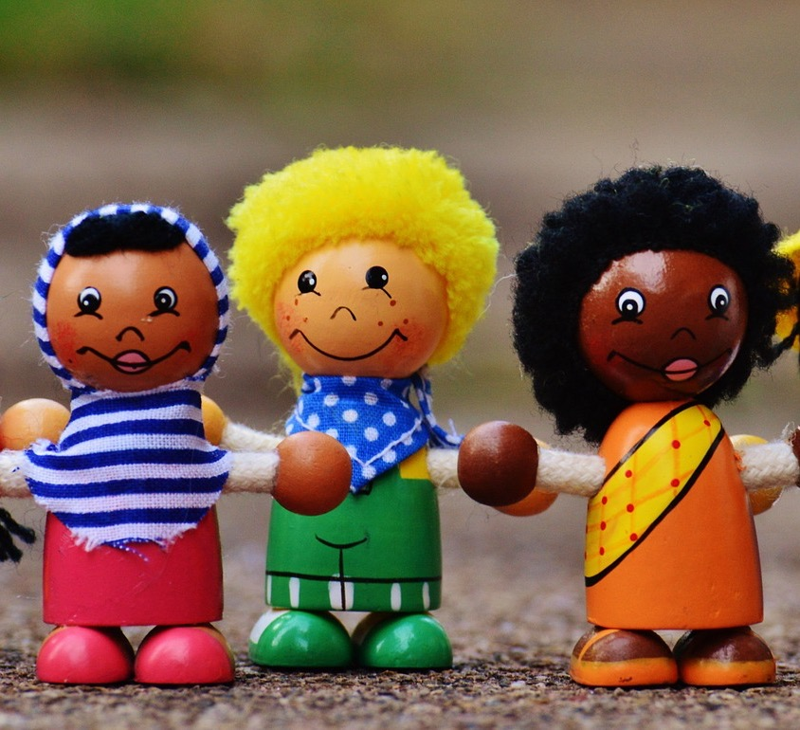
When friends fall out what can you do about it? 6 top tips: 1. Try and imagine it from the other side. 2. Find someone who can help you to get talking – a peacemaker. 3. Listen. Pay attention to what your friend is saying so you can understand. 4. Tell them how you feel. 5. Have a laugh – see the funny side. 6. Accept that you might both have been right – being able to disagree is an important part of a friendship.

Slide 12
More on the YoungScot website here: Falling Out With a Friend – Young Scot

Slide 13
Friendship Soup: Ingredients https://youtu.be/H7w7yXkJTu0 A spoonful of… A bag of… A bottle of… A pinch of… A drop of… A handful of…

Slide 14
We don’t all need to be best friends, but everyone will be happier if we can be friendly.

