Slide 1
Emotional Wellbeing: Looking after myself and others
I reflect on the importance of both my physical and mental/emotional health.
I can recognise when I feel sad, depressed, anxious or stressed.
I understand that mental ill-health is stigmatised and I can show empathy and understanding for others.
I know who or where I can go to for support or if I have a worry or a question.

Slide 2
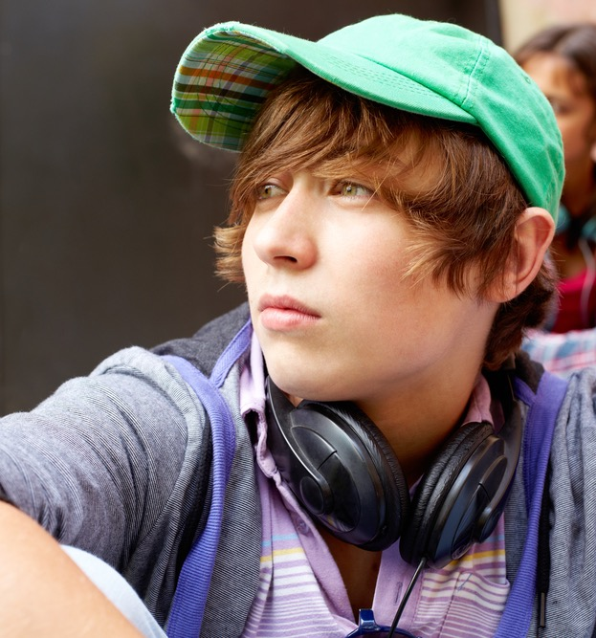
Just like we all have our physical health, we all have mental health.
When we have good mental health, this means we can think, feel and act in a way that allows us to enjoy life and deal with the challenges it presents.
When we have a mental health problem then there is something happening in our lives to make us feel stress or that we are not coping day-to-day, this might make it difficult to do things like go to school or be with other people.

Slide 3
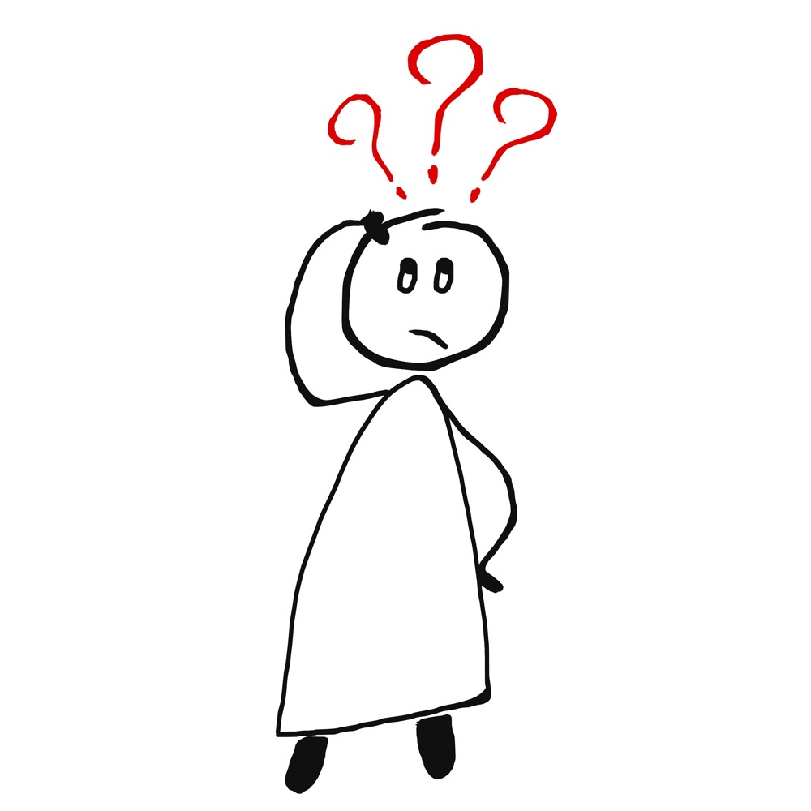
Feelings check-in.
When I woke up this morning, I felt…
Just before coming into this class, I felt…
Right now, I feel…

Slide 4
I’m fine?
Film (2 minutes 3 seconds)
https://youtu.be/lJxXxqsv8Zc

Slide 5
Why do people find it hard to really say how they feel?

Slide 6
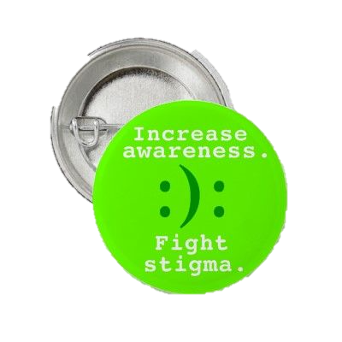
Stigma
Prejudice is about a negative thing you think of another person or group of people, just based on who they are.
Discrimination is about what you do, it is when you treat someone badly because of who they are.
When a person who has a mental health problem experiences prejudice or discrimination then this is called stigma.
Because of stigma, a person might be ashamed, or they might not ask for help when they really need it.

Slide 7
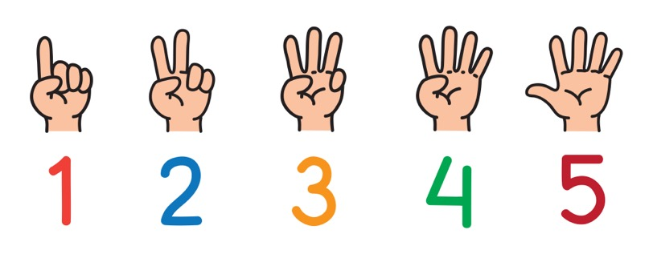
When a person feels sad, angry or stressed what can they do?

Slide 8
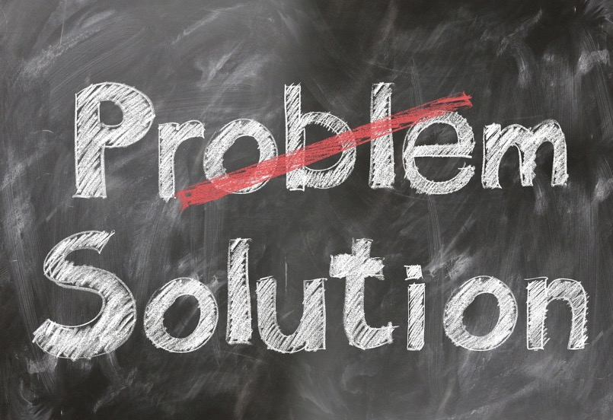
When you feel sad, angry or stressed you can:
Do some exercise, something physical
Listen to music
Take deep breaths
Write about how you feel
Do something you enjoy
Talk to someone about how you are feeling
Play computer games to take your mind off it
Read a book
Have a bath

Slide 9
Characters and scenarios:
Firstly, read about your character’s situation. Then think about:
What can your character change or influence that is happening?
Is there anything going on that they really can’t change or influence?
What do you suggest they do?
What would you do as their friend?

Slide 10
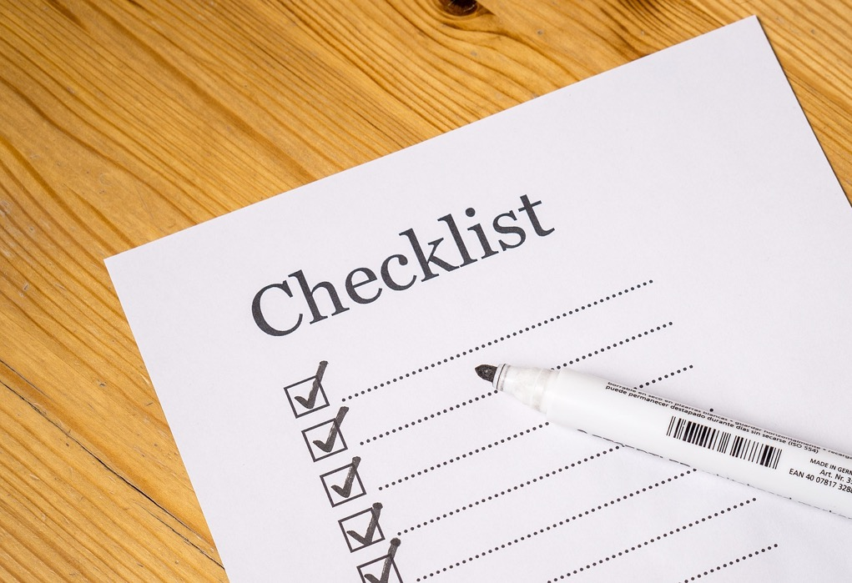
Good mental wellbeing is about feeling good and functioning well. Managing emotions is one of the most important life skills a person can develop. So….
Notice how you feel
Pay attention to how strong the feeling is
Listen to what’s going on around you
Connect with other people
Share your feelings
Be active

Slide 11
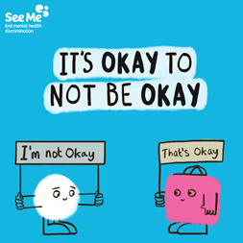
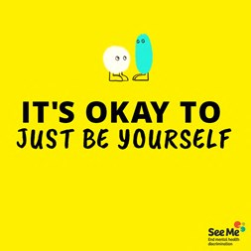
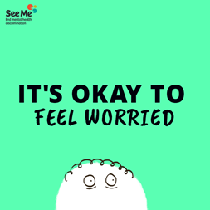
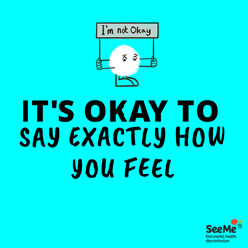
Are you okay?
The Power of Okay Film
(40 seconds)
https://youtu.be/3szHcffKtTY

Slide 12
ChildLine
www.childline.org.uk
If you're under 19 you can confidentially call, email or chat online about any problem big or small
Freephone 24h helpline: 0800 1111
Sign up for a ChildLine account on the website to be able to message a counsellor anytime without using your email address
Chat 1:1 with an online advisor

