Slide 1
Romantic and Loving Relationships: Living together, Marriage and Civil Partnerships
I can talk about the importance of communication, honesty and trust in relationships.
I can talk about the kind of partner I would want to involved with, and what I would bring to a relationship.
I understand that adults can be married, in a civil partnership or live together.
I am developing skills and confidence to make decisions about the relationships I want.

Slide 2
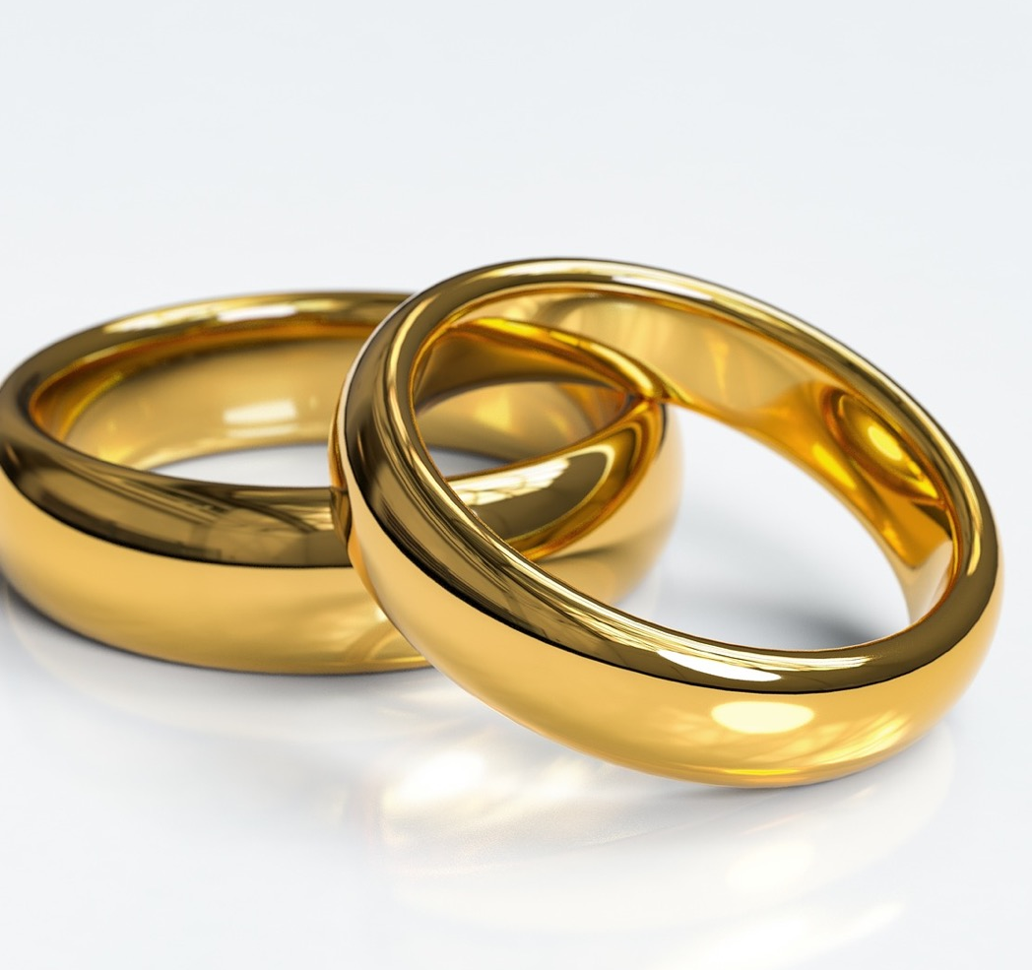
MARRIAGE is a legal union between 2 people. Heterosexual (straight) and lesbian and gay couples can get married.
There are 2 ways to do this:
Have a civil (non-religious) ceremony which is delivered by a Registrar or a trained person called a Celebrant.
Have a religious ceremony which is delivered by someone like a Minister or Priest or Imam.

Slide 3
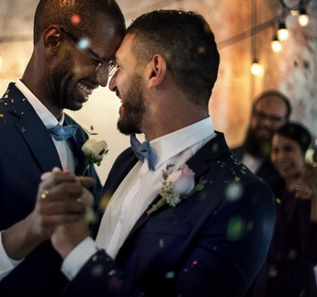
CIVIL PARTNERSHIPS were introduced so that gay and lesbian couples could have their relationship recognised in law.
When it was first introduced this was because some religious groups did not want gay and lesbian couples to be able to get married. But now, there is also the option of getting married for same-sex couples.
It used to be that heterosexual (straight) couples couldn’t get a civil partnership, but the law is changing. Some heterosexual couples would like the option of having a Civil Partnership.

Slide 4
LIVING TOGETHER
When a couple are living together, they are called cohabitants.
Couples living together do not have the same legal rights as people who are married or in a civil partnership. Sometimes this gets complicated. For example, if a relationship breaks up or a partner dies, and the other person has to prove that they lived like a married couple in order to keep their house or claim their pensions.

Slide 5
Marriage is an old-fashioned idea. Most young people will probably just live together.
What do you think?
What would people at home think?

Slide 6
Getting married or having a Civil Partnership is important because it says that people are committed to their relationship.
What do you think?
What would people at home think?

Slide 7
Marriage and Civil Partnerships have become over commercialised, too expensive, and people forget what it really means to get married/civil partnered.
What do you think?
What would people at home think?

Slide 8
You should live with someone before you get married or in a civil partnership.
What do you think?
What would people at home think?

Slide 9
If a couple are having children it’s best if they are married or in a civil partnership, rather than living together.
What do you think?
What would people at home think?

Slide 11
1.
There are approximately 30,000 marriages or civil partnerships every year in Scotland

Slide 12
2.
You have to be aged 18 or over to get married

Slide 13
3.
If you get engaged, you have to marry your partner

Slide 14
4.
There are 2 kinds of marriage ceremonies: a civil marriage or a religious/belief ceremony

Slide 15
5.
You need to have 2 witnesses present at your wedding/civil partnership

Slide 16
6.
To get married you must register your intention to marry at least 28 days before the marriage

Slide 17
7.
If you are already married or in a civil partnership it is illegal to get married/civil partnered again

Slide 18
8.
If you get divorced or your partner dies, you can get married/have a civil partnership again.

Slide 19
9.
If you are not married or in a civil partnership but you live with your partner this is called common-law husband or wife and its just the same as being married.

Slide 20
10.
Forcing someone to marry without their full and free consent is against the law and an abuse of their human rights.

Slide 21
1.
There are approximately 30,000 marriages or civil partnerships every year in Scotland
TRUE

Slide 22
2.
You have to be aged 18 or over to get married.
FALSE
You can marry from the age of 16.

Slide 23
3. If you get engaged, you have to marry your partner.
FALSE
If you or your partner decide to end an engagement, you cannot be forced to marry. In these circumstances, it is not legally clear what should happen about engagement rings. The ring should be returned if the giver made clear that in the event of a broken engagement it should be returned. Gifts should be returned if they were given on condition of marriage. This, however, cannot be legally enforced.

Slide 24
4. There are 2 kinds of marriage ceremonies: a civil marriage or a religious/belief ceremony.
TRUE
A religious ceremony includes religious beliefs and other belief systems such as humanism. A religious ceremony can be held anywhere (for example on a boat or hillside. A civil marriage can take place in a registrar's office or in any other appropriate location (other than religious premises) that has been agreed by the couple, for example, a stately home, or on a hillside.

Slide 25
5. You need to have 2 witnesses present at your wedding/civil partnership.
TRUE
As well as the couple, and the person who is conducting the ceremony, you must have 2 witnesses aged 16 or over.

Slide 26
6. To get married you must register your intention to marry at least 28 days before the marriage.
TRUE
You and your partner will each need to give notice to the district registrar for the area where you intend to marry. Your intention to marry is a public announcement that anyone can see.

Slide 27
7. If you are already married or in a civil partnership it is illegal to get married/civil partnered again.
TRUE
If you marry or enter a civil partnership in the UK when you are already in one, the marriage/partnership is bigamous and will be void. Bigamy is a crime.

Slide 28
8. If you get divorced or your partner dies, you can get married/have a civil partnership again.
TRUE
But some religions have rules about whether you can re-marry in a religious ceremony.

Slide 29
9. If you are not married or in a civil partnership, but you live with your partner this is called common-law husband or wife and its just the same as being married.
FALSE
The term 'common - law' husband or wife is often used but has no legal standing. It is a misunderstanding that a couple will have established a 'common law marriage' after living together for a period of time.

Slide 30
10. Forcing someone to marry without their full and free consent is against the law and an abuse of their human rights.
TRUE
If you are afraid that you may be forced into a marriage in this country, or that someone in this country may be planning to force you into a marriage while you are abroad, you should ask for help immediately. You can ask the Police for help.

Slide 31
More about…..
Forced Marriage: https://www.childline.org.uk/info-advice/bullying-abuse-safety/crime-law/forced-marriage/
Getting married from the Citizens Advice Bureau Scotland: https://www.citizensadvice.org.uk/scotland/family/living-together-marriage-and-civil-partnership-s/getting-married-s/#h-getting-engaged

