Slide 1
Life Cycles
I know what affects the growth of plants; that plants need water, soil, space, sunlight and air to grow.
I can describe how to care for plants and animals (pets).
I can sequence the life cycle of specific animals.
I can investigate factors that affect the growth and development of living things.
I am beginning to understand and describe the things I need as a child to grow and develop.

Slide 2
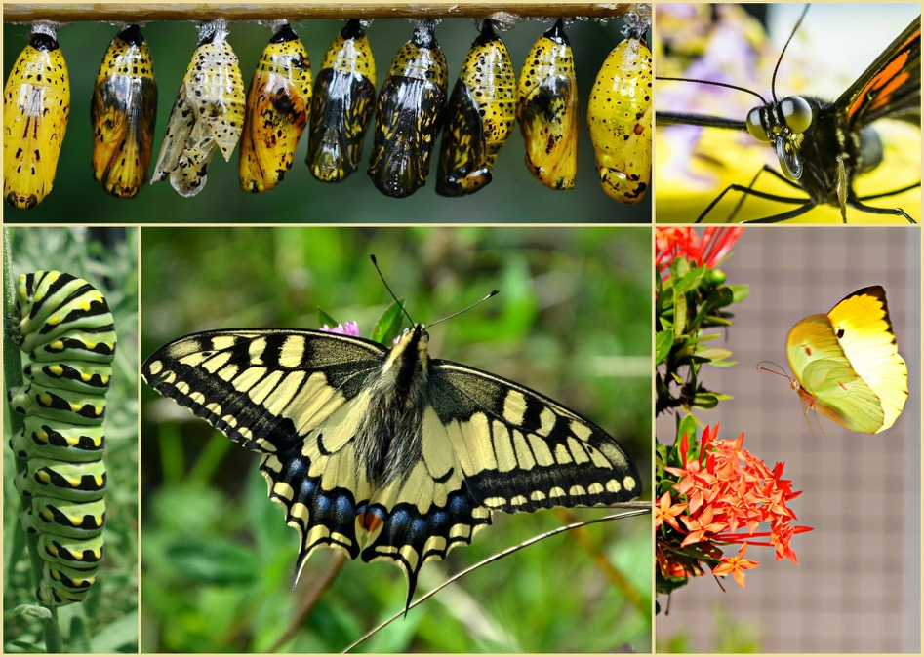
The life cycle of the butterfly
An adult butterfly lays an egg
The egg hatches to a caterpillar (larva)
The caterpillar forms a chrysalis or pupa
The chrysalis matures into a butterfly.

Slide 3
Film:
The life cycle of the butterfly
https://youtu.be/O1S8WzwLPlM (duration 5 minutes 15 seconds)

Slide 4
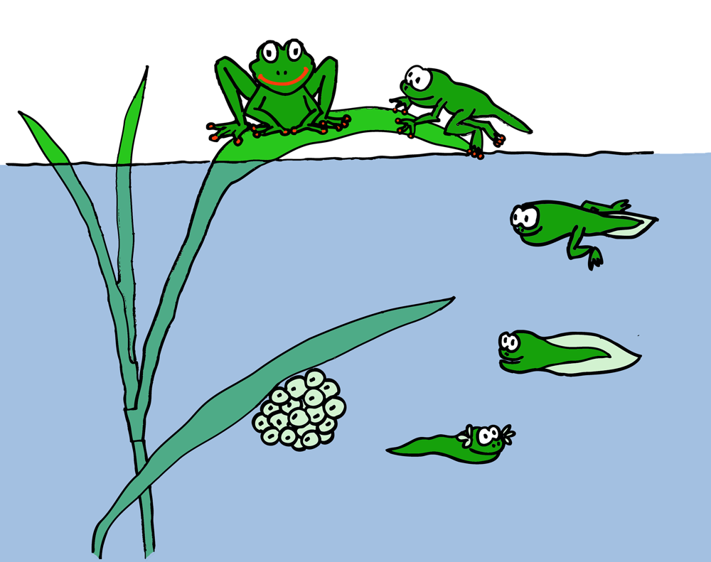
The life cycle of the frog
The female frog lays eggs and the male frog fertilises them.
The eggs hatch and become early tadpoles
Then the tadpoles grow and become froglets
Then the little froglets become frogs.

Slide 5
Film:
The life cycle of the frog
https://youtu.be/FIXoJYbBls0 (duration 5 minutes 6 seconds)

Slide 6
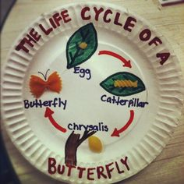
Activity: Life-cycle wheel
Choose either the frog or the butterfly and create a life-cycle wheel.

Slide 7
Activity: Life-cycle wheel
The life cycle of the butterfly
An adult butterfly lays an egg
The egg hatches to a caterpillar (larva)
The caterpillar forms a chrysalis or pupa
The chrysalis matures into a butterfly.
The life cycle of the frog
The female frog lays eggs and the male frog fertilises them.
The eggs hatch and become early tadpoles
Then the tadpoles grow and become froglets
Then the little froglets become frogs.

Slide 8
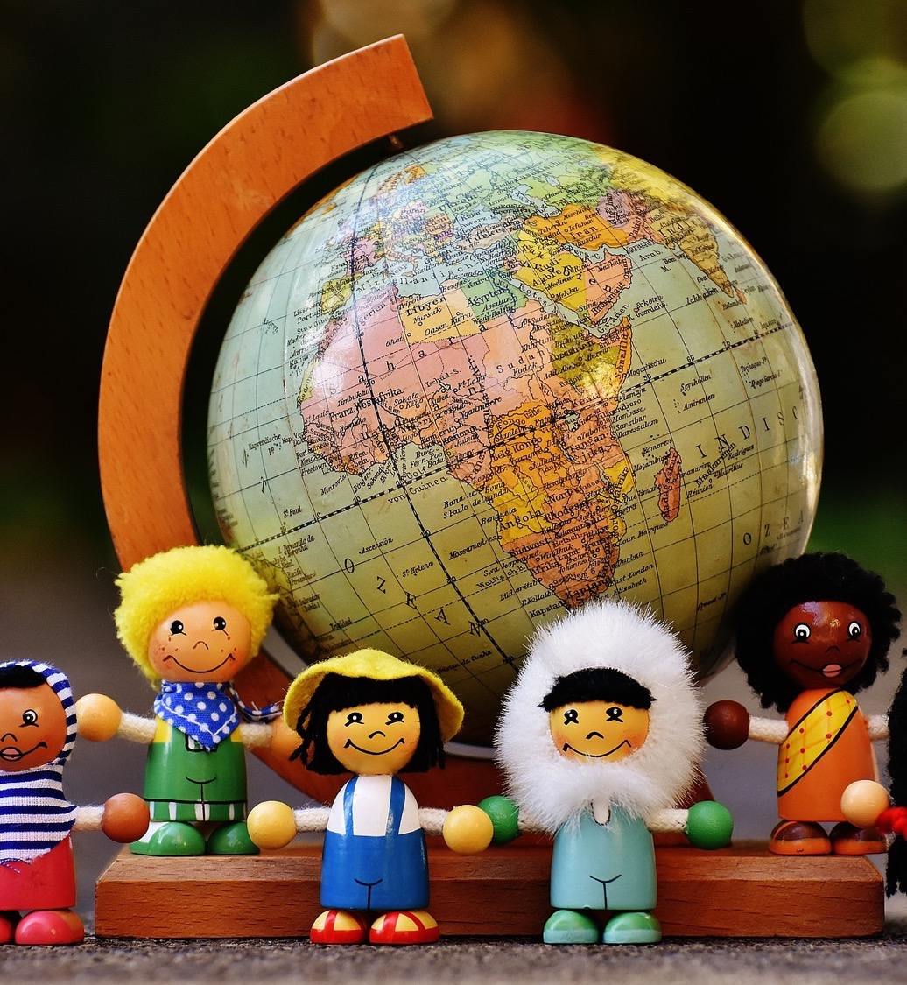
In this class, we are all individuals, different, unique and special.

