Slide 1
Make it good/Loving and intimate Relationships
How and why to end a relationship
I can describe what the good relationship would mean for me.
I am building skills and confidence to make decisions about my own personal relationships, including sexual relationships.

Slide 2
Know your
Relationship Rights

Slide 3

Advice column
8 signs that it’s time to end the relationship.

Slide 4

RED: Not good/Not OK
AMBER: Not Sure
GREEN: Good/OK

Slide 5
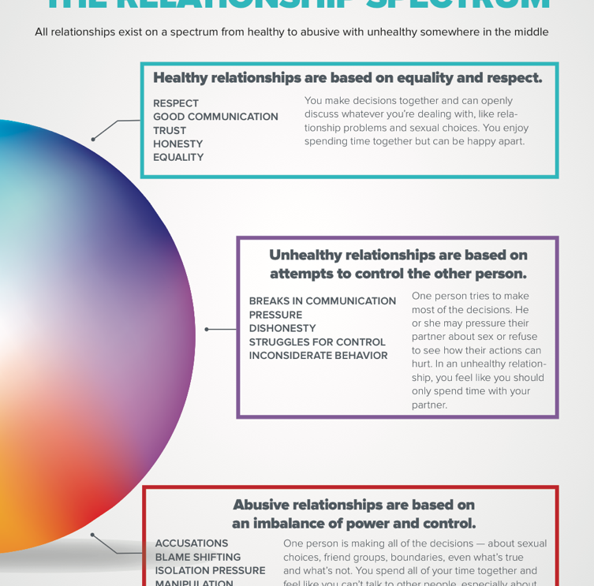
The Relationship
Spectrum

Slide 6

What is domestic abuse?
Domestic abuse is where one person harms another person with whom they have (or have had) some sort of relationship.
They might live in the same house or not.
They can be gay/lesbian and heterosexual (straight).
Both women and men can experience domestic abuse.

Slide 7
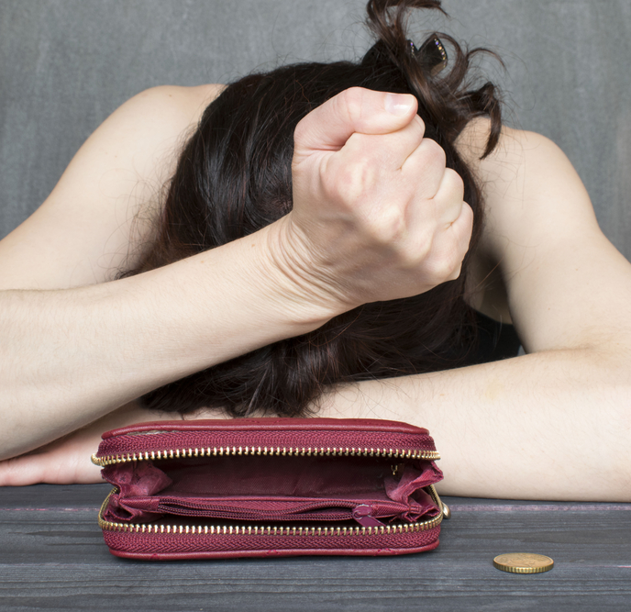
Domestic abuse is when someone uses physical, emotional, digital or financial abuse or sexual violence to control, force, threaten or degrade a partner or an ex-partner.
There are 60,000 incidents of domestic abuse reported in Scotland every year – but it’s thought that many are not reported.

Slide 8
What is gender-based violence?
Domestic abuse is a particular type of abuse, but there are also many other different types including:
Harassment and stalking
Rape and sexual assault
Female genital mutilation
Forced marriage
Honour-based abuse
Trafficking
All such abuse is also known as gender-based violence.

Slide 9

If you ever experience domestic abuse or any kind of gender-based violence, or you know someone who is, ask for help.
ChildLine is a great source of confidential help for young people your age: www.childline.org.uk/

