Slide 1
Gender Equality: Equality and the law
I can talk about what equality means to me.
I can explain what the law says about gender equality and sex discrimination.
I know that learning and work environments must be places of equality and safety for me.
I am building skills and confidence to seek information, support or help when I need it and if my rights are infringed.

Slide 2
What is gender equality?
Gender equality, also known as sex equality, or equality of the genders, is the view that everyone should receive equal treatment and not be discriminated against based on their gender.

Slide 3
The Equality Act (2010) protects people from discrimination based on these nine characteristics:
Age
Disability
Gender reassignment
Marriage and civil partnership
Pregnancy and maternity
Race
Religion or belief
Sexual orientation
Sex

Slide 4
There are 4 main types of sex discrimination:
Direct discrimination
Indirect discrimination
Harassment
Victimisation
Film: Equality and Human Rights Commission (duration 1minute 15seconds) https://youtu.be/tZYiIgRFPkU

Slide 5
What is direct and indirect discrimination?
Equality and Human Rights Commission
(duration 5minutes) https://youtu.be/BdFw_i03V0A

Slide 6
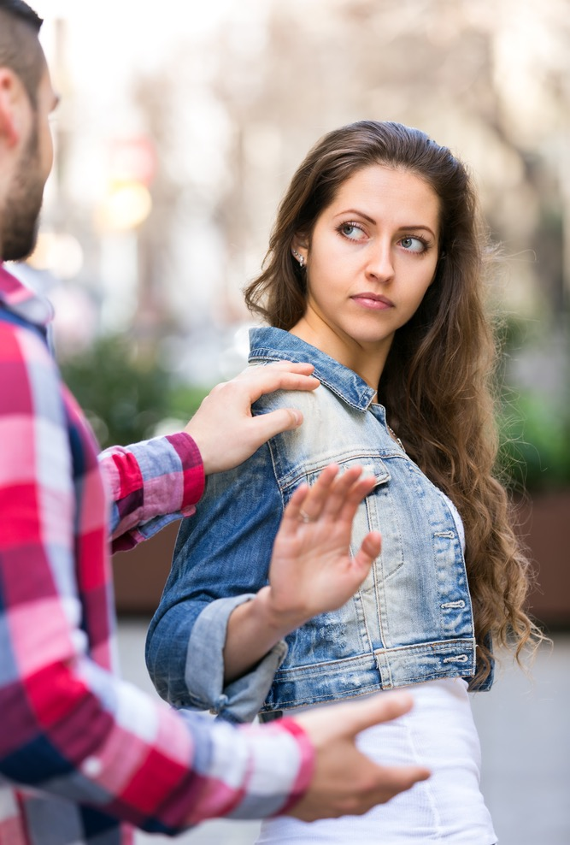
What is sexual harassment?
Sexual harassment is unwelcome sexual behaviour which compromises your dignity and makes you feel offended, humiliated, intimidated or threatened.

Slide 7
What is sexual harassment?
Sexual harassment can be face-to-face, indirect or online. Sexual harassment can also include stalking, sexual assault and rape, these are also serious criminal offences on their own and so should not just be seen as sexual harassment.

Slide 8
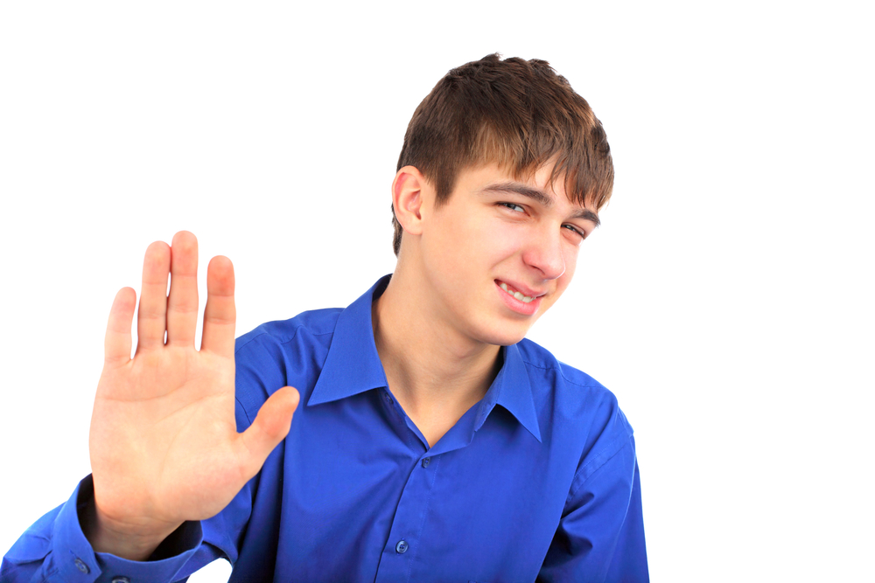
What is sexual harassment?
Although most victims of sexual harassment are women, harassed by men, men can also be harassed by women. Lesbian, gay and bisexual people may also find themselves harassed or bullied by people of either sex.

Slide 9
What is victimisation?
Victimisation is when someone treats you badly because you complain about discrimination or because you have helped someone who’s been the victim of discrimination.

Slide 10
How might a person experience sex discrimination?

Slide 11
Helping make a gender equal world.
Our ideas for change + ideas for action.
HOME
SCHOOLS
WORKPLACES
SPORTS
TELEVISION+FILM
ONLINE+SOCIAL MEDIA

