Slide 1
Being smart online
I can discuss what I do online.
I understand that my online activity requires me to have strategies for safe use.
I can identify an adult/adults I trust and who can help when I have a worry.

Slide 2
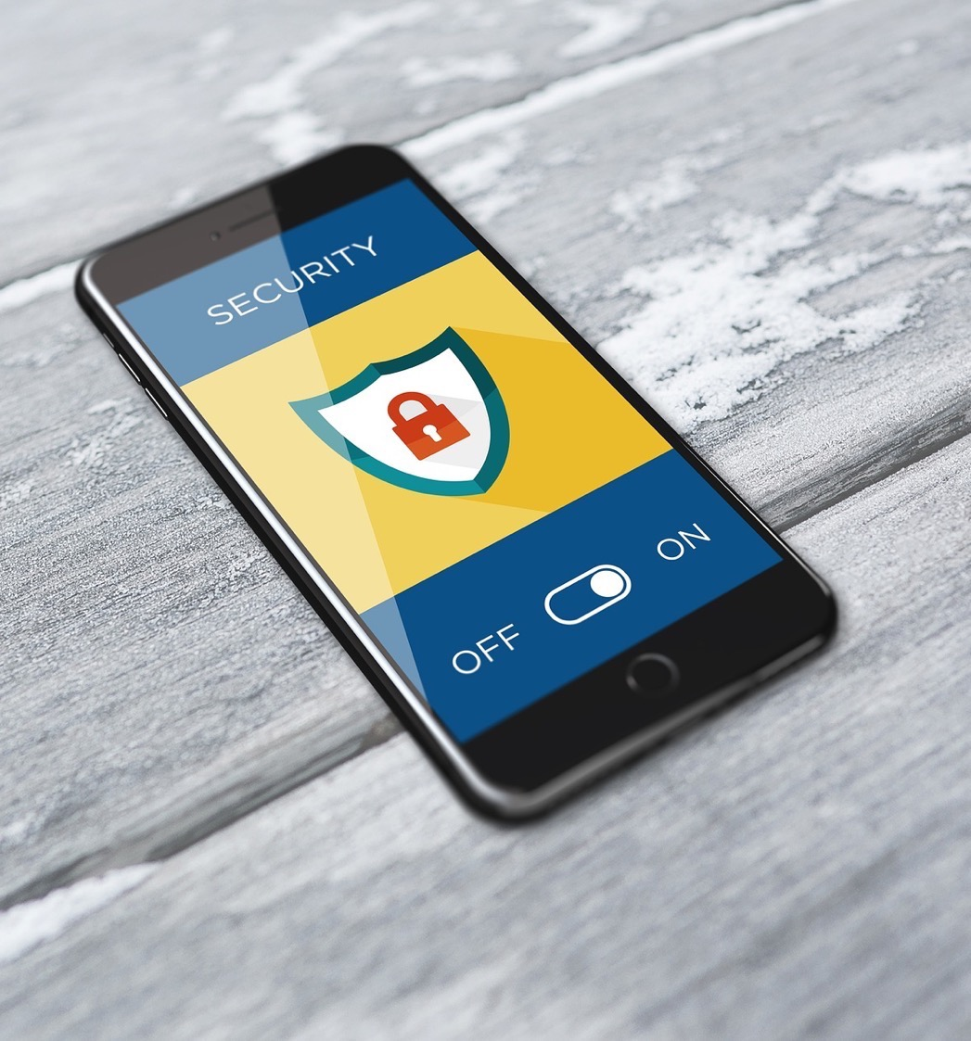
The internet is an exciting and helpful and fun place .
Like every place it also needs to be a place where children are smart and know how to keep themselves safe.

Slide 3
Discussion:
What good things do you see online?
What do you see online that inspires you?

Slide 4
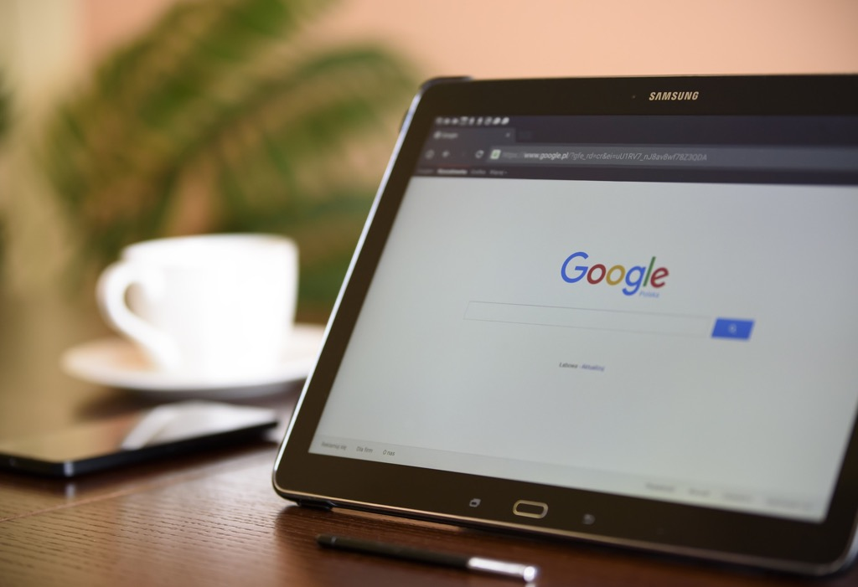
Searching online
What search engines do you use?
Why that one?
If you do a search on Google (or the search engine you use) how do you decide which link to click?

Slide 5
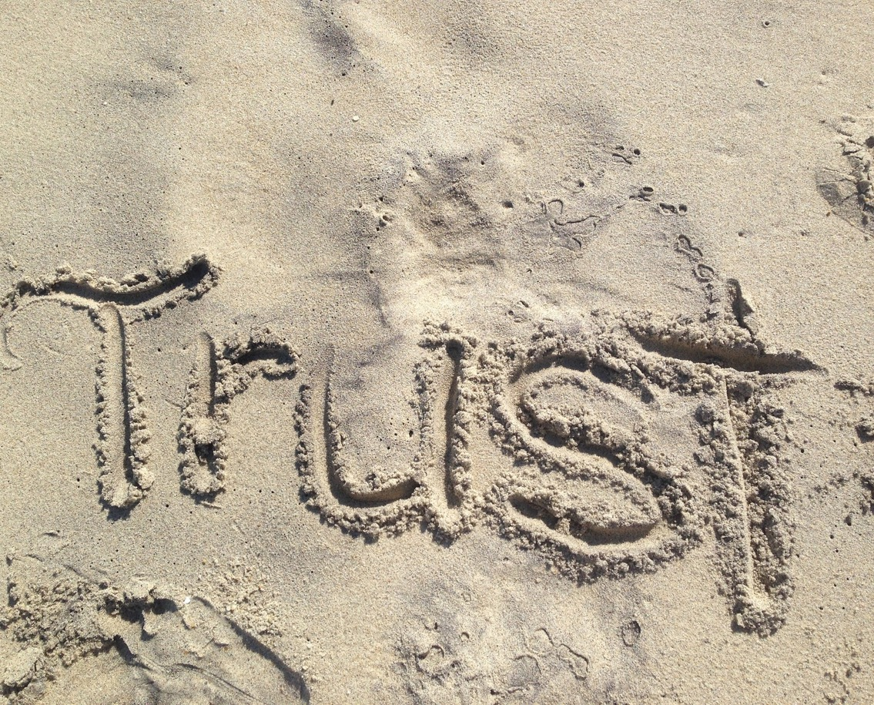
Can you trust what you see online?
What is fake?

Slide 6
Activity: Real or fake?
Pick a website you go to.
Show and tell your partner which website it is.
On this website do you think:
Everything there is true?
Most is true?
Some is true?
I don’t know?

Slide 7
Film:
Real or fake?
Newsround https://youtu.be/lT_V_rQtFr0
Duration: 2 minutes 30 seconds

Slide 8
Real or Fake News
Group game!

Slide 9
Discussion:
Creating and sharing images
Do you ever create photos, pictures or videos and post them online?
Do these get shared by anyone else?
Do you ever share images that you see on your mobile/tablet or computer?
What kinds of things and who do you share with?

Slide 10
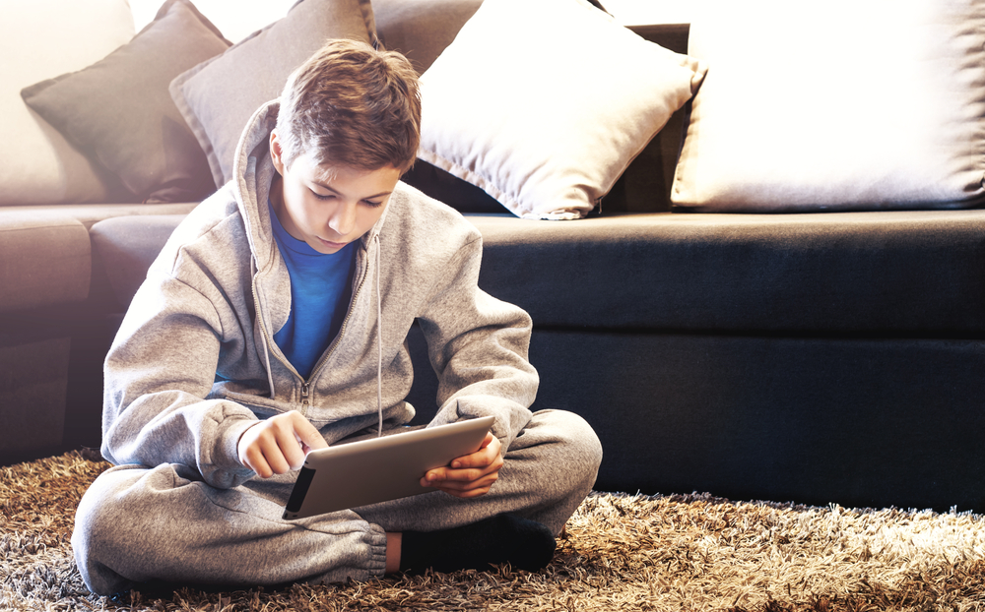
Someone might say they are your friend online, then they might ask you to do something you don’t want to do.
Even if someone says they are a friend it is never okay to make you worried.
Notes:
These should be photos rather than cartoons if possible.

Slide 11
If someone asks you to do something online that you don’t want to do tell an adult you trust.

Slide 12
If someone asks you to send a picture of yourself - maybe just your face, or maybe with your clothes off or in your underwear - then tell an adult you trust. It’s never okay to ask you to do this. Your body is private.

Slide 13
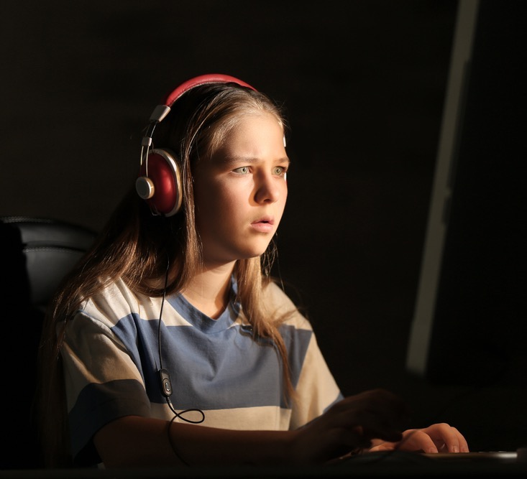
If you feel upset about anything you have seen or if someone says something which makes you feel bad or worried inside, tell an adult at home or at school.

Slide 14
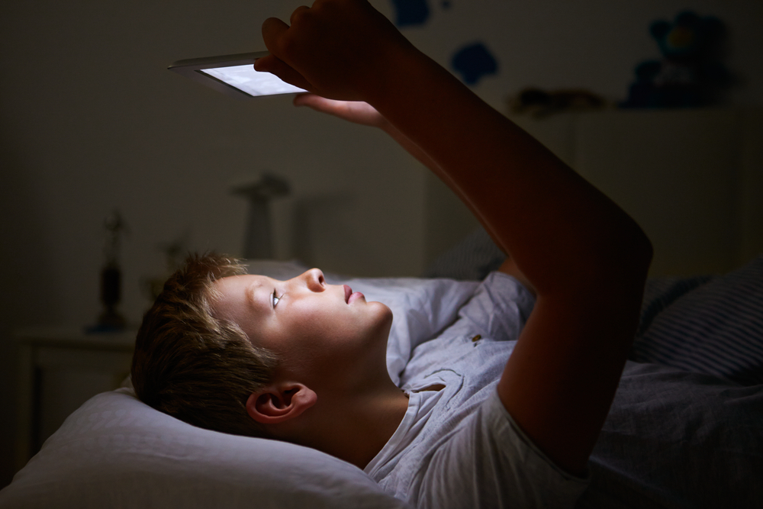
If you ever share a photo of yourself, and you wish you hadn’t done it, then tell someone. Tell them the whole story so that they can help.

Slide 15
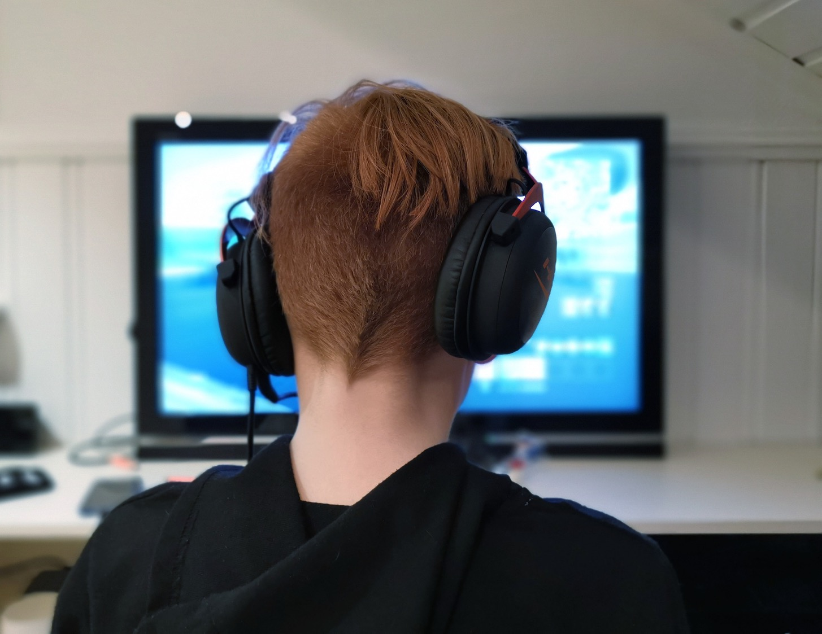
If someone asks to meet you that you have never met before, then say no and tell an adult you trust.

Slide 16
If a person upsets you or makes you worried online, this is NEVER your fault.

Slide 17
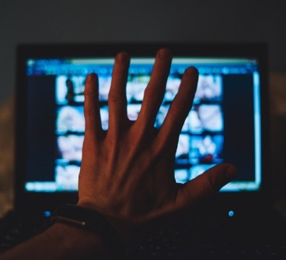
What if someone sends you a photo or image or video that you don’t want to see or is upsetting?
Don’t share the message with anyone else.
Show an adult you trust.
Remember, it’s not your fault and telling an adult will help.

Slide 18
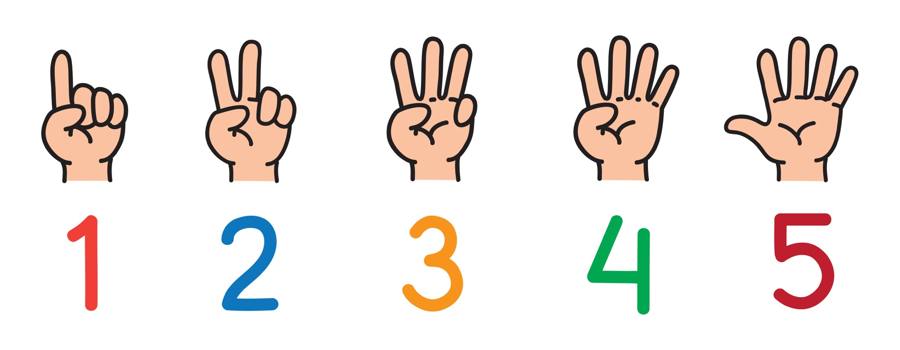
How do I look after myself online?

Slide 19
Film:
The Adventures of Cara, Winston and the Smart Crew
https://www.childnet.com/resources/the-adventures-of-kara-winston-and-the-smart-crew/trailer
Trailer Duration: 36 seconds

