Slide 1
Friends and Friendship: Kindness and empathy
I can talk about how to make and sustain friendships.
I understand the importance of kindness and empathy.
I understand that friends have disagreements and can think of positive ways to cope and respond.

Slide 2
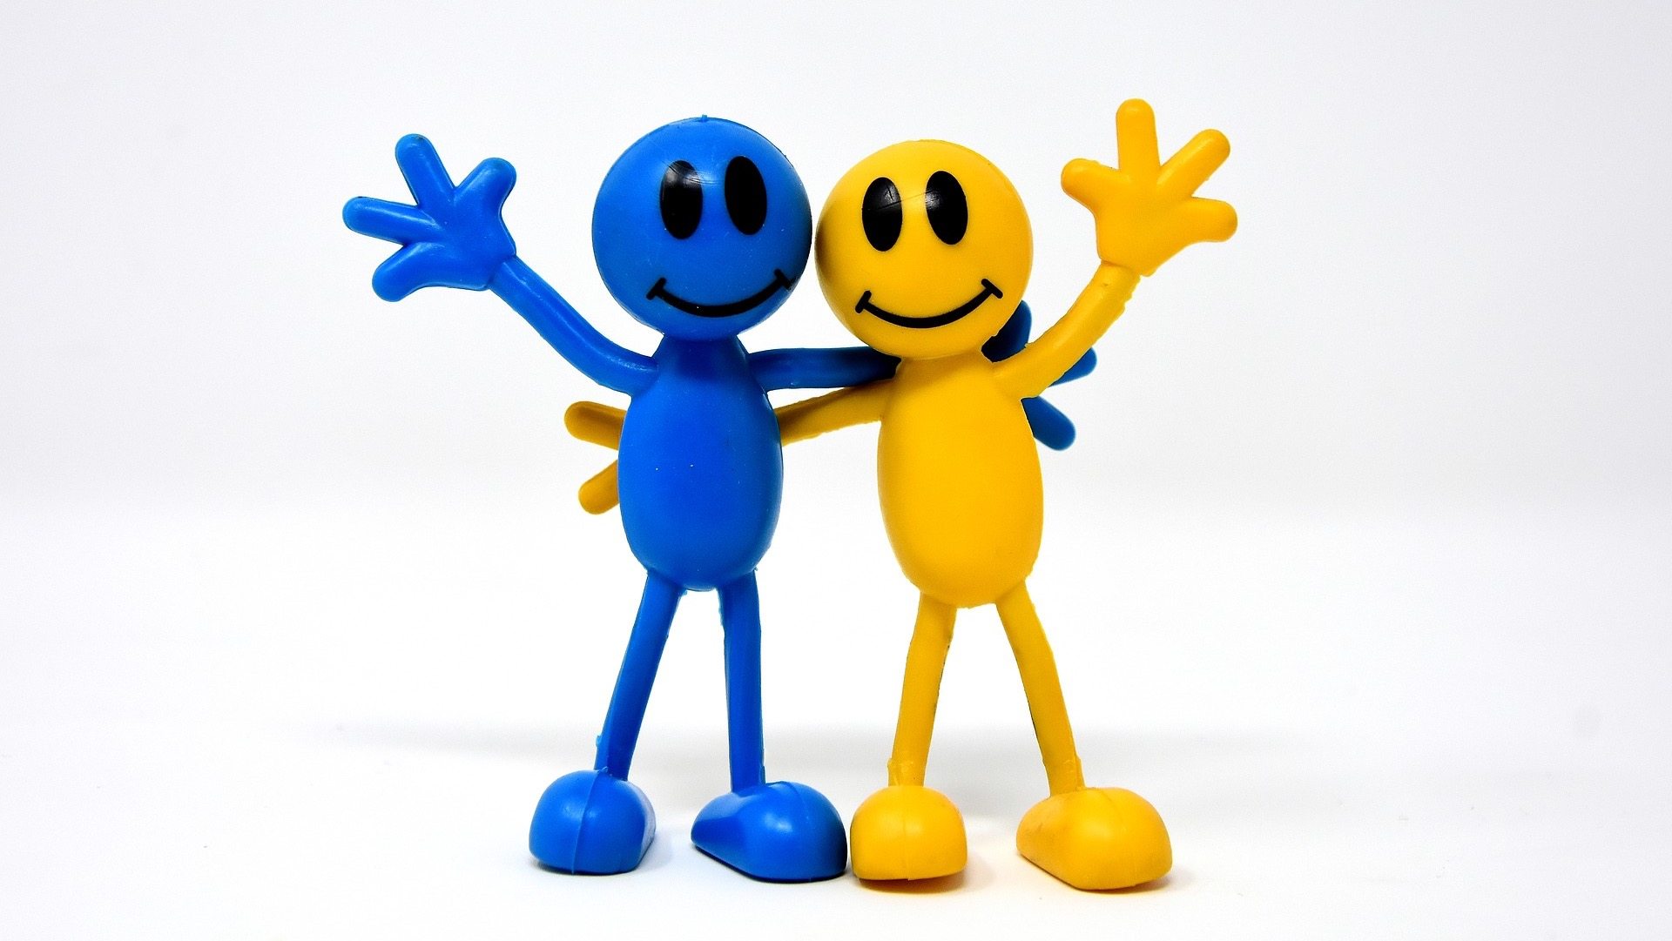
What do you like to do with your friend?

Slide 3
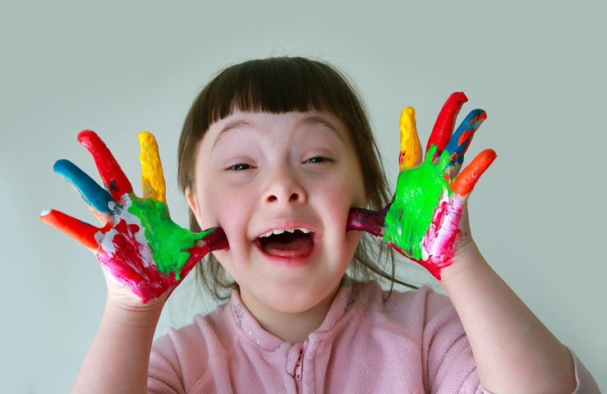
When I am HAPPY I….

Slide 4
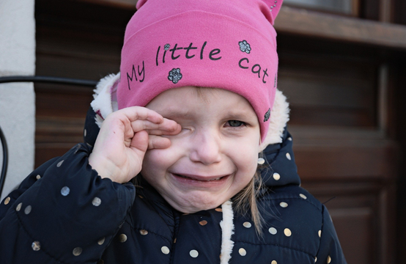
When I am SAD I….

Slide 5
When I am ANNOYED I….

Slide 6
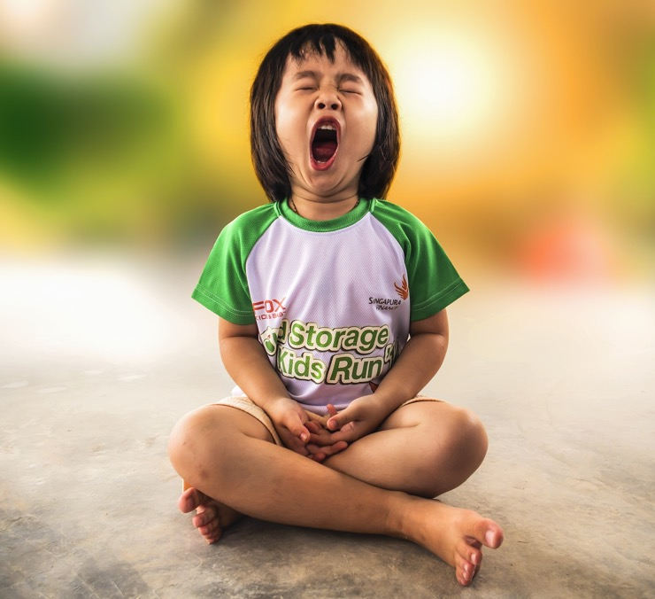
When I am TIRED I….

Slide 7
When I am BORED I….

Slide 8
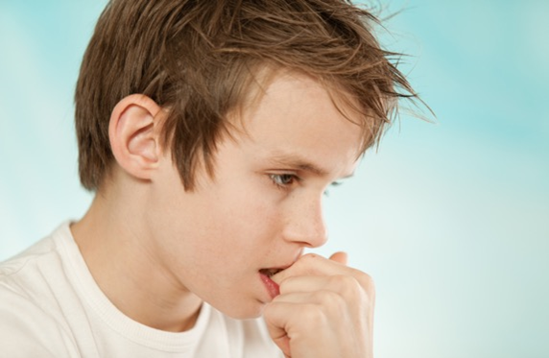
When I am NERVOUS I….

Slide 9
When my friend is HAPPY….

Slide 10
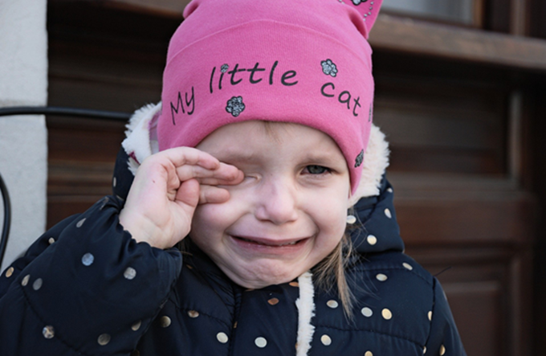
When my friend is SAD….

Slide 11
When my friend is ANNOYED….

Slide 12
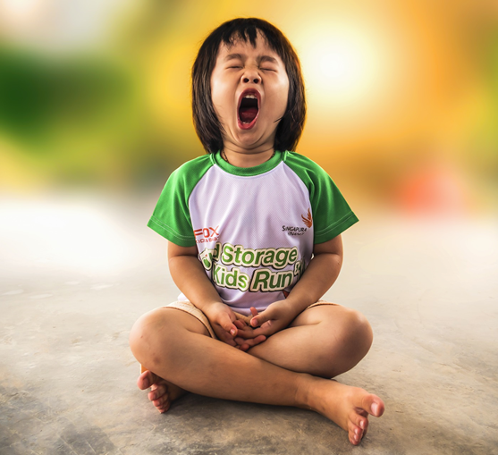
When my friend is TIRED….

Slide 13
When my friend is BORED….

Slide 14
When my friend is NERVOUS….

Slide 15
What is empathy?
Empathy means when you really understand what is happening to another person and how they feel.
There is an expression that helps us understand what we mean by empathy: empathy is ‘to put yourself in someone else’s shoes’.

Slide 16
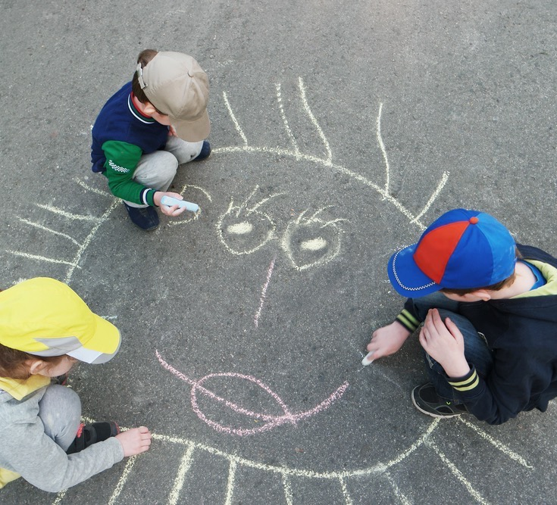
What does being kind mean to you?

Slide 17
What is kindness?
Kindness is when you are friendly and think about other people’s feelings. Kindness is about being good and considerate in what you say to others and what you do for them.

Slide 18
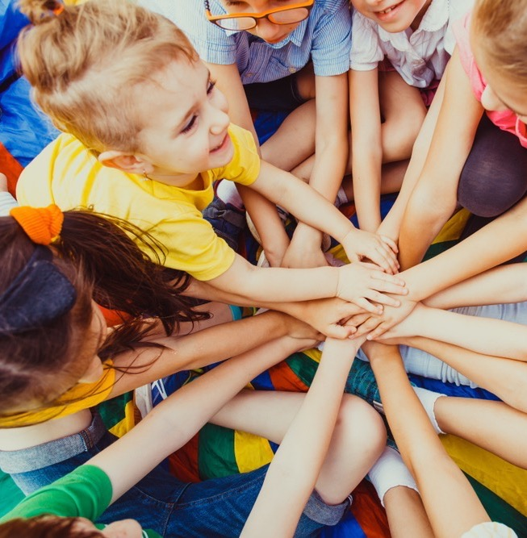
Talking about kindness
Who were you kind to?
What did you do that was kind?
How did it make the person feel?
How did being kind make you feel?

Slide 19
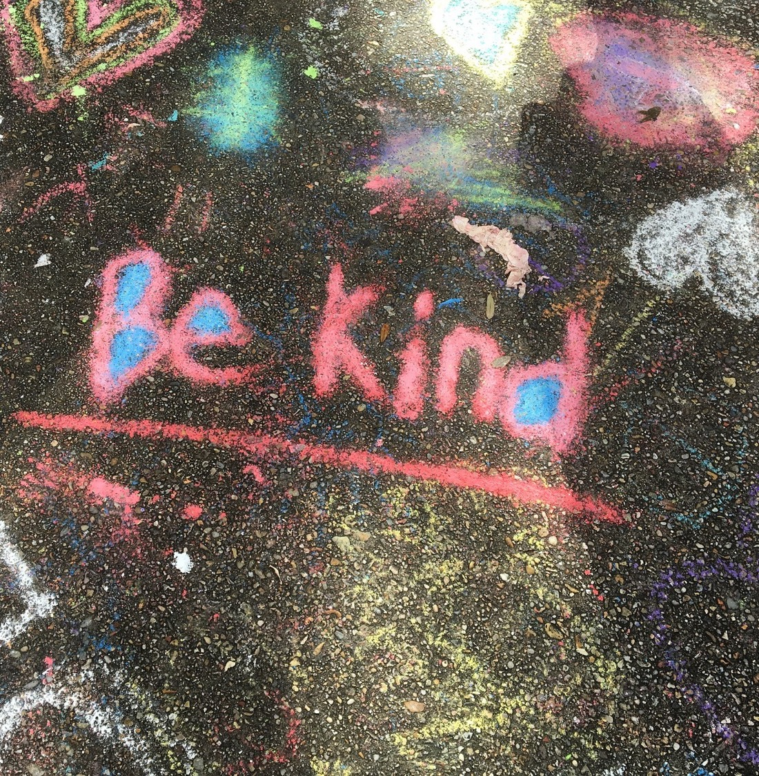
Activity
We are being kind.
Make a list of all the things you can to do to be kind to others

Slide 20
Kindness: additional images

Slide 22
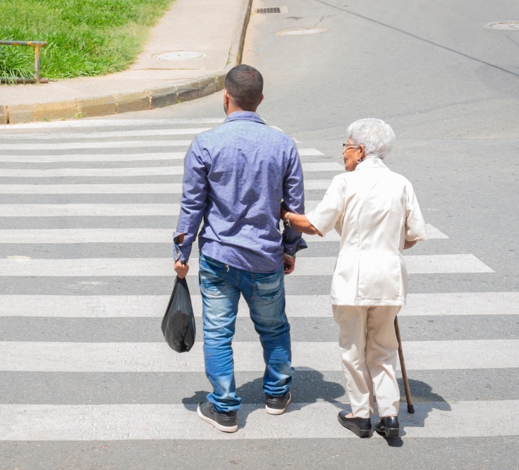

Slide 23
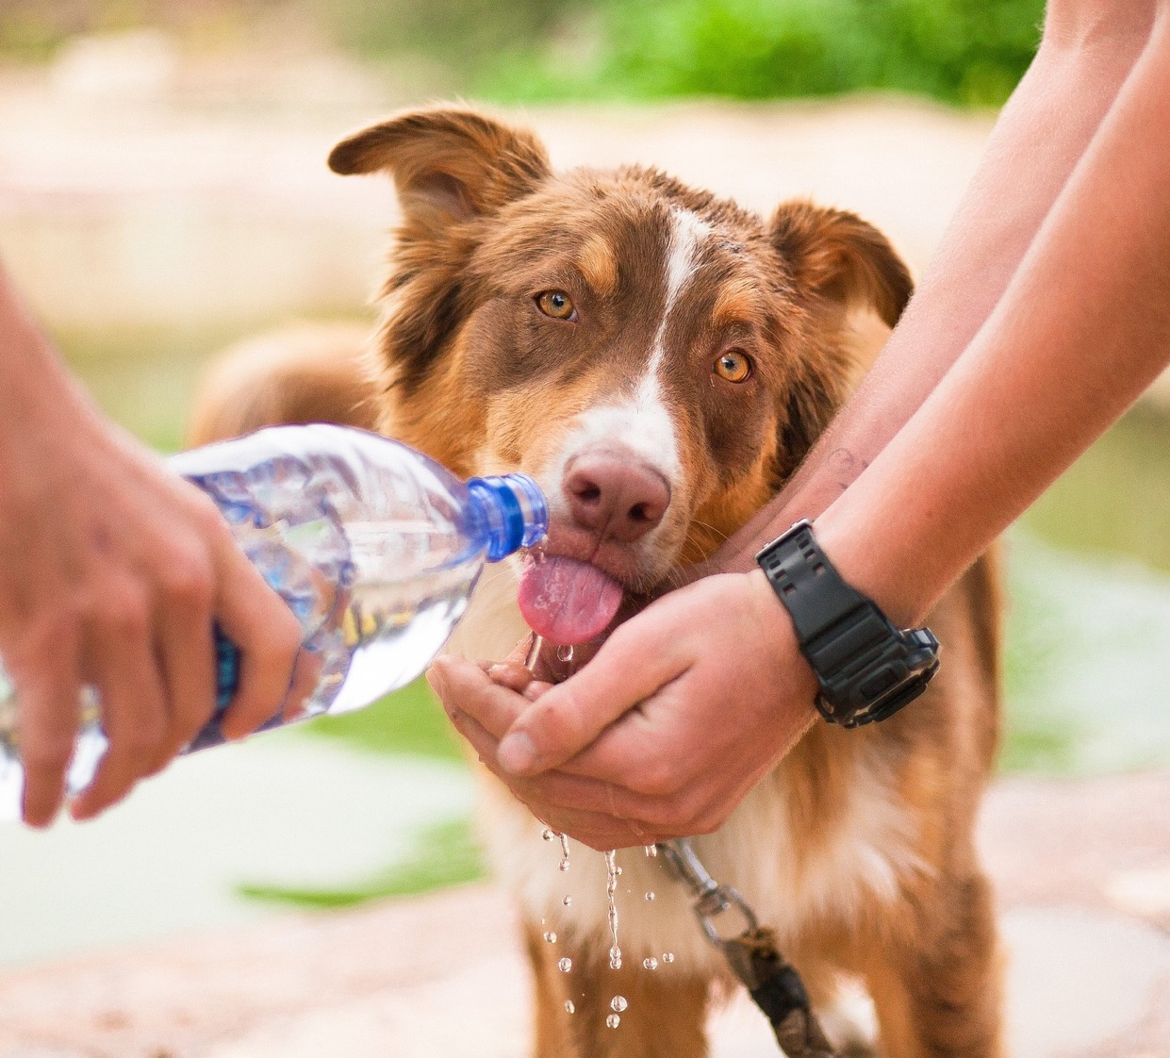

Slide 24
