Slide 1
Abuse and relationships: Grooming and sexual exploitation
I can identify the signs of unhealthy relationship.
I can talk about my right to be safe in intimate and sexual relationships.
I can name sources of information, help and support.

Slide 2
Grooming is when someone builds a relationship with a young person and tricks them or pressures them to do something sexual.
Grooming is a form of sexual exploitation.

Slide 3
Grooming can happen with someone you know like a friend of the family or someone at a club or activity you go to.
Grooming can also happen online.

Slide 4
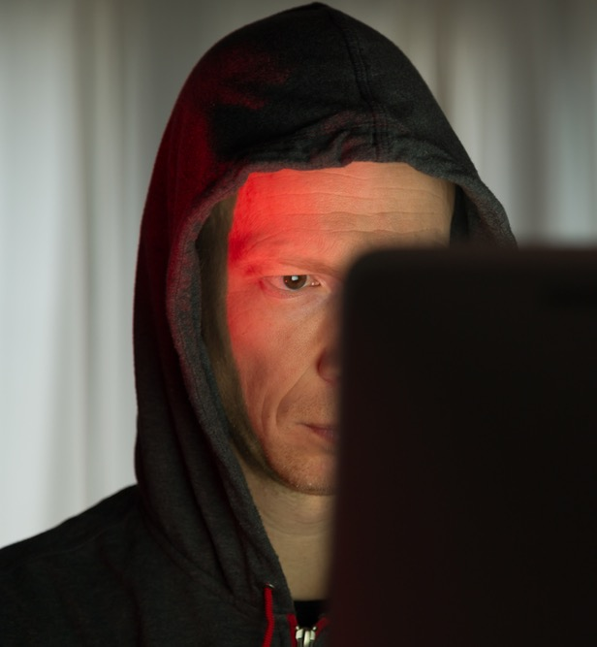
Grooming: How does it start?
What kinds of things would someone who grooms do at first, to try to build trust with a young person?

Slide 5
Grooming: How does it start?
Every situation is different but….
It might start with them being friendly, messages and chat
This person wants you to trust them.
They might pretend to be your friend or boyfriend or girlfriend.

Slide 6
They might ask you to keep it secret that you are in touch.
They might give you money or presents.
They check when you are on your own (so no-one else finds out about them)

Slide 7
They might ask you to send photos of yourself.
They send sexual messages, they might try to be funny or nice at first, then they will get more sexual.

Slide 8
Eventually, they might try to threaten you or frighten you and force you to do more things.

Slide 9
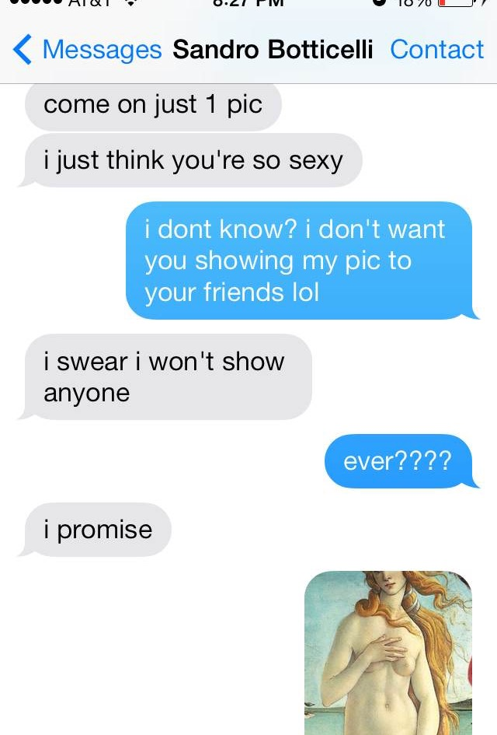
So, what is grooming behaviour?
A person who grooms is someone who makes an emotional connection with you, maybe they say they are your friend at first, then they ask you to do things like:
Talk about sexual things
Send nudes, or pictures of yourself in underwear
Send sexual videos of yourself
Do something live on webcam
Meet up with them in person.

Slide 10
Online grooming
https://youtu.be/47ficaYb2wk
(duration 5 minutes 26)

Slide 11
What stops young people from telling someone?

Slide 12
What stops young people from telling someone? There are at least 6 reasons….
Sometimes a young person doesn’t realise that what’s happening is actually grooming
The person who is grooming a young person can be so clever that they trick the young person into believing they are a friend, boyfriend or girlfriend.
The young person being groomed might worry about getting someone else into trouble.
Because a young person feels tricked, they might feel ashamed or embarrassed
The young person might feel bad about something they have done, even though they were tricked or forced to do it
The person who is grooming the young person will threaten to tell people or hurt them or share something.

Slide 13
Nobody should pressure you into doing something sexual. If someone is doing this, you're not alone.
You can speak to an adult you trust, maybe a teacher or someone in your family.
You can speak to a ChildLine counsellor.
Childline provides free confidential advice and support for all young people your age. Whatever your worry, if it’s about you or someone you love, Childline counsellors are there to help. Speak to them by phone, online or email 24 hours a day.
Information and chat online https://www.childline.org.uk/
Phone 0800 1111

Slide 14
What happens when you contact Childline?
https://youtu.be/rARrprkysqQ.
(3 minutes 8 seconds)

