Slide 1
Feelings and Safety: Feeling safe
I can communicate my feelings.
I can discuss friendships and relationships.
I know who can help me and keep me safe and who I can talk to if I am worried.
I am learning how to communicate effectively.

Slide 2
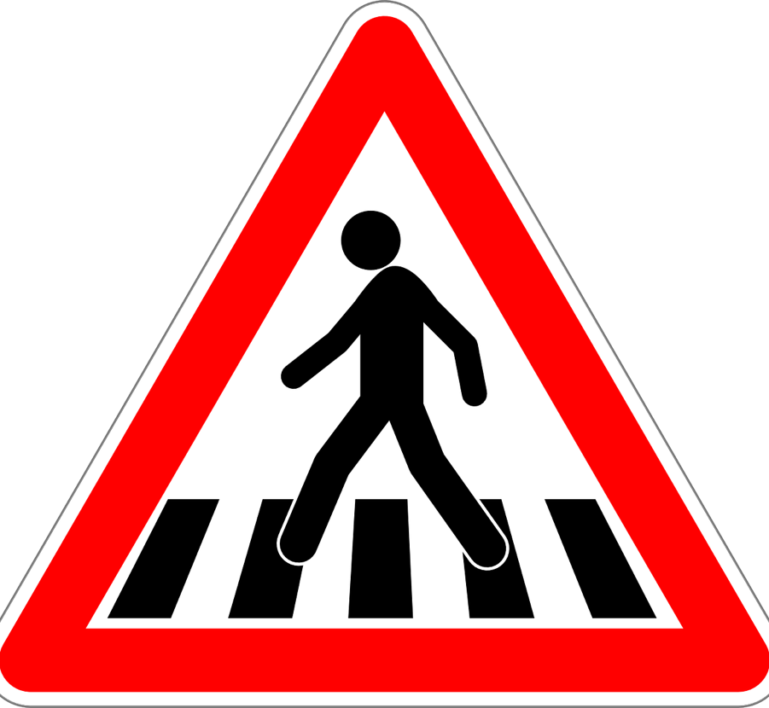
What are the things we do to keep ourselves safe?
When we are crossing the road?

Slide 3
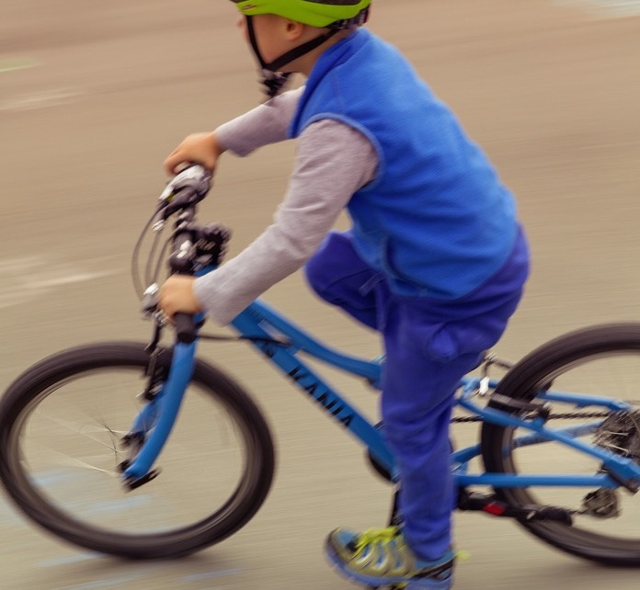
What are the things we do to keep ourselves safe?
When we are on our bike?

Slide 4
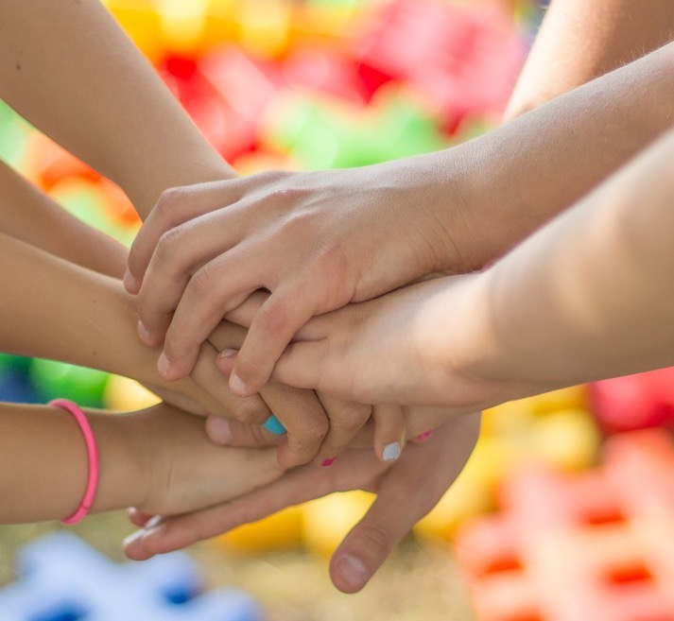
What are the things we do to keep ourselves safe?
When we are out playing with friends?

Slide 5
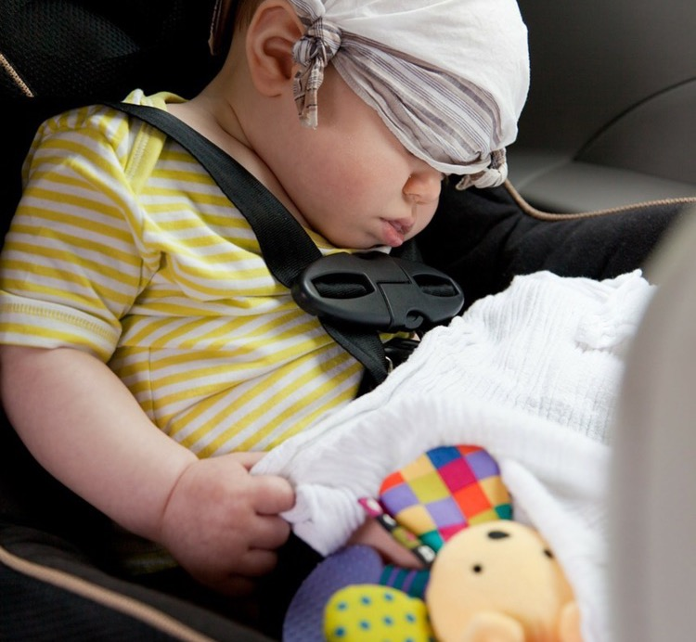
What are the things we do to keep ourselves safe?
When we are travelling in a car?

Slide 6
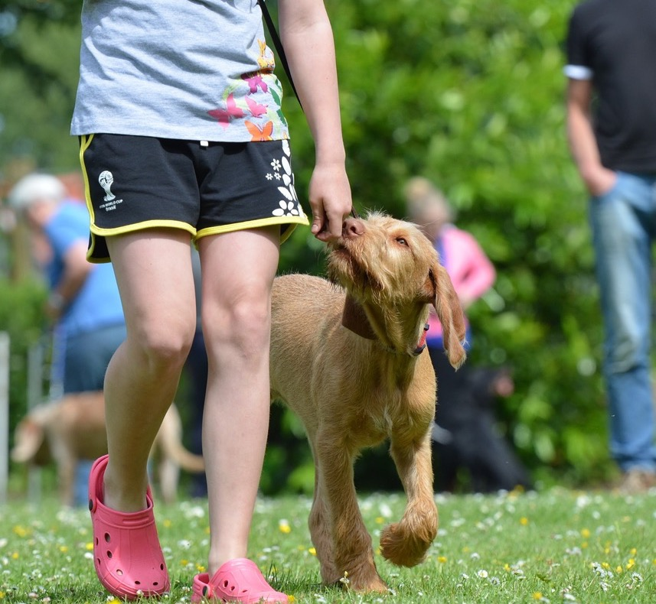
What are the things we do to keep ourselves safe?
When we meet a dog?

Slide 7
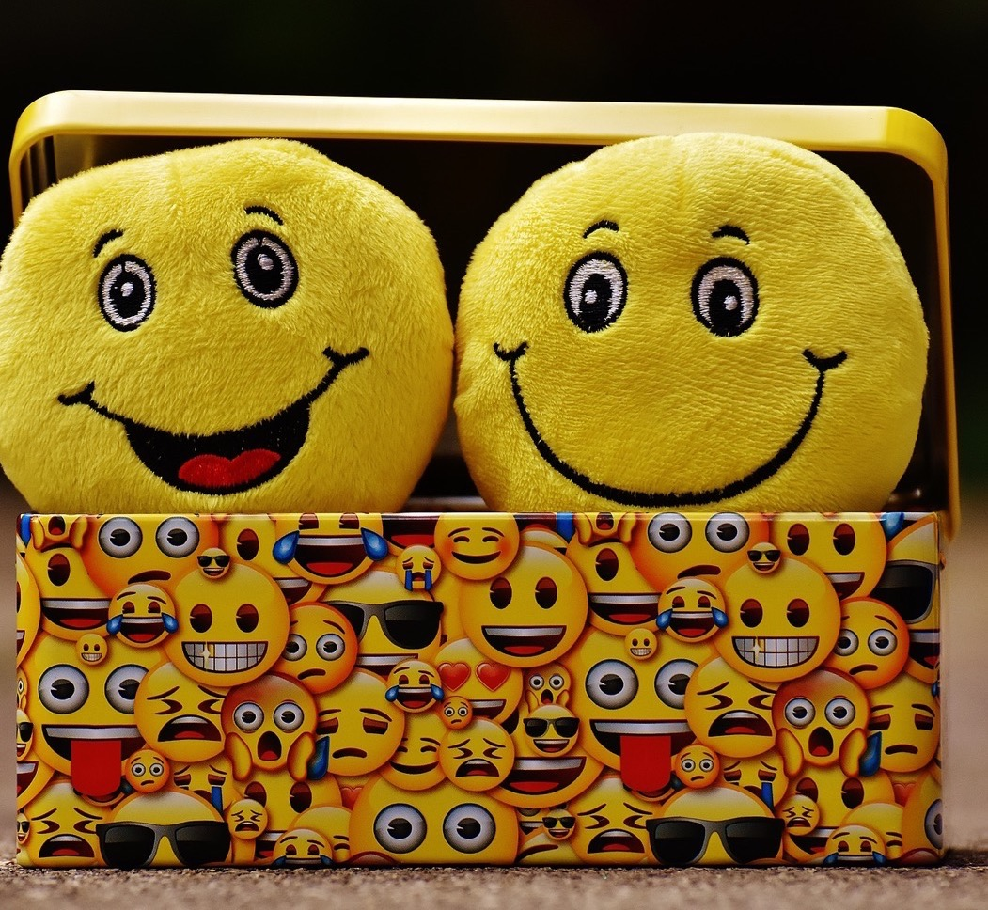
What makes children feel safe? https://youtu.be/KyTqFe55bwg
(1 minute 48 seconds)
I feel safe when…..

Slide 8
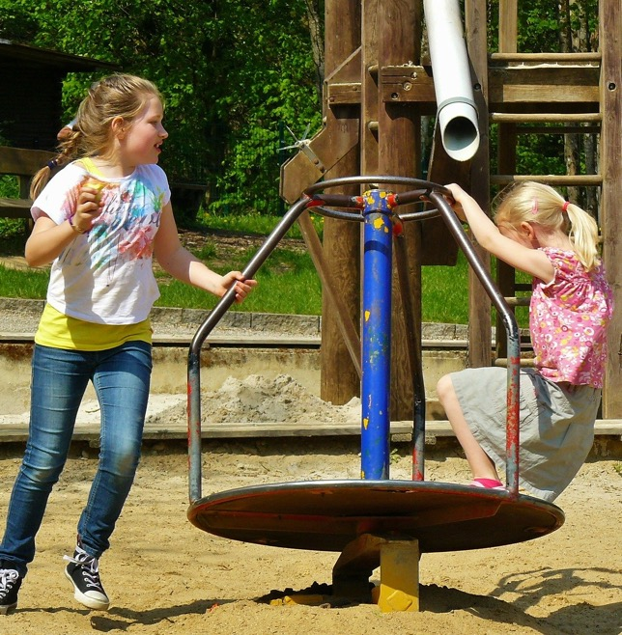
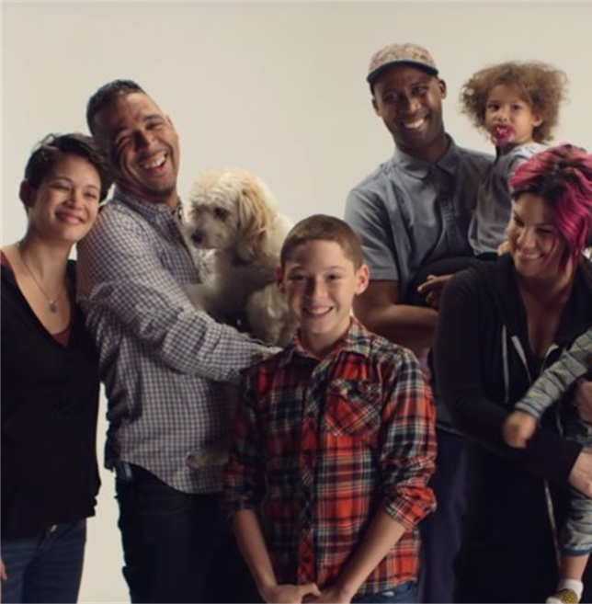
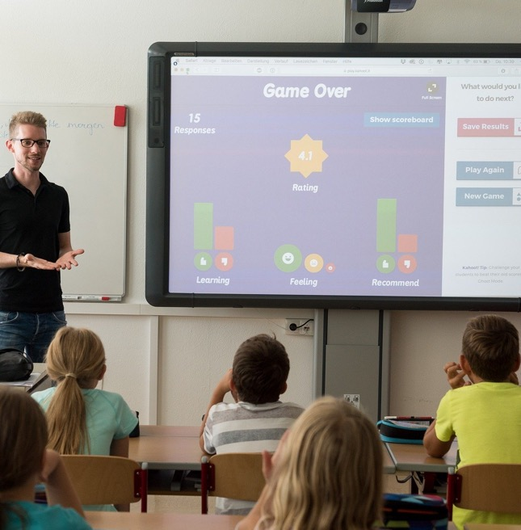
What makes children feel safe?:
At home?
At school?
Outside in the street or playground?

Slide 9
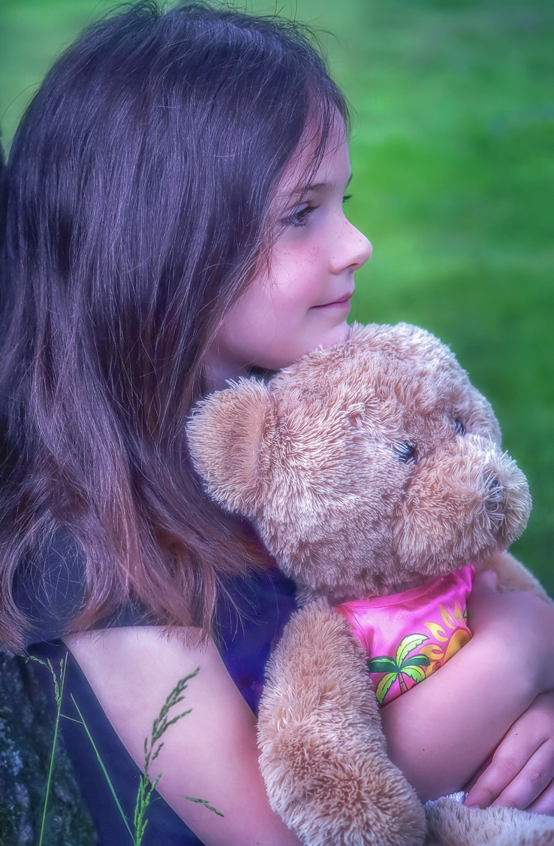
Feeling safe?
Where do you feel safe?
What makes you feel safe? Does anyone have a special toy? A blanket?

Slide 10
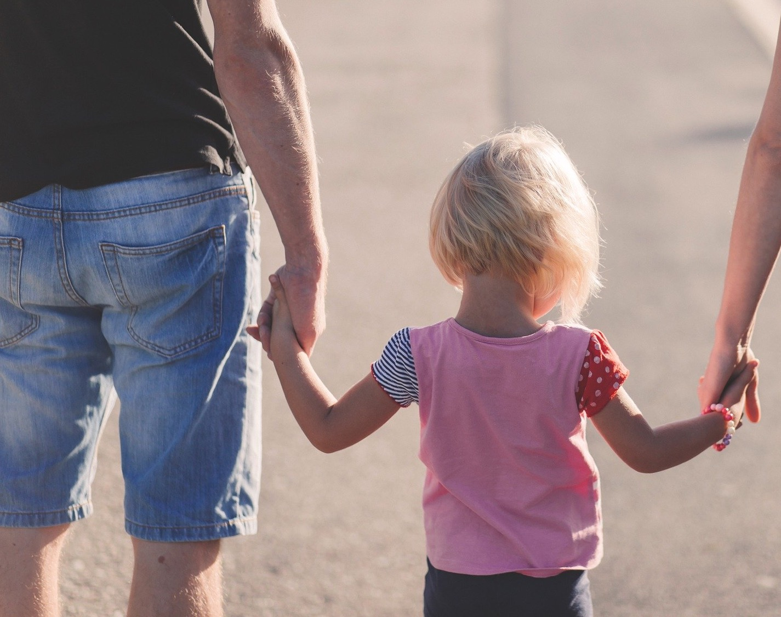
Feeling safe?
Who makes you feel safe?
How do they make you feel safe?
How do you feel when you feel safe?

Slide 11
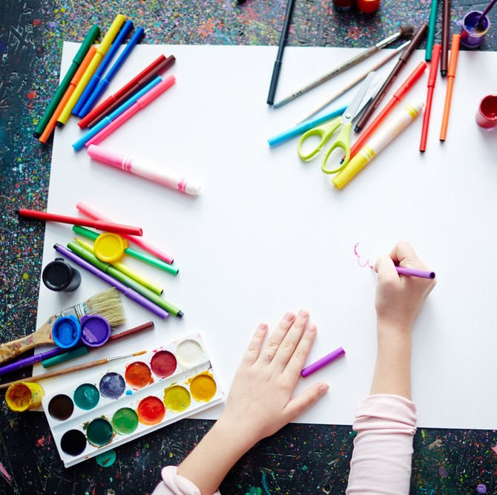
Activity: Me feeling safe
Draw a picture that shows when you are feeling safe.

Slide 12
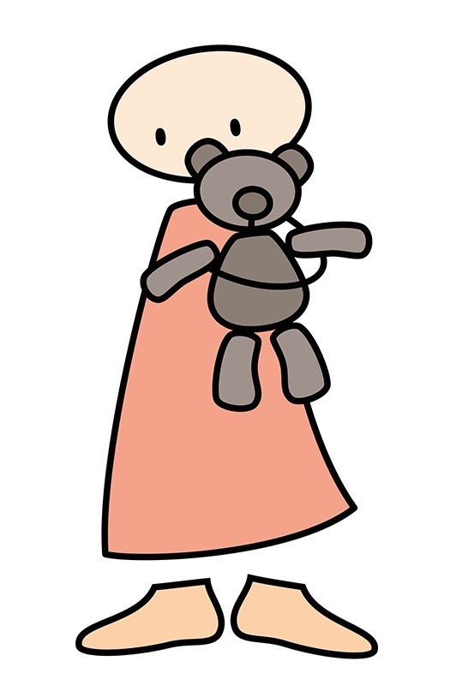
Important things to remember
Every child has the right to feel safe.
No one is allowed to hurt you or touch you in a way that makes you feel uncomfortable, worried or scared.
Even if you are not sure, if something doesn’t feel right you should tell an adult who can help you.

Slide 13
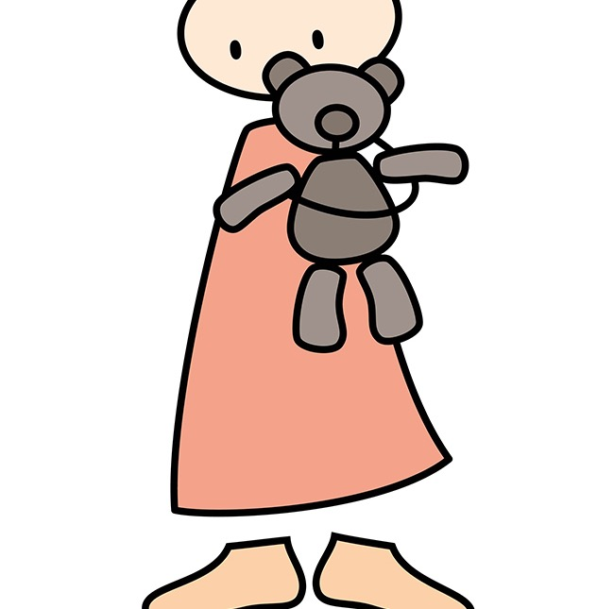
3 things to do if you don’t feel safe when you are out and about:
Say ‘no’
Get away
Find a trusted adult.

Slide 14
Film: The Feelings Song
https://youtu.be/UsISd1AMNYU
(duration 3 minutes 12 seconds)

