Slide 1
Similarity, diversity and respect: Boys and Girls
I can give examples of what makes me a unique individual.
I show respect for others.
I understand that how I look, how I behave, and my aspirations should not be limited by stereotypes, my sex or expectations of what boys and girls should do.
I understand that some children have a disability that can affect how they walk, see, hear, speak, learn, or do other things.
I understand that the terms heterosexual, gay, lesbian, and bisexual can be used to describe who a person is attracted to or falls in love with.

Slide 2
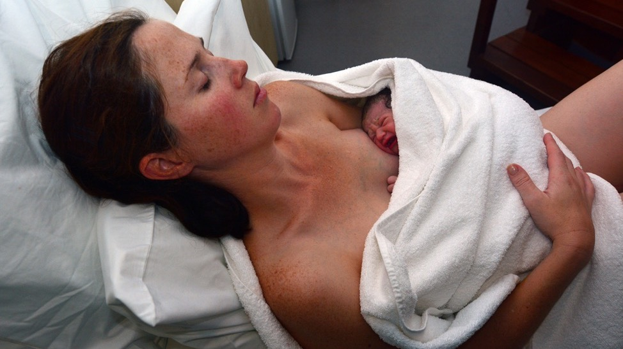
A mum can find out what sex her baby is before it is born, or find out at the birth when the midwife will say the baby is a girl or a boy.

Slide 3
Today we are talking about being boys and girls.

Slide 4
Who can bake a cake?

Slide 6
Who can play football?

Slide 8
Who can build with blocks?

Slide 10
Who can play Minecraft?

Slide 11
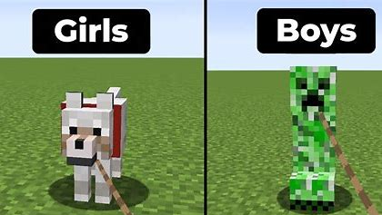

Slide 12
Who can play with technology?

Slide 14
Who can be happy – girls, boys or both?

Slide 15
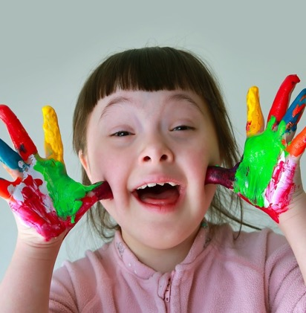
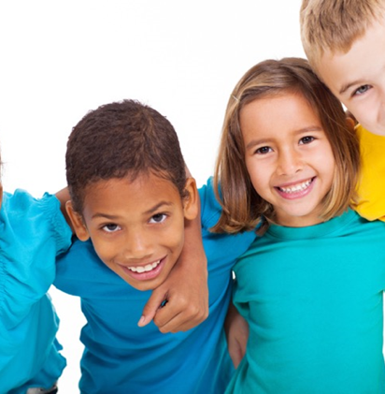
Happy

Slide 16
Who can be worried – girls, boys or both?

Slide 17
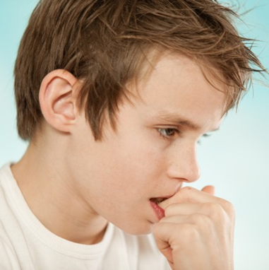
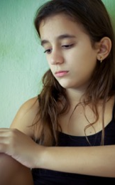
Worried

Slide 18
Who might cry – girls, boys or both?

Slide 19
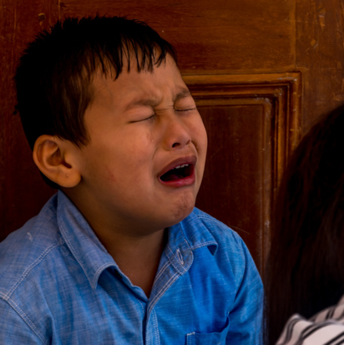
Crying

Slide 20
Who can be shy – girls, boys or both?

Slide 21
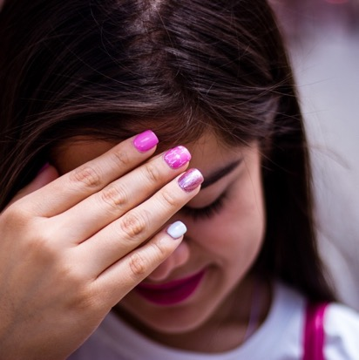
Shy

Slide 22
Who can be angry – girls, boys or both?

Slide 23
angry

Slide 24
Who can feel excited – girls, boys or both?

Slide 25
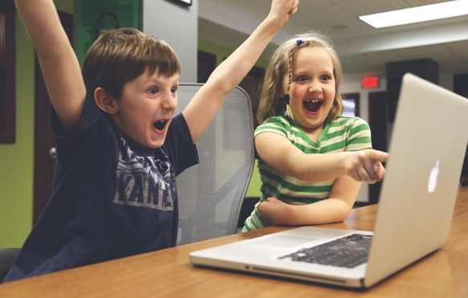
Excited

Slide 26
Who can be a teacher?

Slide 27
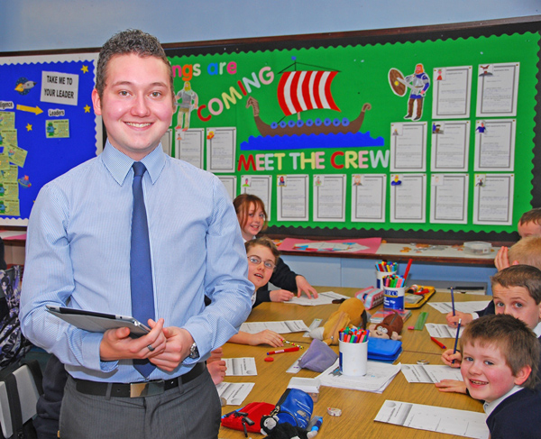

Slide 28
Who can be a bus driver?

Slide 29
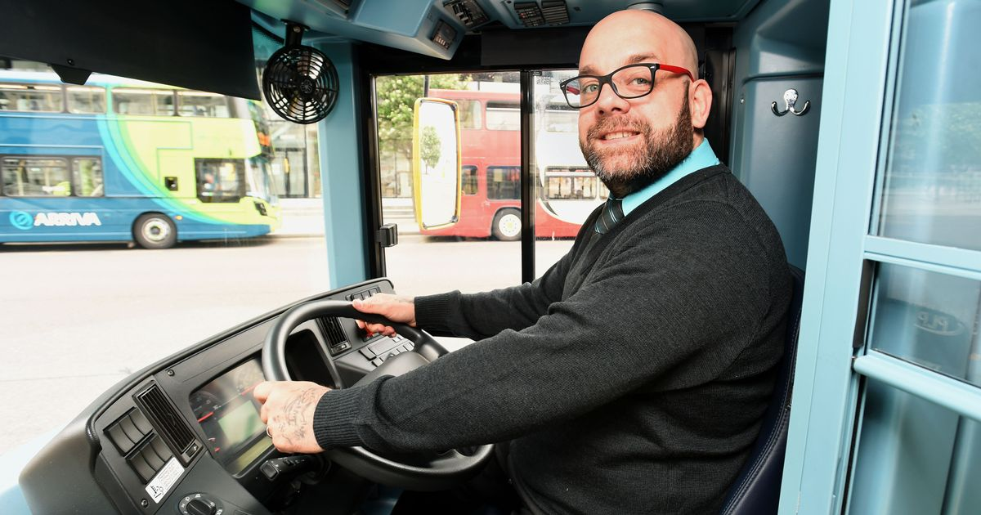

Slide 30
Who can be a Police Officer?

Slide 32
Who can be a dancer?

Slide 34
Who can be a nurse?

Slide 36
Who can be a builder?

Slide 38
Who can be a Firefighter?

Slide 40
Who can be an Engineer?

Slide 42
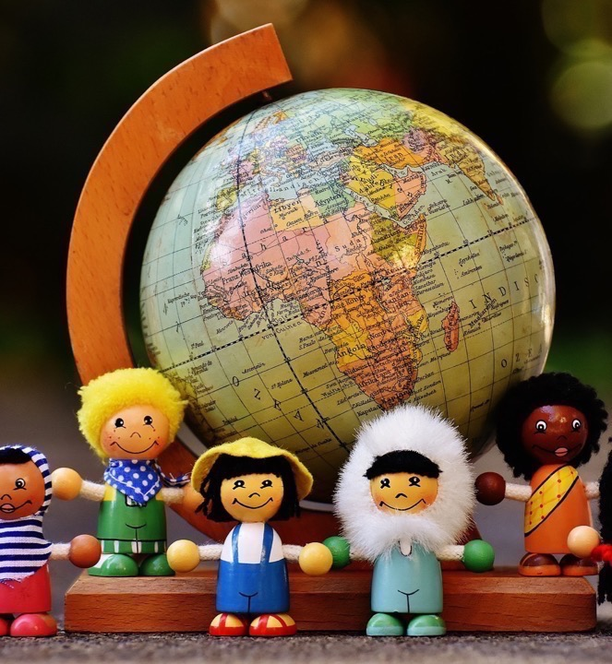
In this class, we are all individuals, different, unique and special.
Scoop and Friends https://youtu.be/St6t1WvbysU

