Slide 1
Love and Relationships: What is love?
I can talk about friendships and relationships.
I can talk about the importance of being cared for, caring for others, caring for myself and what love means.
I know I can have friendships with children of the opposite sex.
I can name an adult/adults I go to if I have a worry.

Slide 2
What is love?

Slide 3
Let’s think about all the things we love….

Slide 4
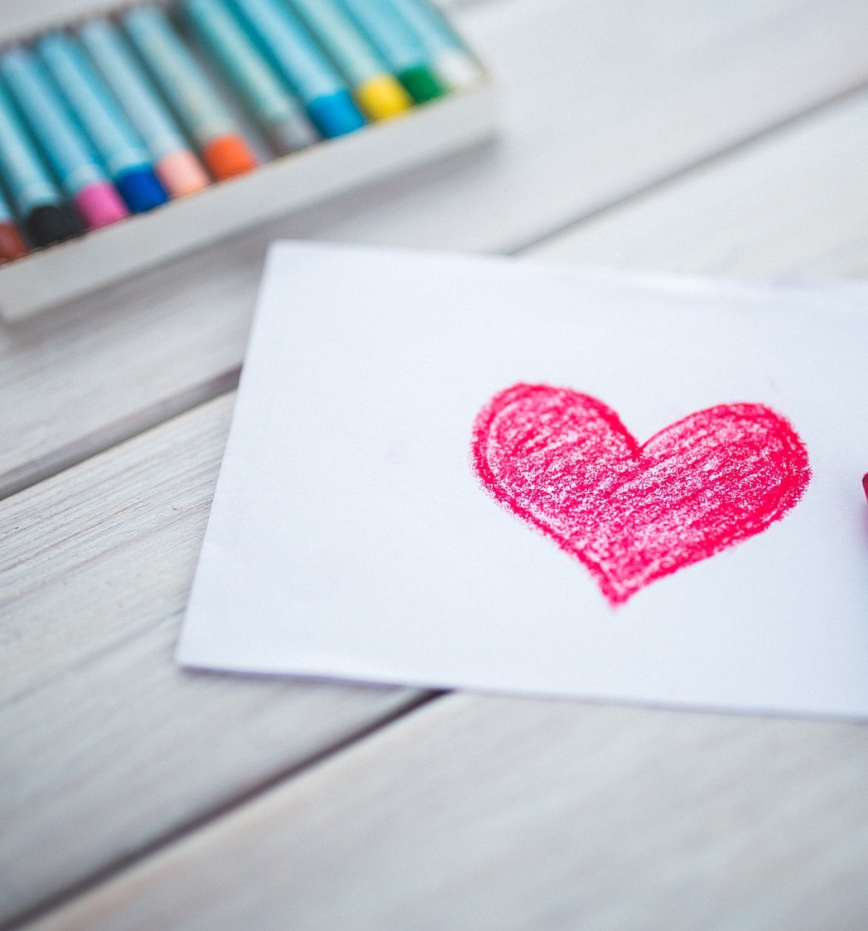
So, what is love?

Slide 5
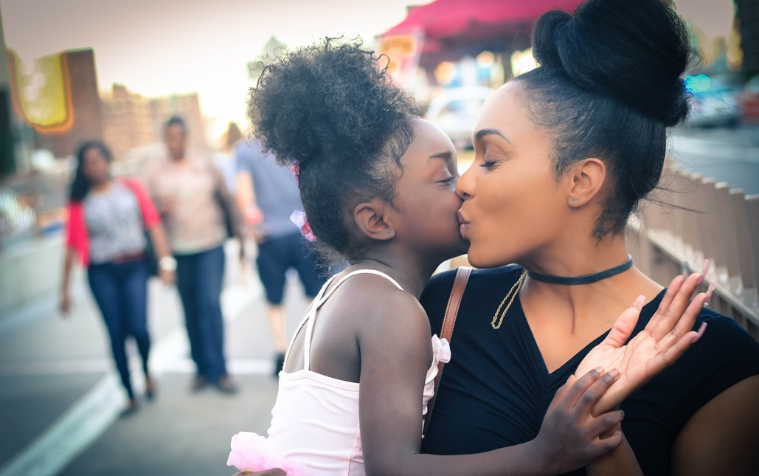
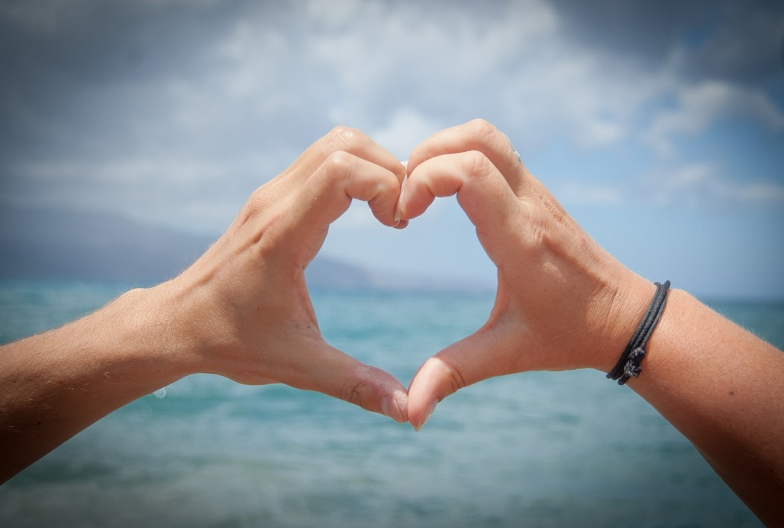
How does love make a person feel?

Slide 6
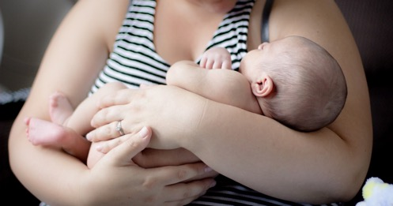
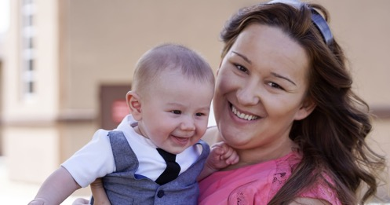
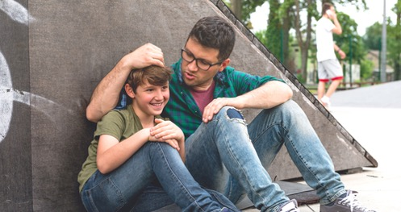
How does a parent/carer show they love their child?

Slide 7
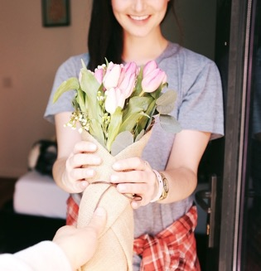
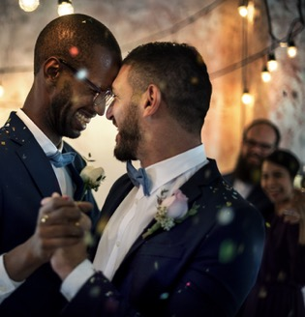
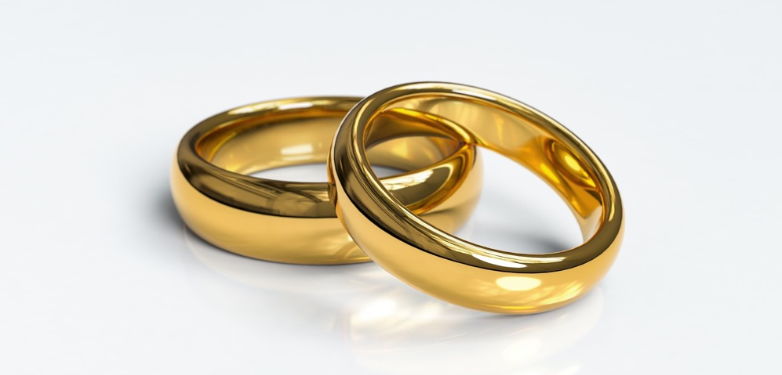
How does a grown up show they love their partner, husband or wife?

Slide 8
100 Kids describe Love
(3 minutes 28) https://youtu.be/T_ObrBLVqWg

Slide 9
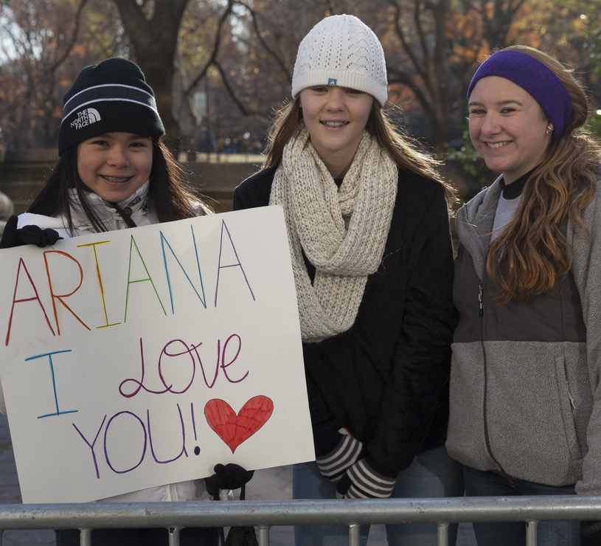
“Be happy with being you. Love your flaws. Own your quirks. And know that you are just as perfect as anyone else, exactly as you are”.
Ariana Grande

Slide 10
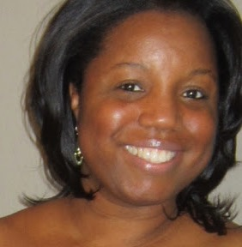
“Above everything else, genuinely love yourself first. Self-love is powerful and it’s the best love that you will ever have.
When you love who YOU are, your relationships will be healthier, and your life will be happier.
Self-love sets the standard in how we allow others to treat us and how we treat ourselves. Your happiness and well-being is important. Protect it by always valuing who you are!”
Stephanie Lahart (Author)

Slide 11
Things we love about ourselves – and each other!

