Slide 1
Friends and Friendships:
What is a friend?
I can talk about what I want from friendships and what kind of friend I can be.
I can explain the benefits of friendships and as well as the challenges that come up in maintaining relationships.
I give examples of things I can do to make and maintain friendships.
I understand that I do not need to be best friends with everyone, but I can be friendly and kind.

Slide 2
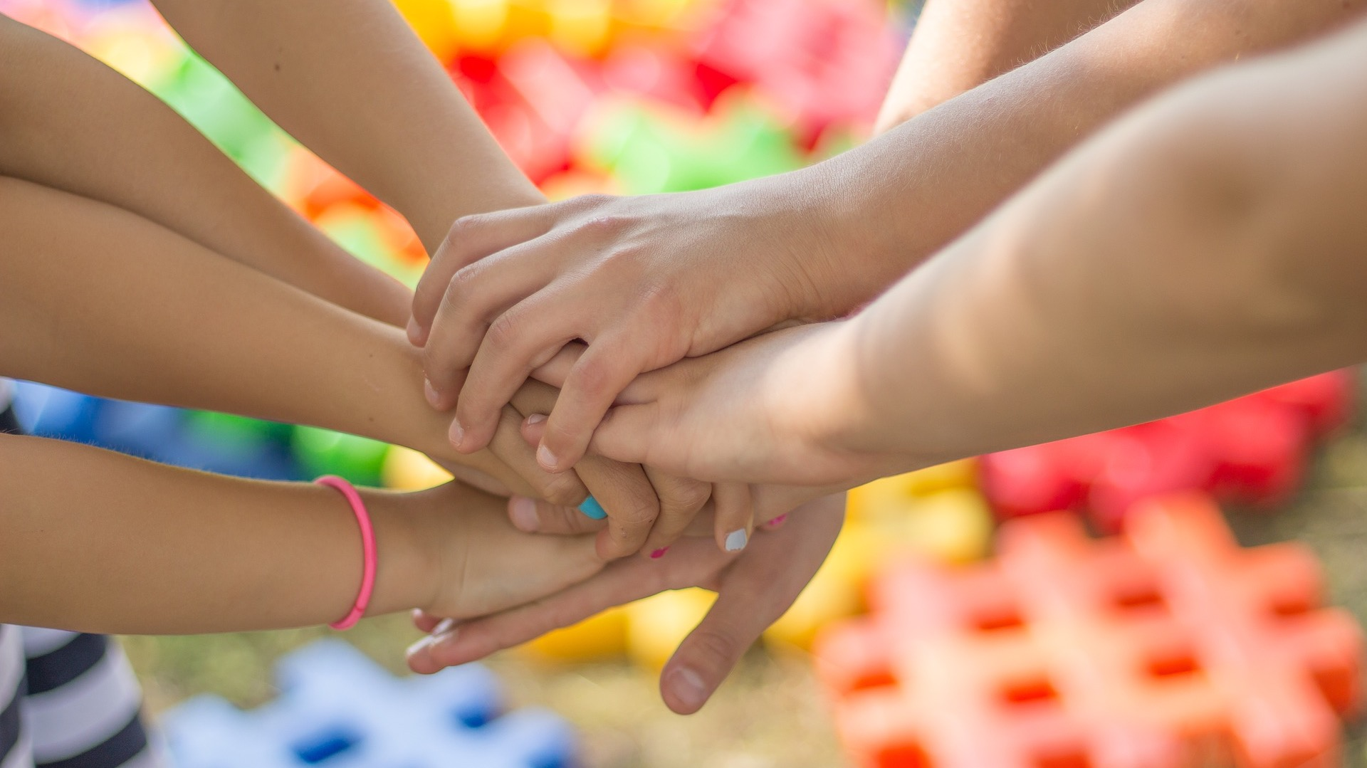
What is a friend?

Slide 3

What is a friend?
A friend is a person who knows you well and that you like a lot.
A friend is someone you can trust and will treat you well.

Slide 4

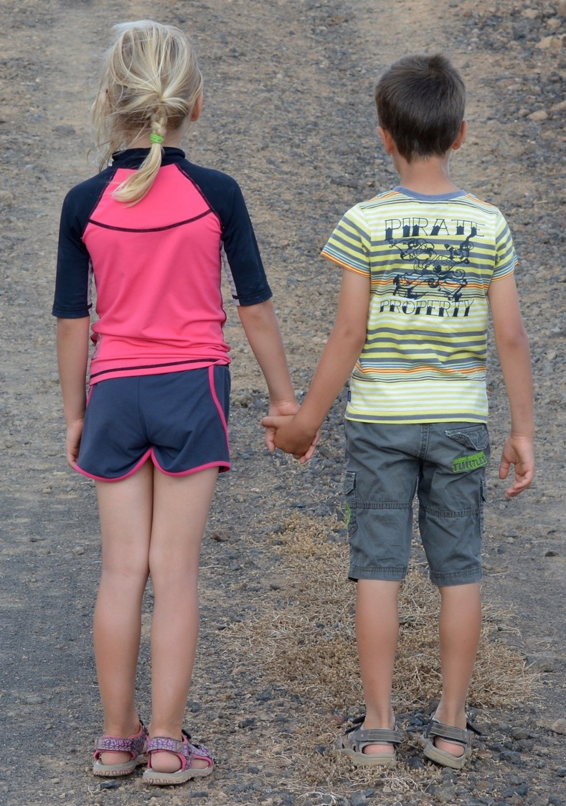
You can be friendly with many people, but a friend is a special person to you.

Slide 5
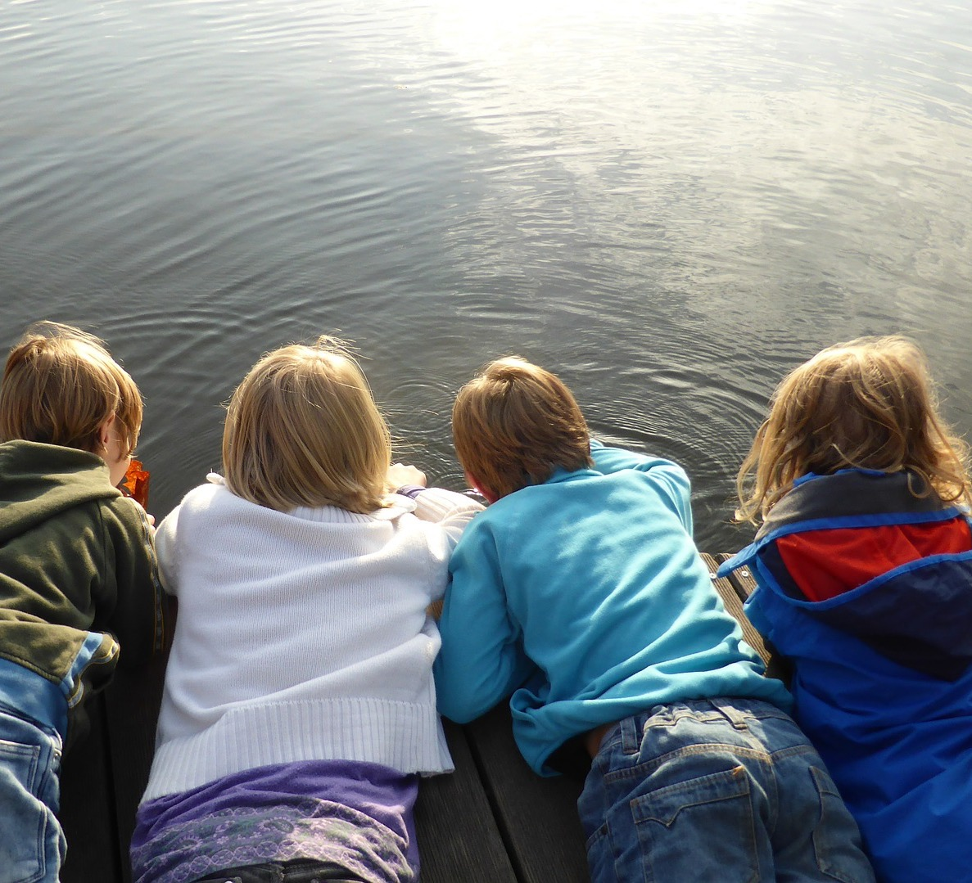
How do you know someone is your friend?

Slide 6
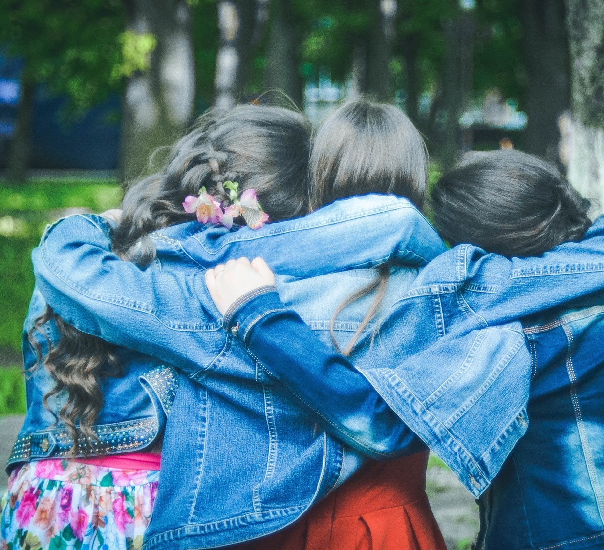
What kinds of things do friends do together?

Slide 7
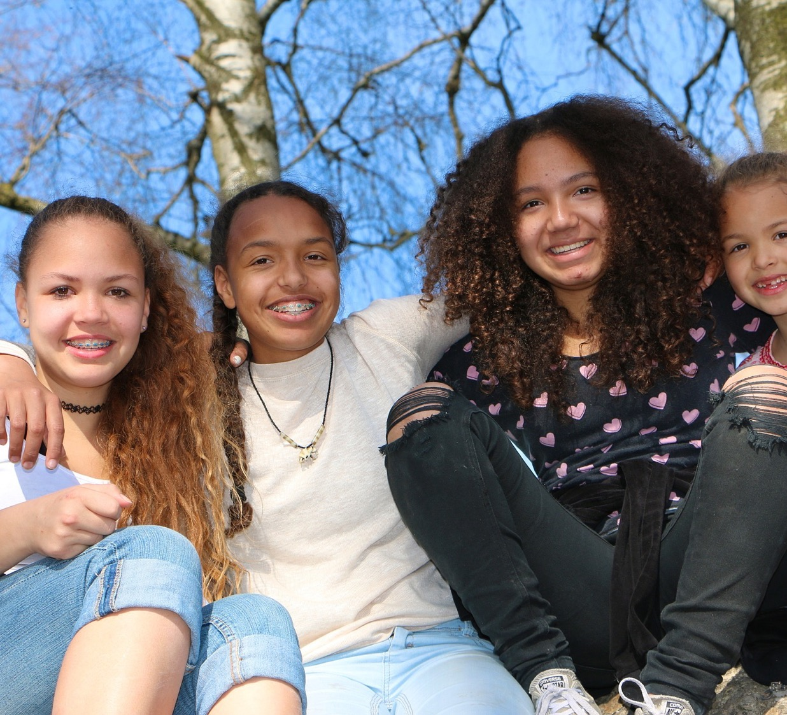
What do you like about your friends?

Slide 8
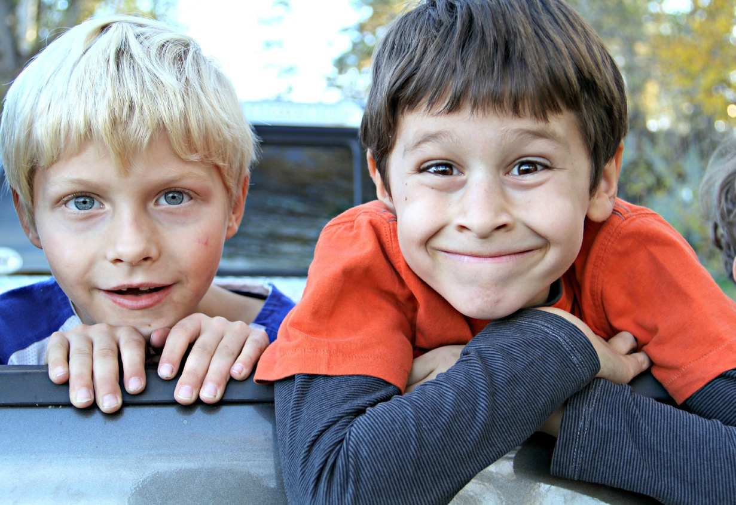
What do your friends like about you?

Slide 9
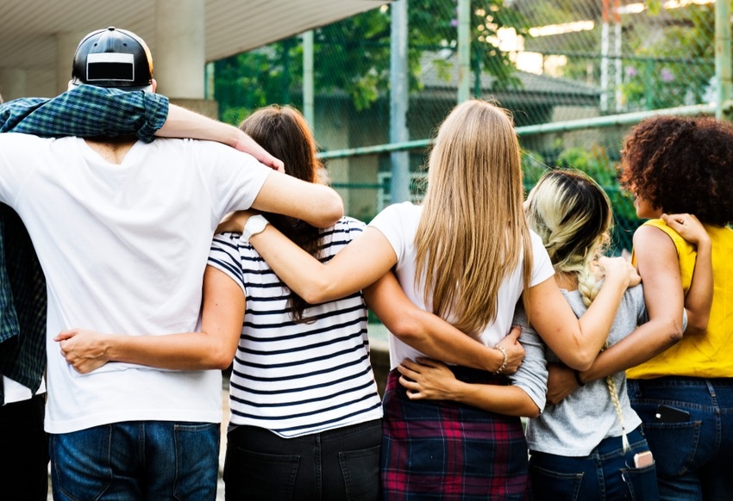
What makes a good friend?

Slide 10
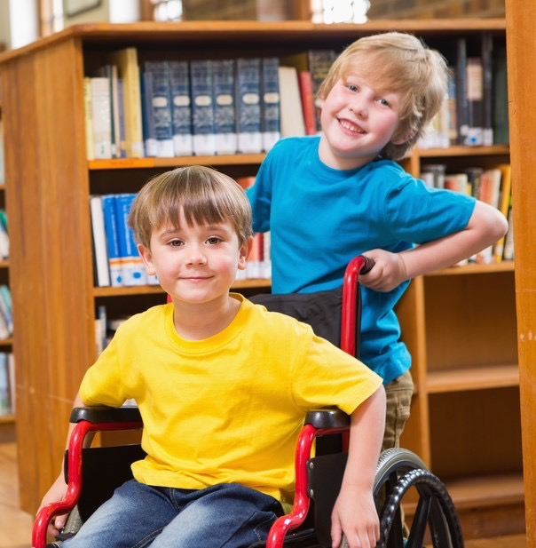
Where can we meet and make new friends?
At school?
In our community?

Slide 11
Friendship Faces: What kind of friend am I?

Slide 12
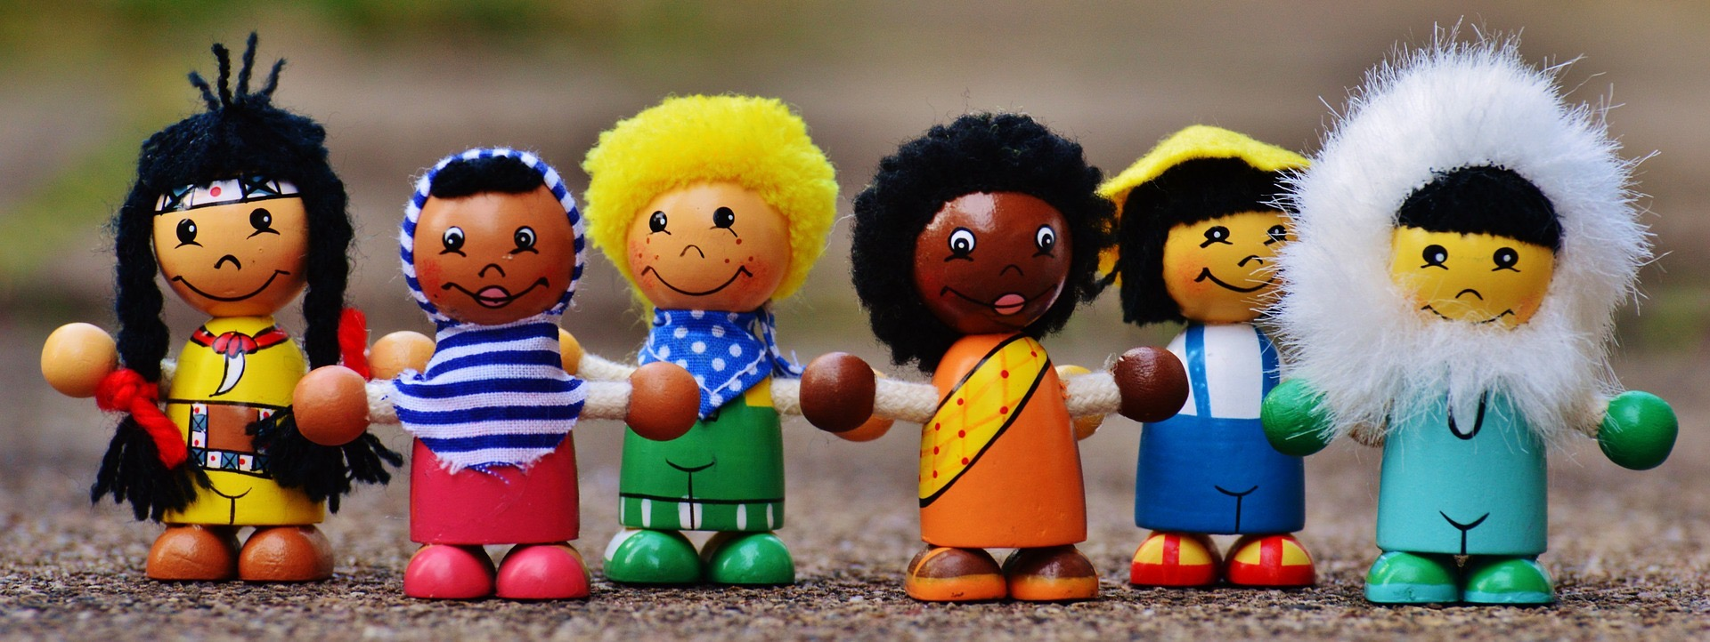
Poems about friends and friendship

Slide 13
The Pleasures of Friendship
by Stevie Smith
The pleasures of friendship are exquisite,
How pleasant to go to a friend on a visit!
I go to my friend, we walk on the grass,
And the hours and moments like minutes pass.

Slide 14
The Best of Friends
by S. Jill Wolf
The best of friends,
Can change a frown,
Into a smile,
When you feel down.
The best of friends,
Will understand,
Your little trials,
And lend a hand.
The best of friends,
Will always share,
Your secret dreams,
Because they care.
The best of friends,
Worth more than gold,
Give all the love,
A heart can hold.

Slide 15
True Friendship
by William S. Tsoukalas Snr.
The feeling of friendship from the start
Is that special feeling in your heart
A feeling from deep down inside
A feeling that no one should hide
A friend is there through good and bad
They make you happy when you're sad
They brighten up your darkest day
Just by the simple thing's they say
Now friendship can't be bought or sold
It may get tarnished, and may get old
You can over come your greatest fear
Just look around and it is there
Now friendship's one and only cost
Is to make sure that it's never lost

Slide 16
Friendship
by Christina Christina
friendship is love but not in love
friendship is a secret never to be told
friendship is a shoulder to cry on
friendship is not having to say sorry, but do
friendship is not judging no matter what
friendship is someone to run to when things are tough
friendship is a hand to hold when things are so rough
friendship is someone to laugh with not at you
friendship is just knowing they are there
my friend is all of these hope you have one just like her...

