Slide 1
Consent: What is consent?
I can describe what consent means to me.
I know that I, and others, can use words, body language and facial expression to communicate what they like and don’t like.
I explain the idea of personal space.
I can explain that my body is my body.
I can name an adult/adults I go to if I have a worry.

Slide 2
Consent

Slide 3
Consent
Consent means asking someone’s permission to do something.

Slide 4
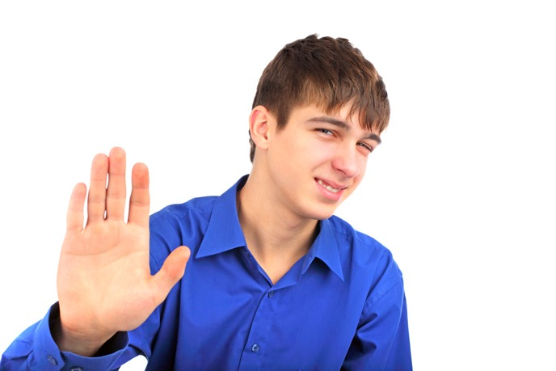
Consent
If the person says yes, they have given their consent.
If the person says no, they have not given consent.
If a person is not sure, or does not say ‘yes’, then this is not consent.

Slide 5
Game: Would you like a cup of tea?

Slide 6
Consent
Apart from what someone says, how else can you tell if they want something or not?
What does someone say with their face or their body if they mean no (even if they don’t say it?)

Slide 7
Consent
When do you ask someone for consent to do something?

Slide 8
Consent scenario A:
Maria has forgotten to bring her colour pencils to school.
She asks her friend Martha if she can borrow her blue pencil.
Martha says “Yes, of course you can”.
Can Maria borrow the pencil?
Has Martha given her consent?

Slide 9
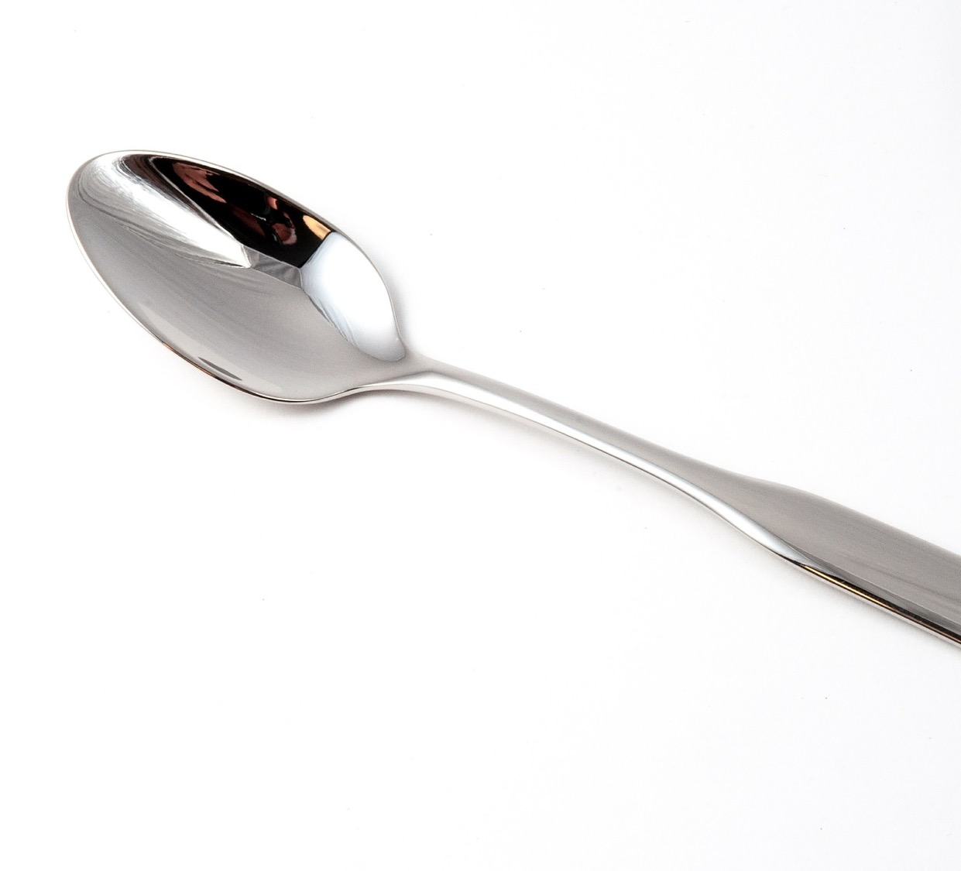
Consent scenario B:
Aadya is in the dining hall having lunch.
She forgot to pick up a spoon and can see that Dimitri has one.
Aadya says “Can I have that spoon?”
Dimitri says “No, I need it”.
Can Aadya take the spoon?
Did Dimitri give his consent?

Slide 10
Consent scenario C:
Michael has a packet of crisps.
His friend Leah says “Can I have one?”
Michael doesn’t look happy, he says “Well….”
Can Leah take a crisp?
Has Michael given his consent?

Slide 11
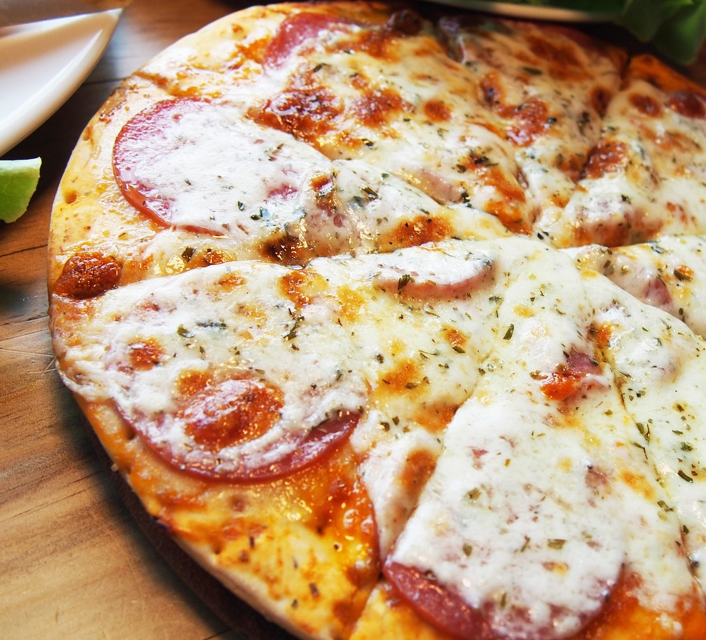
Consent scenario D
Sophie’s big brother Max comes home with a pizza.
He says, “Would you like a piece?”
Sophie takes a piece of pizza.
Did Sophie have her brother’s consent?

Slide 12
Consent scenario E:
The next day, Max comes home with another pizza.
He doesn’t say anything and leaves it on the kitchen table and goes to his room for something.
Sophie takes a bit of pizza.
Did she have her brother’s consent?

Slide 13
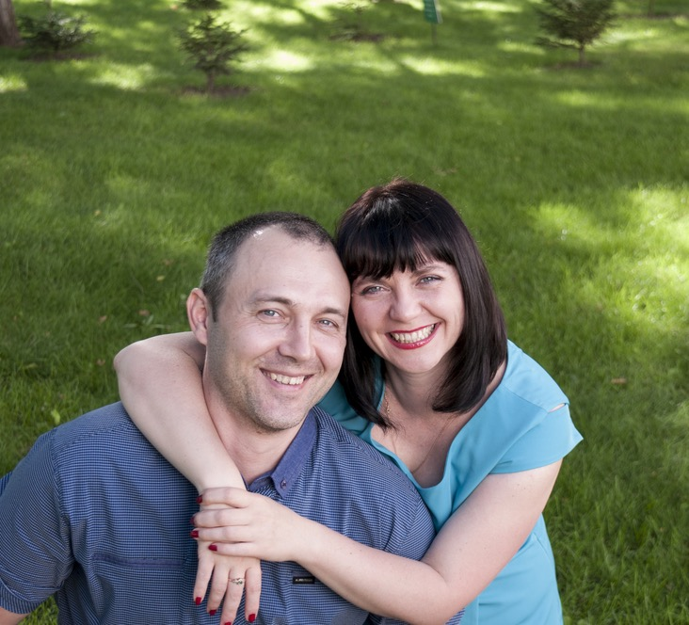
Consent scenario F
Robbie’s auntie and uncle are visiting.
They are leaving soon and his Mum says “Robbie, go give Auntie Rose and Uncle Derek a kiss goodbye”.
Robbie really doesn’t want to kiss them goodbye.
What can Robbie say or do?

Slide 14
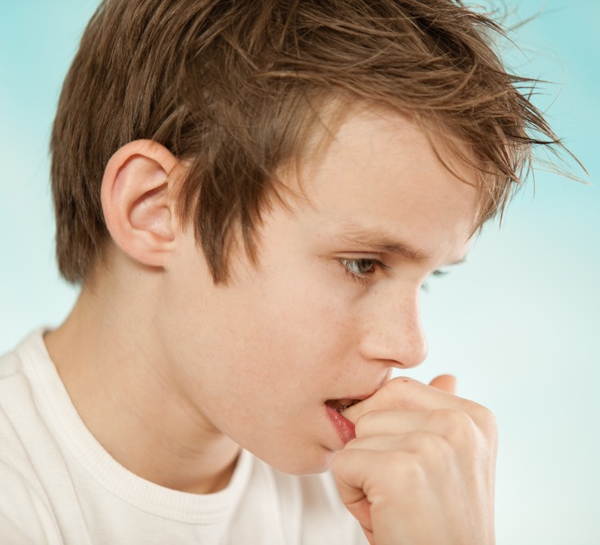
Consent scenario G
Peter has a new friend at school.
His friend has asked him to come for a sleepover, but Peter doesn’t want to.
His friend keeps asking.
What can Peter say or do?

Slide 15
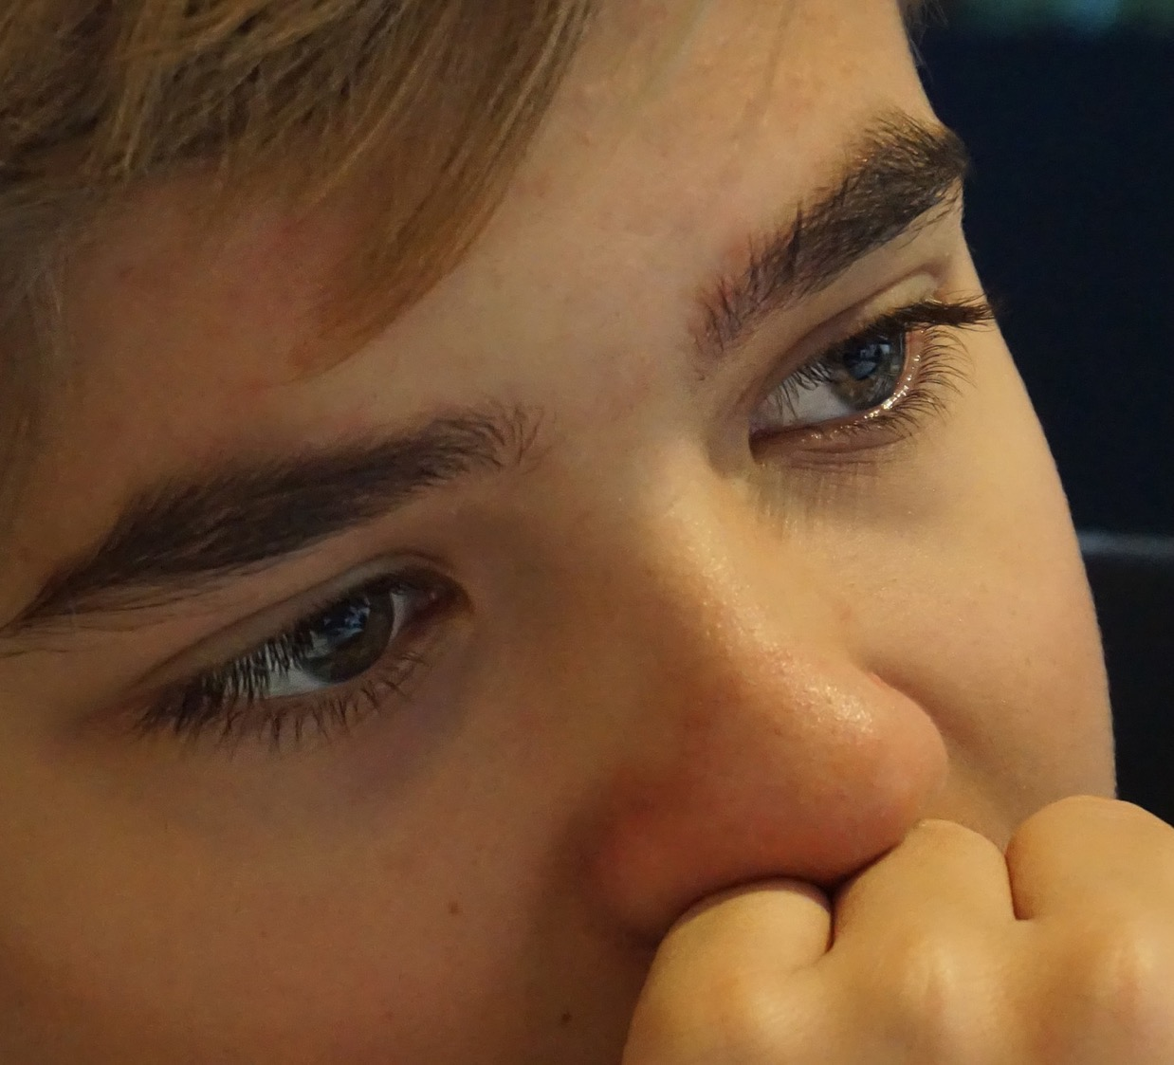
Consent scenario H
Andrew likes Misha, they are friends.
Andrew would like Misha to be his girlfriend.
He wants to hold her hand as they walk home.
What can Andrew say or do?

Slide 16
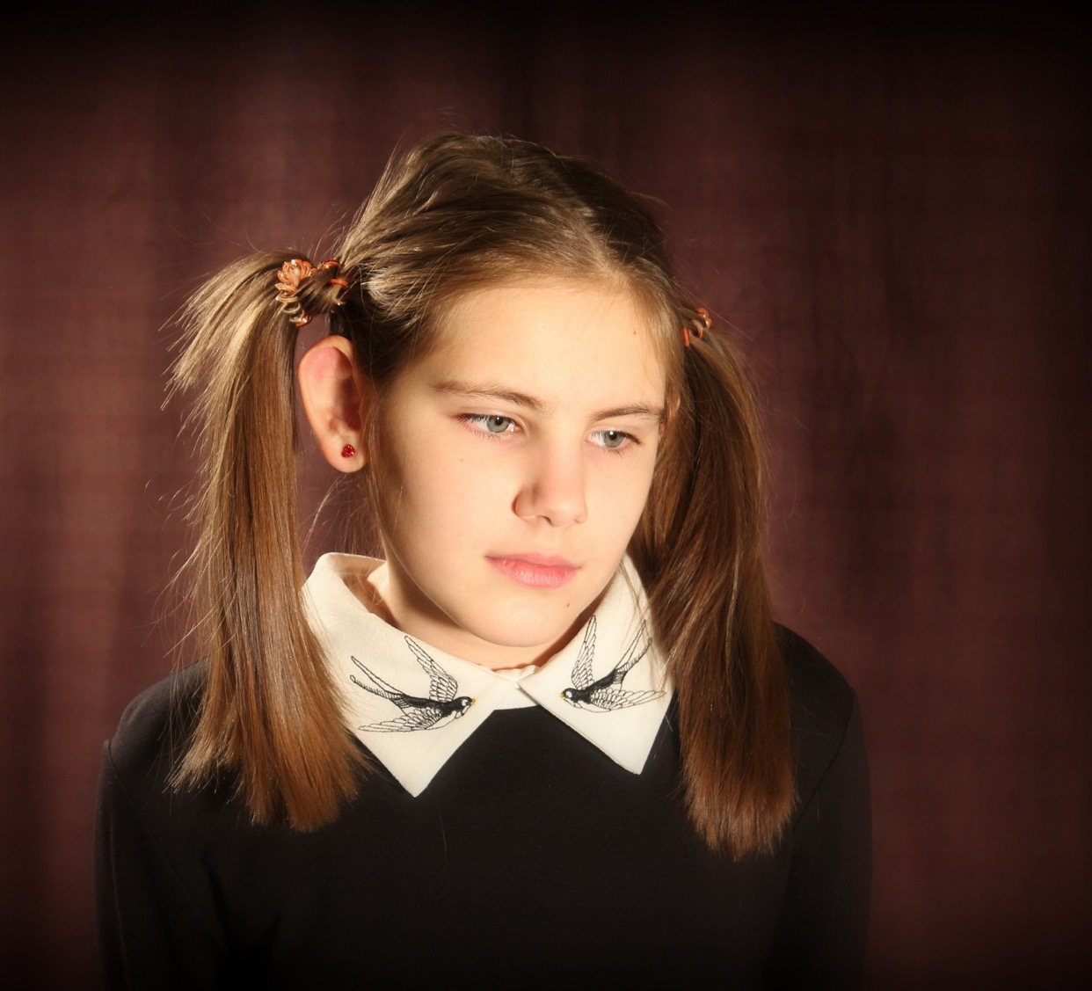
Consent scenario I
Misha likes Andrew, they are friends.
Andrew asked Misha if he could hold her hand when they were walking home.
Misha just wants to be Andrew’s friend, not a girlfriend.
She doesn’t want to hold his hand.
What can Misha say or do?

Slide 17
Video: Boss of My Body https://youtu.be/zAALZxa6NCw Duration: 2 minutes 33 seconds

Slide 18
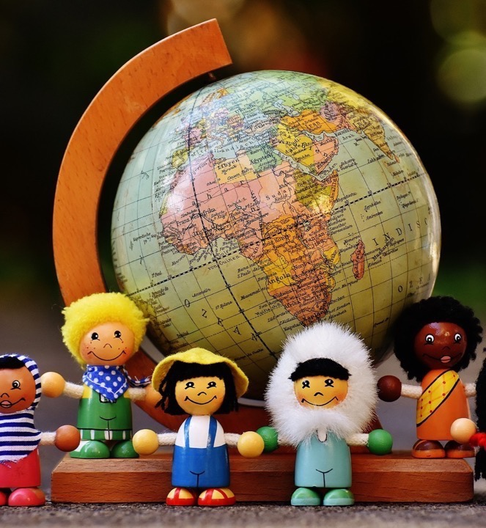
In this class, we are all individuals, different, unique and special.

