Slide 1
Body image: The influence of popular culture
I can describe how popular culture and social media promote stereotypes and unrealistic representations of both women and men, and can reflect on how these impact on groups and individuals.
I describe myself positively and can talk about my unique attributes and interests.
I understand and accept diversity amongst peers.

Slide 2
What do we mean when we talk about body image?

Slide 3
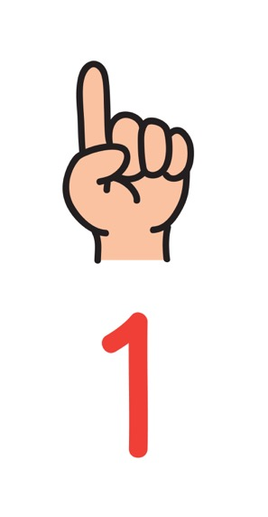
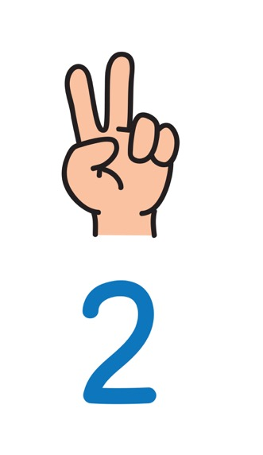
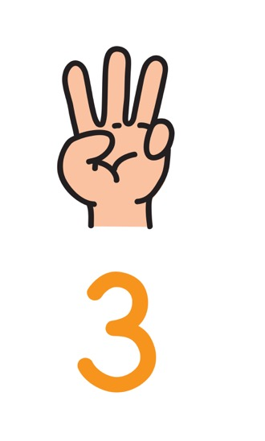
This can include our thoughts and feelings about our height, weight, shape, skin, colour, and our appearance and attractiveness more broadly.
We can have positive or negative body image. We might think positively or negative because of things like what we see around us in our family and friends and what we see and hear online.
Body image describes our idea of how our body looks and how we think it is viewed by others.

Slide 4
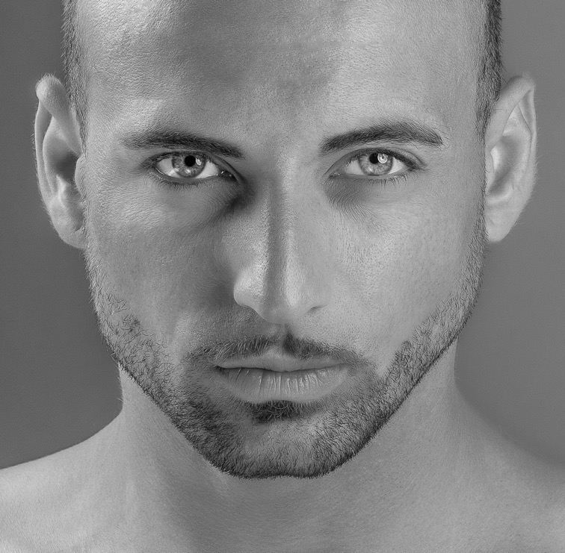
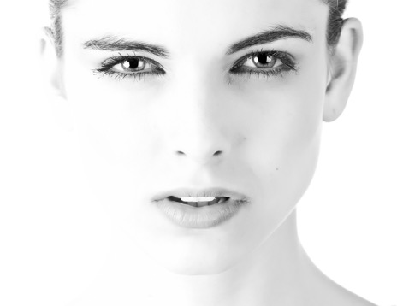
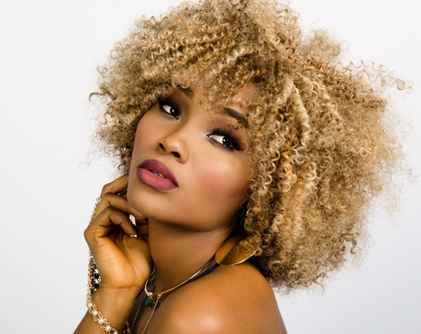
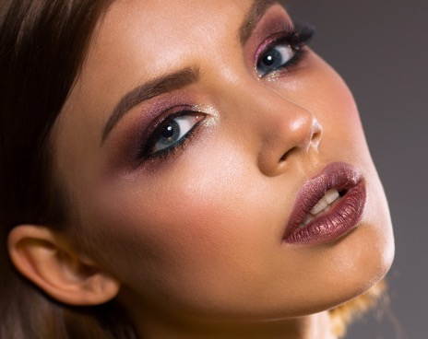
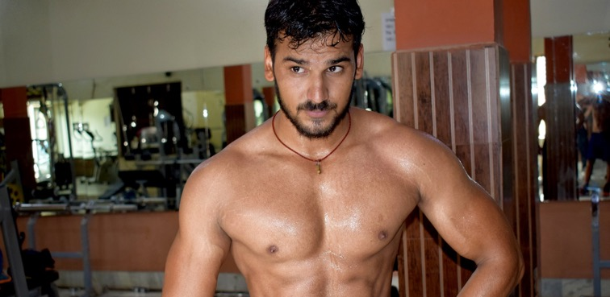
What is the ideal way to look?
An ideal is an idea of something that’s perfect, but it normally only exists in the imagination. So the appearance ideal is the idea of the perfect way to look, even if it doesn’t naturally exist.

Slide 5
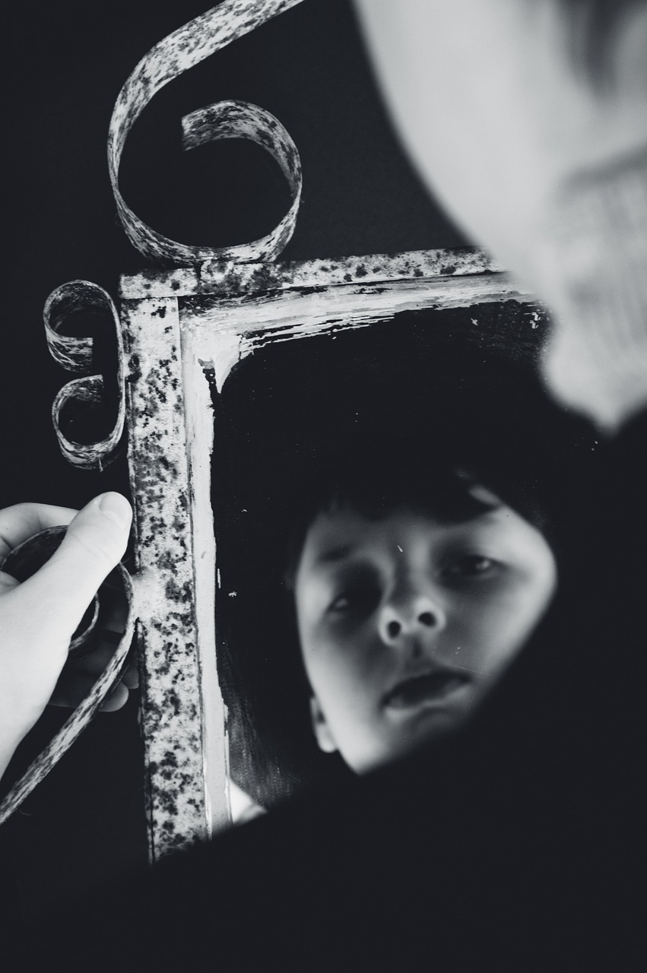
In your early teenage years, your body is changing. Your emotions can also feel very strong. These two things together mean that a young person can worry about how they look. You sometimes here people say ‘I wish I looked like….’ and naming someone else. Someone they think is ideal.
Why do you think so many of us feel or say such things?

Slide 6
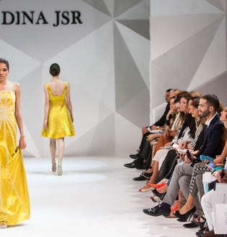
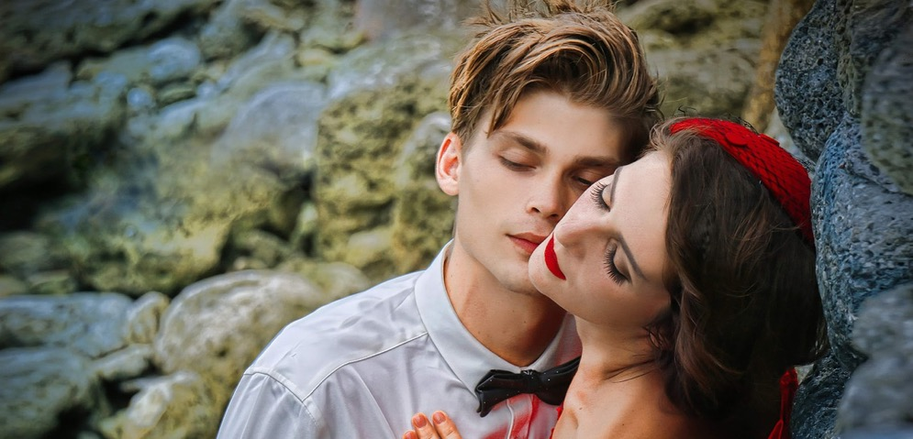
How real is what we see in social media or magazines?

Slide 7
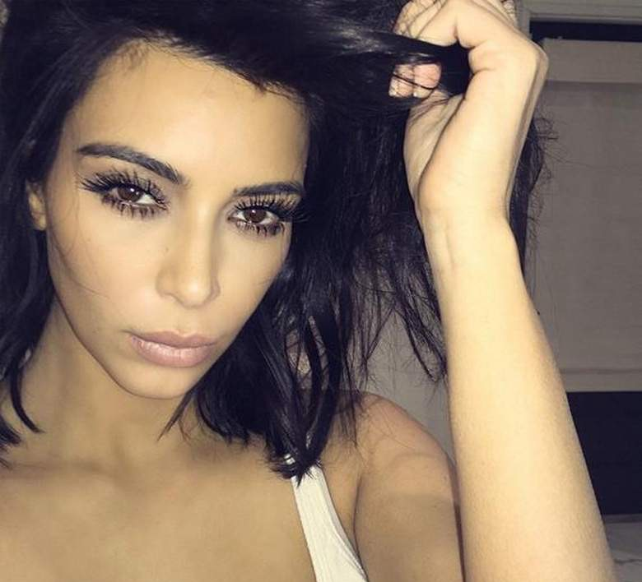
The truth about the (celebrity) selfie
When you look at a celebrity image online how real do you think it is?
What do you think might have been done to change how this person looks?

Slide 8
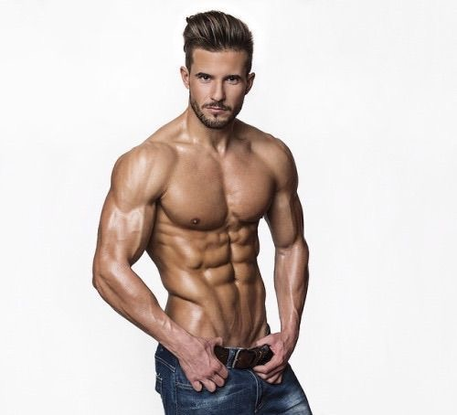
The truth about the (celebrity) selfie
When you look at a celebrity image online how real do you think it is?
What do you think might have been done to change how this person looks?

Slide 9
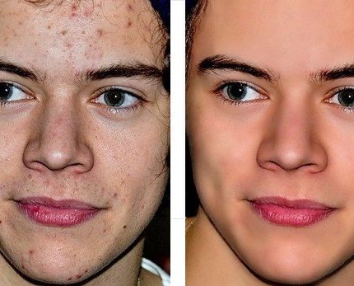
The truth about the (celebrity) selfie
When you look at a celebrity image online how real do you think it is?
What do you think might have been done to change how this person looks?

Slide 10
A selfie
https://youtu.be/sQS9pymkLiU
‘No wonder our perception of beauty is distorted’.

Slide 12
When it comes to the faces and bodies we see on social media: Does it matter if they aren’t real?

Slide 13
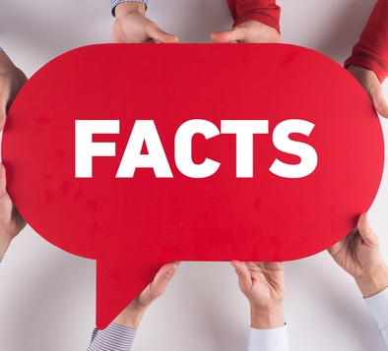
Does it matter?
One in four girls (26%) and one in seven boys (14%) have restricted their food intake by fasting, skipping meals or throwing away food, during the last three months.
Plastic surgeons are worried about the number of young people who are wanting cosmetic procedures to change the way they look.

Slide 14
Being Me: A Newsround Special (14 minutes 36 seconds)
https://www.bbc.co.uk/newsround/32131619
Bodies: Different shapes and sizes All Beautiful: https://youtu.be/Fcy_VQZG5Dg (1 minute 53)
Why don’t I like the way I look? https://youtu.be/v7zUHOEYlN8 (4 minutes 32) a film by Rachel Gitlevich

Slide 15
Jameela Jamil thinks what we see on social media does matter
https://youtu.be/BXzO0z6fmhI
I Weigh campaign https://www.instagram.com/i_weigh/

