Slide 1
The importance of communication
I can reflect on my own communication skills.
I consider how I respond to cues from a partner that may be verbal or non-verbal.
I talk about empathy as a characteristic of a healthy relationship.
I can describe what behaviours and attitudes will help and nurture a relationship.
I am developing skills to de-escalate conflict, and I can give examples of strategies to do so.

Slide 2
How do we human beings communicate with each other?

Slide 3
There are four main types of communication:
Written communication includes messaging, email, letters, magazines, books and anything else that is typed or handwritten words.
Verbal communication includes speaking, music, sounds and language.
Nonverbal communication is body language and gestures including eye contact, sign language, sculpture, movement, dancing, facial expressions, body posture, touching and physical contact.
Visual communication involves a visual display, such as pictures, illustrations, charts, graphs, television and films.

Slide 4
Activity:
Non verbal communication

Slide 5
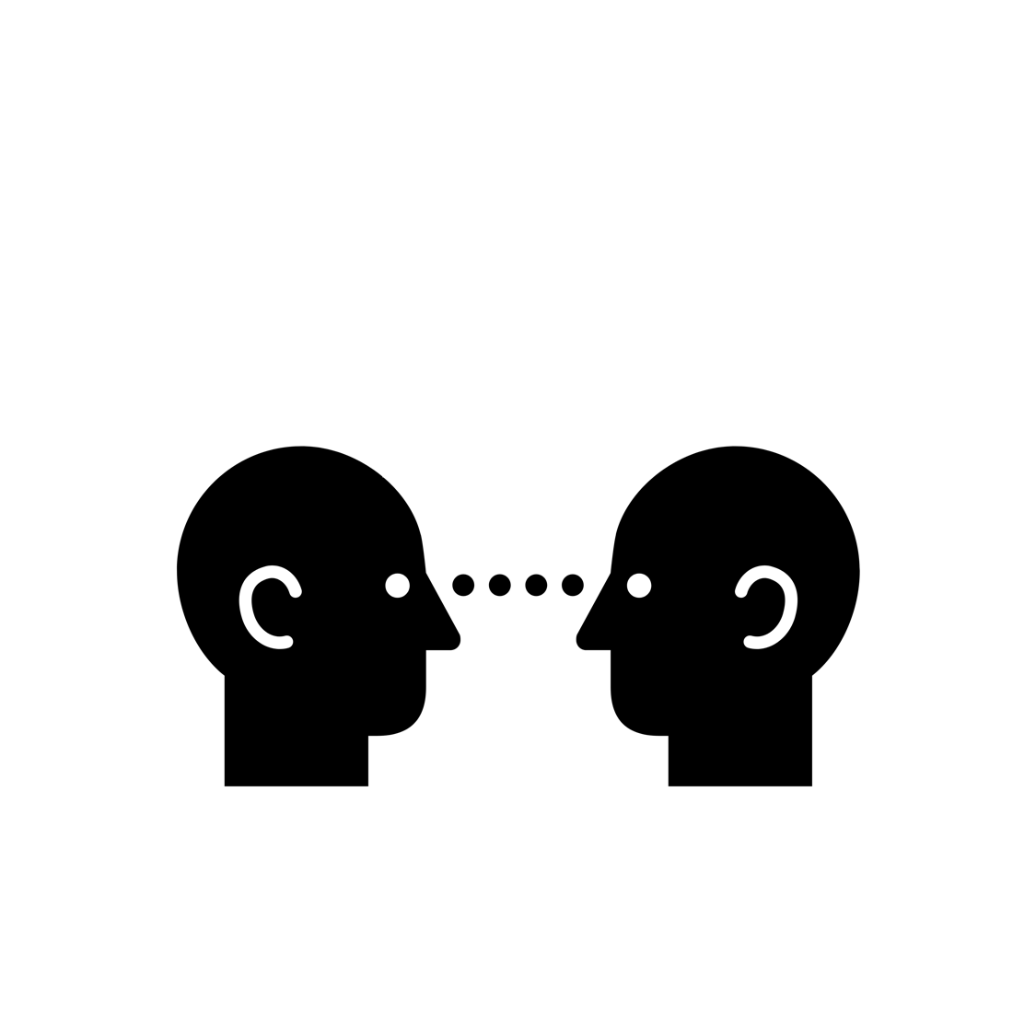
Non-verbal communication includes:
Facial expressions
Posture
Eye contact
Leaning forward
Nodding
Open body posture
Hand gestures
Appropriate vocal encouragers (uh-uh, oh, no, ok, yeah)

Slide 6
How to say I’m not listening (with non-verbal communication)
Folded arms in front of a person may mean they’re feeling defensive or closed off.
Lack of eye contact may mean they’re not really interested in what you’re saying, are ashamed of something, or find it difficult to talk about something.
Someone who’s turned away from you when talking to you may mean disinterest or being closed off.

Slide 7
Why is communication important in a relationship?

Slide 8
Communication and social media.
Relationships are harder now because conversations become texting, arguments become phone calls and feelings become status updates.
What do you think?

Slide 9
And the saying goes….
TRUE?
FALSE?
DEPENDS?

Slide 10
The importance of empathy https://youtu.be/UzPMMSKfKZQ
(Duration: 3 minutes 30)

Slide 11
TASK
In the next few days, pay attention to how other people communicate with you. Do they use verbal or non-verbal communication?
Thinking also about empathy: do you see and do you show empathy?

