Slide 1
The idea of sexual rights
I know that my sexuality is about my feelings, thoughts, attractions and behaviours.
I can talk about my sexual rights including the right to personal and intimate relationships that are healthy, happy and safe.
I know where to find information, help and support if I need it.

Slide 2
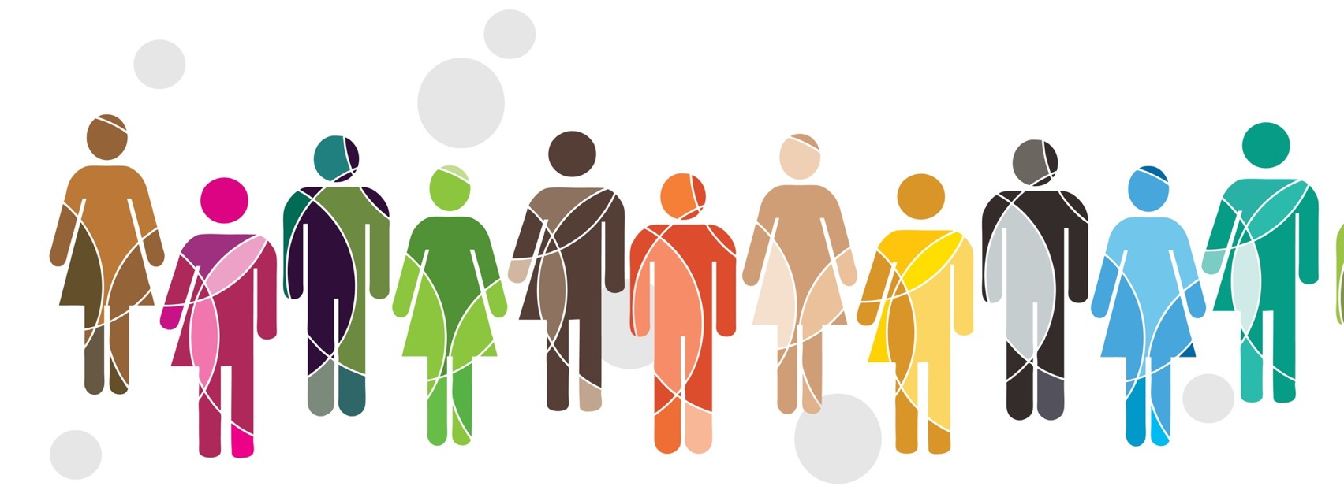
We are all sexual beings – this does not mean that we are all having sex. It could be put like this:
Sexuality is something we feel, something we do, that comes from within ourselves.

Slide 3
Sexuality is about our sexual feelings, thoughts, attractions and behaviours towards other people. We can find other people physically, sexually or emotionally attractive, and all those things are a part of our sexuality.

Slide 4
The most common ways you might hear a person describe their sexuality is for them to say they are heterosexual, lesbian, gay or bisexual.
But there are other ways a person can choose to describe it – for example you may have heard people say they are asexual or pansexual. What is important is to respect the individual’s choice when they describe their sexuality.

Slide 5
Activity:
Are these activities anything to do with human sexuality?

Slide 6
Sexual rights relate to a person’s sexuality, to sexual orientation, gender identity, sexual behaviours and sexual health. Sexual rights, because they are human rights, belong to everybody.

Slide 7
1. The right to equality: Everyone is born free and equal in dignity and rights. No person should be discriminated against on the basis of their sex, gender or sexuality.

Slide 8
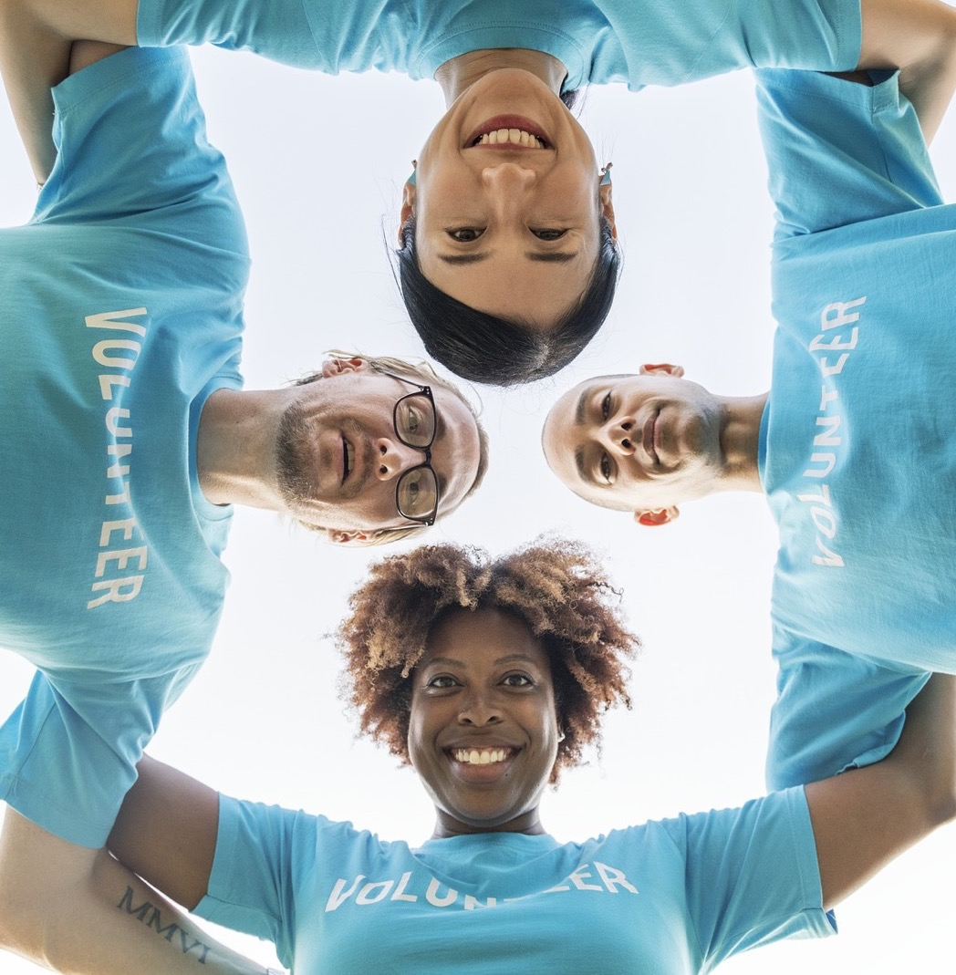
2. The right to participation: Young people should have a say on anything that affects their lives. This includes what sexual health information and services they get, including what they learn at school.

Slide 9
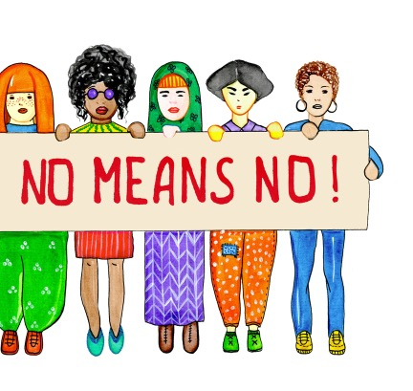
3. The right to life and to be free from harm: No one should be harassed, harmed, punished, trafficked or killed because of their sexual practices, gender identity or expression, nor as a way to protect the reputation or honour of a family or community.

Slide 10
4. The right to privacy: Young people have the right to privacy about their sexuality, they should decide if they want to share information about themselves.

Slide 11
5. The right to personal autonomy. Young people have the right to decide on matters about their sexuality. They are free to explore their sexuality in safe and pleasurable ways, as long as they do not interfere with someone else’s rights.

Slide 12
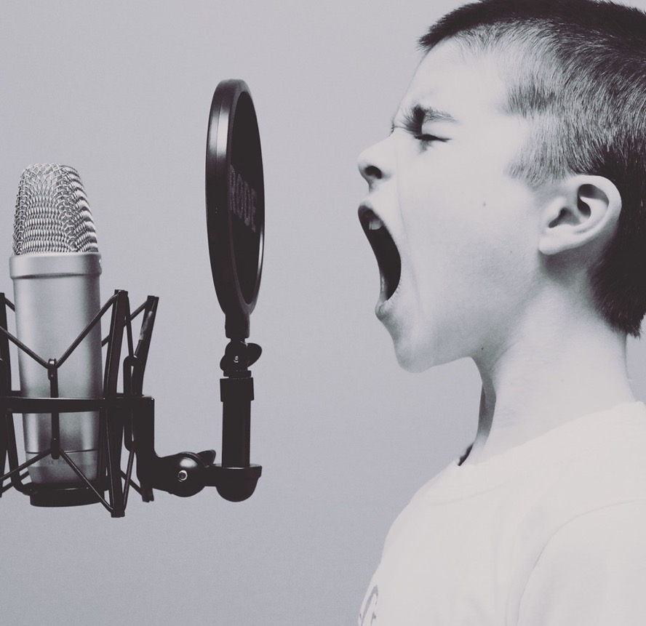
6. The right to think and express oneself freely. All young people have the right to explore their sexualities and should be able to have dreams and fantasies, and express their sexuality without fear, shame or guilt, while respecting other people’s rights.

Slide 13
7. The right to health: all young people have the right to the best physical and mental health and wellbeing and to be protected from anything that might harm their health, including their sexual health.

Slide 14
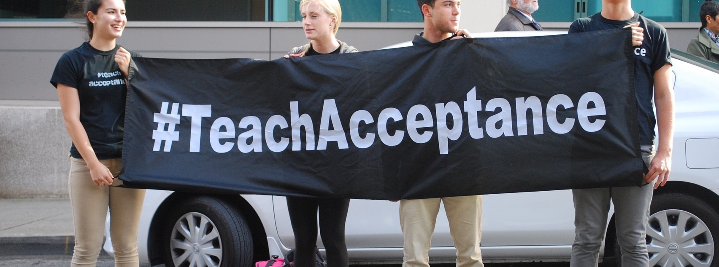
8. The right to know and learn: All young people have the right to education and information, including comprehensive, gender-sensitive and rights-based sexuality education, including in school.

Slide 15
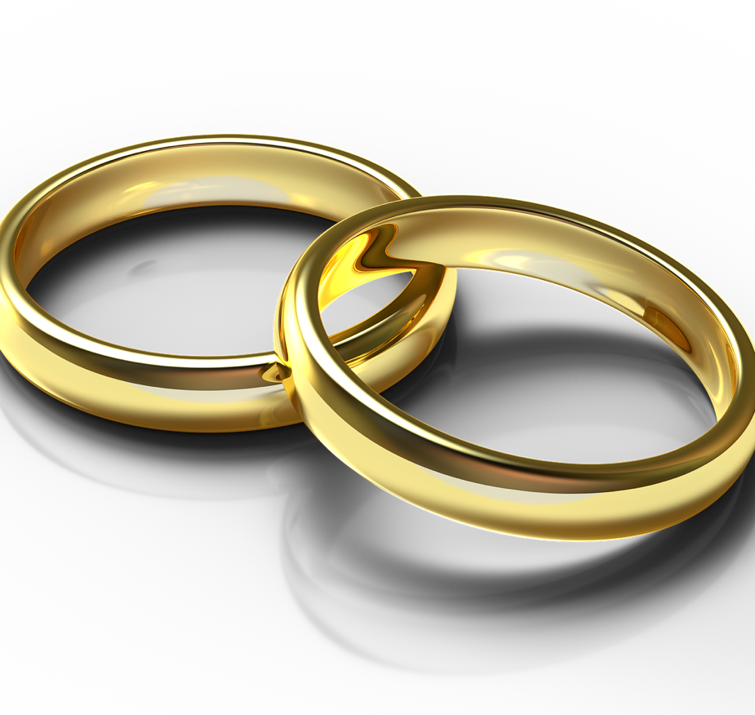
9. The right to choose whether or not to marry or have children: Every young person has the right to choose when, if, how and whom to marry and have children in an environment that recognizes diverse family types. No-one should be forced to marry or marry when they are a child.

Slide 16
10. The right to have your rights upheld: Governments must respect, protect and fulfil all sexual rights for all young people.

Slide 17
Female Genital Mutilation
FGM for girls is child abuse. It involves a girl's genitals (private parts) being cut so they are removed or altered in different ways.
Girls can feel pressured or forced to have FGM, especially if other people in the family have been cut.
It is a painful and dangerous procedure.
It is illegal in Scotland and is considered a form of child abuse.
Women and men all over the world are campaigning to stop FGM.

Slide 18
Sara’s story
https://www.fgmaware.org/
ChildLine information: https://www.childline.org.uk/info-advice/bullying-abuse-safety/abuse-safety/female-circumcision-fgm-cutting/
FGM: If you’re worried you might be forced to have FGM in the future, talk to a trusted adult, such as a teacher at school, or a doctor. If you think you’re in immediate danger of being cut or being taken abroad for this to happen, you can call the police (dial 999).

Slide 19
Let’s face it – young people are sexual. We have sexual needs, desires, fantasies and dreams. But we also have a lot of questions and uncertainty. It’s important for all young people around the world to be able to explore, experience and express our sexualities in healthy, positive, pleasurable and safe ways. This can only happen when our sexual rights are guaranteed.
The International Planned Parenthood Federation (IPPF)

